Slide 2
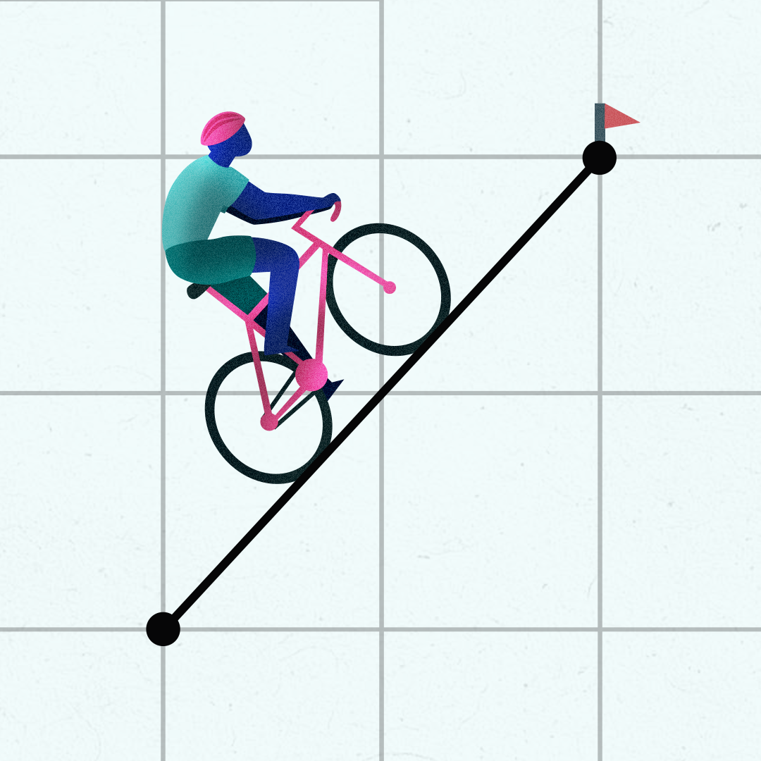
Riding the Slope
Finding Slopes from Tables, Graphs, and Equations

Slide 3
Essential Question
How do we find slope from a table, a graph, and an equation?

Slide 4
Learning Objectives
Interpret a graph to represent real-world situations.
Draw a graph to represent real-world situations.
Describe the rate of change of the linear relationship.

Slide 5
Being an Entrepreneur
You are going to be in charge of a business. You will need to come up with a name for your business and determine the products you are selling.
You are then going to graph your bank account through various scenarios on the next few slides.

Slide 6
February: Business is Booming
Within a month of starting your business, you’re seeing incredible profits. You are earning slightly more than you invested in your business, which is surprising! Your targeted advertisements, community outreach, and innovative business model have successfully attracted customers.

Slide 7
April: Business is Bad
Someone built a shop right next to yours, and you’re curious as to who will move in.
Oh no! It’s your competitor, whose business model is much like yours. They’re selling a product similar to yours, but they’re selling it for less. You try to lower your prices to compete, but lowering prices means you’ll lose money on every product you sell.
You decide not to lower your prices. As a result, your business slowly declines.

Slide 8
May: Breaking Even
Fortunately for you, some of your customers have realized that your product is better than your competitor’s, even if yours costs more.
Gradually, more customers are returning to your store. You aren’t making a profit yet, but you are breaking even—earning profits equal to your costs.

Slide 9
August: Disaster Strikes
As you’re researching ways to increase your profit, a natural disaster strikes your town. Your storefront and your competitor’s storefront are both intact. However, your customers are now busy with other things. Instead of spending their hard-earned money on your product, which isn’t a necessity, customers are spending their money on repairs, groceries, and other basic needs. Within a month, your business drops off dramatically with no hope of recovery.

Slide 10
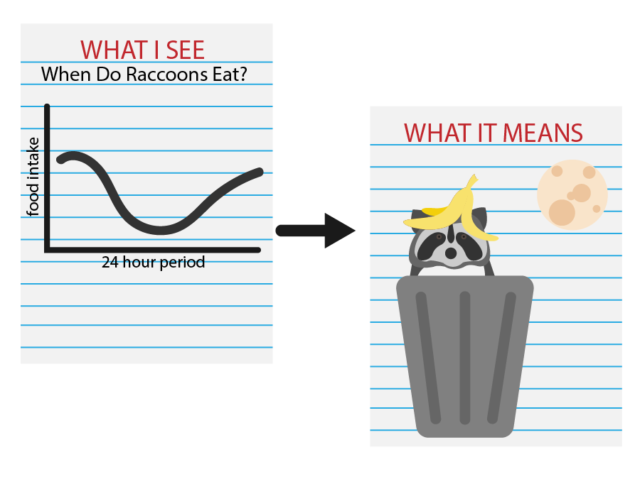
What I See, What It Means
With your partner, select a graph to use to complete your WIS-WIM.
Identify three things you see regarding changes, trends, or differences across your graph, then determine what each one means.
Finally, add a caption to your graph that summarizes the whole graph based on your WIS-WIM

Slide 11

Card Sort
In your groups match the graph to the equation and set of numbers given.
Once you have matched all your cards, return to your business graph and compare the slopes to the card sort. Which card looks like August in your business?

Slide 12
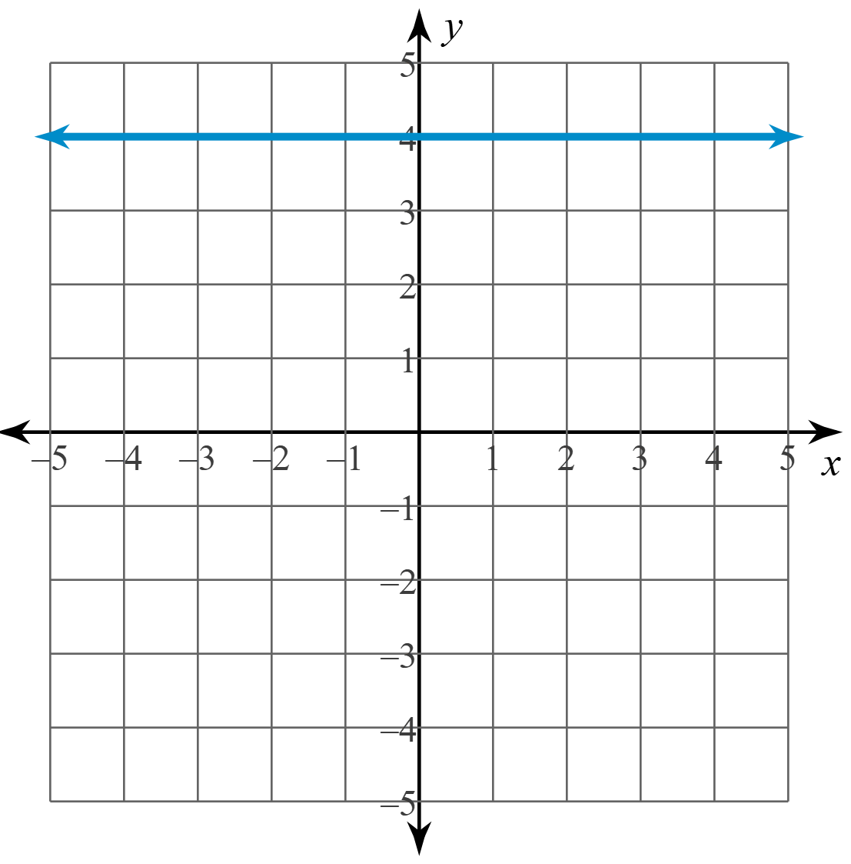
Card Sort – Example
Match the equation to table and graph
Equation: y = 4
Table:
Graph:
x | –2 | 0 | 2 | 4
y | 4 | 4 | 4 | 4

Slide 13
The Four Types of Slope
Assign each of your four colors to one of the types of slope:
  Positive slope – Color 1
  Negative slope – Color 2
  Zero slope – Color 3
  Undefined – Color 4
Write your name using the proper color for the slope as you write.

Slide 14
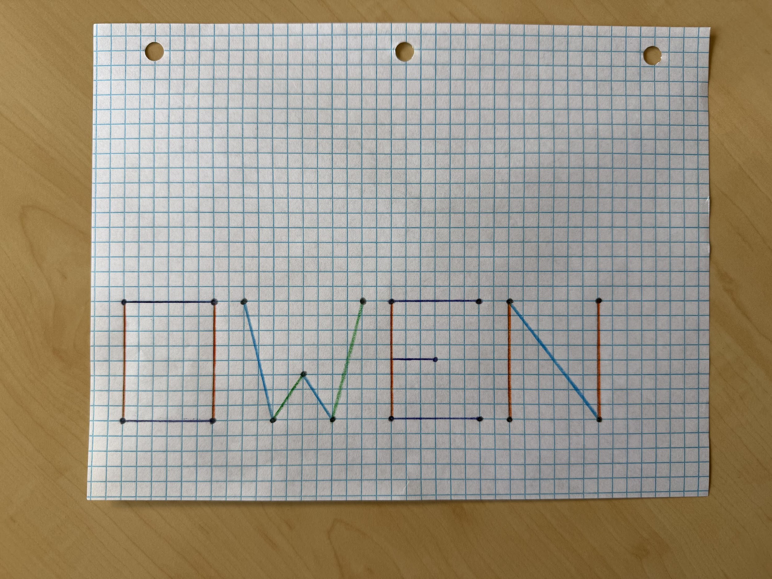
The Four Types of Slope - Example

Slide 15

Slope Dude

Slide 16
Slope Dude - Questions
Have you ever struggled going uphill on a bike?
Look at the front of the trifold titled Intro to Slope.
Respond to: How does Slope Dude move from one point to the next?

Slide 17
Does This Match?
Look at the front of the next section of the trifold. Determine if the points match the graph.
What type of slope is the graph?

Slide 18
Vocabulary and Symbols
Vocabulary | Definition | Symbol
Slope | Rate of Change. Can be found by counting rise over the run. | m Remember: “mountains have a steep slope.”
y-Intercept | Where the line crosses the y-axis (Vertical Line) | b
Independent Variable | An input, usually given, not dependent on an equation. | x

Slide 19
Vocabulary and Symbols
Vocabulary | Definition | Symbol
Dependent Variable | An outcome, or output, found by using the input, x, in an equation | y
Slope-Intercept Form | An equation with slope, y-intercept, dependent, independent variables | y = mx + b When graphing, plot the y-intercept (b) first

Slide 20
Vocabulary and Symbols - Continued
For slope intercept equations, the slope is always in front of x—the independent variable.
Example: y = 2x + 17
If there’s not an x, what can we assume about slope?
Look again at the graph of your business model, when did this slope occur?

Slide 21
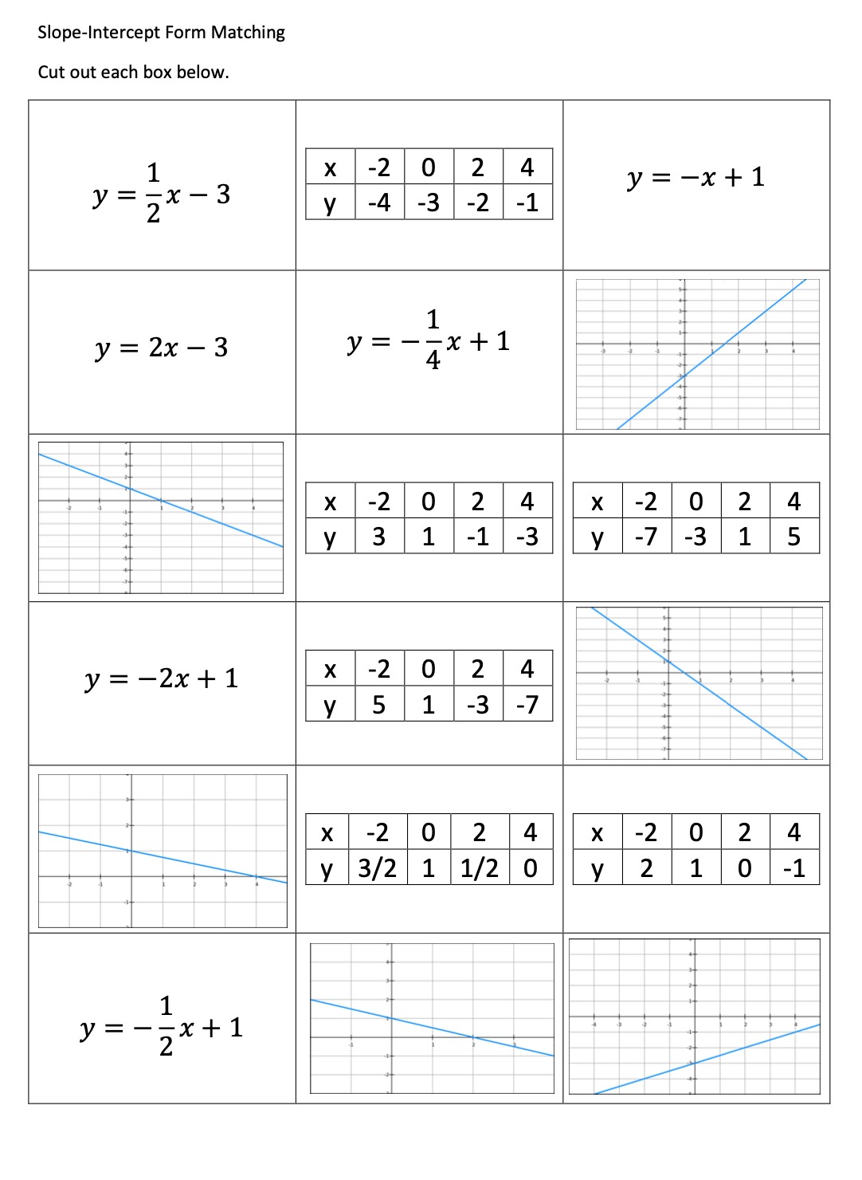
Slope Intercept Examples

Slide 22
Slope Intercept Continued

Slide 23
Slope Intercept Continued

Slide 24
Slope Intercept Continued

Slide 25
Slope Intercept Continued

Slide 26
Identify the Slope and Y-Intercept
Turn to this section of your trifold.
With your partner, one determines the slope, and the other the y-intercept. Then switch, so now the one that found the slope finds the y-intercept and vice versa.

Slide 27
What’s My Slope?
Draw a positive, negative, zero, and undefined slope on your trifold.
Then, produce an equation for each type of slope.
When you have finished, share your equations with your partner.

Slide 28

3-2-1
What are three things you learned?
What are two things you want to explore further?
What is one conclusion you can make about slopes?

