Slide 2
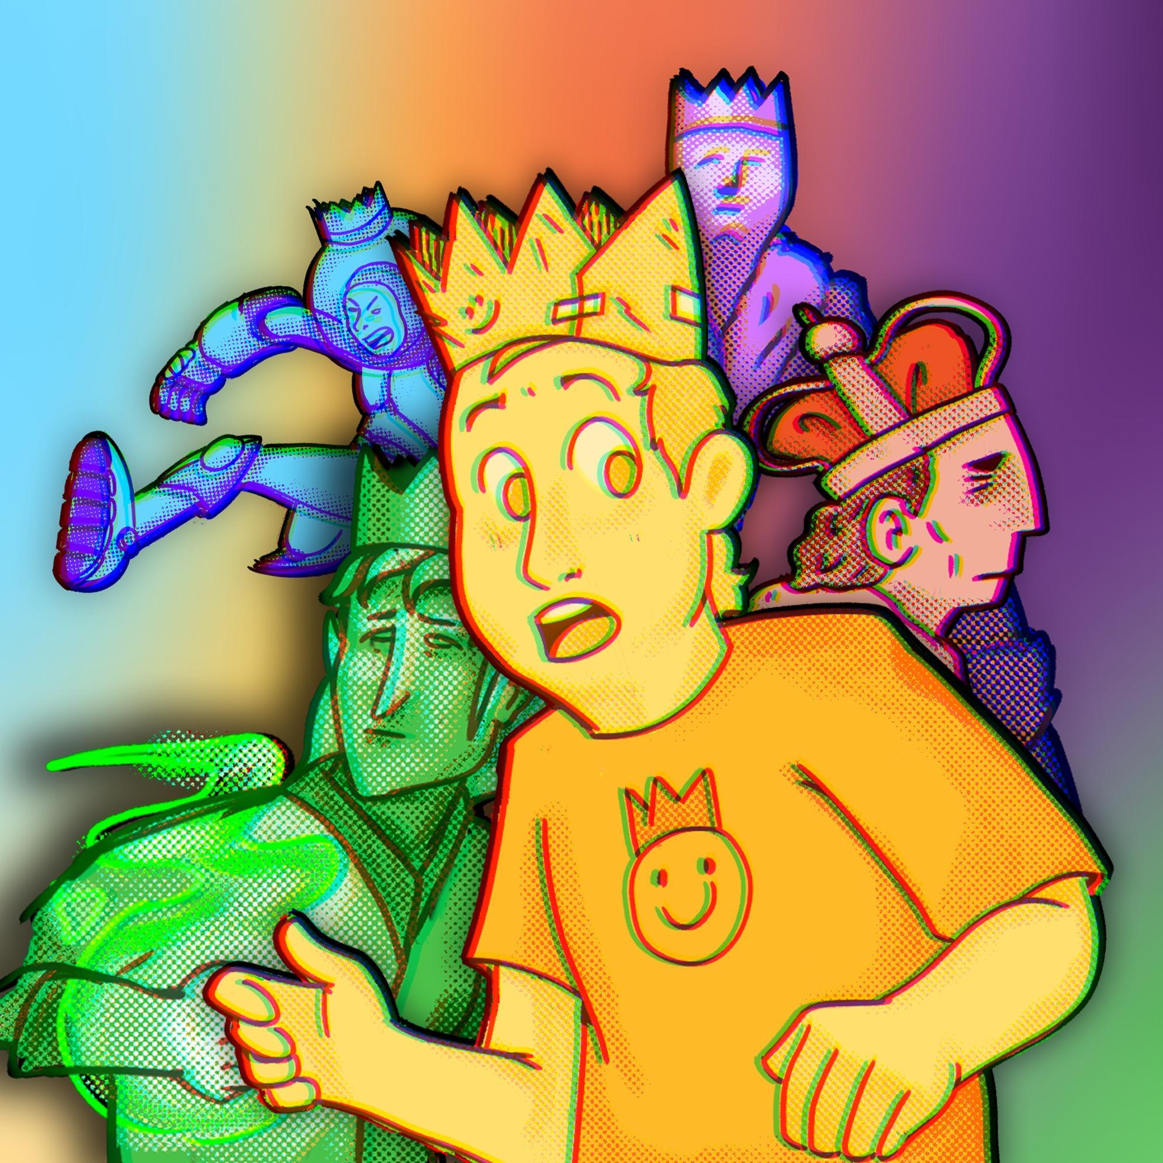
Genre Quest:
Choose Your Adventure
Literary Genres

Slide 3
Essential Question
How do different literary genres shape the way stories are told and understood?

Slide 4
Learning Objectives
Identify key characteristics of genres and major subgenres of literature.
Apply characteristics of subgenres in your own writing.

Slide 5
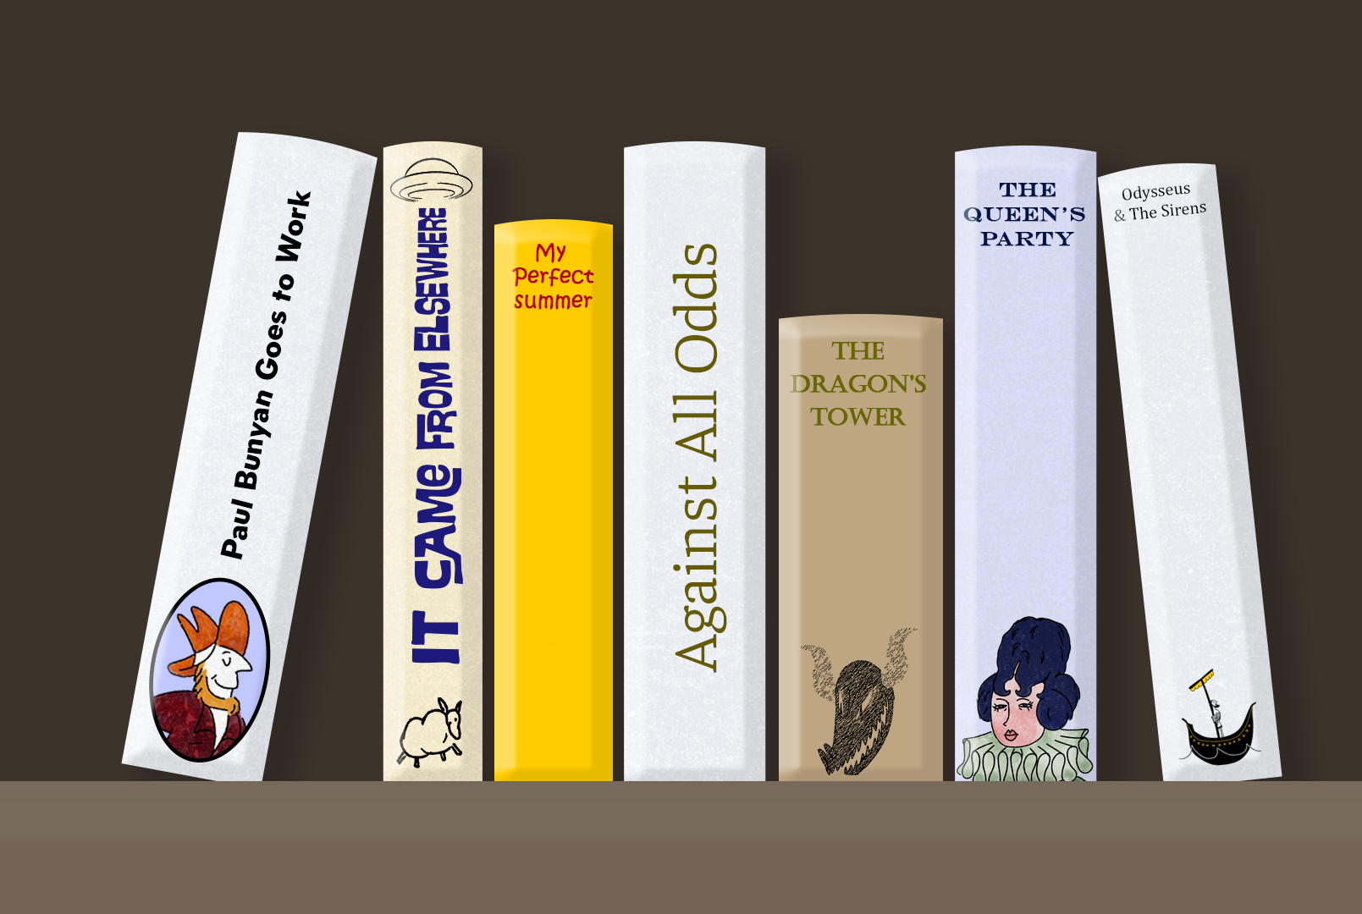
Can You Judge a Book By Its Cover?
Number your piece of paper 1–7.
Next to each number, write what you think the genre and subgenre are for each corresponding book cover.

Slide 6

Can You Judge a Book By Its Cover?
Options:
Biography
Fantasy
Historical Fiction
Myth
Realistic Fiction
Science Fiction
Tall Tale
Against All Odds
It Came From Elsewhere
The Queen’s Party
Odysseus & The Sirens
My Perfect Summer
Paul Bunyan Goes to Work
The Dragon’s Tower

Slide 7
Can You Judge a Book By Its Cover?
Against All Odds
It Came From Elsewhere
The Queen’s Party
Odysseus & The Sirens
My Perfect Summer
Paul Bunyan Goes to Work
The Dragon’s Tower
Biography
Science Fiction
Historical Fiction
Myth
Realistic Fiction
Tall Tale
Fantasy

Slide 8

Fiction in the Facts
Your group will visit six posters.
At each poster, you will read three statements:
  Two statements are true; one is false.
Place a sticker next to the statement you believe to be the false statement.
Notes:
K20 Center. (n.d.). Fiction in the facts. Strategies. https://learn.k20center.ou.edu/strategy/60

Slide 9
Fiction in the Facts: Poster 1
Read each of the following statements and decide which one is false.
Realistic fiction features characters and events that could happen in real life.
Realistic fiction stories often include magical creatures.
Realistic Fiction settings are familiar and based on real places.
Notes:
K20 Center. (n.d.). Fiction in the facts. Strategies. https://learn.k20center.ou.edu/strategy/60

Slide 10
Fiction in the Facts: Poster 1
Fantasy often includes magical creatures, while realistic fiction often describes things that could really happen.
Realistic fiction features characters and events that could happen in real life.
Realistic fiction often includes magical creatures.
Realistic Fiction settings are familiar and based on real places.
Notes:
K20 Center. (n.d.). Fiction in the facts. Strategies. https://learn.k20center.ou.edu/strategy/60

Slide 11
Fiction in the Facts: Poster 2
Read each of the following statements and decide which one is false.
Historical fiction is set in a real time period from the past.
Historical fiction characters are always real people from history.
Historical fiction is a blend of fictional characters and real historical events.
Notes:
K20 Center. (n.d.). Fiction in the facts. Strategies. https://learn.k20center.ou.edu/strategy/60

Slide 12
Fiction in the Facts: Poster 2
Characters from historical fiction may be based on real people but may be fictional, just from a real time.
Historical fiction is set in a real time period from the past.
Historical fiction characters are always real people from history.
Historical fiction is a blend of fictional characters and real historical events.
Notes:
K20 Center. (n.d.). Fiction in the facts. Strategies. https://learn.k20center.ou.edu/strategy/60

Slide 13
Fiction in the Facts: Poster 3
Read each of the following statements and decide which one is false.
Science Fiction explores futuristic ideas and space travel.
All science fiction must take place in the past.
Science fiction often includes robots and aliens.
Notes:
K20 Center. (n.d.). Fiction in the facts. Strategies. https://learn.k20center.ou.edu/strategy/60

Slide 14
Fiction in the Facts: Poster 3
A science fiction story may be set in the past but is often set in the future.
Science fiction explores futuristic ideas and space travel.
All science fiction must take place in the past.
Science fiction often includes robots and aliens.
Notes:
K20 Center. (n.d.). Fiction in the facts. Strategies. https://learn.k20center.ou.edu/strategy/60

Slide 15
Fiction in the Facts: Poster 4
Read each of the following statements and decide which one is false.
A biography is a true story about someone’s life written by another person.
An autobiography is written by the person the story is about.
Biographies are always fictional.
Notes:
K20 Center. (n.d.). Fiction in the facts. Strategies. https://learn.k20center.ou.edu/strategy/60

Slide 16
Fiction in the Facts: Poster 4
Biographies are stories about a real person, so they are not fictional.
A biography is a true story about someone’s life written by another person.
An autobiography is written by the person the story is about.
Biographies are always fictional.
Notes:
K20 Center. (n.d.). Fiction in the facts. Strategies. https://learn.k20center.ou.edu/strategy/60

Slide 17
Fiction in the Facts: Poster 5
Read each of the following statements and decide which one is false.
Fables are short stories that teach a moral lesson.
Fables often feature animals that talk and act like humans.
Fables must be written in poem form.
Notes:
K20 Center. (n.d.). Fiction in the facts. Strategies. https://learn.k20center.ou.edu/strategy/60

Slide 18
Fiction in the Facts: Poster 5
Fables often are short stories with talking animals that teach a moral lesson.
Fables are short stories that teach a moral lesson.
Fables often feature animals that talk and act like humans.
Fables must be written in poem form.
Notes:
K20 Center. (n.d.). Fiction in the facts. Strategies. https://learn.k20center.ou.edu/strategy/60

Slide 19
Fiction in the Facts: Poster 6
Read each of the following statements and decide which one is false.
Tall tales are exaggerated stories.
Tall tales are known for being completely realistic and factual.
Tall tales take place in the Wild West.
Notes:
K20 Center. (n.d.). Fiction in the facts. Strategies. https://learn.k20center.ou.edu/strategy/60

Slide 20
Fiction in the Facts: Poster 6
Tall tales are a type of fiction, so they are not factual and often have outrageous characters.
Tall tales are exaggerated stories.
Tall tales are known for being completely realistic and factual.
Tall tales take place in the Wild West.
Notes:
K20 Center. (n.d.). Fiction in the facts. Strategies. https://learn.k20center.ou.edu/strategy/60

Slide 21


Honeycomb Harvest
Arrange the hexagons so that the sides of the related hexagons are touching.
  Be prepared to explain your reasoning.
10-Minute Timer
Notes:
K20 Center. (n.d.). Honeycomb harvest. Strategies. https://learn.k20center.ou.edu/strategy/61
K20 Center. (2021, September 21). K20 Center 10 minute timer [Video]. YouTube. https://www.youtube.com/watch?v=9gy-1Z2Sa-c

Slide 22
Genres: Subgenres:
Nonfiction
Characteristics
Fiction
Historical Fiction
Biography
Made Up
Real Time or Place
Life Story

Slide 23
Nonfiction
Autobiography: first person; author’s life story; personal thoughts, feelings, and reflections; real events and experiences
Biography: third person; subject’s life events; research, interviews, and factual evidence; chronological order

Slide 24
Nonfiction
Informational Writing: factual (no opinions); teaching or explaining; evidence, data, and examples
Persuasive Essay: clear opinion or claim; logic, emotion, or ethics; opposing viewpoints; call to action

Slide 25
Fiction
Fantasy: magic, monsters, vampires, dragons, etc.
Historical Fiction: real time or place, real historical figure, made-up story
Realistic Fiction: could happen, but it is made up
Science Fiction: aliens, space or time travel, advanced technology

Slide 26
Folklore
Fable: short, talking animals, teaches a moral
Fairy Tale: talking animals; magic; often starts “Once upon a time,” and ends “happily ever after”
Myth: gods and goddesses, explains the creation of something
Tall Tale: set in the Wild West, outrageous characters, humorous

Slide 27

Why-Lighting
Read each short story.
While you read, highlight characteristics that would help you determine the subgenre of the story.
  Make note of why you highlighted what you highlighted.
Notes:
K20 Center. (n.d.). Why-lighting. Strategies. https://learn.k20center.ou.edu/strategy/128

Slide 28
Why-Lighting
Compare your work with a partner.
Did you highlight the same things?
Did you find the same information important?
Did you identify the same characteristics?
Do you agree on the subgenre of the story?
Notes:
K20 Center. (n.d.). Why-lighting. Strategies. https://learn.k20center.ou.edu/strategy/128

Slide 29
Multiverse Stories
Choose a fable from: read.gov/aesop/001.html.
Identify Key Elements:
  Characters (who the story is describing)
  Setting (where the story unfolds)
  Conflict (problem/challenge)
  Climax (most exciting part of the story)
  Resolution (how the story ends)

Slide 30
Multiverse Stories
Pick one of the following subgenres:
  Science Fiction
  Fantasy
Change each of the key elements from before (character, setting, conflict, etc.) to fit the new subgenre you selected.
  Think about the characteristics of that subgenre as you make your changes.
  Historical Fiction
  Tall Tale

Slide 31
Multiverse Stories
The Tortoise and the Hare | Fable | Science Fiction
Characters & Setting (Who & Where) | In a far away time, when animals could talk, an impulsive hare encounters a steady tortoise in the countryside. | On the high-tech planet Neo-Terra, the steady Cyber-Tortoise (Model CT-01) and the boastful Hyper-Hare (Unit HH-9) line up for the Great Interplanetary Race through asteroid fields and shifting gravity zones.

Slide 32
Multiverse Stories: Characteristics
The Tortoise and the Hare | Fable | Science Fiction
Characters & Setting (Who & Where) | In a far away time when animals could talk, an impulsive hare encounters a steady tortoise in the countryside. | On the high-tech planet Neo-Terra, the steady Cyber-Tortoise (Model CT-01) and the boastful Hyper-Hare (Unit HH-9) line up for the Great Interplanetary Race through asteroid fields and shifting gravity zones.

Slide 33
Multiverse Stories
The Tortoise and the Hare | Fable | Science Fiction
Conflict (Problem) | The Hare teases the Tortoise’s slowness, leading to a foot race to prove if speed or perseverance matters more. | The sleek Hyper-Hare teases the slower Cyber-Tortoise, claiming superior upgrades and speed will guarantee victory in the galaxy’s most dangerous race.

Slide 34
Multiverse Stories: Characteristics
The Tortoise and the Hare | Fable | Science Fiction
Conflict (Problem) | The Hare teases the Tortoise’s slowness, leading to a foot race to prove if speed or perseverance matters more. | The sleek Hyper-Hare teases the slower Cyber-Tortoise, claiming superior upgrades and speed will guarantee victory in the galaxy’s most dangerous race.

Slide 35
Multiverse Stories
The Tortoise and the Hare | Fable | Science Fiction
Climax (Most Exciting Part) | The overconfident Hare naps midway through the race while the Tortoise steadily continues on passing the Hare. | Midway through the course, the overconfident Hyper-Hare enters standby mode to recharge, while the Cyber-Tortoise keeps moving with calm, consistent programming.

Slide 36
Multiverse Stories: Characteristics
The Tortoise and the Hare | Fable | Science Fiction
Climax (Most Exciting Part) | The overconfident Hare naps midway through the race while the Tortoise steadily continues on passing the Hare. | Midway through the course, the overconfident Hyper-Hare enters standby mode to recharge, while the Cyber-Tortoise keeps moving with calm, consistent programming.

Slide 37
Multiverse Stories
The Tortoise and the Hare | Fable | Science Fiction
Resolution (The End) | The Tortoise crosses the finish line first, teaching that slow and steady wins the race. | When Hyper-Hare reboots, it finds Cyber-Tortoise has already crossed the finish line, proving that steady systems and reliable code outperform flashy shortcuts and overconfidence.

Slide 38
Multiverse Stories: Characteristics
The Tortoise and the Hare | Fable | Science Fiction
Resolution (The End) | The Tortoise crosses the finish line first, teaching that slow and steady wins the race. | When Hyper-Hare reboots, it finds Cyber-Tortoise has already crossed the finish line, proving that steady systems and reliable code outperform flashy shortcuts and overconfidence.

Slide 39
Multiverse Stories
Write a short paragraph explaining your thinking.
Why did you select that new subgenre?
How did you determine how to change the conflict, climax, and resolution?

