Slide 2
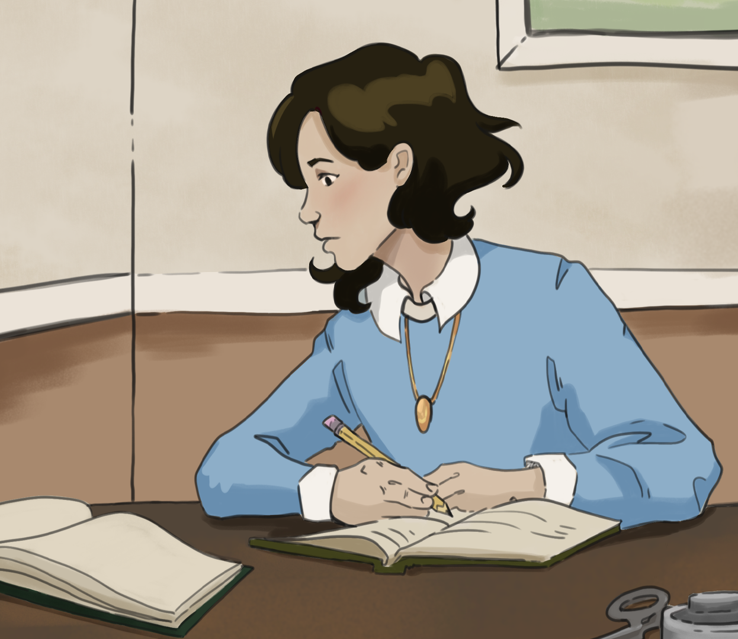
Writing From the Heart
The Diary of Anne Frank

Slide 3
Essential Question
How could personal writing, such as a diary, help people express and preserve their experiences during difficult times?

Slide 4
Learning Objectives
Analyze different nonfiction texts, including personal diaries, to compare author’s purposes.
Apply understanding of perspective and context in nonfiction writing by writing a diary entry.

Slide 5

Quick Write: Prompt #1
As you answer the following, focus on your response, not your grammar or punctuation:
Imagine you had to hide or go silent for weeks or months—no posting, talking freely, or seeing your friends. What would be the most difficult part for you? How would you try to keep your sense of identity and hope?
Notes:
K20 Center. (n.d.). Quick write. Strategies. https://learn.k20center.ou.edu/strategy/1127

Slide 6
Quick Write: Prompt #2
As you answer the following, focus on your response, not your grammar or punctuation:
Why do you think people choose to write, even when it is dangerous or forbidden?
Notes:
K20 Center. (n.d.). Quick write. Strategies. https://learn.k20center.ou.edu/strategy/1127

Slide 7
Quick Write: Prompt #3
As you answer the following, focus on your response, not your grammar or punctuation:
If you were living through a major event, what kinds of things would you write about that might never appear in a textbook?
Notes:
K20 Center. (n.d.). Quick write. Strategies. https://learn.k20center.ou.edu/strategy/1127

Slide 8


Card Sort
Sort the cards with quotes into one of the categories:
Fear
Hope
Loneliness
Courage
Daily Life
5-Minute Timer
Notes:
K20 Center. (n.d.). Card sort. Strategies. https://learn.k20center.ou.edu/strategy/147
K20 Center. (2021, September 21). K20 Center 5 minute timer [Video]. YouTube. https://www.youtube.com/watch?v=EVS_yYQoLJg

Slide 9
Card Sort: Results
Fear
  “Not being able to go outside…”
  “At night in bed…the Annex is on fire…”
Hope
  “It’s difficult in times like these…I still believe…”
  “Where there’s hope, there is life…”
  “As long as this exists…there will be solace for every sorrow…”
Notes:
Frank, A. (1997). The Diary of a Young Girl: The Definitive Edition (B. M. Mooyaart-Doubleday, Trans., O. H. Frank & M. Pressler, Eds.). Bantam Books.
K20 Center. (n.d.). Card sort. Strategies. https://learn.k20center.ou.edu/strategy/147

Slide 10
Card Sort: Results
Loneliness
  “You can be lonely even when you are loved by many…”
  “Writing in a diary…I have an even greater need…”
  “I don’t have a friend.”
Courage
  “I can shake off everything as I write…”
  “I know what I way…and a great deal of courage!”
  “I believe in the sun, even when it rains.”
Notes:
Frank, A. (1997). The Diary of a Young Girl: The Definitive Edition (B. M. Mooyaart-Doubleday, Trans., O. H. Frank & M. Pressler, Eds.). Bantam Books.
K20 Center. (n.d.). Card sort. Strategies. https://learn.k20center.ou.edu/strategy/147

Slide 11
Card Sort: Results
Daily Life
  “Whenever someone comes in from outside…breath fresh air…”
  “Every day I feel…why should I despair?”
  “Riches, prestige, everything can be lost…your own heart…to make you happy…”
Notes:
Frank, A. (1997). The Diary of a Young Girl: The Definitive Edition (B. M. Mooyaart-Doubleday, Trans., O. H. Frank & M. Pressler, Eds.). Bantam Books.
K20 Center. (n.d.). Card sort. Strategies. https://learn.k20center.ou.edu/strategy/147

Slide 12
Types of Writing and Purpose
While nonfiction deals with real things, different types of nonfiction writing can have different purposes.
A few different types of nonfiction writing:
  Diary
  Newspaper/Magazine Article
  Textbook
  Encyclopedia Entry

Slide 13
Nonfiction Writing
Diary
  Purpose: to help the writer reflect on their life, express emotions, and preserve memories
  Characteristics: personal, dated entries; honest, emotional, and descriptive
Newspaper/Magazine Article
  Purpose: to inform, educate, or entertain readers
  Characteristics: informative, factual, and structured

Slide 14
Nonfiction Writing
Textbook
  Purpose: to provide comprehensive instruction and support learning
  Characteristics: structured, organized, and detailed
Encyclopedia Article
  Purpose: to provide reliable, summarized knowledge about a topic
  Characteristics: formal, factual, and comprehensive

Slide 15

“Amsterdam” Encyclopedia Entry
Discusses the events happening in Amsterdam around the time that Anne Frank’s family was in hiding.
Highlight details that connect to either:
  Anne Frank’s diary
  Anne Frank’s story/life
For each detail you highlight, make a note in the margin about why you highlighted it.
Notes:
K20 Center. (n.d.). Why-lighting. Strategies. https://learn.k20center.ou.edu/strategy/128

Slide 16
The Diary of Anne Frank
Diaries often capture personal thoughts and feelings and give voice to one’s life experiences.
Anne Frank’s diary gives us a unique glimpse into history and helps us better understand what it looked and felt like to live during that difficult time.

Slide 17

RAFT
Role: the point of view you take on, as the writer
Audience: who you are writing for
Format: the style or layout your writing should be in
Topic: what your writing should be about

Slide 18
RAFT
Use the following to write your own diary entry.
Role: select a historical or fictional character living through a challenging time
Audience: yourself (private reflection)
Format: a dated, diary entry
Topic: the struggle or conflict you are experiencing

Slide 19
RAFT: Example
Role: Anne Frank, a 13-year-old girl
Audience: Kitty (her diary personified
as a friend)
Format: personal diary entry
Topic: beginning a new diary; seeking understanding and friendship
“I hope I will be able to confide everything to you, as I have never been able to confide in anyone, and I hope you will be a great source of comfort and support.
I suppose I should begin by telling you what my diary is going to be: a story of my life. I don’t mean the facts, but the feelings. I want the diary to be my friend, and I shall call my friend Kitty.”
Notes:
Frank, A. (1997). The Diary of a Young Girl: The Definitive Edition (B. M. Mooyaart-Doubleday, Trans., O. H. Frank & M. Pressler, Eds.). Bantam Books.

Slide 20
What Makes an Impact?
Think about your diary entry as you answer one of the following prompts:
Imagine you had a different role for your diary entry. Identify a different role and describe how that would have changed your diary entry.
Imagine you were writing to a different audience. Identify a different audience and describe how that would have changed your diary entry.

