Slide 2
A Geometer’s Perspective
Trigonometric Ratios

Slide 3
Essential Question
How are the angles and the sides of a right triangle related?

Slide 4
Lesson Objectives
Define sine, cosine, and tangent.
Use the definitions of sine, cosine, and tangent to find triangle ratios.

Slide 5
Card Sort
Sort your cards into groups.
Be ready to share why you sorted the way you did.
How did you decide which cards should be grouped together?
Which card(s) did you find challenging to put into a group?
Notes:
K20 Center. (n.d.). Card Sort. Strategies. https://learn.k20center.ou.edu/strategy/147

Slide 6
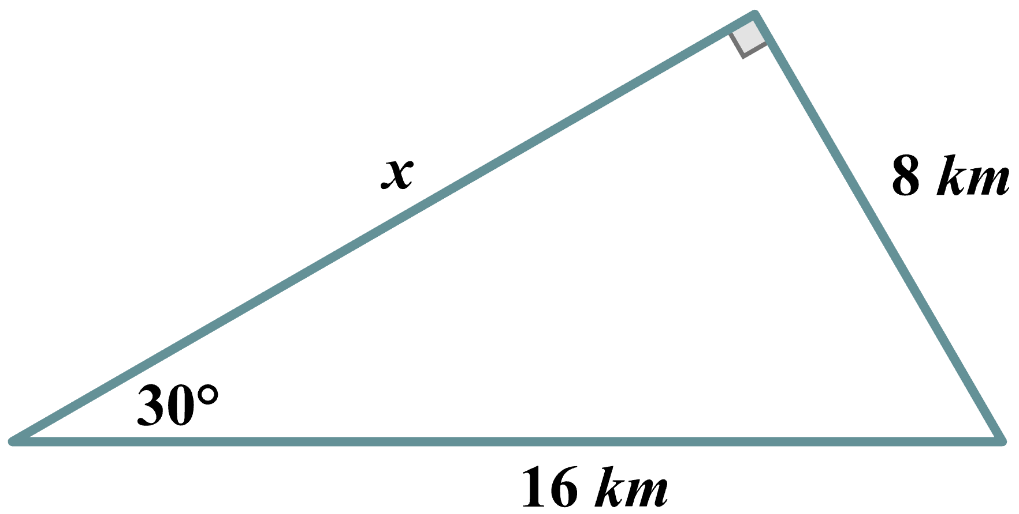
Right Triangle Exploration
How do you find the unknown side length?

Slide 7
Right Triangle Exploration
How can we solve this triangle?

Slide 8
Right Triangle Exploration: Gathering Data
Identify or calculate the value of each angle measure Triangles 1, 2, and 3.
Use a ruler to measure the sides of each triangle in centimeters.
Record your findings in the table.
Be sure to label your table such that each row has corresponding parts.
For example, in row 1, m∠??? corresponds to m∠ABK.
Label it and write the value of its angle measure.

Slide 9
Right Triangle Exploration: Comparing Data
Use your measurements find the ratios of the different sides of each triangle.
Use a calculator and round your answers to two decimal places.

Slide 10
Right Triangle Exploration
Making Observations
Write anything you noticed about these ratios.
Making Predictions
Based on your observations, write what you think the relationship is between the sides of a triangle.

Slide 11
Making Connections: Calculator Time
Use your results from your Right Triangle Exploration handout to complete the Reference Angle Measure column.

Slide 12
Making Connections: Calculator Time
There are mathematical functions that give us information about the relationships between an angle and the side measures of a right triangle: sine, cosine, and tangent.
However, we don’t yet really know much about them.
Work with your group to complete the table and then write definitions for these functions.

Slide 13
Making Connections: Calculator Time
On your calculator, locate the keys that read: SIN, COS, and TAN (or sin, cos, and tan).
These refer to the trigonometric functions: sine, cosine, and tangent.
Use your calculator to determine the results of using the functions sine, cosine, and tangent on the Reference Angles to complete the last 3 columns.
Let’s try the first row together.

Slide 14
Making Connections: Connections Time
Compare your completed table with the one on your Right Triangle Exploration handout.
Below your table, record your observations.
What do you notice?
What patterns do you see?

Slide 15
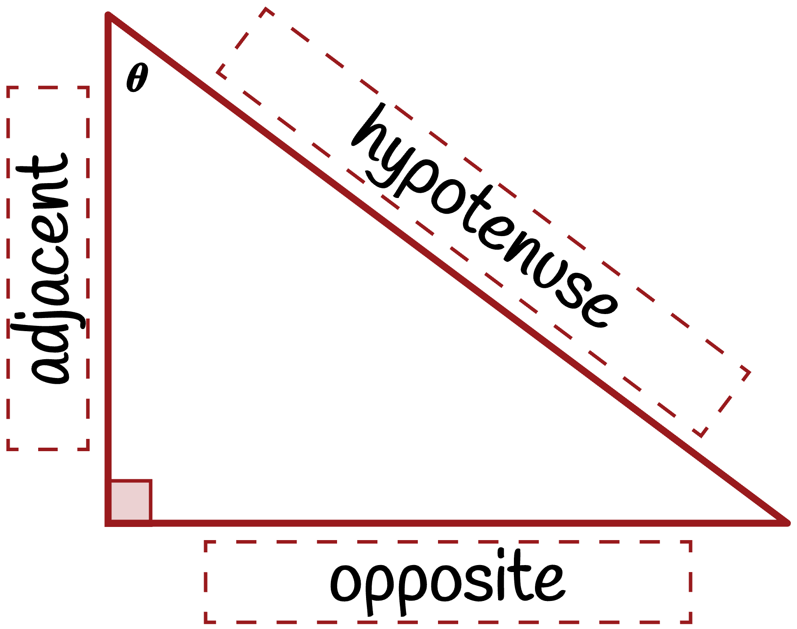
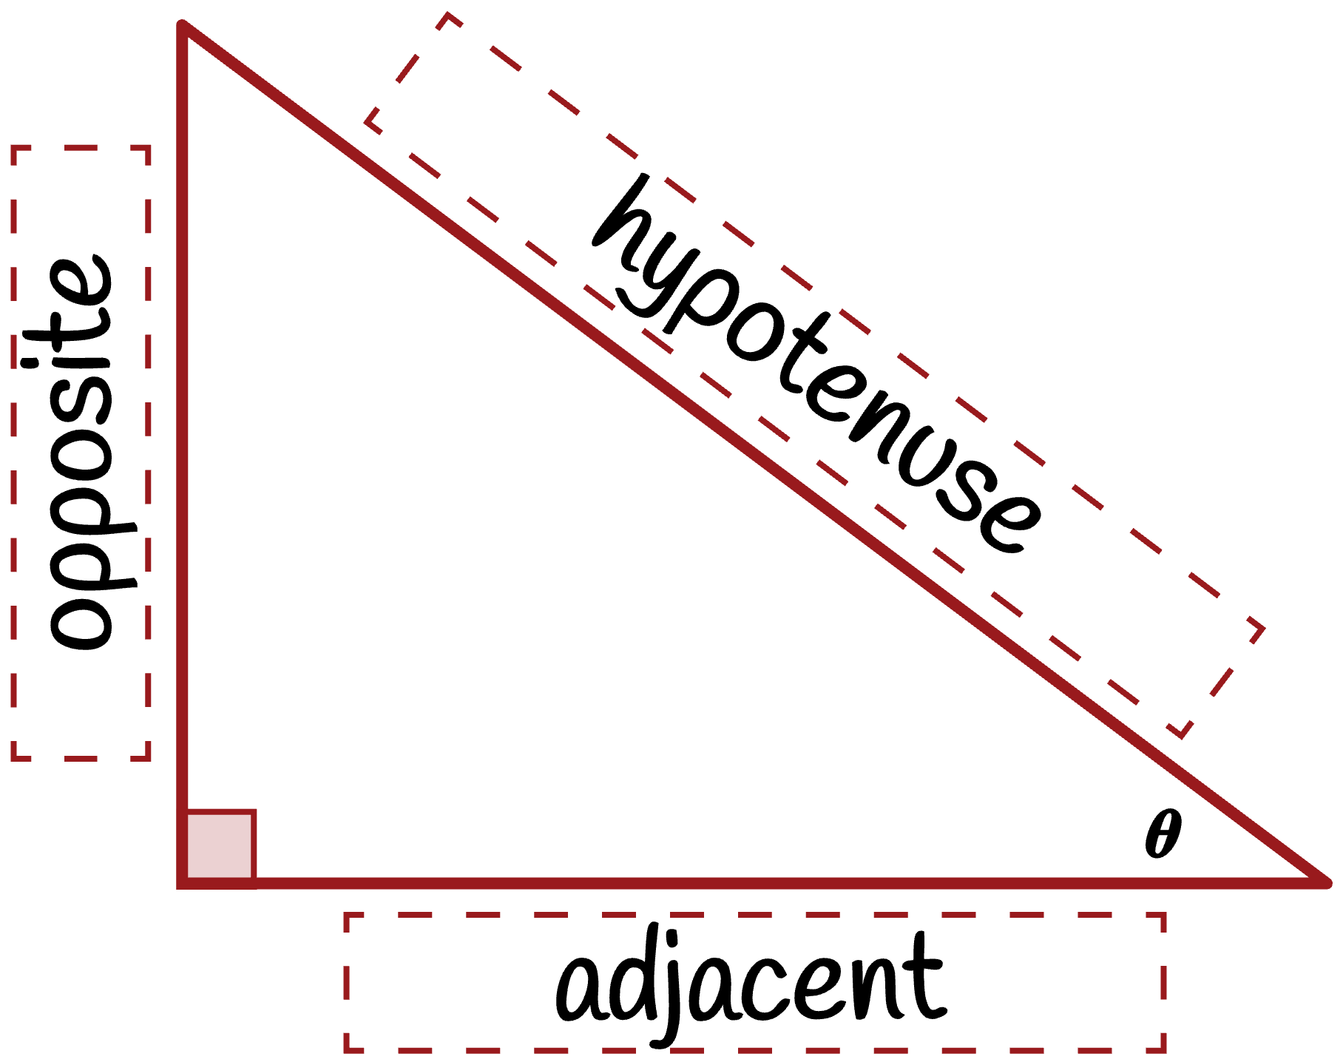
Making Connections: Vocabulary Time

Slide 16
Making Connections: Definition Time
As a group, make hypotheses about the definitions of sine, cosine, and tangent using your new vocabulary for opposite, adjacent, and hypotenuse.
Record your definitions on the back of your handout.
Try to write a general definition, something you could apply to any problem.
Think about what you would use to find sin(A), cos(A), or tan(A) for any right triangle with angle A.

Slide 17
Making Connections: Clarity Time
A
Find another pair and trade definitions/handouts.
On a piece of notebook paper, find the sin(A), cos(A), and tan(A) using only the definition you’ve been given.
5
3
B
C
4

Slide 18
Making Connections: Clarity Time
Return the definitions/handouts to the authors.
Now compare your results with the pair who wrote the definition you used.
Did you get the same result?
How could you definition be clearer?
Revise your definition, if needed.

Slide 19
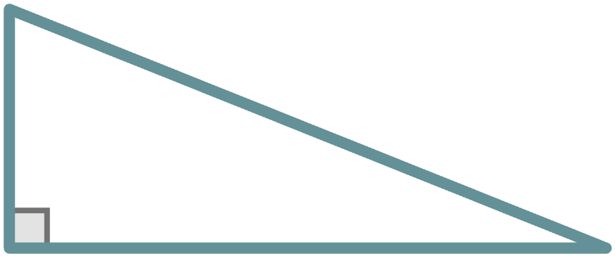
Making Connections: Clarity Time
Find another pair and trade your revised definitions.
On a piece of notebook paper, find the sin(S), cos(S), and tan(S) using only the definition you’ve been given.
T
13
5
R
S
12

Slide 20
Making Connections: Clarity Time
Return the definitions/handouts to the authors.
Now compare your results with the pair who wrote the definition you used.
Did you get the same result?
How could you definition be clearer?

Slide 21
Making Connections: Right Triangle Trig
The sine of the angle is the ratio of the opposite side to the hypotenuse.

Slide 22
Making Connections: Right Triangle Trig
The cosine of the angle is the ratio of the adjacent side to the hypotenuse.

Slide 23
Making Connections: Right Triangle Trig
The tangent of the angle is the ratio of the opposite side to the adjacent side.

Slide 24
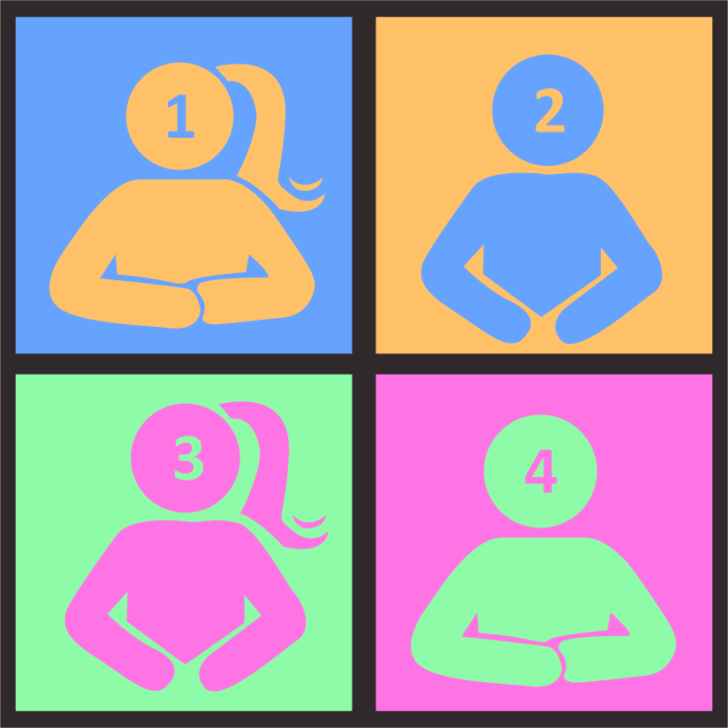
Using Trig Ratios
Work together to answer each question.
Everyone in your group needs to be ready to share.
Which trig ratio did you use?
Why did you select that trig ratio?
How did you get your answer?
Notes:
K20 Center. (n.d.). Numbered Heads Together. Strategies. https://learn.k20center.ou.edu/strategy/2476

Slide 25
Exit Ticket
Now can we solve this triangle?
Notes:
K20 Center. (n.d.). Bell Ringers and Exit Tickets. Strategies. https://learn.k20center.ou.edu/strategy/125

Slide 26
Exit Ticket (Solution)
Now can we solve this triangle?
Notes:
K20 Center. (n.d.). Bell Ringers and Exit Tickets. Strategies. https://learn.k20center.ou.edu/strategy/125

