Slide 2
Trigonometric Ratio: A Geometer’s Perspective
Trigonometric Ratios

Slide 3
Essential Question
How are the angles and the sides of a right triangle related?

Slide 4
Lesson Objective
Students will investigate and discover the trigonometric ratios through observations about right triangles.

Slide 5
Card Sort
Each group will receive a set of cards
Sort any way you see fit
Be ready to explain why you sorted the way you did!

Slide 6
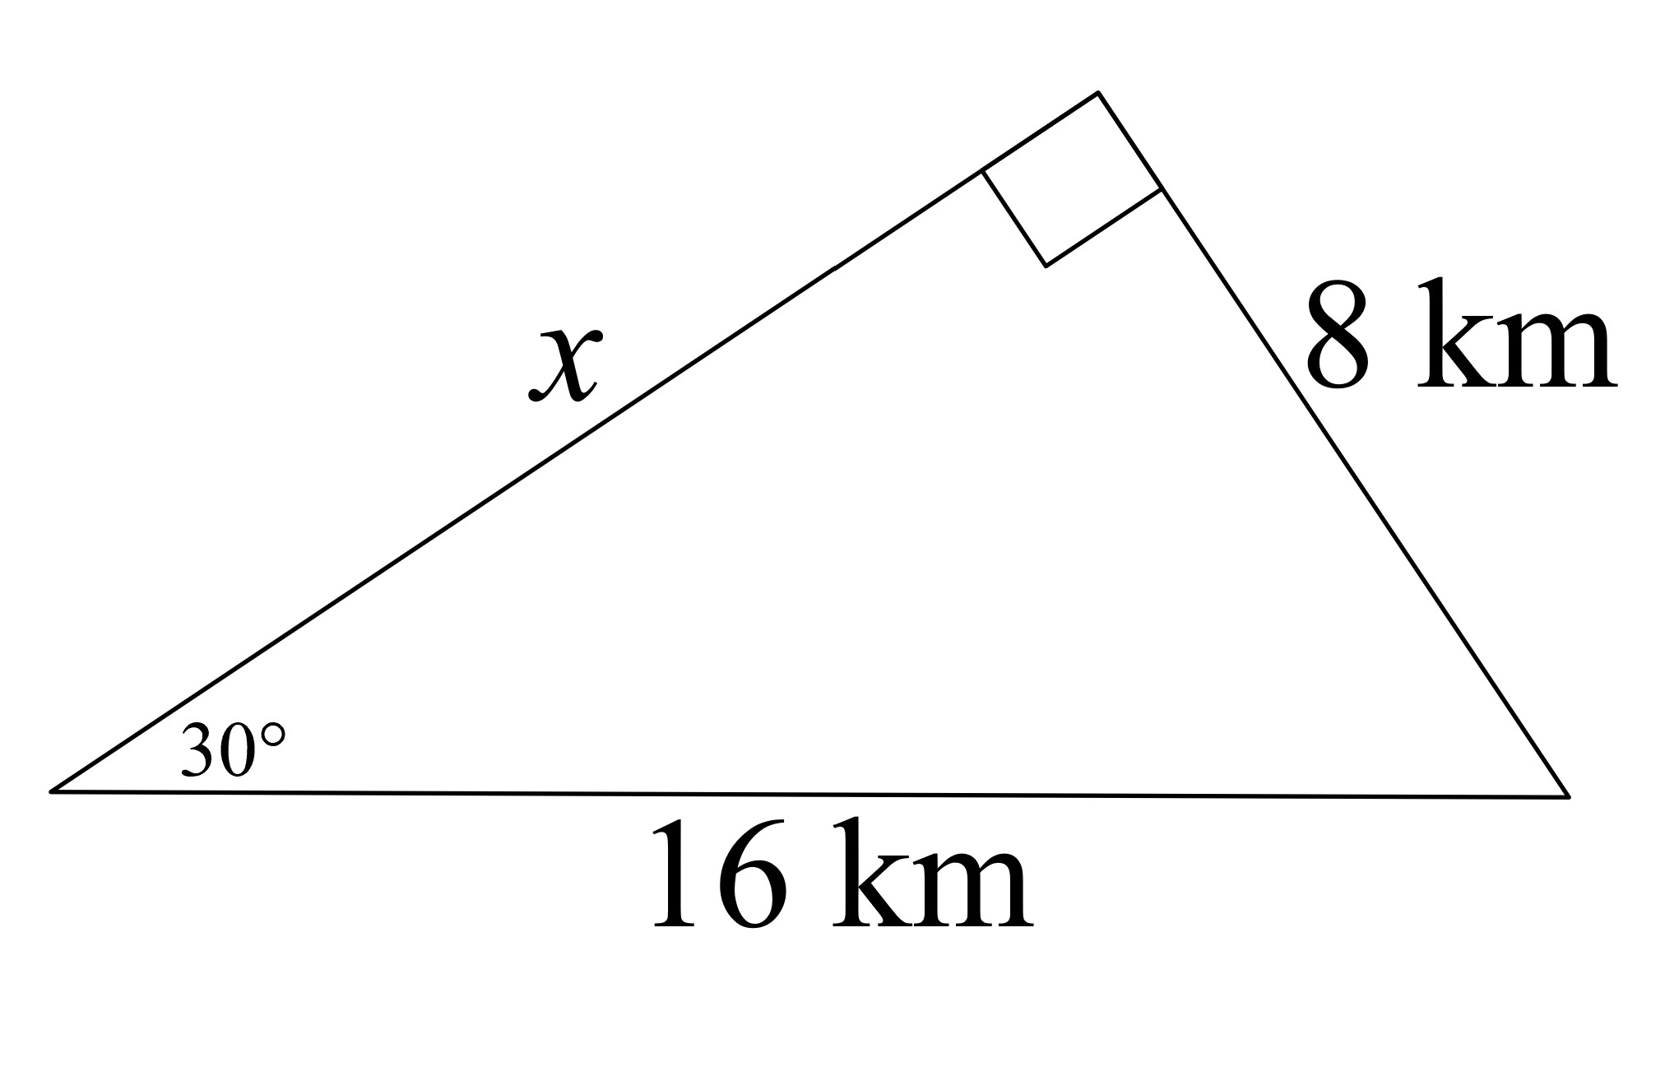
Right Triangle Exploration
How do you find the missing measure?
Think about the card sort we just did!

Slide 7
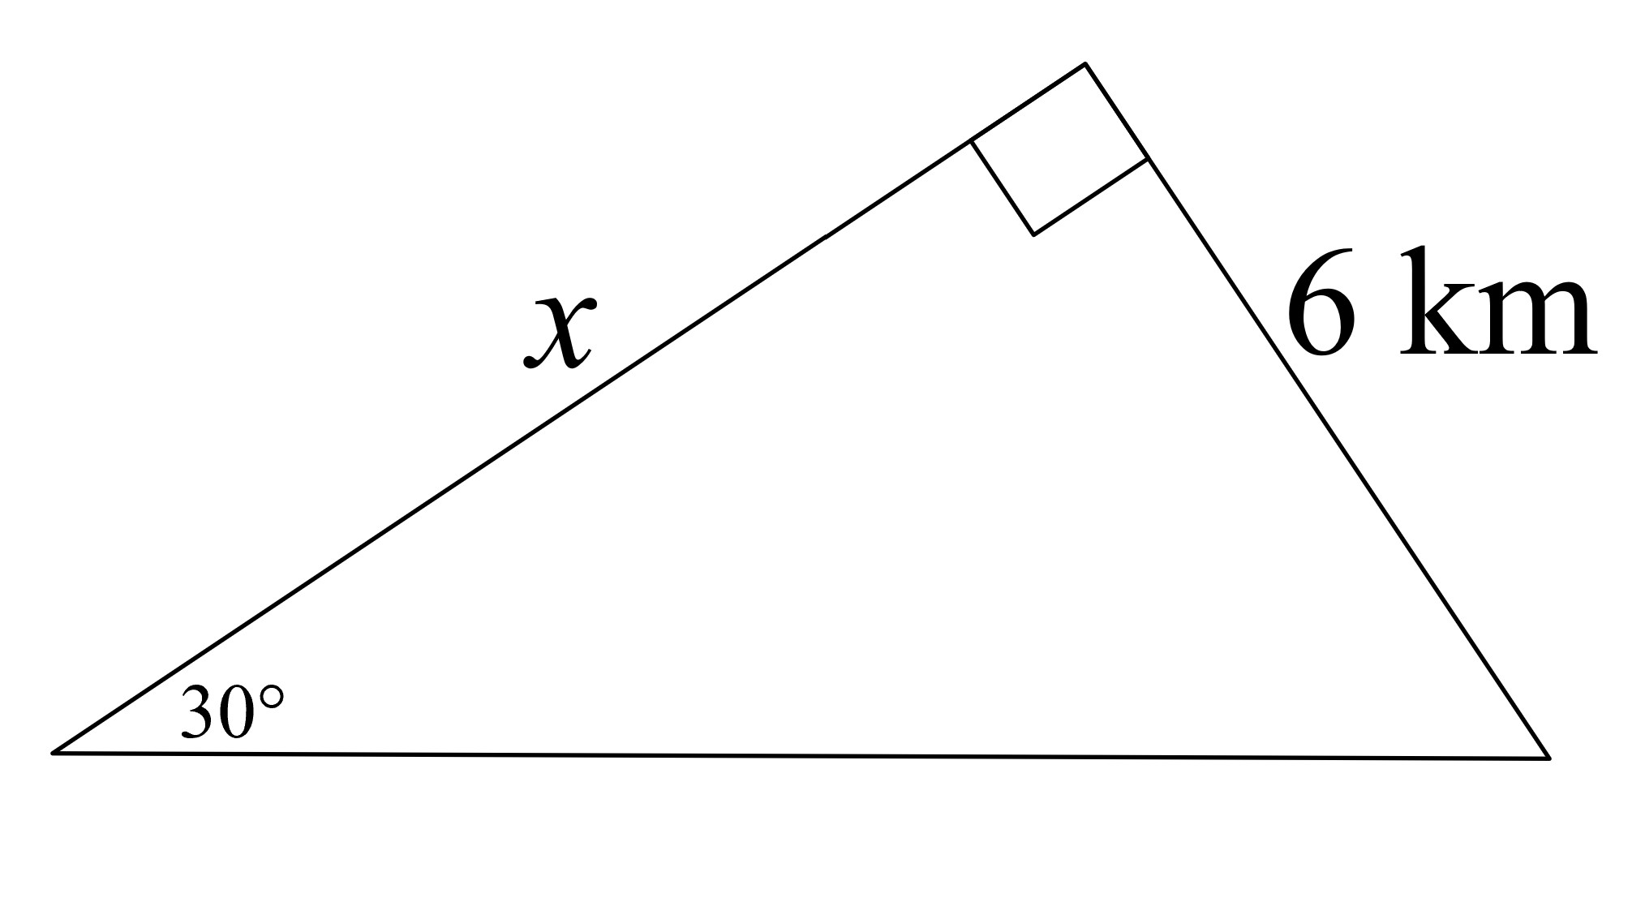
Right Triangle Exploration
How can we solve this one?
Is it even possible?

Slide 8
Right Triangle Exploration
By investigating the relationship of triangles, you will be able to solve the triangle from the previous slide.
Complete the Right Triangle Relationship handout
Be sure to time and measure correctly
Analyze your data
Does it always occur no matter the situation?

Slide 9
Discussion
What is your hypothesis about the ratio relationship you observed during your investigation?
Could your new understanding of right triangles help you solve for a missing side?
Can we do this for any triangle with a 21 degree angle?
What about a 30 degree angle? 60 degree angle? 45 angle?
Complete Sine, Cosine, and Tangent Handout
Create your own definition of sine, cosine, and tangent after completing the handout

Slide 10
Right Triangle Exploration
How can we solve this one? Is it even possible?

Slide 11
Create Your Own Scenario
Using your understanding trigonometric functions, create a word problem scenario to solve for a missing side.
Below the word problem, write down your definitions to sine, cosine, and tangent from earlier in the lesson

Slide 12
Exit Ticket
Find a partner and solve their trigonometric function scenario.
At the bottom of their scenario should be their definitions of sine, cosine, and tangent.
Does the definition resemble yours?
Is there a way you can combine your definition and their definition to make one solid representation of those three terms?

