Slide 2
Which world events and people have had the biggest impact on how you see the world?

Slide 3

Notes:
Mellowdi. (2024). We Didn’t Start The Fire – Billy Joel (clean) [Video]. YouTube. https://www.youtube.com/watch?v=BgwVgGpk1Ks&list=RDBgwVgGpk1Ks&start_radio=1

Slide 4

Stand Up, Sit Down
On a piece of paper, write down three events or people with the biggest impact on the world in your lifetime.
Everyone stand up.
Each person will read out one of their ideas and then mark it off.
If someone says an idea on your paper, mark it off.
Sit down once you have shared all your ideas or all items on your list are marked off.
Notes:
K20 Center. (n.d.). Stand up, sit down. Strategies. https://learn.k20center.ou.edu/strategy/1771

Slide 5
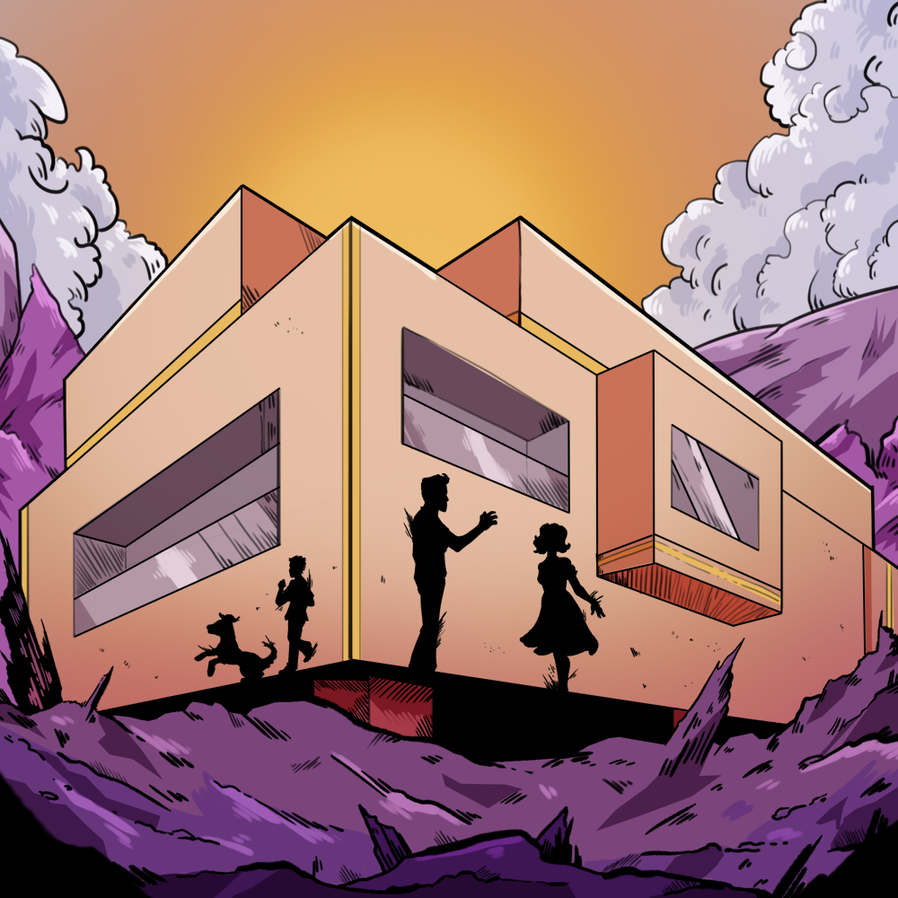
Ghosts in the Machine
Echoes of the Atomic Age in Ray Bradbury’s “There Will Come Soft Rains”

Slide 6
Essential Question
In what ways can literature reflect the values, fears, and perspectives of its time?

Slide 7
Lesson Objectives
Understand how historical and cultural perspectives influence how an author writes.
Learn how to analyze the components of an author’s writing style.

Slide 8
Which world events and people have had the biggest impact on how you see the world?

Slide 9
Historical and Cultural Perspectives
This refers to how people’s thoughts, feelings, and decisions are shaped by the time period they lived in and the culture they were part of—including their beliefs, traditions, values, knowledge, and events happening around them.

Slide 10
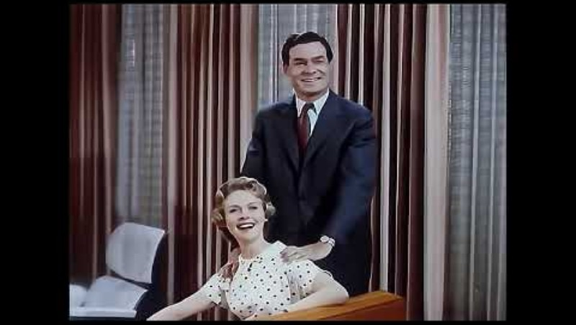
Notes:
[Rebecca Pattinson the History Buff]. (2025). The total electric home the home of the future 1959. [Video]. YouTube. https://www.youtube.com/watch?v=ZZ9m3jerR5I

Slide 11
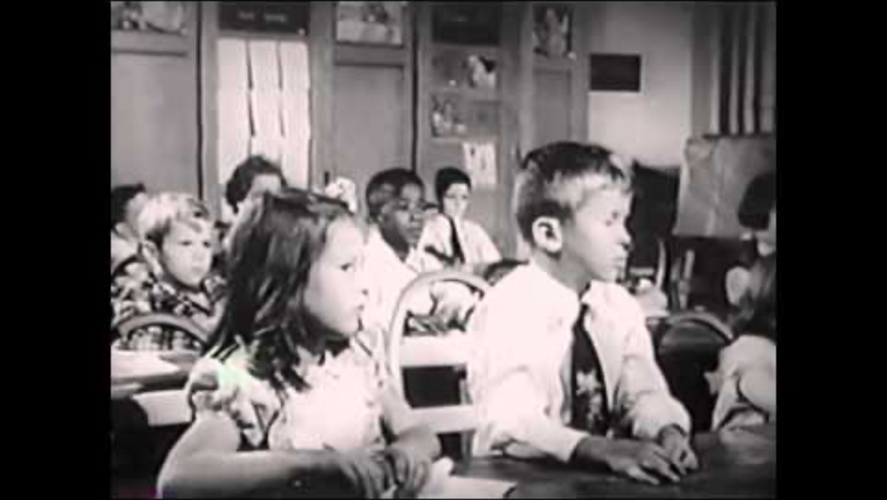
Notes:
Ooms, A. (2011). Bomb drills. [Video]. YouTube. https://www.youtube.com/watch?v=120wGLgCTkg

Slide 12

Honeycomb Harvest
Each hexagon has one of the following:
  Term (in bold)
  Definition (in italics and bold)
  “Example” (in quotes)
With your partner, match the term with the definition and example.
Arrange hexagons so the sides of related hexagons are touching.
Notes:
K20 Center. (n.d.). Honeycomb harvest. Strategies. https://learn.k20center.ou.edu/strategy/61

Slide 13
Honeycomb Harvest
Read the definitions and examples on the new cards.
Determine which group each belongs to.
Discuss with your partner why you put the cards together in that way.
Notes:
K20 Center. (n.d.). Honeycomb harvest. Strategies. https://learn.k20center.ou.edu/strategy/61

Slide 14
Style Element Notes
Diction: An author’s intentional choice of words, often to create a specific effect.
Figurative Language: Using words and comparisons in a non-literal way to create a more vivid or creative effect.
Imagery: Descriptive language that appeals to any of the reader’s senses, creating a mental picture or feeling.

Slide 15
Style Element Notes: A Little Deeper
Diction
  Tone: The general attitude of a piece of writing; often reveals an author’s attitude toward the subject.
Figurative Language
  Personification: Giving human characteristics to something nonhuman.
Imagery
  Juxtaposition: Contrasting two or more things to create an effect.

Slide 16


Categorical Highlighting
Read the poem “There Will Come Soft Rains” by Sara Teasdale.
As you read, highlight these style elements in these colors:
  Diction/Tone
  Figurative Language/Personification
  Imagery/Juxtaposition
Notes:
K20 Center. (n.d.). Categorical highlighting. Strategies. https://learn.k20center.ou.edu/strategy/192

Slide 17
Poem Analysis
What do you think the meaning of this poem is?
Which author’s style element helped you understand the meaning the most, and how does it contribute to the meaning?

Slide 18
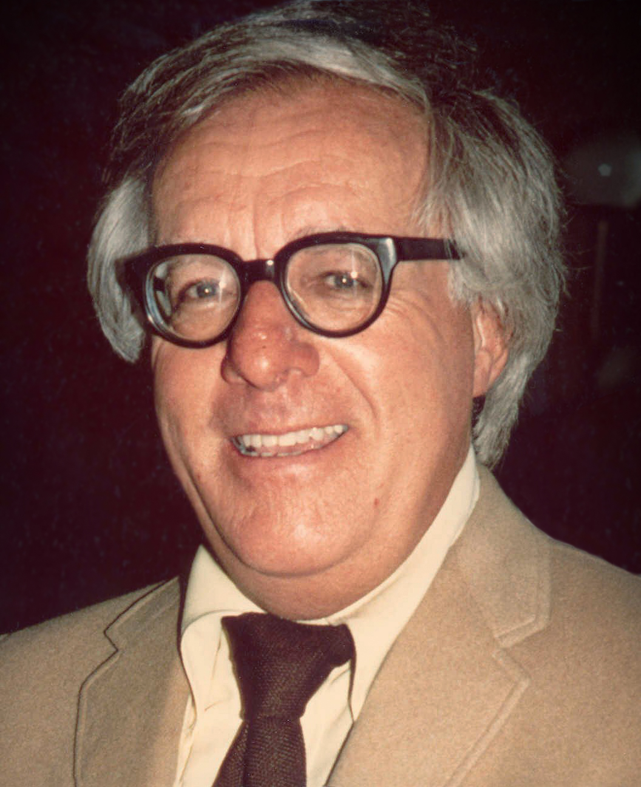
Ray Bradbury (1920-2012)
One of the most celebrated sci fi and fantasy writers of the 1900s.
Author of Fahrenheit 451, The Martian Chronicles, and “A Sound of Thunder”
Many of his stories deal with the dangers of technology
Photo by Alan Light

Slide 19
Categorical Highlighting
Read the short story “There Will Come Soft Rains” by Ray Bradbury.
As you read, highlight these style elements in these colors:
  Diction/Tone
  Figurative Language/Personification
  Imagery/Juxtaposition
Notes:
K20 Center. (n.d.). Categorical highlighting. Strategies. https://learn.k20center.ou.edu/strategy/192

Slide 20
Text Analysis
Use the information you gathered from Bradbury’s short story to show how an author’s style can convey the historical and cultural perspectives of that time.

