Slide 1
Voices from the past
HISTORY AND LITERATURE

Slide 2
KWL CHART
K What I KNOW | W I WANT to know | L I LEARNED
Notes:
Review students’ K column for what they already know. Then review the W chart to get a feel for the information the students want to know. The presentation is general enough that teachers can take the conversation whatever direction they want to go and answer questions posed by students.
Encourage students to use the L column to add new information that they gain during this presentation.

Slide 3
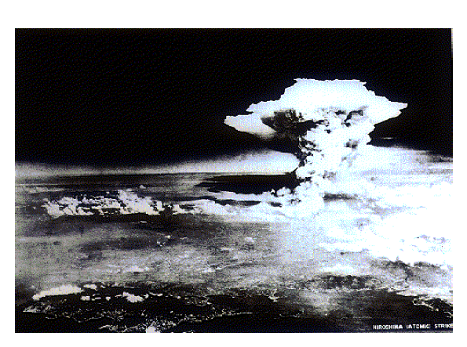
Photo by U.S. Army
The huge atomic cloud August 6, 1945, after an Uranium bomb, the first nuclear weapon in the world, was dropped in Hiroshima City. It was estimated that its energy was equivalent to 15 kilotons of TNT. This is an aerial photograph from 80 kilometers away from the Inland Sea, taken about one hour after the dropping.
Notes:
Picture of the actual huge atomic cloud on 6 August, 1945. A Uranium bomb, the first nuclear weapon in the world, was dropped in Hiroshima City. It was estimated that its energy was equivalent to 15 kilotons of TNT. Aerial photograph from the 80 kilometers away of the Inland Sea, taken about 1 hour after the dropping.

Slide 4
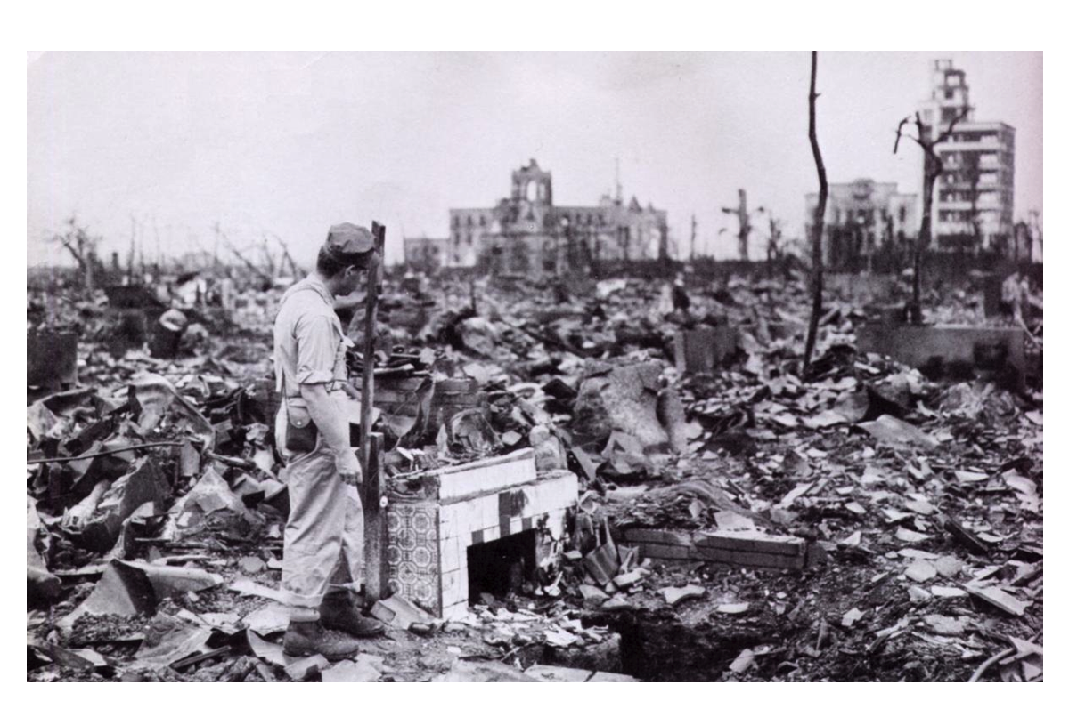
Witness to Destruction [photograph]. (1945). Retrieved from http://newsclick.in/content/remembering-hiroshima-nagasaki
Notes:
Begin with this close up shot of the damage for students to pay attention to small details, the following slides will pull out further and further to allow students to see the damage on a large scale.

Slide 5
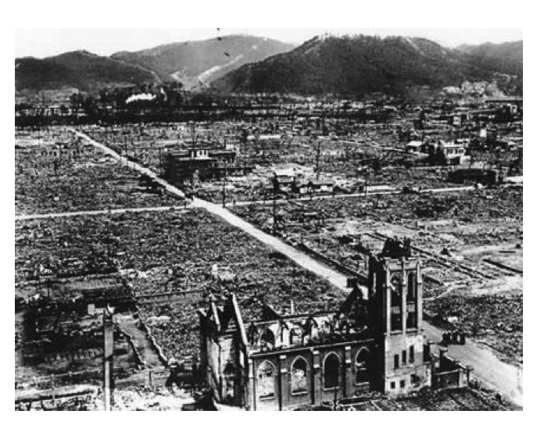
Hiroshima Church. (1945). [photograph]. Retrieved from http://www.neatorama.com/2012/02/27/the-unluckiest-train-ride/
Notes:
View with larger scope than previous picture

Slide 6
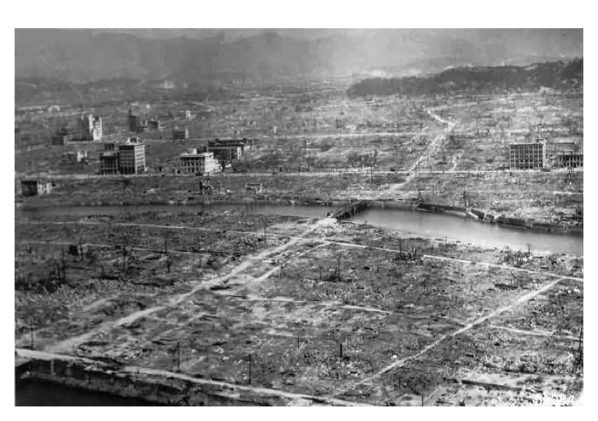
Tibbets, P. W. (1945). Hiroshima [photograph].
Notes:
Visual provided to show how a cross-curricular lesson/unit will have the same overarching essential question. Review from Cross-Curricular Teaching session. Remember that the overarching Essential Question and/or theme, is the focus in the center. Once we branch out from the overarching question, we will explore how to break this down into smaller chunks across contents to develop content specific essential questions and activities. All of the content specific questions and activities should still allow students to make the connections across subject areas, and most importantly to the “big picture” we have at the center. (*Instructional strategy card and Unit Planning Template pass out from resource packet)

Slide 7
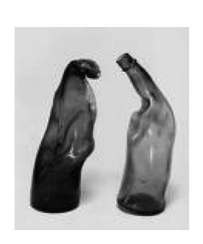
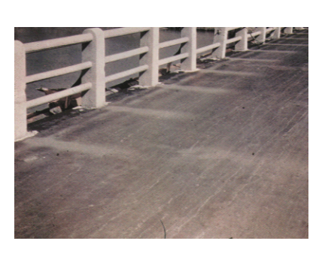
Tsuchiya, H. (n.d.) Melted Sake Bottles [photograph]. Retrieved from http://www.english.illinois.edu/maps/poets/g_l/levine/bombing.htm
The shadows of the parapets were imprinted on the road surface of the Yorozuyo Bridge, 1/2 of a mile south-southwest of the hypocenter. It is one of the important clues for establishing the location of the epicenter.
From Modern American Poetry. ( ). A Photo-Essay on the Bombing on Hiroshima and Nagasaki. Retrieved from http://www.english.illinois.edu/maps/poets/g_l/levine/bombing.htm
Photo by U.S. Army. (1945).
Notes:
Bottles- damaged by thermal pulse, hot enough to melt glass
Road- thermal pulse scorched asphalt, left thermal shadows due to the heat

Slide 8
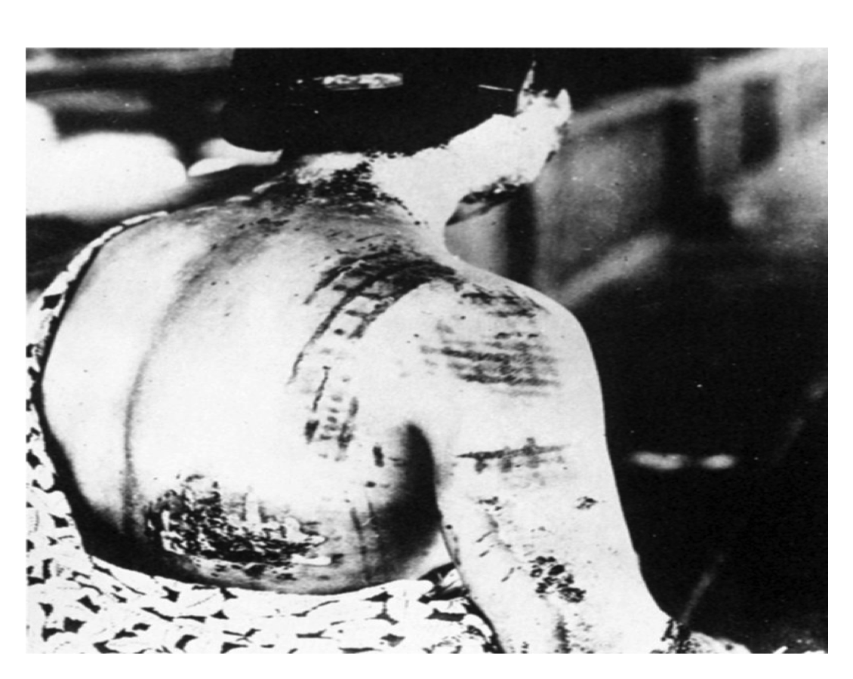
The burns on this victim look like kimono patterns; the lighter areas of the cloth reflected the intense light from the bomb, causing less damage.
From New World Encyclopedia. (2015). Bombing of Hiroshima and Nagasaki. Retrieved from http://www.newworldencyclopedia.org/entry/Bombing_of_Hiroshima_and_Nagasaki
Notes:
Injuries due to thermal pulse, many miles away from epicenter

Slide 9
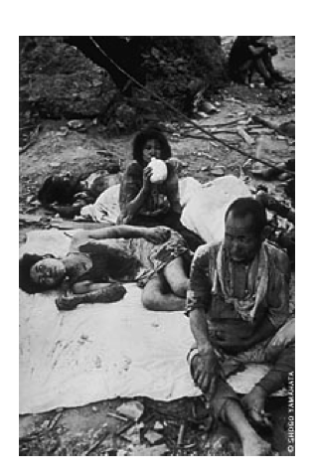
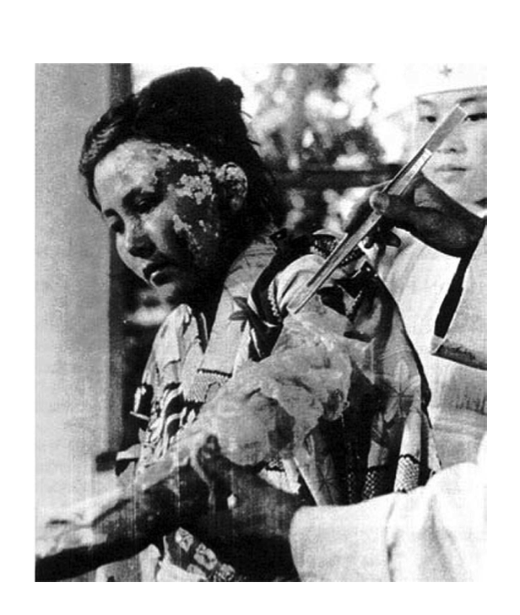
Right: Yamahata, Y. (1945). From Nagasaki Journey: The Photographs of Yosuke Yamahata. Retrieved from http://www.english.illinois.edu/maps/poets/g_l/levine/bombing.htm
Below: Hiroshima bombing victims. (1945). [photograph]. Retrieved from http://www.vreme.com/cms/view.php?id=944058
Notes:
injuries

Slide 10
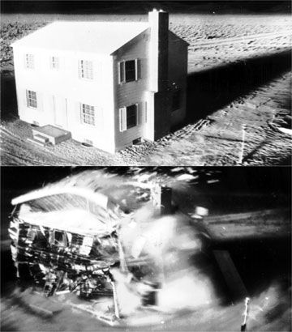
Blast Wave Testing
Link to Blast Wave video:
http://youtu.be/tr76hNngqts
Link to Thermal Pulse video:
http://www.atomicarchive.com/Effects/thermalpulse.shtml
Notes:
Picture shows blast wave to help students better understand the power of the bomb in order to better understand some of the details in Hersey’s Hiroshima excerpt. Video links show government footage of blast wave and thermal pulse testing.

