Slide 2
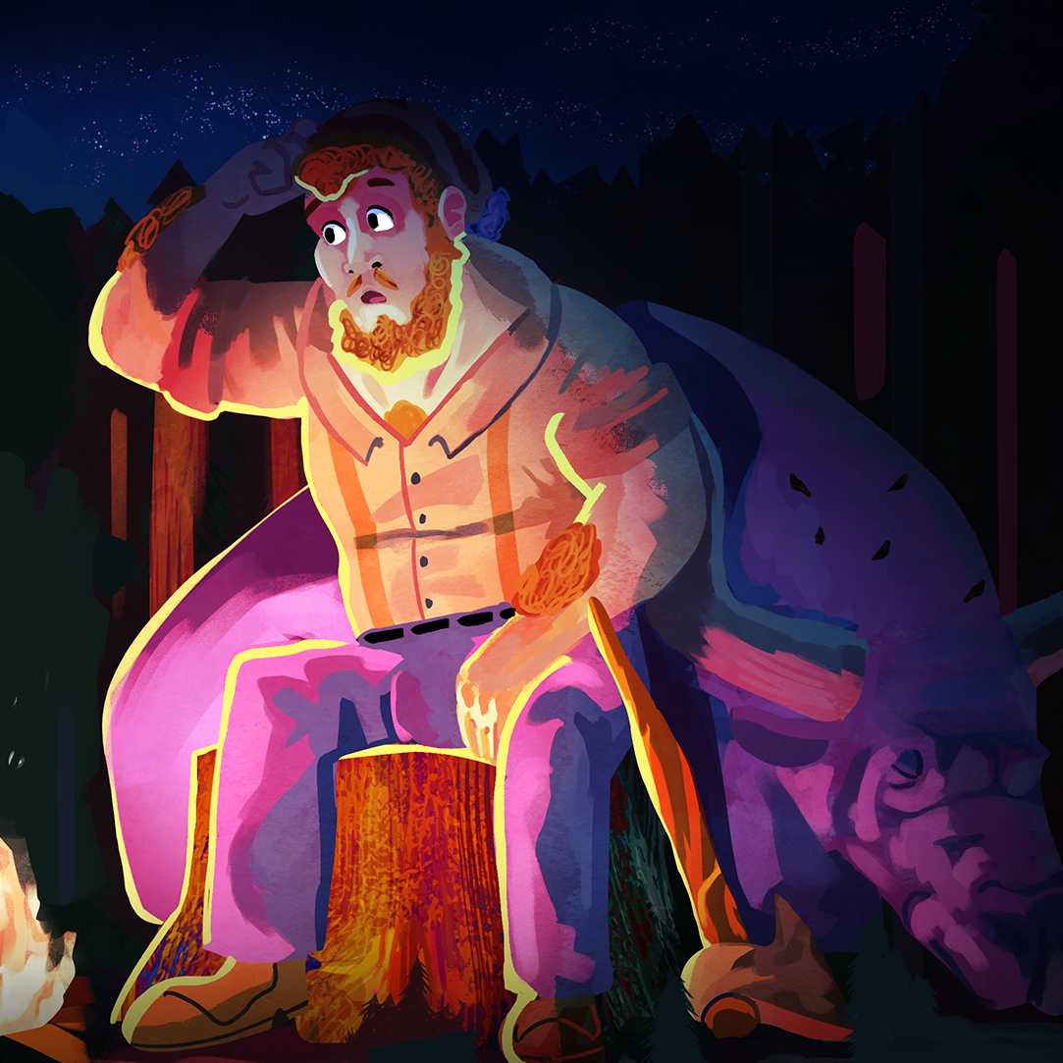
Here’s How I Heard It
Using Folklore to Improve Close Reading Skills

Slide 3
Essential Questions
How can we connect works of literature to similar works from other cultures?
What literary tools can we use to approach any work of literature, regardless of genre?

Slide 4
Learning Objectives
Use elements of text to defend responses and interpretations
Draw conclusions, generalizations, and predictions, then support them with evidence and personal experience
Use text features and elements to support inferences and generalizations about information
Analyze satire, sonnet, epic, myths and legends, mystery, and editorials.

Slide 5
Journal Writing
  Can you think of a story your parents told you as a child that turned out to not be true?
  How did you feel when you found out it was not true?
  Why do you think your parents would do something like that?
  What was the purpose in telling you stories like this? Were they just being mean?

Slide 6
Folklore
These types of stories were used to establish our ideas of right and wrong.
The purpose was for us, as children, to learn that there are rewards for behaving, for being kind, and in the case of the Tooth Fairy, for enduring the pain of having a tooth pulled.

Slide 7
Questions to Consider
If we were to read a story together, would everyone have the same reaction to what happens in the story?
Would we all agree on the lesson we should learn from the story?
Why/why not?

Slide 8
Fables
Does anyone know what a fable is?
Has anyone heard of Aesop’s Fables?
What lesson or moral can we learn from this fable?
Does anyone have another perspective or suggestion as to what we might learn from this fable?

Slide 9
Tall Tales
Can anyone tell me what a tall tale is?
Has anyone heard the stories of Paul Bunyan, Davy Crockett, or Daniel Boone?
What makes these stories different from other stories?
What do you think is the purpose of these symbols at the end of each sentence in the Tall Tale description?
How can we use these symbols to better understand the story as we read?

Slide 10
Tall Tales
Notation Devices
X – exaggeration
F – presented as fact
S – slang or dialect
N – nature
Is there a valuable lesson or moral we can learn from this story?
Now that we have decided that this story is only meant to be funny and entertaining, who do you think the original audience might have been?
Where do you think these crazy stories were probably told?

Slide 11
Folktales
Does anyone know what a folktale is?
What if I told you that folktales and fairy tales are basically the same thing?
Does anyone remember any fairytales they learned growing up?

Slide 12
Folktales
The story often opens with a very typical phrase: Once upon a time, in a faraway land, a long time ago, etc. O
The story establishes a clear difference between good and evil, right and wrong, good and bad, and will often label characters as such early in the story. VS (versus)
The story will most likely be repetitive, rhythmic, or will use rhyme to engage the audience. R
The characters in the story will often use trickery, magic, or the help of a powerful friend. T
Folktales often contain a “stock” setting such as a forest, a castle, a bridge, a cave, etc. S
In the end, good is rewarded and evil is punished. The conclusion is satisfying to the listener because everything comes to a nice, neat finish. E

Slide 13
Folktales
What type of lesson or moral can we learn from this story?
Who do you think the intended audience of this story was originally?
Why do you think this type of story was created?
Are there any stories that you can think of that are similar to this story?
What is it about these stories that made them similar?

Slide 14
Myths
Can anyone tell the class what a myth is?
What about Greek Mythology? Does that trigger anyone’s memory?

Slide 15
Myths
What lesson or moral can we learn from this myth?
Does this myth remind you of any other stories that you have heard?
Has anyone ever read, or been told, about a story in which a god creates a human specifically for the purposes of naming animals and tending the gardens of the earth?
How is this myth similar to a popular religious story that some of us may have learned growing up?

