Slide 2
The War of the Words
Grammar and Parts of Speech

Slide 3
Essential Question
How can our word choice affect the message we want to convey as writers?

Slide 4
Lesson Objectives
Students will be able to:
identify and use the four main parts of speech
transform sentences through changes in word choices
collaboratively strategize to convince their classmates that one part of speech is superior to another by using debate techniques

Slide 5
Which of the four main parts of speech (noun, adjective, verb, adverb) do you feel is the most important to the English language?
noun: person, place thing
adjective: a word used to describe or modify a noun
verb: an action word
adverb: word used to modify a verb, adjective, or other adverb

Slide 6
Which of the four main parts of speech (noun, adjective, verb, adverb) do you feel is the most important to the English language?
Respond to the prompt in writing.

Slide 7
The Importance of Parts of Speech
In two sentences, tell me about your dream car.
Do not use any adjectives.

Slide 8
The Importance of Parts of Speech
In one sentence, tell me what you want to be when you get older. What do you want to do with your life?
Do not use any nouns.

Slide 9
The Importance of Parts of Speech
In one sentence, tell me what you ate for lunch yesterday. Did you enjoy your lunch?
Do not use any adverbs.

Slide 10
The Importance of Parts of Speech
Tell me what you plan on doing when school gets out today. This can be as long or as short as you want.
Do not use any verbs.

Slide 11
The Importance of Parts of Speech: Reflect
Which of these was the easiest to write about, even when a tough rule was placed on writing your response?
Which rule was the hardest to follow?

Slide 12
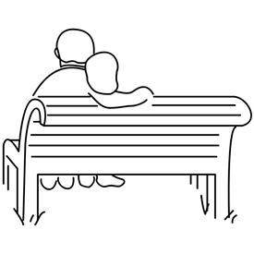
The Importance of Parts of Speech: Playing with Sentences

Slide 13
The Importance of Parts of Speech: Articles
What differences do you notice between the two articles?
Are these two articles recounting the same event?
Does one version of the article force the reader to assume certain things?
Do you, as readers, get a better sense of the author’s opinion in the second article?
What are some words that helped you understand the author’s opinion?
What article seemed to make the event out to be a much bigger deal?
What details have been included to provide the reader with more important information?
Did this article seem as big of a deal before the adjectives and adverbs were included?

Slide 14
Parts of Speech Word Battle
As a group, prepare an argument that shows how your part of speech is the most important part of speech in the English language.

Slide 15
Parts of Speech Presentation
Develop a presentation that communicates the points made in your argument. Include the following:
A brief definition of your part of speech: A formal definition from the dictionary as well as in your own words
Sample sentences using your part of speech: Highlight or underline your part of speech in the sentences
Two or three statements from your argument as to why your part of speech is the most important
Example sentences showing how communication can break down without your part of speech

Slide 16
How do parts of speech play a role in the music we listen to, or the TV shows we watch?
Bring in examples to show the class.

Slide 17
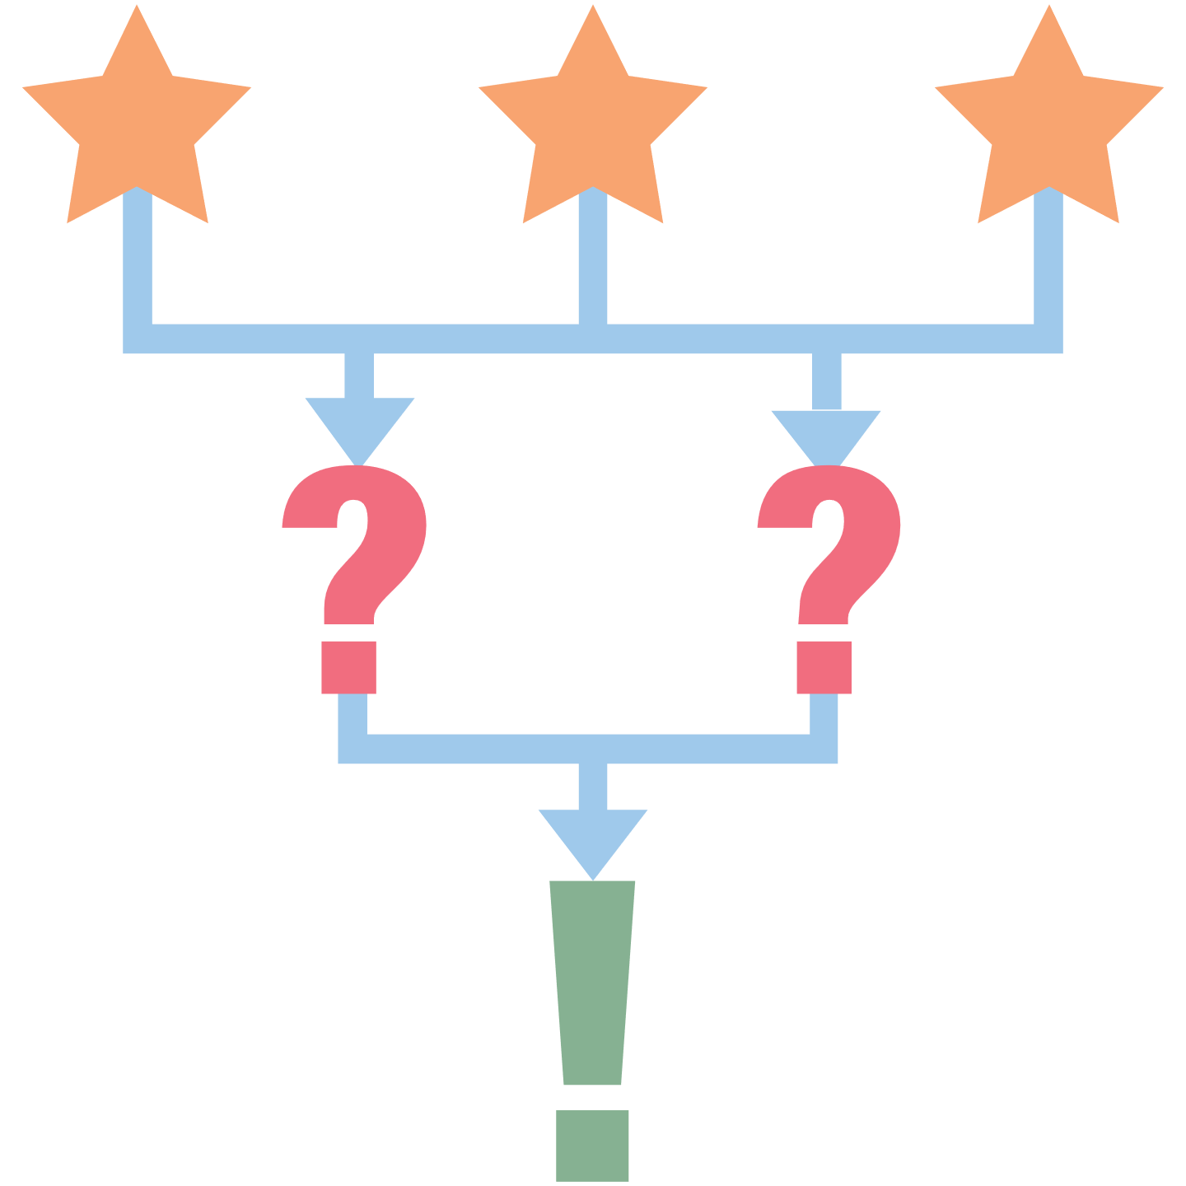
What are three things you learned?
What are two questions you still have?
What is one thing you found interesting?

