Slide 2
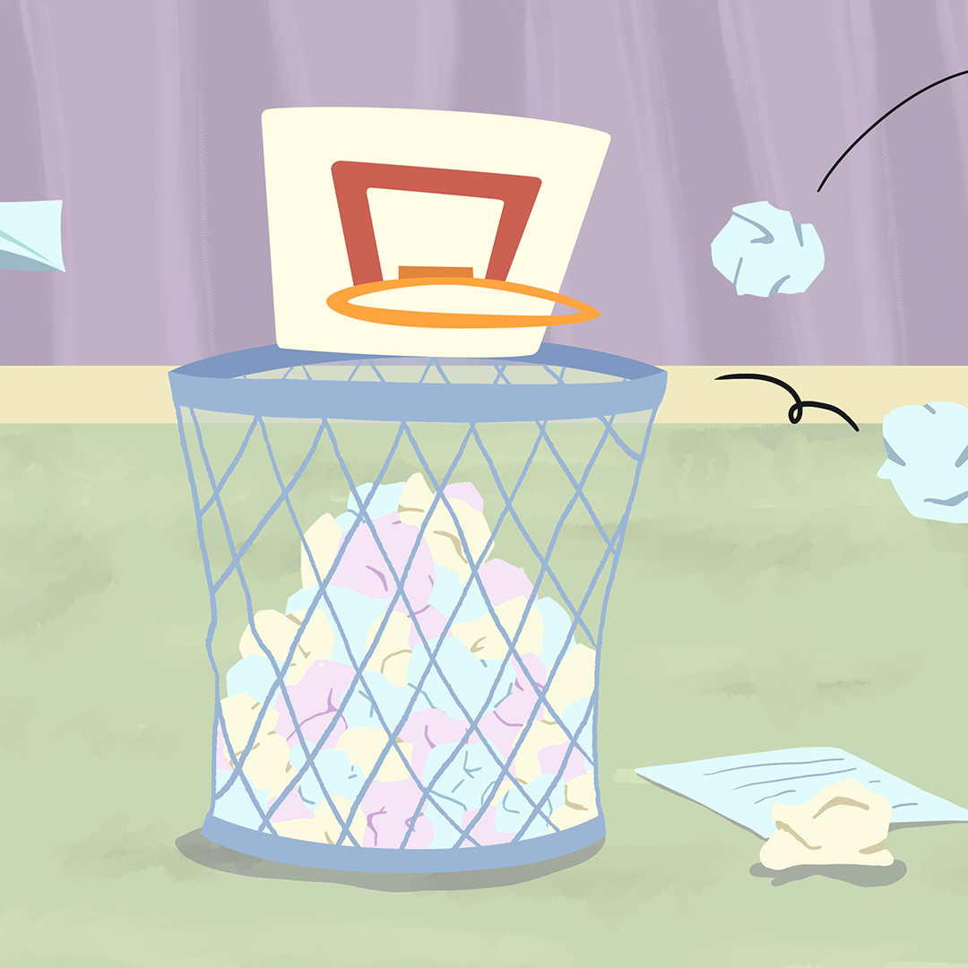
Trashketball: Part 1
Scatter Plots and Lines of Best Fit

Slide 3
Essential Question
How can linear relations and data analysis help us to understand the abilities of people?

Slide 4
Lesson Objectives
Use data to determine a relationship between the independent and dependent variables.
Use technology to perform linear regression.

Slide 5
Bowling with Jacob
Work in your group to complete the Bowling with Jacob handout.
Be sure to record all your answers.

Slide 6
Which weight of bowling ball do you think Jacob should use?

Slide 7
How did the data that Jacob collected help you make your decision?

Slide 8
Could data help people make decisions in other sports as well?

Slide 9
What do you think it means?
Work with your partner and determine a definition for the term:
Shooting Percentage

Slide 10
What does it mean mathematically?
Work with your partner and determine a formula for the term:
Shooting Percentage
Write your formula on the provided paper. Make it large enough for others to see from the other side of the classroom.

Slide 11
High or Low Shooting Percentage?
Hold up a green sticky note if you think the shooting percentage is high.
Hold up a red sticky note if you think the shooting percentage is low.

Slide 12
High or Low Shooting Percentage?
7 attempts, 3 shots made

Slide 13
High or Low Shooting Percentage?
9 attempts, 8 shots made

Slide 14
High or Low Shooting Percentage?
5 attempts, 0 shots made

Slide 15
High or Low Shooting Percentage?
12 attempts, 12 shots made

Slide 16
High or Low Shooting Percentage?
15 attempts, 16 shots made

Slide 17
Shooting Percentages
Now use your formula to calculate the shooting percentage for the following data:
7 attempts, 3 shots made
9 attempts, 8 shots made
5 attempts, 0 shots made
12 attempts, 12 shots made

Slide 18
Trashketball
If you moved away from the basket, how will that affect your shooting percentage?
Record your hypothesis on your Trashketball handout
  Include the words increase, decrease, or constant.
  Write a complete sentence
Identify the independent, dependent, and control variables for your hypothesis on question 2.

Slide 19
Trashketball
You will now take turns shooting at the wastebasket.
Tear your formula paper in half, you and your partner will each get one half of the paper.
Crumple up your half of the sheet, this is your ball for the game.
Bring the following materials with you:
  Trashketball handout, pencil, clipboard, and crumpled paper

Slide 20
Trashketball
In your group find the shooting percentages for question three on your handout.
Use your calculator to double check your work before recording the answer.

Slide 21

I Notice, I Wonder
What do you notice about the connections between the two variables in your graph?
What do you wonder about the two connections between the two variable in your graph?
Notes:
K20 Center. (n.d.). I notice, I wonder. Strategies. https://learn.k20center.ou.edu/strategy/180

Slide 22
Definition
Discuss with your group a definition for the term:
Correlation
Choose a volunteer to share your definition with the class.

Slide 23
Correlation
Definition: a relationship between two or more measures (or variables)
What is similar and different about the formal definition and the definition we created as a class?
What changes do we need to make?

Slide 24
Definitions
Discuss with your group a definition for the terms:
Positive correlation
Negative correlation
Relativity no correlation
Choose a volunteer to share your definition with the class.

Slide 25
Positive Correlation
Definition: a type of correlation in which the approximation of the correlation (line of best fit) has a positive slope
What is similar and different about the formal definition and the definition we created as a class?
What changes do we need to make?

Slide 26
Negative Correlation
Definition: a type of correlation in which the approximation of the correlation (line of best fit) has a negative slope
What is similar and different about the formal definition and the definition we created as a class?
What changes do we need to make?

Slide 27
Relativity No Correlation
Definition: a type of correlation in which there is no reasonable approximation for the data
What is similar and different about the formal definition and the definition we created as a class?
What changes do we need to make?

Slide 28
Back to Your Handout
Answer questions 5 and 6.
5. What type of correlation does the data have? How do you know?
6. What does your answer from question 5 tell you about the hypothesis you made in question 1? Explain

Slide 29
Line of Best Fit
What could the definition be?
Why would a line of best fit be useful?
What would some of the characteristics of a line of best fit be?

Slide 30
Line of Best Fit
What similarities and differences did you notice between your line of best fit and others’ line of best fit in the group?

Slide 31
Trashketball
Using what you have learned about line of best fit, use the data collected from the game Trashketball and determine the line of best fit.

Slide 32
Line of Best Fit
Use a red pen or marker to graph the new line of best fit found using technology on their scatter plots.
How do your two graphs compare?
Which one do they think is a better line of best fit and why?

