Slide 2
I Need a (Super)hero
Literary Elements and Narrative Writing

Slide 3
Essential Questions
What are the elements of a story?
What makes someone (or something) a hero?
What role do heroes play in stories?

Slide 4
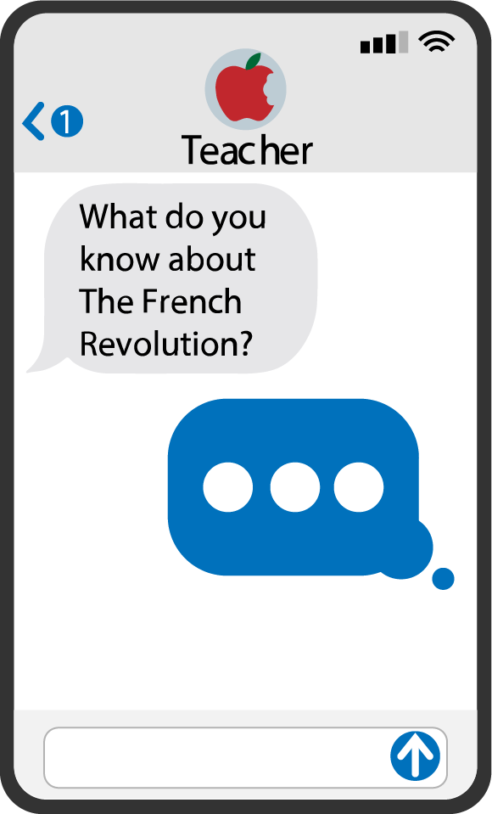
Quick Write
What prior experiences have you had with reading and writing stories?
What elements make up a story?
What components must be present for something to be considered a story?
Notes:
K20 Center. (n.d.). Quick write. Strategies. https://learn.k20center.ou.edu/strategy/1127
K20 Center. (n.d.). K20 5 minute timer [Video]. YouTube. https://www.youtube.com/watch?v=EVS_yYQoLJg

Slide 5
Elbow Partners
Share your responses to the prompt with your Elbow Partner.
Prepare to share out your responses.
Notes:
K20 Center. (n.d.). Elbow partners. Strategies. https://learn.k20center.ou.edu/strategy/116

Slide 6
Story Spine
Notes:
Khan Academy Labs. (2017, April 26). Story spine [Video]. YouTube. https://www.youtube.com/watch?v=ilDsFrcHsuI&t=16s

Slide 7
Story Spine
Compare and contrast your Quick Write with the structure from the video.
What are the similarities?
What are the differences?
What did you learn?
Notes:
K20 Center. (n.d.). Quick write. Strategies. https://learn.k20center.ou.edu/strategy/1127

Slide 8
Revise and Discuss
Revise your Quick Write based on what you learned from the video.
Discuss the changes you made with your Elbow Partner.
Consider one change you made that you would like to share with the whole class.
Notes:
K20 Center. (n.d.). Quick write. Strategies. https://learn.k20center.ou.edu/strategy/1127
K20 Center. (n.d.). Elbow partners. Strategies. https://learn.k20center.ou.edu/strategy/116

Slide 9
Five Primary Elements of a Story
The five primary elements of a story are:
Plot: A series of events and actions that make up a story.
Setting: The environment (social, cultural, physical) and the time and place in which a story occurs.
Characters: The individuals or beings who carry out the actions in a story. Often referred to as protagonists, antagonists, and supporting characters.
Conflict: The struggle that creates tension and drives the plot in a story.
Theme: The overarching message or idea that a story conveys.
What are some other important elements of a story?
Notes:
OpenAI. (2023). ChatGPT [Large language model]. https://chat.openai.com/chat

Slide 10
Lesson Objectives
Explore different character traits and develop a complex character.
Write narrative stories including plot, setting, characters, conflict, and theme.

Slide 11
KWHL: Superheroes
K: Write everything you know about superheroes.
W: Write what you want to learn about superheroes.
H: Explain how you will find the information you want to know.
Notes:
K20 Center. (n.d.). KWHL graphic organizer. Strategies. https://learn.k20center.ou.edu/strategy/127

Slide 12
What have you learned?
Watch the video then respond to the following prompt in the “L” column of your KWHL handout.
L: Write what you have learned about superheroes from the video.
Notes:
Sony Pictures Entertainment. (2016, December 9). Spider-Man: Homecoming - Official trailer [Video]. YouTube. https://www.youtube.com/watch?v=rk-dF1lIbIg

Slide 13
Class Observations of Superheroes

Slide 14
Gathering Credible Sources
What are examples of sources?
Where do you find sources and information?
What do you consider to be credible sources?
What aspects of a source do you think make it invalid or not credible?
Find three sources about superheroes and writing superhero stories.
Add each resource to the “H” column of your handout.

Slide 15
Explore Superhero Resources
Navigate to https://wakelet.com/wake/wI4n0jIVj1bXoTVyuHVtK
Explore the sources in the Wakelet.
In the “L” section of your handout, add at least three ideas about how to write a superhero story.
Add any additional resources that you found helpful to the “H” column.
Notes:
K20 Center. (n.d.). KWHL graphic organizer. Strategies. https://learn.k20center.ou.edu/strategy/127
K20 Center. (n.d.). Wakelet. Tech Tools. https://learn.k20center.ou.edu/tech-tool/2180

Slide 16
Triangle-Square-Circle
Triangle: Write one idea for the plot of your story.
Square: Write one idea for the central conflict of your story.
Circle: Using what you learned about superheroes, write down your favorite idea for your story.
Notes:
K20 Center. (n.d.). Triangle-square-circle. Strategies. https://learn.k20center.ou.edu/strategy/65

Slide 17
“Theseus and the Minotaur”
Read the short story silently.
As you read, pause after each paragraph and write the following in the margins:
Your reaction to the text
Literary elements in the section (plot, setting, characters, conflict, theme)
Superhero characteristics
Notes:
Lane, S. (2020). Theseus and the minotaur. CommonLit. https://www.commonlit.org/en/texts/theseus-and-the-minotaur-1

Slide 18
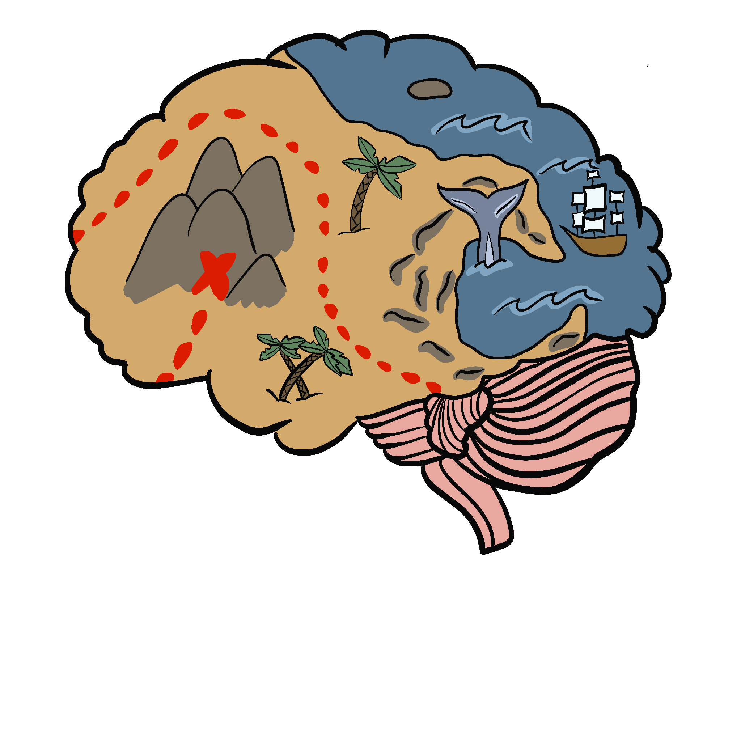
Mind Maps
In your groups, use the Mind Map handout to brainstorm examples of the following elements for your narrative:
Story title
Plot
Setting
Characters (a superhero and an archenemy)
Conflict
Theme
Notes:
K20 Center. (n.d.). Mind maps. Strategies. https://learn.k20center.ou.edu/strategy/1277
K20 Center. (2021, September 21). K20 Center 10 minute timer [Video]. YouTube. https://www.youtube.com/watch?v=9gy-1Z2Sa-c&t=3s

Slide 19
Pixton Comic Strips
As a group, use Pixton to create a comic strip that includes the following:
a minimum of 3 different settings
a minimum of 2 characters (superhero, archenemy) with unique characteristics
the name of the superhero
a representation of how the superhero gained their powers
a representation of the superhero’s powers
a representation of the superhero’s weakness
Notes:
K20 Center. (2022, April 6). K20 Center 20 minute timer [Video]. YouTube. https://www.youtube.com/watch?v=bjcwzinQlEE
K20 Center. (n.d.). Pixton. Tech Tools. https://learn.k20center.ou.edu/tech-tool/1307

Slide 20
Narrative Criteria
Work together to write a narrative that describes the story of your comic strip. Your narrative must include:
a minimum of 2 paragraphs
third-person point of view
plot
settings
characters (superhero, archenemy)
conflict
theme
Follow the sequence you created in your comic strip.
Notes:
K20 Center. (2021, September 21). K20 Center 15 minute timer [Video]. YouTube. https://www.youtube.com/watch?v=m3zT2IxZQaw

Slide 21
Share Your Superhero!
Prepare to share your narrative.
As you listen to other groups’ narratives, take notes over the following:
Literary elements (plot, setting, character, conflict, theme)
Superhero traits

