Slide 2
I Need a (Super)hero
English Language Arts

Slide 3
Essential Questions
What are the elements of a story?
What makes someone (or something) a hero?
What role do heroes play in stories?

Slide 4
Quick Write
What are your prior experiences with reading and writing stories?
What makes up a story?
What components must be present for something to be considered a story?
Notes:
Sources: K20 Center. (n.d.). Quick Write. Strategies. https://learn.k20center.ou.edu/strategy/1127
K20 Center. (n.d.). K20 5 minute timer [Video]. YouTube. https://www.youtube.com/watch?v=EVS_yYQoLJg

Slide 5
Elbow Partners
Share your responses to the Quick Write prompt with your Elbow Partner.
Notes:
Source: K20 Center. (n.d.). Elbow Partners. Strategies. https://learn.k20center.ou.edu/strategy/116

Slide 6
Compare and Contrast
As you watch the following video, compare and contrast your Quick Write with the information from the video.
What are the similarities?
What are the differences?

Slide 7
Notes:
Source: Flocabulary. (2019, August 25). Five Elements of a Story Rap [Video]. SchoolTube. https://www.schooltube.com/media/Five+Elements+of+a+Story+Rap/1_qvi49wjh

Slide 8
Revise Your Quick Write
Revise your Quick Write based on what you learned from the video.
What did you add to what you wrote? What did you need to erase or cross out?
Turn back to your Elbow Partner and discuss the changes you made.
Think of one change to share with the class.

Slide 9
Five Primary Elements of a Story
The five primary elements of a story are:
Plot
Setting
Characters
Conflict
Theme
What are other important elements in a good story? Discuss with your classmates.

Slide 10
Lesson Objectives
We will explore different character traits and develop a complex character.
We will write narrative stories including plot, setting, characters, conflict, and theme.

Slide 11
KWHL: Superheroes
K: Write everything you know about superheroes.
W: Write what you don’t know about superheroes that you want to learn more about.
H: Explain how you will find the information you want to know.
Notes:
Source: K20 Center. (n.d.). KWHL Graphic Organizer. Strategies. https://learn.k20center.ou.edu/strategy/127

Slide 12
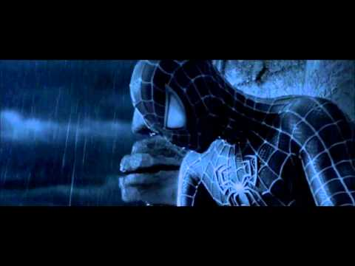
Notes:
Source: S1lverPheon1x (Adapter) & Paolo K. (Editor). (2012, July 12). 21st Century Superheroes [Video]. YouTube. https://www.youtube.com/watch?v=t4YScSnwb6U

Slide 13
Class Observations of Superheroes

Slide 14
Class Resources for Superhero Information

Slide 15
Explore Superhero Resources
Visit www.superheronation.com.
Explore the first five (5) links on the left listed under “Superhero Writing Advice.”
Add at least three good ideas for writing a superhero story to the “L” section of your KWHL graphic organizer.

Slide 16
Triangle-Square-Circle
Triangle: Write an idea you would share with a friend.
Square: Write an idea that you might want to include in your story.
Circle: Write your favorite idea that you have learned about superheroes.
Notes:
Source: K20 Center. (n.d.). Triangle-Square-Circle. Strategies. https://learn.k20center.ou.edu/strategy/65

Slide 17
“The Shadow”
Notes:
Source: Peakpx. (n.d.). Male shadow [Image]. https://www.peakpx.com/394141/male-shadow

Slide 18
Stop and Jot
Jot down your reactions to the text.
Focus specifically on literary elements and superhero characteristics.
Notes:
Sources: K20 Center. (n.d.). Stop and Jot. Strategies. https://learn.k20center.ou.edu/strategy/168
K20 Center. (n.d.). K20 5 minute timer [Video]. YouTube. https://www.youtube.com/watch?v=EVS_yYQoLJg

Slide 19
Write Your Own Superhero Story
With your group:
Visit https://tinyurl.com/y6t2mx5g.
Read the steps for creating your own superhero.
Design your own superhero.

Slide 20
Checklist for Creating a Superhero
Name your superhero
Choose their powers
Decide how the character got those powers
Consider how the powers have evolved
Create a weakness for your superhero
Give your character a tragic flaw
Choose a gender and physical traits for your superhero
Flesh out their personality
Design a costume for them
Give your superhero a catchphrase
Decide if your superhero has an archenemy

Slide 21
Story Rubric
Your story must have a plot, setting, conflict, theme, and characters.
You must use correct mechanics, spelling, and grammar.
You must create an original design for your superhero.

Slide 22
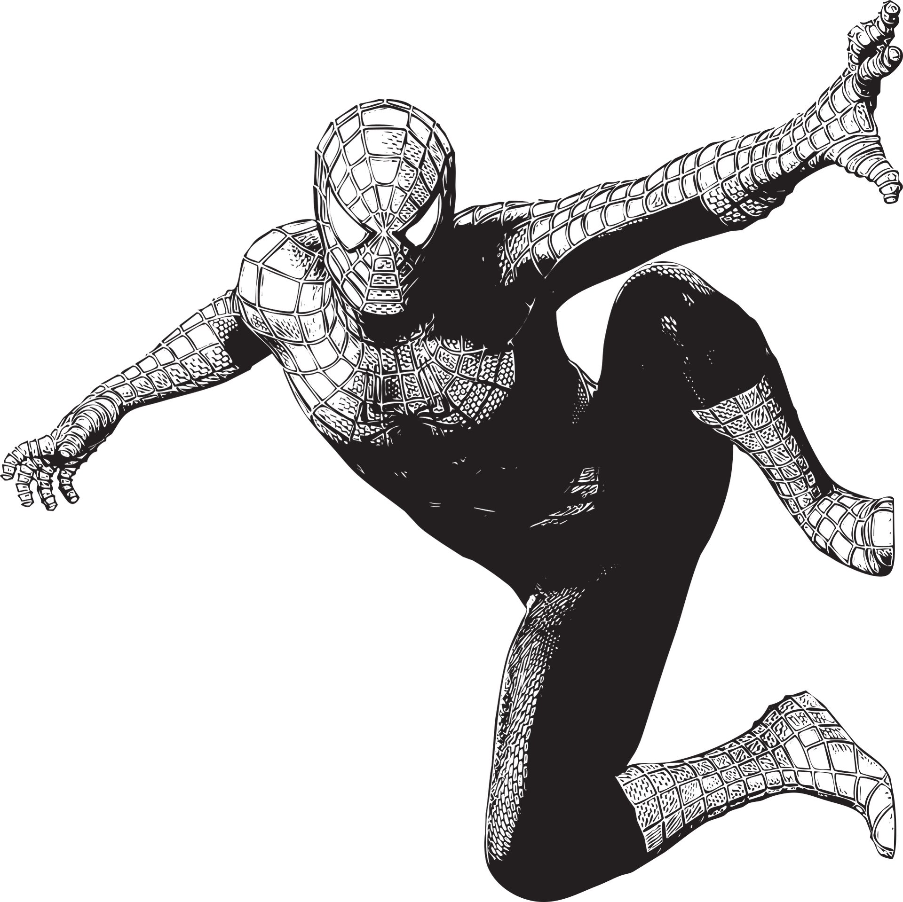
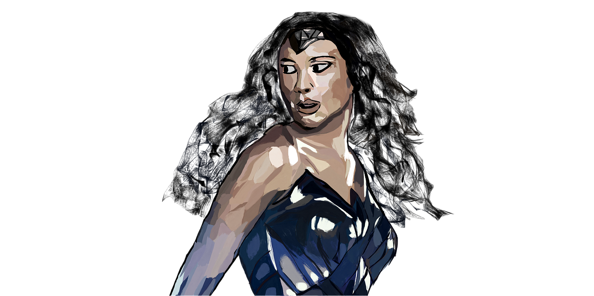
Share Your Superhero
Notes:
Sources: Borodinova, V. (2020, August 8). Iron Man [Graphic Art]. https://pixabay.com/illustrations/iron-man-marvel-cartoon-character-5471434/
Bavillo13. (2017, July 31). Wonder Woman [Graphic Art]. https://pixabay.com/illustrations/wonder-woman-gal-gadot-super-hero-2561434/
Naumovski, D. (2019, August 2). Spiderman [Graphic Art]. https://pixabay.com/illustrations/spiderman-movie-superhero-spider-4378357/

