Slide 2
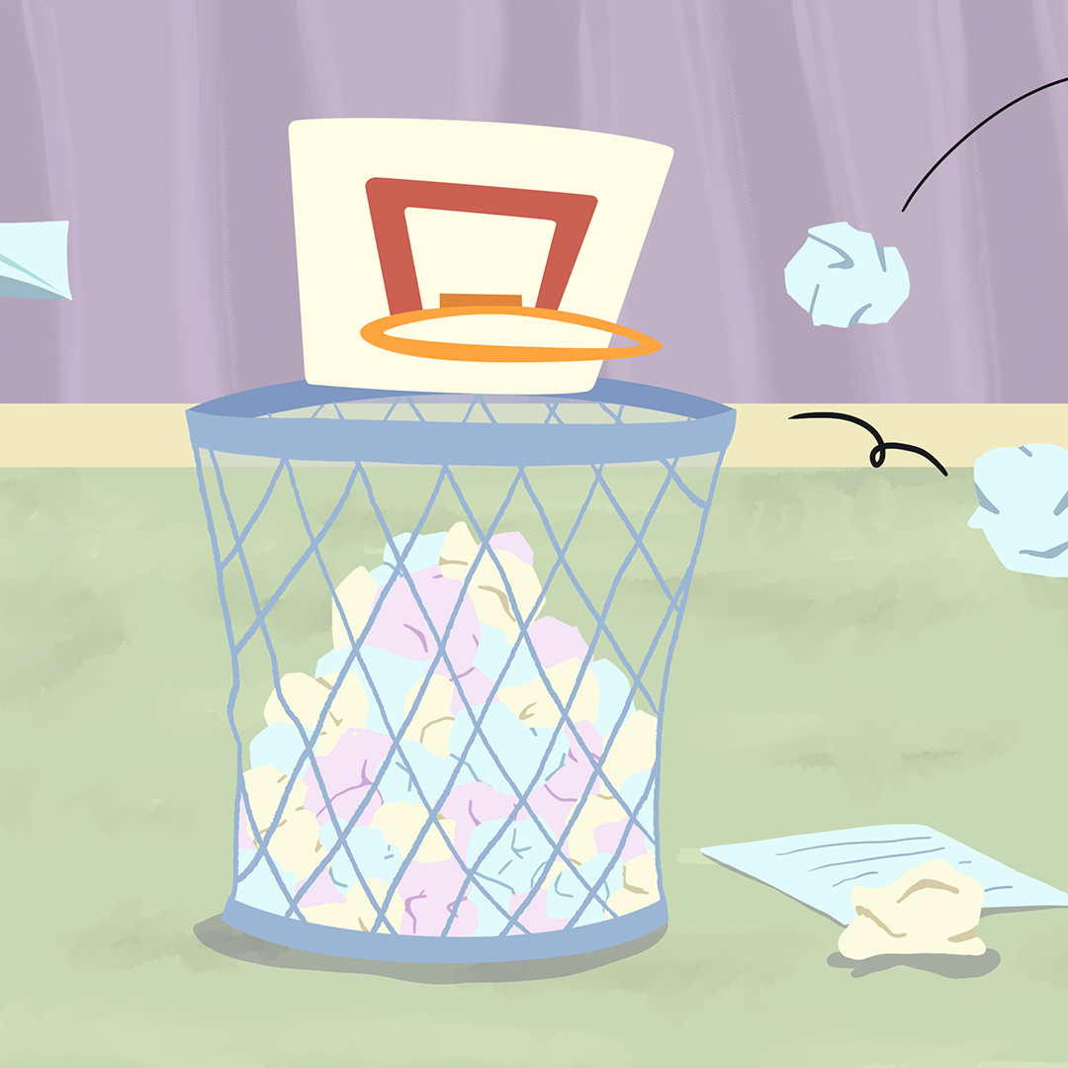
Trashketball Part 2
Linear Inequalities

Slide 3
Essential Question
How can we compare different sets of data?

Slide 4
Lesson Objectives
Graph linear inequalities on the coordinate plane
Interpret linear inequalities as representing values greater than, less than, greater than or equal to, and less than or equal to.

Slide 5

Think-Pair-Share
On your own answer questions A-E on your handout.
Once complete find a partner to discuss your answers with.
Be prepared to share your thinking with the class.
Notes:
K20 Center. (2014). Think-pair-share. Strategies. https://learn.k20center.ou.edu/strategy/139

Slide 6
Think-Pair-Share
What was your answer for question A?
How do the answers your classmates shared compare with each other?
How are their answers different?
Notes:
K20 Center. (2014). Think-pair-share. Strategies. https://learn.k20center.ou.edu/strategy/139

Slide 7
Think-Pair-Share
What were your answers for questions B-E?
How do the answers your classmates shared compare with each other?
How are their answers different?
Notes:
K20 Center. (2014). Think-pair-share. Strategies. https://learn.k20center.ou.edu/strategy/139

Slide 8
Why might it be useful for Jacob to know if he knocks down more or less pins than expected?

Slide 9
Trashketball Part 2
Each graph represents the shooting percentage of 24 students.
Each graph contains a statement by one student about their individual shooting percentage.
Cut apart the 6 graphs.
Sketch a possible line of best fit for all 6 graphs.
  Many answers are possible, as long as the line of best fit makes the statement true.

Slide 10
Line of Best Fit
With your group, create rules for the line of best fit for your assigned graph.
Consider the following:
  What are the possible values for the slope?
  What are the possible values for the y-intercept?
  Are there any other restrictions on the line of best fit?

Slide 11
Inequality
With your group write an inequality for at least four of the six students we have discussed (Ariana, Bethany, Camila, Dante, Elijah, and Francisco).
Be prepared to share your answers with the group.

Slide 12
Control Variables
With your partner review the list of control variables from Trashketball Part 1.
Brainstorm ways the control variables could change.
For each control variable, make a hypothesis about one way the control variable could be changed so shooting percentage improves and one way each control variable could be changed so that shooting percentage decreases.
Record each change on a separate index card.

Slide 13
Sorting Control Variables
Draw the top card from the deck.
Decide where that card best fits:
  Less than
  Less than or equal to
  Greater than or equal to
  Greater than
Choose the next student:
  Explain if you agree or disagree with the placement of the card.

Slide 14
Designing and Conducting an Experiment
Using your assigned strategy, design an experiment that will allow you to create a line of best fit.
Record your procedures and create a method for organizing your data.
Once your experiment is approved, test it out!
After you have completed your experiment, plot all the data collected and graph a line of best fit.

Slide 15
Trashketball Part 1
Plot a line of best fit for the class’s shooting percentage.
How do your results compare to the predictions made by the class?
Was the new shooting percentage greater or less than the original?
Were they ever equal?

Slide 16
Inequalities
With your partner, brainstorm situations in which inequalities might be useful.

Slide 17
Graphing Stories
For each graph write a story that could be described using the linear inequality shown.
Consider the following:
  Whether the line is increasing or decreasing.
  Whether the line is solid or dashed.
  Whether the shading is above or below the line.
After creating your story, write an algebraic inequality to describe the graph.

