Slide 2
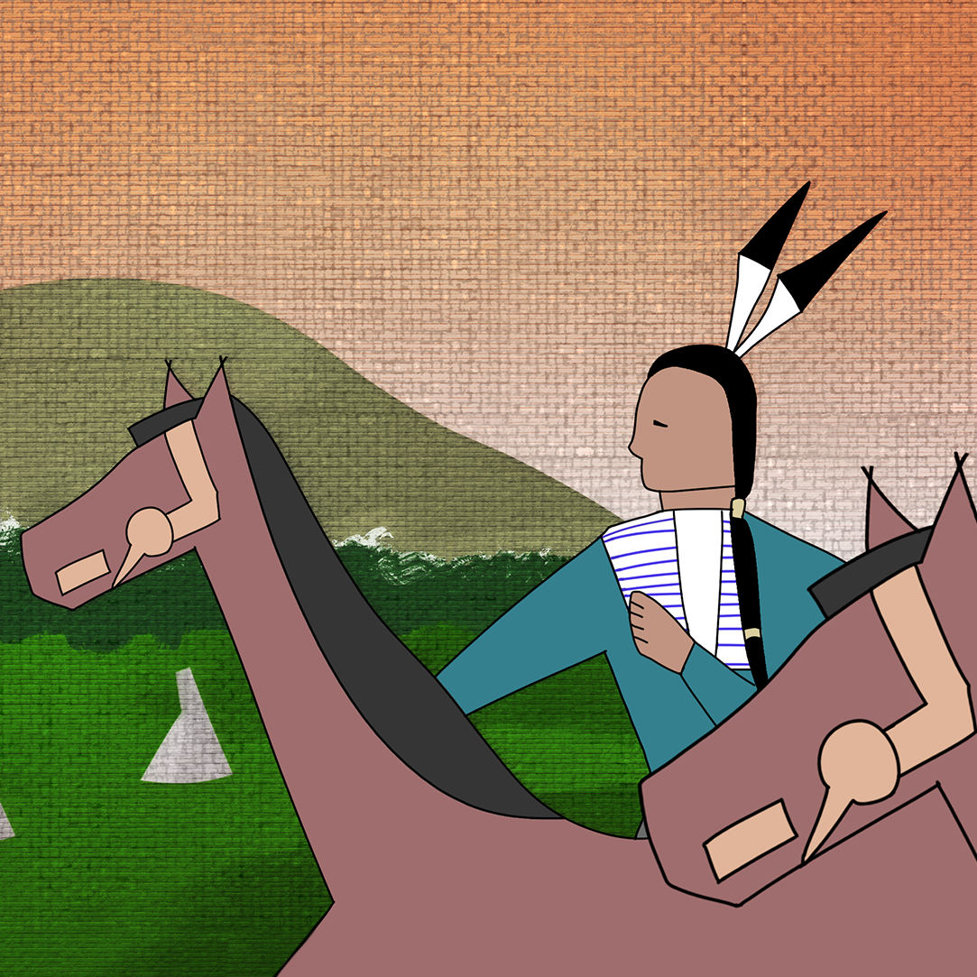
Weaving the Way
Cultural Perspectives and
Author’s Style

Slide 3
Essential Question
How do people use their personal and cultural backgrounds to create art?

Slide 4
Learning Objectives
Understand how cultural perspectives shape an artist’s work.
Analyze how an author’s perspective influences their style.

Slide 5

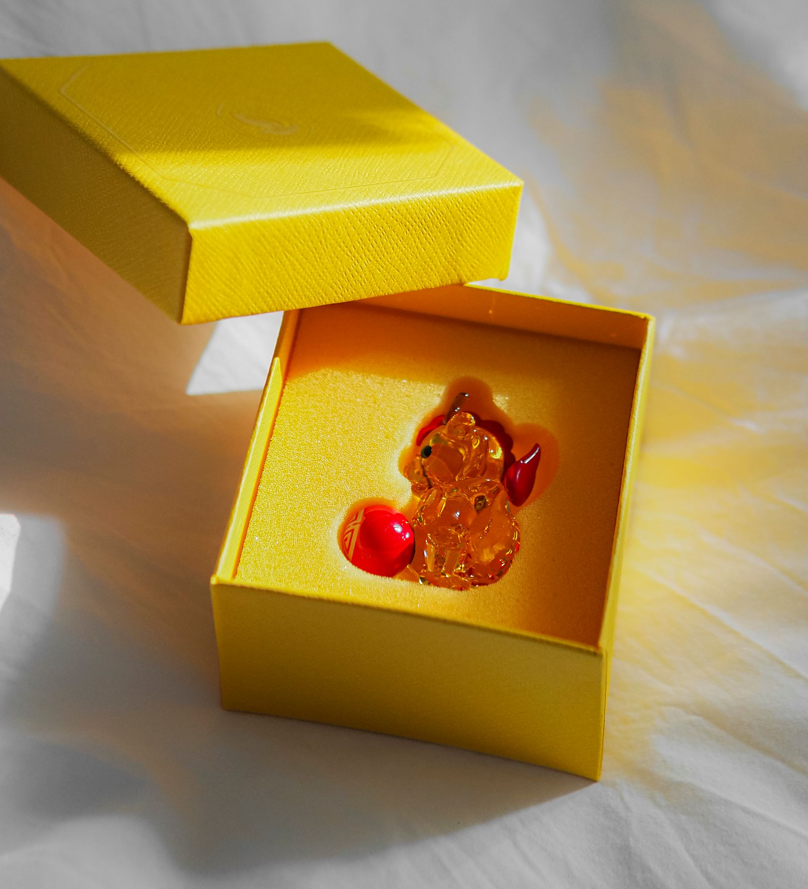
What Is Important to You?
Think of a place or object that holds
special meaning for you. It could be:
A gift that someone special gave to you
The setting of an important event in your life
A family heirloom
A place connected to your family or ancestors
Something else that is meaningful to you
Notes:
Chouette, L. (2025, January 20). Elegant crystal bear [Photograph]. Pexels. https://www.pexels.com/photo/elegant-crystal-bear-in-luxurious-yellow-gift-box-30324301/
K. (2019, June 17). Log cabin [Photograph]. Pexels. https://www.pexels.com/photo/photo-of-log-cabin-surrounded-by-plants-2510067/

Slide 6


Making Meaning
Draw the place or object you chose.
Then, answer the questions about your drawing.
8-Minute Timer
Notes:
K20 Center. (2021, September 21). K20 Center 8 minute timer [Video]. YouTube. https://www.youtube.com/watch?v=R-21YM7Ey7k
Sajhad. (2026, April 21). Collection of antique frames on a rustic wall in Jodhpur, India [Photograph]. Pexels. https://www.pexels.com/photo/colorful-vintage-frames-on-wall-in-jodhpur-37192120/

Slide 7
Making Meaning
What place or object did you choose?
Notes:
Sajhad. (2026, April 21). Collection of antique frames on a rustic wall in Jodhpur, India [Photograph]. Pexels. https://www.pexels.com/photo/colorful-vintage-frames-on-wall-in-jodhpur-37192120/

Slide 8
Apparel Designing and Culture
In the video on the following slide, apparel designer Leslie Deer talks about how she uses something important to her to create art.
Watch the video and think about:
  Does apparel design or a similar career interest you?
  What classes could someone take in high school or college to prepare for this type of career?

Slide 9

Cultural Perspectives through Apparel Design
Notes:
K20 Center. (2026, August 4). Cultural perspectives through apparel design [Video]. YouTube. https://www.youtube.com/watch?v=np521LvQchs

Slide 10
Apparel Designing and Culture
Does apparel design or a similar career interest you?
What classes could someone take in high school or college to prepare for this type of career?

Slide 11

Art, Literature, and Perspective
Just like an artist uses paint or an apparel designer uses fabric, writers use words to convey their perspective.
What an author writes about can tell you a great deal, but how they write about it may tell you even more.

Slide 12
Author’s Perspective
An author's perspective, or how they view the world, is shaped by their experiences, culture, and time in history.
Their perspective directly influences the stylistic choices they make when writing about a topic.
Notes:
Rahman, F. (2020, February, 27). A mysterious eye peeks through a small gap in a brick wall [Photograph]. Pexels. https://www.pexels.com/photo/photo-of-person-peeking-through-the-hole-3820281/

Slide 13
Author’s Perspective and Style
An author’s perspective is conveyed through both what they write about and how they write about it.
An author’s style refers to the elements that make an author’s writing unique. These elements include:
  Diction
  Imagery
  Figurative language
  Mood
  Tone

Slide 14
Elements of Author’s Style
Diction:
the specific words that an author chooses to use
  simple, poetic, formal, dramatic, funny, etc.
Imagery:
language that appeals to the senses (touch, taste, sound, sight, and smell)
  vivid and bright, dark and gritty, etc.

Slide 15
Elements of Author’s Style
Figurative Language:
language that makes creative comparisons that are not meant to be literal
includes similes, metaphors, personification, and hyperbole
  Some authors use lots of figurative language that creates a more imaginative, poetic style.
  Other authors use very literal language without much figurative language.

Slide 16
Elements of Author’s Style
Tip: Mood is how writing makes the reader feel. Tone is the author's attitude that comes through in the writing.
Mood:
the feeling that writing creates
in the reader
  joyful, frightening, tense, etc.
Tone:
the author or speaker’s attitude
  Sarcastic, formal, joyous, gloomy, etc.

Slide 17

Creative Annotations
In the last column of your Note Catcher,
draw an illustration or symbol to represent each term.
Choose a visual representation that
will help you remember the meaning.
You will redraw each representation
several times, so keep them simple.
author’s
perspective
Notes:
K20 Center. (n.d.). Creative annotations. Strategies. https://learn.k20center.ou.edu/strategy/5629

Slide 18
Putting It All Together
You will now:
Learn about the author, N. Scott Momaday.
Identify ways his background influenced his perspective.
Read an example of his writing to identify elements of his writing style.
Analyze how his perspective may have affected his writing style.

Slide 19
Introducing N. Scott Momaday
Watch the next two short videos about N. Scott Momaday, an author born in Oklahoma.
He is the first Native American author to win a Pulitzer Prize, which is one of the most prestigious honors awarded to writers.
While watching, consider the following:
  What do you think is important to Momaday?
  What likely influenced his perspective?

Slide 20
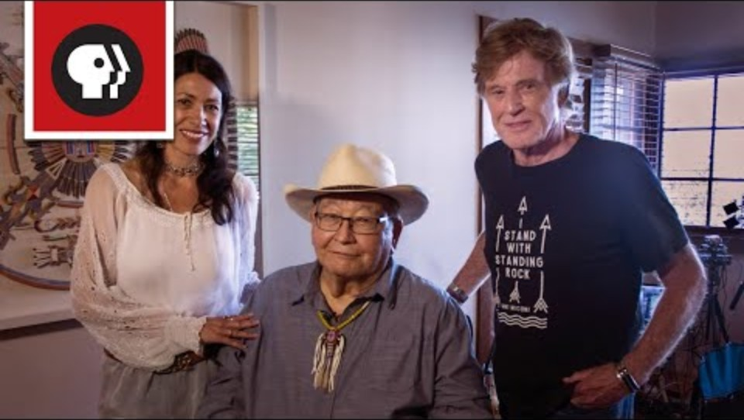
The First Native American to Win the Pulitzer
Notes:
American Masters PBS. (2019, November 4). The first Native American to win the Pulitzer [Video]. YouTube. https://www.youtube.com/watch?v=5h7N_bcNeu0

Slide 21
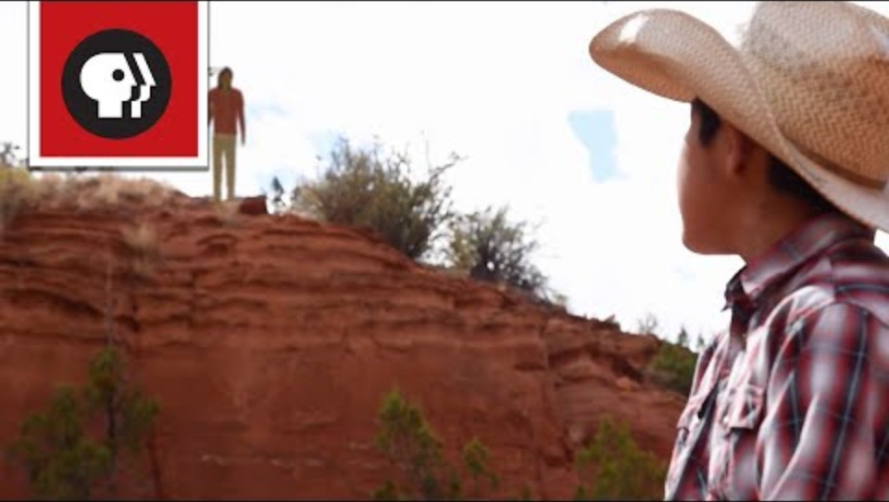
How N. Scott Momaday Connected with his Kiowa Ancestry
Notes:
American Masters PBS. (2019, November 27). How N. Scott Momaday connected with his Kiowa ancestry [Video]. YouTube. https://www.youtube.com/watch?v=8kgtYM1iliQ

Slide 22
Introducing N. Scott Momaday
What do you think is important to Momaday?
What likely influenced his perspective?

Slide 23
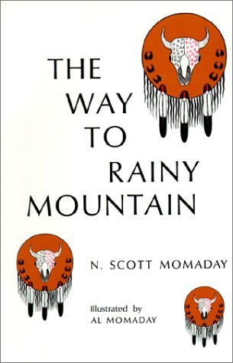
The Way to Rainy Mountain
Published in 1969
Traces the journey of the Kiowa people to modern-day Oklahoma
Combines history, folklore, and Momaday’s own poetic memoir
Notes:
Momaday, N. S. (1969). The way to rainy mountain. The University of New Mexico Press.

Slide 24
Creative Annotations
As you read The Way to Rainy Mountain,
highlight examples of each element of the author’s style.
Draw the corresponding Creative Annotation icon from your Note Catcher in the margins next to each element.
  This will help you identify different examples.
  Highlight and annotate at least 2 examples of each term.
Notes:
K20 Center. (n.d.). Creative annotations. Strategies. https://learn.k20center.ou.edu/strategy/5629

Slide 25
Author’s Perspective
Review your annotations and choose 2
elements of the author’s style that best
show N. Scott Momaday’s perspective.
Look for elements that reveal how he
feels about:
  nature
  the Kiowa tribe
  his family
  the past
Notes:
Rahman, F. (2020, February 27). A mysterious eye peeks through a small gap in a brick wall [Photograph]. Pexels. https://www.pexels.com/photo/photo-of-person-peeking-through-the-hole-3820281/

Slide 26
Author’s Perspective
Consider what each of those elements reveals about what is important to the author or how he sees the world (his perspective).
Use the back of your Note Catcher to brainstorm.
Notes:
Rahman, F. (2020, February 27). A mysterious eye peeks through a small gap in a brick wall [Photograph]. Pexels. https://www.pexels.com/photo/photo-of-person-peeking-through-the-hole-3820281/

Slide 27
Justify Your Selection
For each element you selected,
write a Claim, Evidence, Reasoning (CER)
paragraph that explains how the
author’s style helps reveal the author’s perspective.

Slide 28
Justify Your Selection
CER Paragraph Structure:
Claim: Identify which element of the author’s
style helps reveal the author’s perspective.
Evidence: Quote an example of that element from the reading.
Reasoning: Explain what the element helps show about the author’s perspective and how it helps show it.

