Slide 2
Meet Me in the Middle
Discovering Midpoint Formula Through Estimations

Slide 3
Essential Question
How can we mathematically determine when something is “in the middle?”

Slide 4
Lesson Objectives
Find the midpoint of a line segment.
Apply the concept of midpoint to solve real-world problems.

Slide 5

Elbow Partners
How much do we know about the
population of our community?
Work with your elbow partner to create an educated estimate about the population of the following:
  our school
  our town
  our state
  our country
  our world
Notes:
K20 Center. (n.d.). Elbow Partners. Strategies. https://learn.k20center.ou.edu/strategy/116

Slide 6
Our Community
Community | Population
School | <insert population value>
Town | <insert population value>
State | <insert population value>
Nation | <insert population value>
World | <insert population value>

Slide 7
Exploring Population: Part A
Go to the following websites to complete Part A.
National Data per Decade: https://bit.ly/national10
State Data per Decade: https://bit.ly/state10
Town Populations: Wikipedia.org
  Look for “Historical Population.”
When you are finished, put your devices away.
Notes:
Bureau, U. S. C. (2021, October 8). Historical Population Change Data (1910-2020). Census.gov. Retrieved July 19, 2022, from https://www.census.gov/data/tables/time-series/dec/popchange-data-text.html
Bureau, U. S. C. (2021, November 24). Decennial census of population and housing by decades. Census.gov. Retrieved July 19, 2022, from https://www.census.gov/programs-surveys/decennial-census/decade.2020.html?utm_source=US%2BCensus%2BBureau
Wikimedia Foundation. (2022, June 17). The Free Encyclopedia. Wikipedia. Retrieved July 19, 2022, from https://www.wikipedia.org/

Slide 8
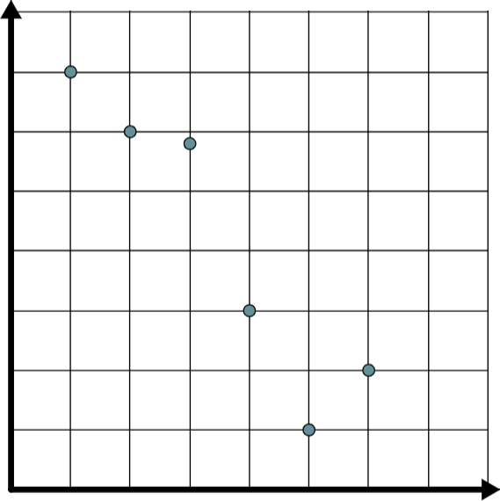
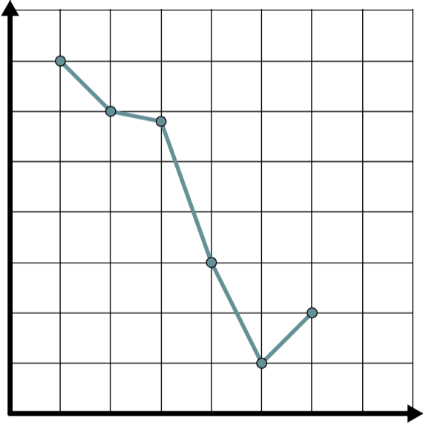
Exploring Population: Part B
1) Plot Your Points
2) Use a Ruler to Create a Line Graph

Slide 9
Exploring Population: Part C
Use the data from
Parts A and B to estimate the town and state populations for the years in Part C.
Skip the country population for now.
Year | Census Population
1965
1975
1985
1995
2005

Slide 10
What’s Your Approach?
Explain how you found your estimates on Part C.
Who used the graph?
Who used a formula?
Who did something else?

Slide 11
Use Another Approach
Consider all of the different methods that were just shared.
Select one of those methods and find the estimate for your country’s population.

Slide 12

Exploring Population: Part D
Use a second colored pencil
to plot the points from Part C
onto the graphs in Part B.
What do you notice about these points?
Notes:
K20 Center. (n.d.). Think-Pair-Share. Strategies. https://learn.k20center.ou.edu/strategy/139

Slide 13
Exploring Population: Part E
What must be true about the year
you are estimating the population
for in order to use your method from Part C?
Notes:
K20 Center. (n.d.). Think-Pair-Share. Strategies. https://learn.k20center.ou.edu/strategy/139

Slide 14
Midpoint Definition
Midpoint: The single point that is exactly in the middle of a line segment; the distance from the midpoint to each endpoint is congruent.
Did your estimates fit the definition of midpoint?
  Be ready to share this information with the class.
endpoint
midpoint
endpoint

Slide 15
Finding Midpoint
Create a formula that allows you to find the coordinates of a midpoint using only endpoints.
  Be ready to share the formula you created.

Slide 16
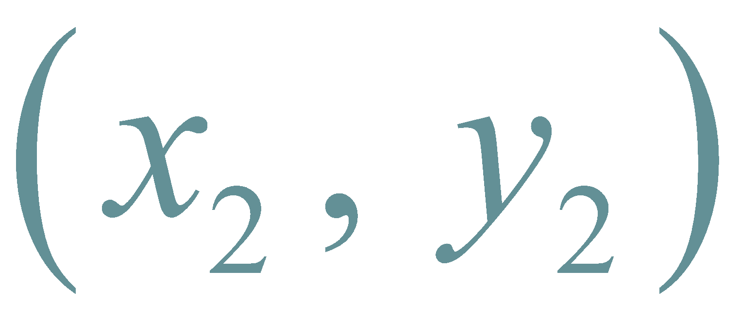
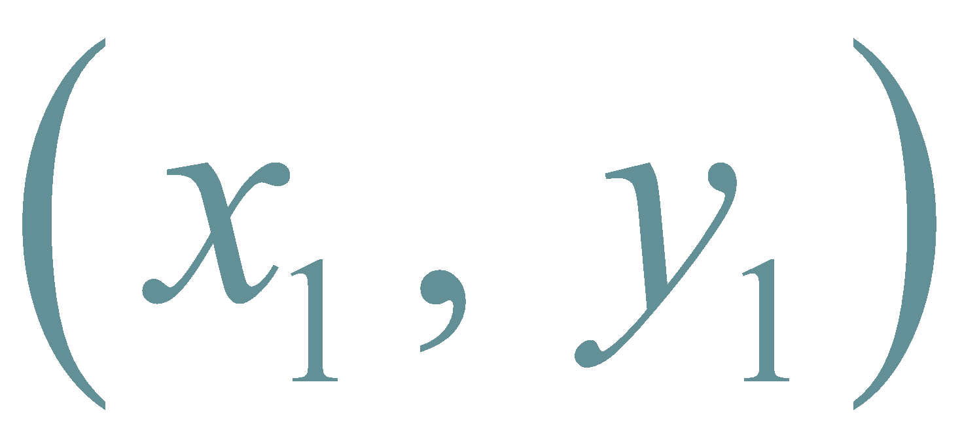
Midpoint Formula
endpoint
midpoint
endpoint

Slide 17
Midpoint Formula in the Real World
In groups of 2–3, discuss the following and
be ready to share:
How can the midpoint formula be used in real life?

Slide 18
Story Problem Cards
Examine the Story Problem Cards and look for similarities and differences.
  Discuss in your groups and be ready to share.
After examining the cards, solve each problem.
  Use your graph paper and notebook paper.

Slide 19
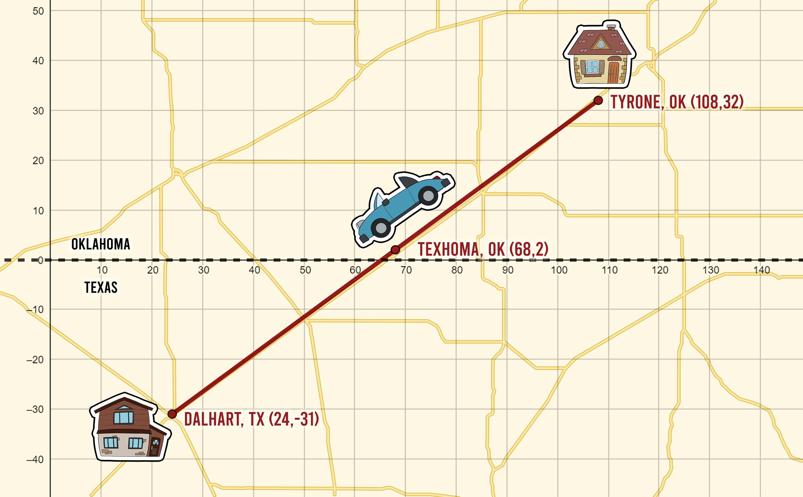
Car Trouble
Individually complete the question on the handout.
  Justify your answer with mathematical words and symbols.

