Slide 2
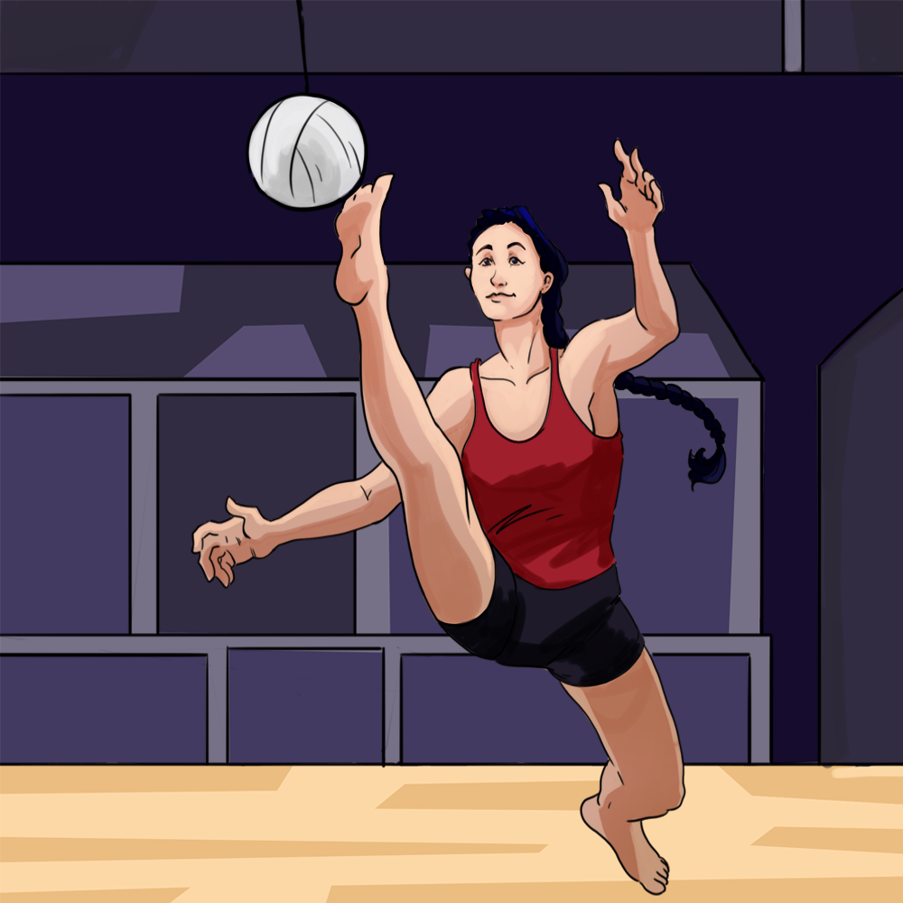
Lifted By Legacy, Moving with Meaning
Forces and Motion

Slide 3
Learning Objectives
Analyze motion using Newton’s Law by identifying how force, mass, and acceleration are demonstrated in physical activities rooted in ancestral heritage and traditions.
Design an original, movement-based game or event inspired by ancestral heritage, incorporating scientific explanations of force, motion, and safety design.
Construct force diagrams to explain how the net force and mass of an object affect its acceleration during motion.

Slide 4
Essential Question
In what ways do Newton’s Laws of Motion apply to movements and games rooted in ancestral heritage and traditions?

Slide 5

Preflection
Review the following questions:
What do you think you will be learning?
How do you think it might be connected to Newton’s Laws?
Did the video lead you to have any questions?
Notes:
K20 Center. (n.d.). Preflections. Strategies. https://learn.k20center.ou.edu/strategy/191

Slide 6

Native Games: Origins
Notes:
CITC Alaska. (2019b, February 4). Native Games: Origins [Video]. YouTube. https://www.youtube.com/watch?v=TvpAREkxGlg

Slide 7

Preflection
Respond to the following questions on your handout:
What do you think you will be learning?
How do you think it might be connected to Newton’s Laws?
Did the video lead you to have any questions?
Notes:
K20 Center. (n.d.). Preflections. Strategies. https://learn.k20center.ou.edu/strategy/191
K20 Center. (2021, Sept. 21). K20 Center 5 minute timer [Video]. YouTube.
https://youtu.be/EVS_yYQoLJg?si=4VHb4BWfyxBSvfqU

Slide 8
Station #1
While you watch the video, complete the S-I-T strategy on your handout identifying one surprising fact or idea, one interesting fact or idea, and one troubling fact or idea.

Slide 9
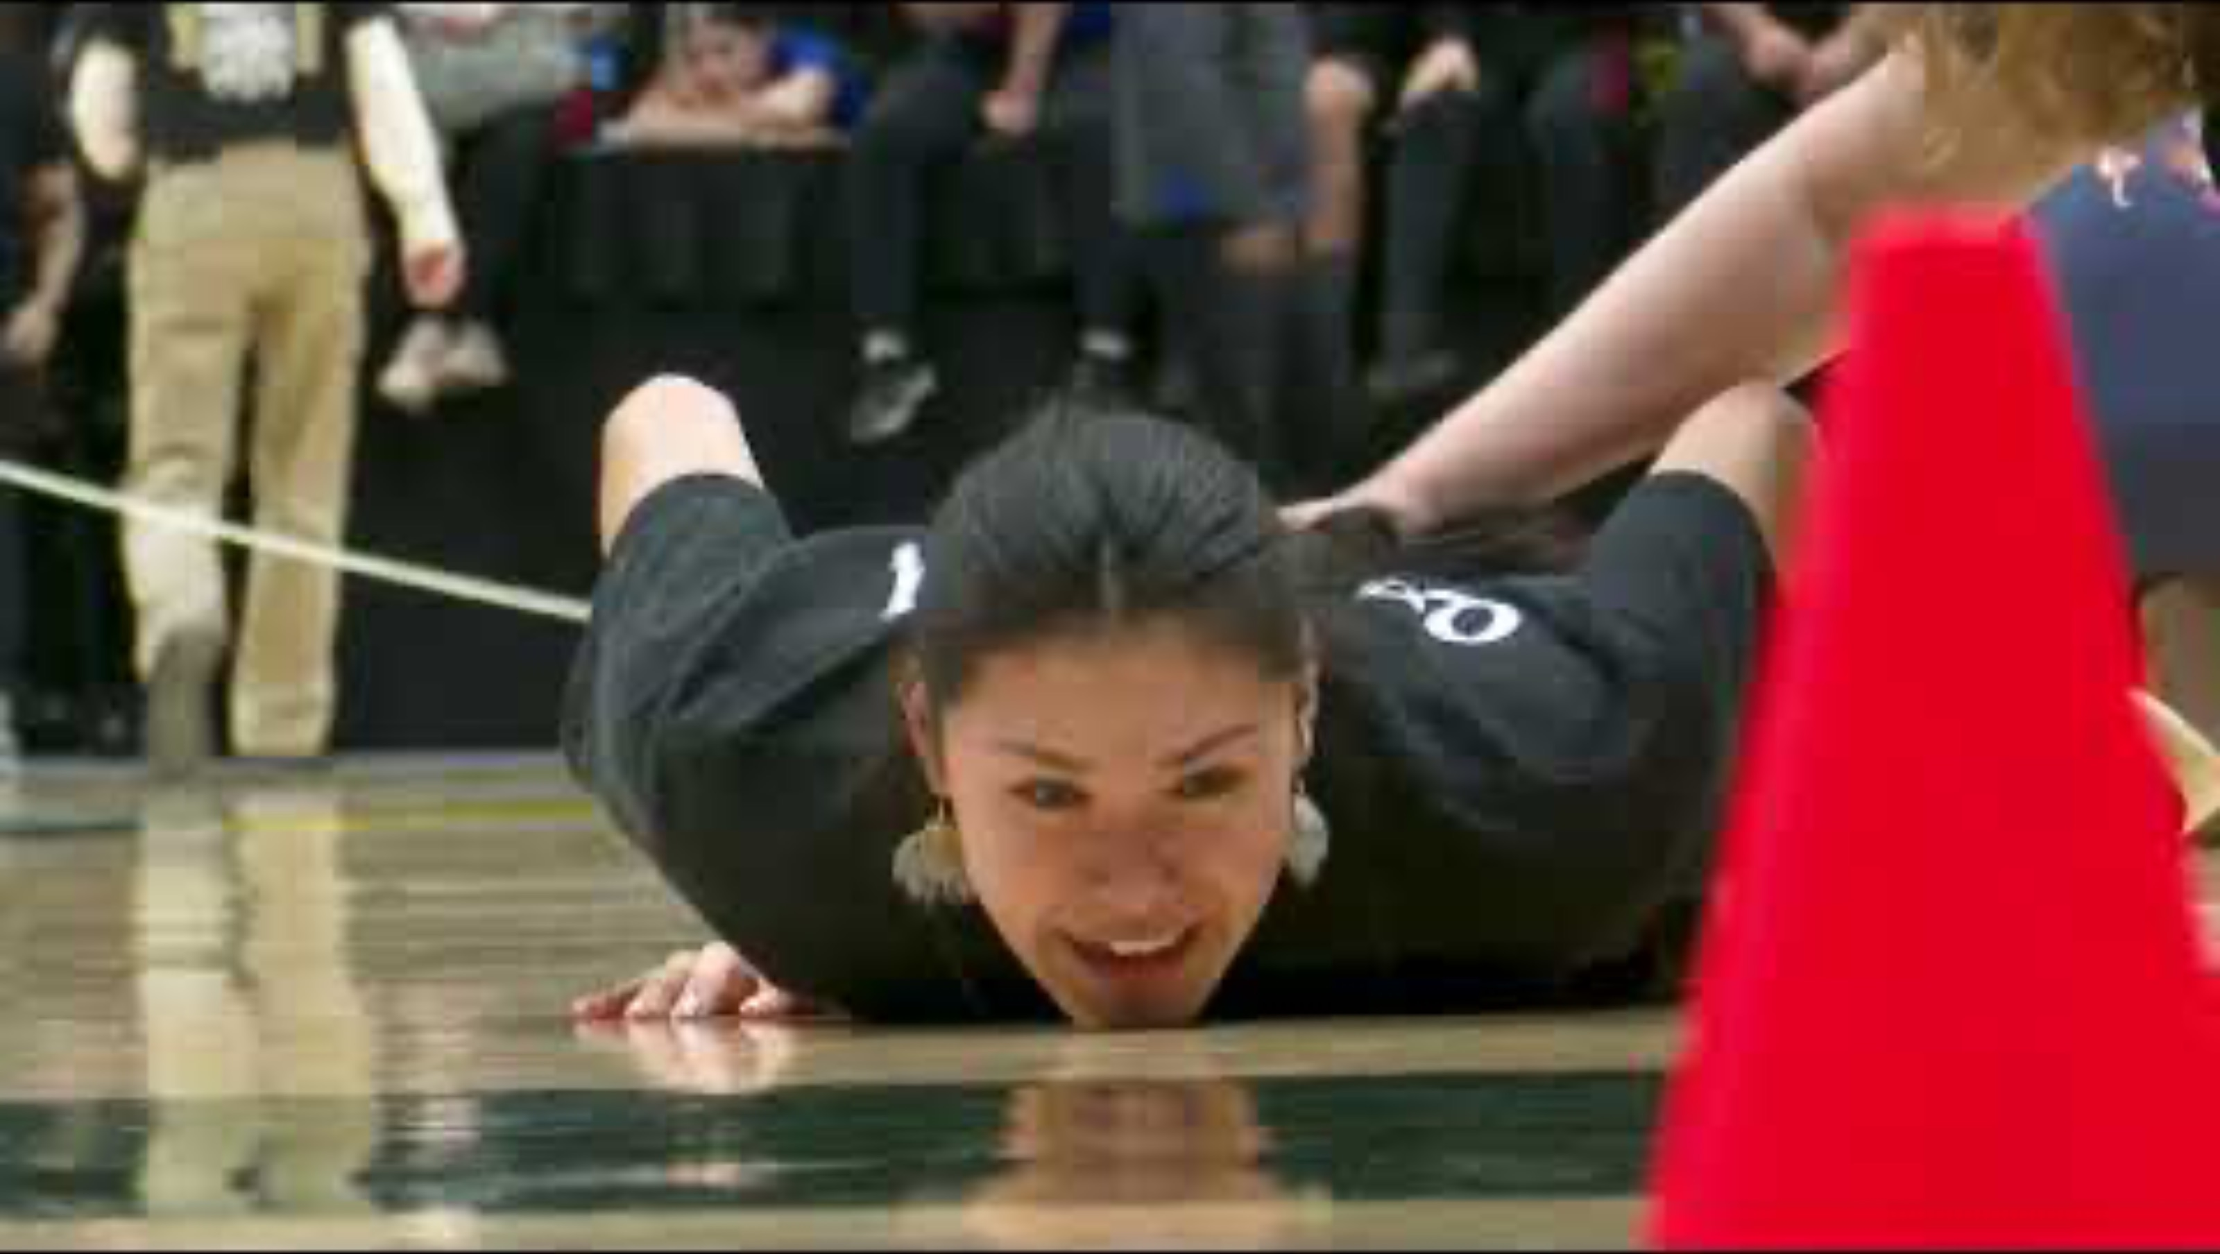
Native Youth Olympic Games 2024
Notes:
Native Voice One. (2024, June 10). Native Youth Olympic Games 2024 [Video]. YouTube. https://www.youtube.com/watch?v=3lJ4kTAHcv4

Slide 10
Stations 2–6
As a group, transition through each station. Use your Station guide handout to help you engage with the activities and reflect on them.

Slide 11

NYO Events
Scan the QR code to review the NYO events.
As a group, review the events and decide which one you want to create a poster or digital slide.

Slide 12
8th Grade
Your poster or digital slide over your event should include the following:
Draw and label a force diagram that shows the forces acting on the athlete during the movement. Include the direction of forces and label the applied force, gravitational force, normal force, and friction (if relevant).
A brief explanation (four to six sentences) connecting the diagram to Newton’s Laws.
Use Newton’s third law to describe the action-reaction forces involved in the movement.
Use Newton’s second law to explain how the athlete’s mass and net force affect their motion.

Slide 13
High School
Your poster or digital slide over your event should include the following:
Draw and label a force diagram showing the net force acting on the athlete during the event. Identify and label all external forces and the direction of acceleration.
Analyze how the net force and the athlete’s mass affected their motion using Newton’s Second Law. (F=ma).
Describe how you might design or modify something in the event (like the landing surface or footwear) to reduce the force on the athlete’s body during a collision or landing.

Slide 14

Gallery Walk
In your groups, rotate through your peers’ posters and slides.
Use one color of post-it notes to write down any questions you have about the presentation and the other color of sticky notes to write down any additional comments you have. Your group must provide one question and one comment.
Notes:
K20 Center. (n.d.). Gallery walk/carousel. Strategies. https://learn.k20center.ou.edu/strategy/118

Slide 15

S-I-T (Surprising, Interesting, Troubling)
Write the letters S-I-T along the side of your paper.
During the career-focused video, record notes about the profession using the following format:
  S - Write something that you found surprising.
  I - Write something you found interesting.
  T - Write something you found troubling.
Notes:
K20 Center. (n.d.). S-I-T (Surprising, interesting, troubling). Strategies. https://learn.k20center.ou.edu/strategy/926

Slide 16

Athletic Training with Rachel Allen
Notes:
K20 Center. (2026, March 2). K20 Career-Focused – Athletic Training with Rachel Allen [Video]. YouTube. https://www.youtube.com/watch?v=h0N2-VVvhF4

Slide 17
Design Guidelines
Review your Design Guidelines handout to help your group design an original, ancestral-heritage inspired event or game.
You may do any of the following when designing your event:
  Modify a current NYO event
  Select a movement from your own ancestral heritage.
  Create your own movement-based activity inspired by ancestral heritage.

Slide 18
Goals
Create a movement-based game that connects science with ancestral heritage
Respect ancestral traditions
Include Newton’s Laws of Motion
Explain how your game involves force, mass, acceleration, and/or action-reaction forces

Slide 19
Preflections
Revisit the following questions:
What do you think you will be learning?
How do you think it might be connected to Newton’s Laws?
Did the video lead you to have any questions?
Add, revise, or expand on your original responses.
Notes:
K20 Center. (n.d.). Preflections. Strategies. https://learn.k20center.ou.edu/strategy/191

