Slide 1
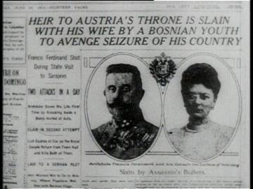
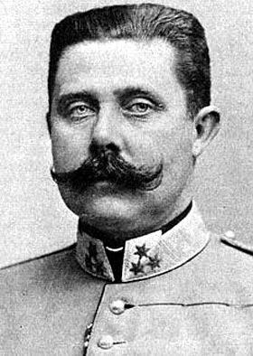
Who Murdered Franz Ferdinand? Why?
Notes:
Image (left): The New York Times. (1914, June 29). Headline of the New York Times June-29-1914.jpg (Image). The New York Times. Retrieved from https://commons.wikimedia.org/wiki/File:Headline_of_the_New_York_Times_June-29-1914.jpg
Image (right): The New York Times. (1919, December 31). Archduke Franz Ferdinand of Austria (Image). The New York Times. Retrieved from https://commons.wikimedia.org/wiki/File:Franz_ferdinand.jpg

Slide 2
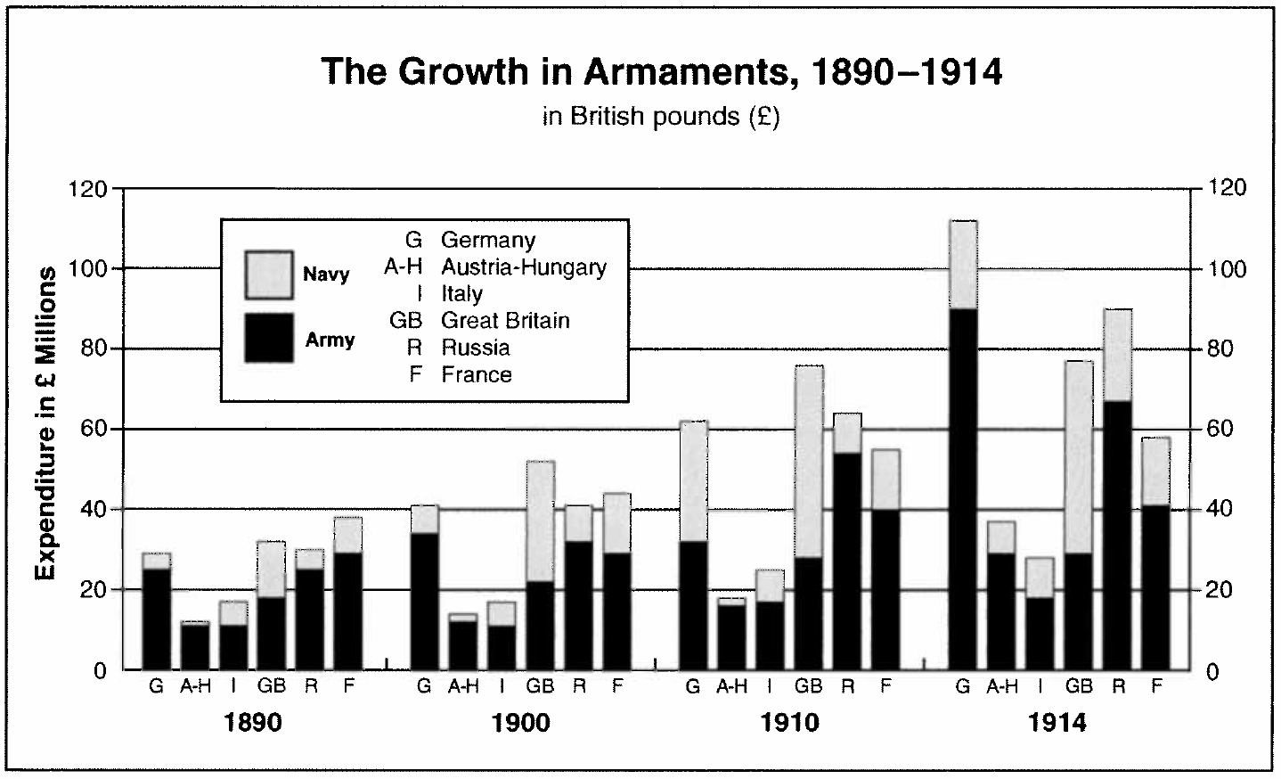
Militarism
Glorification of the military
Belief that military strength meant that a nation would be prosperous and powerful
Huge buildup of military power
Notes:
Image: As cited in Green, M. (2015). Background Questions 1.The world was theirs's for the taking…. 2.1914-1918 3.About 1/10 (3,000,000/30,000,000) 4.With even power, it would be hard for (Slide show). Retrieved from http://slideplayer.com/slide/8565804/

Slide 3
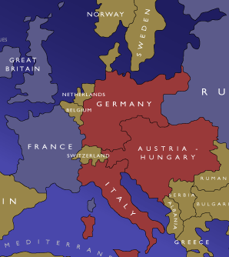
Alliances
Nations promised to defend each other in case of conflict.
If one set of nations formed an alliance, it was only logical that those left out would form one as well.
Meant that conflict involved many countries quickly.
Notes:
Image: As cited in Whitehead, M. (2015). WARMUP #1 Just before World War I, about one-third of all Americans were first- or second-generation immigrants (Slide show). When the war broke out in Europe, many.
Retrieved from http://slideplayer.com/slide/7499331/

Slide 4
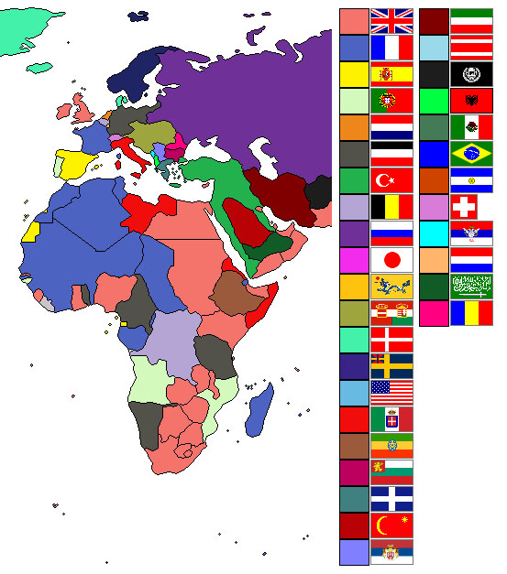
Imperialism
Stronger nations taking over weaker nations or areas to make them colonies or to annex them
Motivated by desire for natural resources, raw materials, trade, missionary work, etc.
Stronger nations competed with each other for colonial possessions
Notes:
Image: Ishvara7. (2007). World empires and colonies around WWI.png (Image, Rev. Ed.). Retrieved from https://commons.wikimedia.org/wiki/File:World_empires_and_colonies_around_World_War_I.png

Slide 5
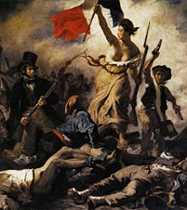
Nationalism
Great pride in one’s own nation (patriotism) but also prejudice or hatred against the peoples and ways of life of other nations.
  Pride
  Superiority over other countries
  Wanting independence, a country for one’s own ethnicity/race only
  Unification (like unification of Slavic people)
Notes:
Image: Delacroix, E. (1830). Liberty leading the people (Image). Musée du Louvre, Atlas database: entry 22746. Retrieved from https://commons.wikimedia.org/wiki/File:Eug%C3%A8ne_Delacroix_-_La_libert%C3%A9_guidant_le_peuple.jpg

Slide 6
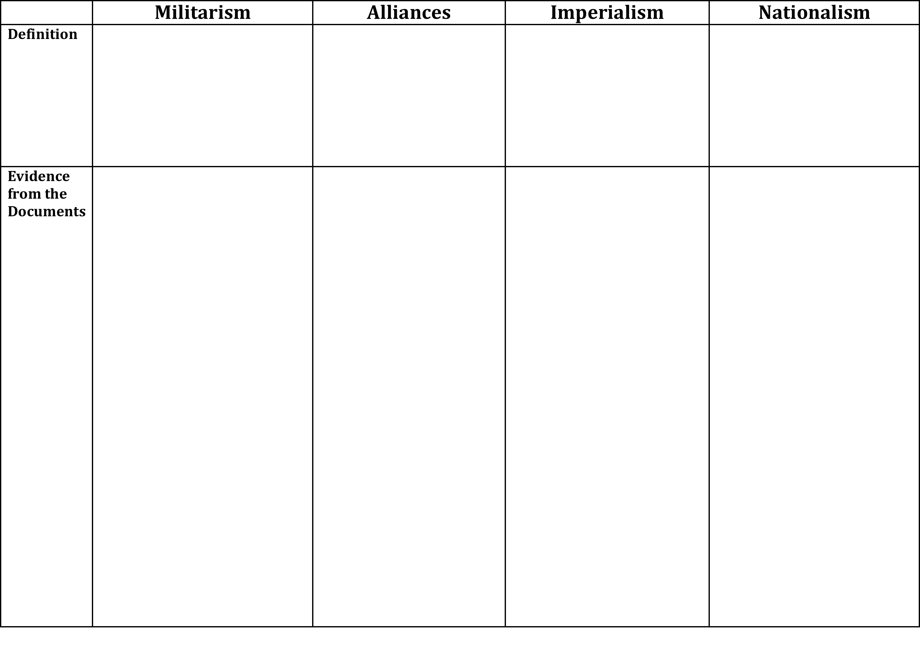
M.A.I.N.
Fill out the M.A.I.N. worksheet by placing information from the documents in the appropriate columns. (NOTE: Some documents may fit in more than one column).

Slide 7
Militarism
From the 1890s onward, the major powers of Europe competed to have the strongest and largest militaries.
There was also a general glorification of war—a belief that war made your country strong and proved its success. This tied in with nationalism—pride in your country or ethnic group.
Notes:
Notes: Ask students to think back to the documents and questions: Which country consistently spent the most money on it’s navy? Why? (Answer: Great Britain because it’s an island and at the time, it had many colonial possessions it needed to protect.
Ask students which nation spent a dramatic amount in 1914. Answer: Germany
Why might this be? Answer: Point to the tensions between Germany and Great Britain leading to the war, and the German desire to compete with England for colonial and imperial power. They would need an army to do this!
Image: As cited in Green, M. (2015). Background Questions 1.The world was theirs's for the taking…. 2.1914-1918 3.About 1/10 (3,000,000/30,000,000) 4.With even power, it would be hard for (Slide show). Retrieved from http://slideplayer.com/slide/8565804/

Slide 8
Alliances
Beginning in the 1870s, European nations formed alliances to protect each other from perceived threats
By 1907, the major powers of Europe were divided into two alliances that were rapidly building up their armies.
The Triple Alliance of Germany, Austria-Hungary, and Italy
was counter-balanced by
The Triple Entente of France, Russia, and Great Britain.
Notes:
Notes: Ask students what a major perceived threat was for both Germany and Austria-Hungary (Answer: Russia), and why Germany, in particular, would feel like it needed to make alliances (Answer: It faces the potential for attack on both sides). That was the Dual Alliance. Then they allied with Italy, creating the Triple Alliance

Slide 9
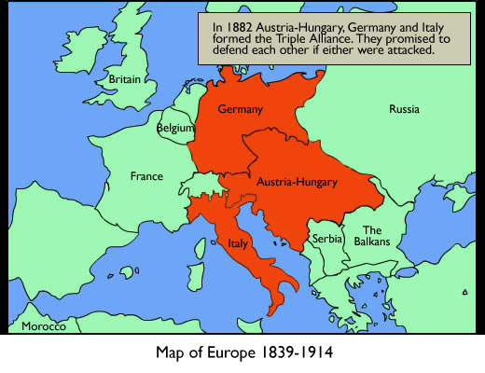
Notes:
Image: The National Archives. (n.d.). Background image: 1 (Image). The Great War: 1914-1918. Retrieved from http://www.nationalarchives.gov.uk/education/greatwar/g2/g2s1_bg.htm

Slide 10
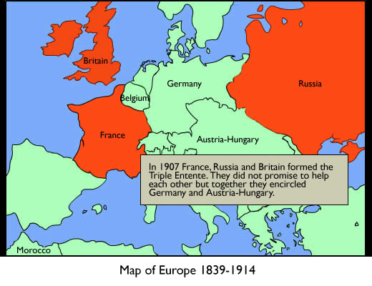
Notes:
Image: The National Archives. (n.d.). Background image: 2 (Image). The Great War: 1914-1918. Retrieved from http://www.nationalarchives.gov.uk/education/greatwar/g2/g2s2_bg.htm#

Slide 11
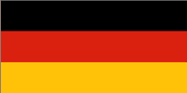
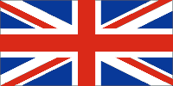
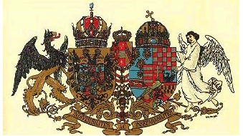


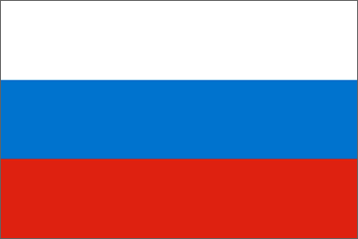
Alliances
Triple Alliance
Triple Entente

Slide 12

Imperialism
After 1870, European nations began to acquire colonies in Asia, Africa, and the Pacific.
Colonial rivalry
  Holding colonies in the same area created strained relations between the European powers that held them. For example, all of the European powers (except Austria and Russia) had colonies in Africa, so there was an ongoing struggle for power within that area as nations fought for more land.
  This led to the indirect strengthening, dissolution, and formation of alliances between the nations.
  As a result of the continual shift in power, borders, and alliances, the arms race intensified.
Notes:
Notes: Ask students which European power had the greatest number of colonies (Answer: Great Britain) and how this affected it’s relationship with other nations (Answer: Other nations became jealous, angry, and competitive—especially Germany. Point to documents that show that Germany increased military spending so it could compete imperially with Britain)
Image: Ishvara7. (2007). World empires and colonies around WWI.png (Image, Rev. ed.). Retrieved from https://commons.wikimedia.org/wiki/File:World_empires_and_colonies_around_World_War_I.png

Slide 13
Nationalism
Nationalism means two things:
  Pride and patriotism for one’s nation, which translated to European powers wanting to be the most powerful (biggest military, most money, and biggest empire) at the expense of the other European powers
  The idea that people with the same ethnic origins, language, and/or political beliefs had the right to form independent countries of their own
Notes:
Notes: Ask students which documents from the Gallery Walk demonstrate pride in one’s nation and competition with others (Answer: Russian national anthem, “Rule Britannia,” statements from Germans wanting to be as strong or stronger than Britain, etc.)
Ask students where we could see problems (Answer: The second aspect of nationalism—point to Austria-Hungary being made up of many nationalities, including some of the Slavs who did not want to be part of Austria-Hungary but wanted to unite with Serbia for a bigger Slavic country/empire)

Slide 14
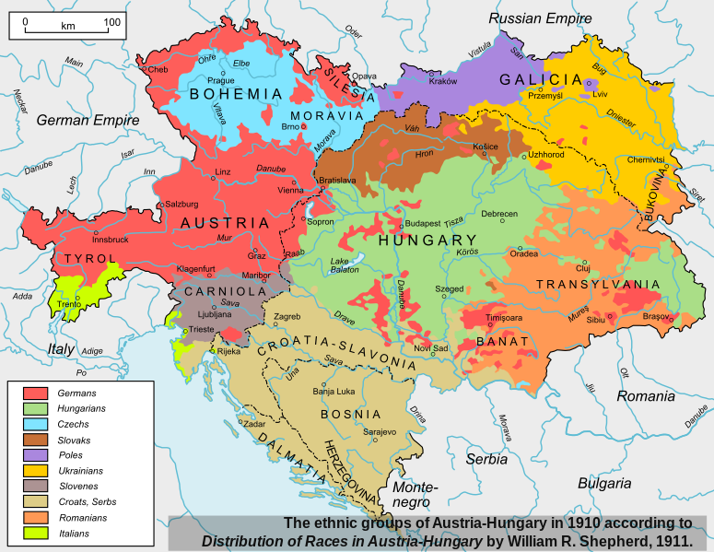
Notes:
Point out that these are all different ethnic groups w/in Austria-Hungary empire—this causes a lot of tension!!!
Image: Andrein. (2008, December 22). Austria Hungary ethnic.svg (Image). Retrieved from https://commons.wikimedia.org/wiki/File:Austria_Hungary_ethnic.svg

Slide 15
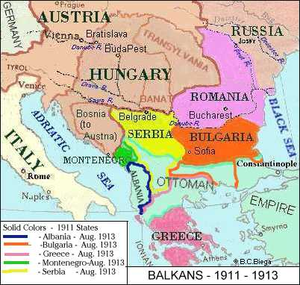
Nationalism in the Balkans (the Slavs)
The Balkans had been ruled by the Ottoman Empire (based in what’s now Turkey) for 100s of years
  This included Albanians, Greeks, Romanians, and Slavs
  Each group was struggling for their own independence
In 1908, Austria-Hungary annexed Bosnia
Serbia, independent and next to Bosnia, wanted to unite with Bosnia as a Slavic nation, and many in Bosnia agree
Notes:
Note: Point out Bosnia on the map.
Image Source: As cited in Beiga, B. (2002). Part 5: 19th and 20th Centuries - Struggles for freedom. Two Thousand Years of the Modern Era in Central & Eastern Europe. Retrieved from http://biega.com/history20.html

Slide 16
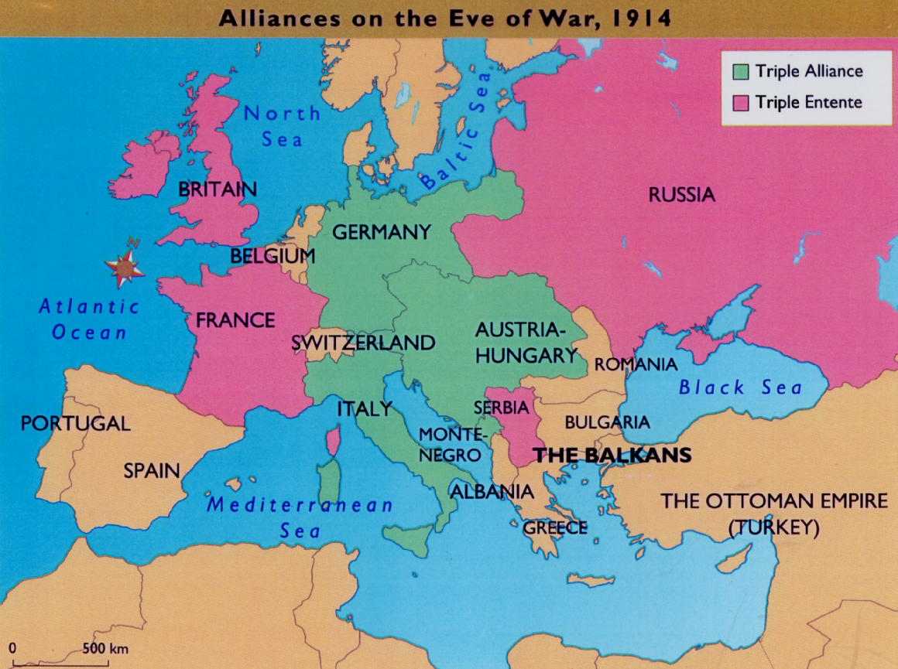
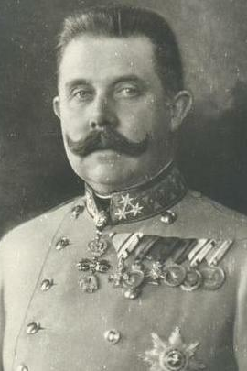
Notes:
In June 1914, heir to the throne of Austria-Hungary Archduke Franz Ferdinand goes to Sarajevo in Bosnia to attend a museum opening with his wife Sophie
Background image: As cited in Tate, G. (2014). World War I “MANIA”: Causes of the War What events and actions led to the start of WWI? Why was WWI different than any war before it? How did world leaders [Slide show]. Retrieved from http://slideplayer.com/slide/8312931/
Smaller image: The New York Times. (1919, December 31). Archduke Franz Ferdinand of Austria (Image). The New York Times. Retrieved from https://commons.wikimedia.org/wiki/File:Franz_ferdinand.jpg

Slide 17
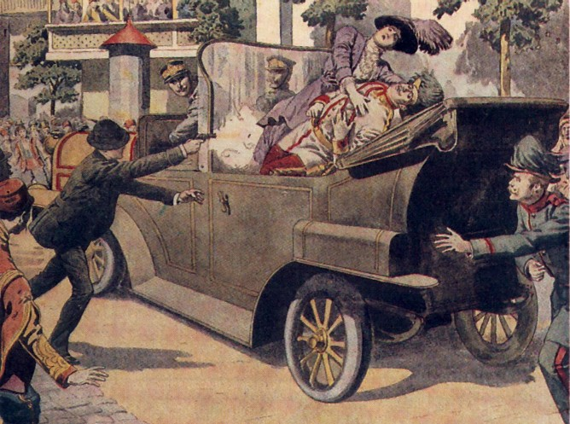
The Assassination
The Black Hand, a Slavic nationalist group that wanted Bosnia to unite with Serbia, decides to make a stand
Six would-be assassins set out to attempt the murder, but many are too scared or are thwarted.
Gavrilo Princip succeeded. He fatally shot both Franz Ferdinand and his wife Sophie.
Notes:
Note: The case notes in the lesson, the students’ textbook, or the suggested reading from the lesson (found at http://www.authentichistory.com/1914-1920/1-overview/1-origins/) can add more information to the story of his assassination, if necessary.
Image: As cited in Trouillard, S. (n.d.). June 28, 1914 in Sarajevo: Two gunshots, one world war. FRANCE 24. Retrieved from http://graphics.france24.com/assassination-sarajevo-1914-archduke-princip-photos/

Slide 18

Domino Effect
Austria Hungary blamed Serbia for Ferdinand’s death and declared war on Serbia.
Germany pledged their support for Austria -Hungary.
Russia pledged their support for Serbia.
(united as Slavs).
Notes:
Note: Point out that alliances are responsible for many countries being pulled in so quickly.
Image: Angelsharum. (2004). Dominos Falling.jpg (Image). Retrieved from https://commons.wikimedia.org/wiki/File:Dominos_Falling.jpg

Slide 19
Domino Effect
Germany declares war on Russia.
France pledges their support for Russia.
Germany declares war on France.
Germany invades Belgium on the way to France.
Great Britain supports Belgium and declares war on Germany.
Notes:
Note: And it’s war. You may choose to tell students about the United States joining later, Italy switching sides, etc.; or you may wait until teaching about the actual war.

Slide 20

Central Powers:
Allied Powers:
Germany
Great Britain
Austria-Hungary
France
Ottoman Empire
World War I
Russia
Italy

Slide 21
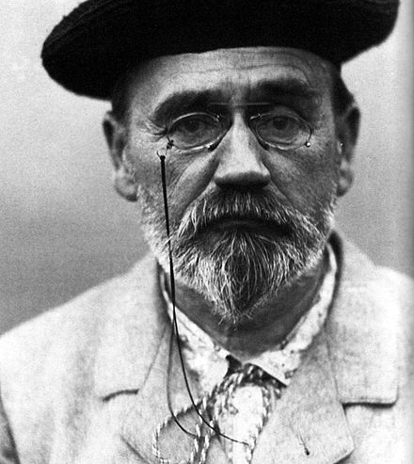
War is life itself-Emile Zola, French author
“Would not the end of war be the end of humanity? War is life itself. Nothing exists in nature, is born, grows or multiplies except by combat. We must eat and be eaten so that the world may live. It is only warlike nations which have prospered; a nation dies as soon as it disarms. War is the school of discipline, sacrifice and courage.”
Zola’s remarks at the 21st anniversary of the Battle at Sedan
Notes:
Quote: Emile Zola quote as cited in Pick, D. (1996). War machine: The rationalisation of slaughter in the Modern Age. London: Yale University Press. (p. 86)
Image: Zola. E. (1902). Autoportrait d’Emile Zola (Image). Retrieved from https://commons.wikimedia.org/wiki/File:ZOLA_1902B.jpg

Slide 22

Four Corners
World War I was an inevitable result of European nations’ prosperity.
Notes:
Image: K20 Center. (2014). Four corners (Image). Instructional Strategies. Retrieved from http://k20center.ou.edu/instructional-strategies/four-corners/

