Slide 2
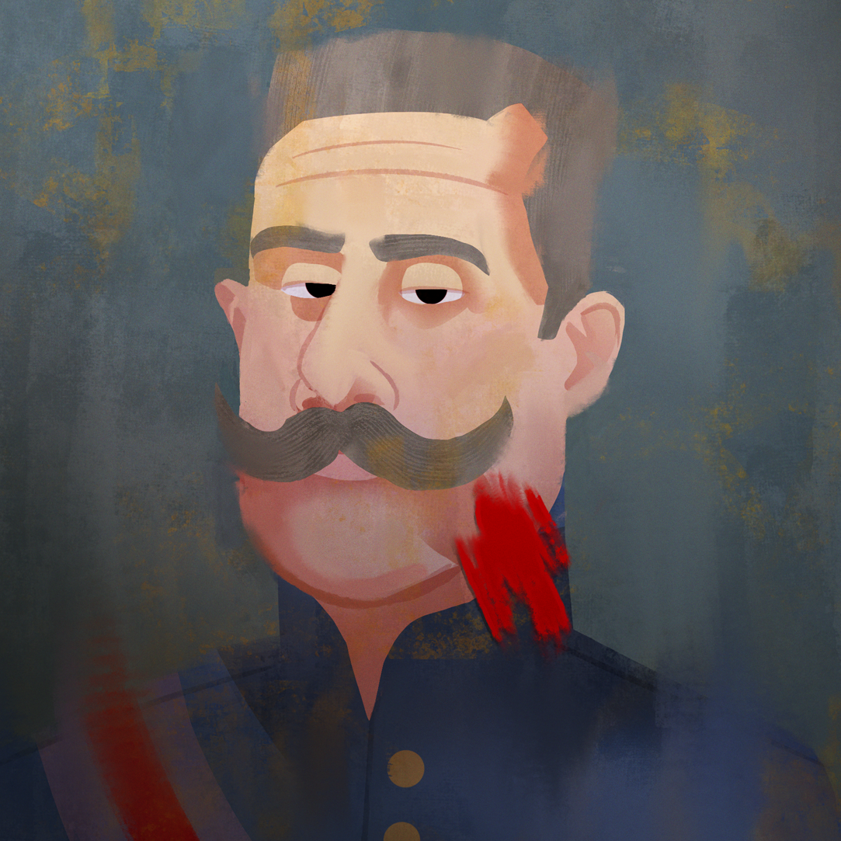
War is Life Itself
The Causes of World War I

Slide 3
Essential Question
Is war between nations inevitable?

Slide 4
Learning Objective
Explain the causes of World War I.

Slide 5

Why-Lighting
Review the case file.
Highlight the information that describes:
  Location of the murder
  The victims
  The murderer and their motive (reason) for killing the victims
  What happened after the crime
Notes:
K20 Center. (n.d.). Why-lighting. Strategies. https://learn.k20center.ou.edu/strategy/128

Slide 6
Why-Lighting
Why was the Archduke assassinated?
What happened afterward?
Notes:
K20 Center. (n.d.). Why-lighting. Strategies. https://learn.k20center.ou.edu/strategy/128

Slide 7
World War I
Is one person’s murder enough to justify a world war?
Is an alliance, the promise to have someone’s back enough to justify a world war?
What other reasons might cause countries to engage in war?

Slide 8
Causes of World War I
Visit each station and answer the questions on the handout.

Slide 9
Militarism
Glorification of the military.
Belief that military strength meant that a nation would be prosperous and powerful.
Huge buildup of military power.

Slide 10
Alliances
Nations promised to defend each other in case of conflict.
If one set of nations formed an alliance, it was only logical that those left out would form one as well.
Meant that conflict involved many countries quickly.

Slide 11
Imperialism
Stronger nations taking over weaker nations or areas to make them colonies or to annex them.
Motivated by desire for natural resources, raw materials, trade, missionary work, etc.
Stronger nations competed with one another for colonial possessions.

Slide 12
Nationalism
Great pride in one’s own nation (patriotism) but also prejudice or hatred against the peoples and ways of life of other nations.
  Pride
  Superiority over other countries
  Wanting independence, a country for one’s own ethnicity/race only
  Unification (like unification of Slavic people)

Slide 13
“Would not the end of war be the end of humanity? War is life itself. Nothing exists in nature, is born, grows or multiplies except by combat. We must eat and be eaten so that the world may live. It is only warlike nations which have prospered; a nation dies as soon as it disarms. War is the school of discipline, sacrifice and courage.”
-Emila Zola, French author
Notes:
K20 Center. (n.d.) Elbow partners. Strategies. https://learn.k20center.ou.edu/strategy/116

Slide 14

Four Corners
Strongly Agree
Agree
Disagree
Strongly Disagree
Notes:
K20 Center. (n.d.). Four corners. Strategies. https://learn.k20center.ou.edu/strategy/138

Slide 15
Write a Response
Was World War I inevitable for the nations involved to survive and thrive?

