Slide 1
Immigration to the United States
1880s-1920s

Slide 2
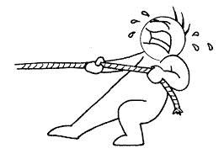
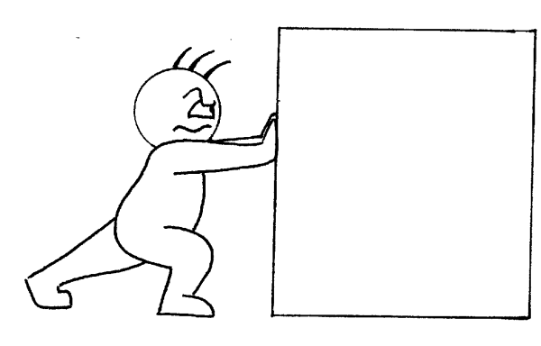
Which of these factors do we still see today?
PULL FACTORS:
Jobs in factories
Land
Religious/political freedom
Friends and family who already live in the U.S.
PUSH FACTORS:
Religious persecution (e.g., Jews)
Political oppression
Poverty
Famine (no food)
Notes:
Ask students to consider the pull and push factors. Ask them to consider some of the factors we still see today. Ask for some examples.

Slide 3
The Process
The Long Journey
The Arrival
Settling In
?????????????????????????????????????????????????
As we go through each step in the immigration process, consider which one would be the hardest or scariest for you and why.

Slide 4
The Long Journey
From the 1880s through the 1930s, most immigrants came to the U.S. on steamships.
They traveled in steerage, the worst accommodations on the ship, located on the lower decks; they were crowded, dirty, and had no privacy. Disease spread quickly, and many (especially the elderly and young) died.

Slide 5
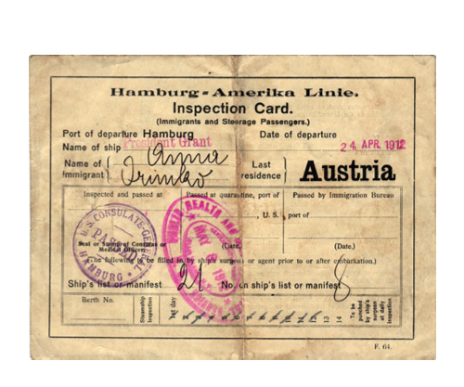
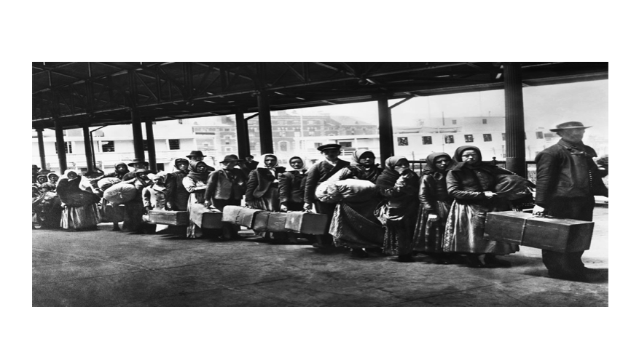
The Arrival
Once here, immigrants underwent medical inspection and their paperwork was processed.
On the East Coast, Ellis Island, New York, was the main processing station, while Angel Island, off of San Francisco, was the main West Coast station.

Slide 6
Settling In
Most new immigrants stayed in cities, close to industrial jobs in factories, and lived in neighborhoods with other immigrants who shared their culture/values/language.
According to the 1890 U.S. census, immigrants made up more than 40% of the population in San Francisco, New York, and Chicago^{[1]}. Four out of five New Yorkers were foreign­ born or had foreign­-born parents^{[2]}.
Immigrants helped contribute to the rapid growth of cities, but these cities were often dirty, disease-filled, and overcrowded. Immigrants often lived in the worst conditions in tenements—cramped, dirty, apartments with shared bathrooms.
Notes:
[1] Gibson, A., & Lennon, E. (1999). Nativity of the population for the 50 largest urban places: 1870 to 1990. U.S. Census Bureau, Population Division. Retrieved from https://www.census.gov/population/www/documentation/twps0029/tab19.html
[2] Goyens, T. (2007). Beer and Revolution: The German Anarchist Movement in New York City, 1880-1914 (p. 19). Chicago, Il: University of Illinois Press.

Slide 7
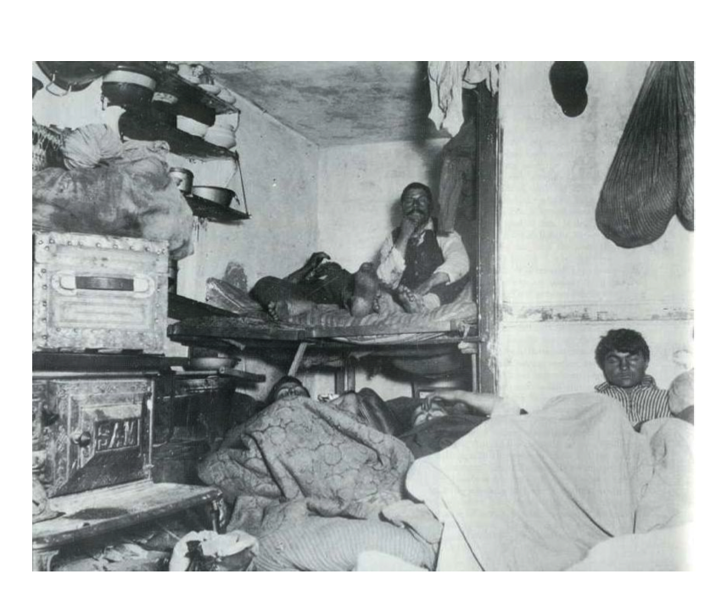
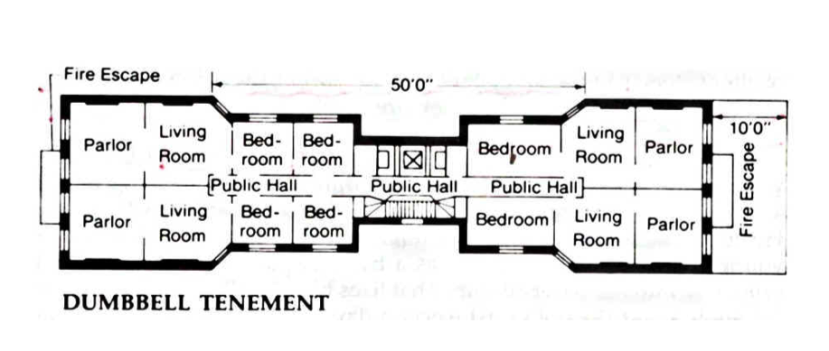
Jacob Riis, an immigrant himself, documented the lives of immigrants in NYC during the late 1800s.
Notes:
Some of Riis’s photos can be found online at http://petapixel.com/2013/06/16/how-the-other-half-lives-photographs-of-nycs-underbelly-in-the-1890s/ if you wish to share these with your class.
A full, free copy of Riis’s book (now in the public domain) can be found here: http://elearn.uni-sofia.bg/pluginfile.php/170076/mod_resource/content/1/JacobRiis_hypertext.pdf
Image: Riis, J. (1890). Lodgers in a crowded Bayard Street tenement—”Five Cents a Spot.” In How the Other Half Lives. New York: Charles Scribner’s Sons.

Slide 8
Think-Pair-Share
Out of the three steps discussed, which would be the most difficult for you? Why?

Slide 9
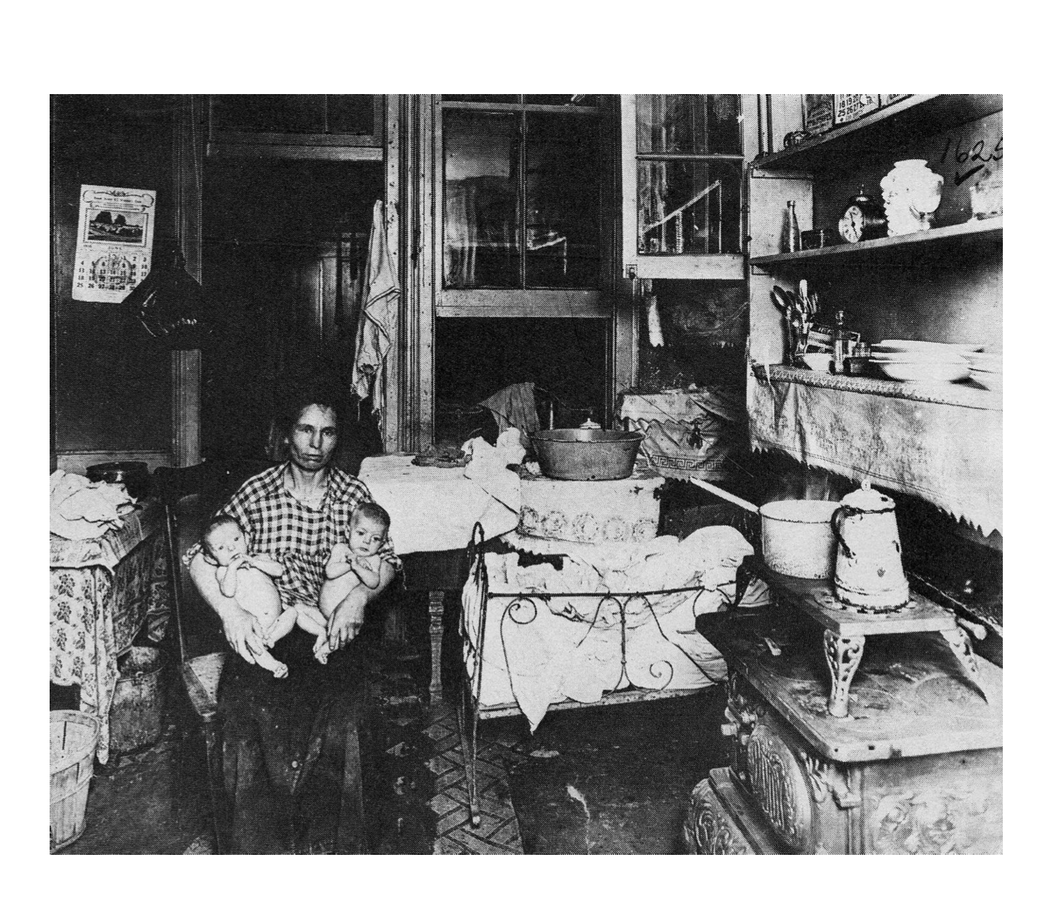
3-2-1
3 things you notice, 2 questions you have, 1 inference

Slide 10
Americanization Programs & Settlement Houses
Some wanted to help immigrants assimilate (blend in) into American society.
They established settlement houses, where immigrants could attend "Americanization" programs, which helped them learn English and adopt American clothes, food, etc.
One of the earliest settlement houses was Chicago's Hull House, founded by Jane Addams (far left) in 1898.

Slide 11
Nativism
Nativists believed that immigrants would steal their jobs and destroy and/or corrupt American culture.
They often refused to hire immigrants or sell or rent property to them.
Nativists often backed up their prejudice with "scientific" theories like Social Darwinism, connecting immigrants’ ethnicities with crime and low intelligence.
Chinese were especially criticized. The Chinese Exclusion Act of 1882 banned immigration by the Chinese and limited the civil rights of Chinese immigrants already in the U.S. including denying them citizenship.

Slide 12
Nativism
Notes:
Flag of the Know Nothing party, nativists who supported policies that further regulated immigration in an effort to “preserve” American culture and jobs for those born in the United States.

Slide 13
Melting Pot
Are ideas like assimilation and nativism helpful to the idea of a melting pot or harmful?

Slide 14
Irony
Situational irony: Irony involving a situation in which actions have an effect that is opposite from what was originally intended, so the outcome is contrary to what was expected
(Dictionary.com, n.d.)
Notes:
Give students a review of the definition of irony. Inform them that political cartoonists often use visuals to depict situational irony. This situational irony is used to send a message.
Dictionary.com. (n.d.). Situational irony. Dictionary.com's 21st Century Lexicon. Retrieved from http://www.dictionary.com/browse/situational-irony

Slide 15
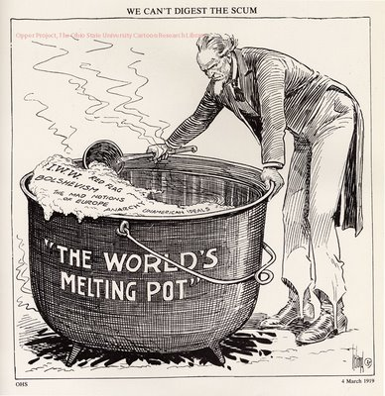

Slide 16
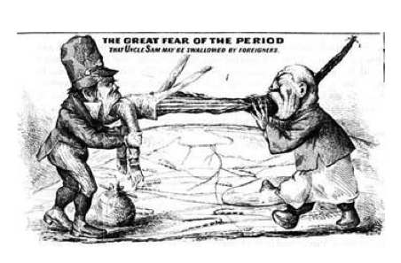

Slide 17
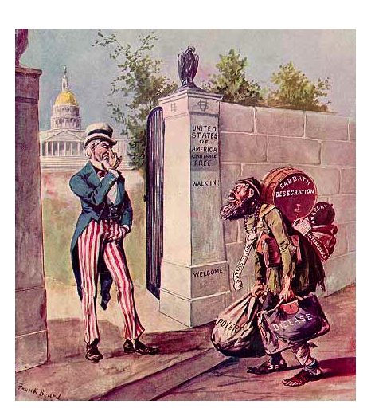

Slide 18
Political Cartoons
Which of the three political cartoons shows the most irony? Why?

