Slide 2
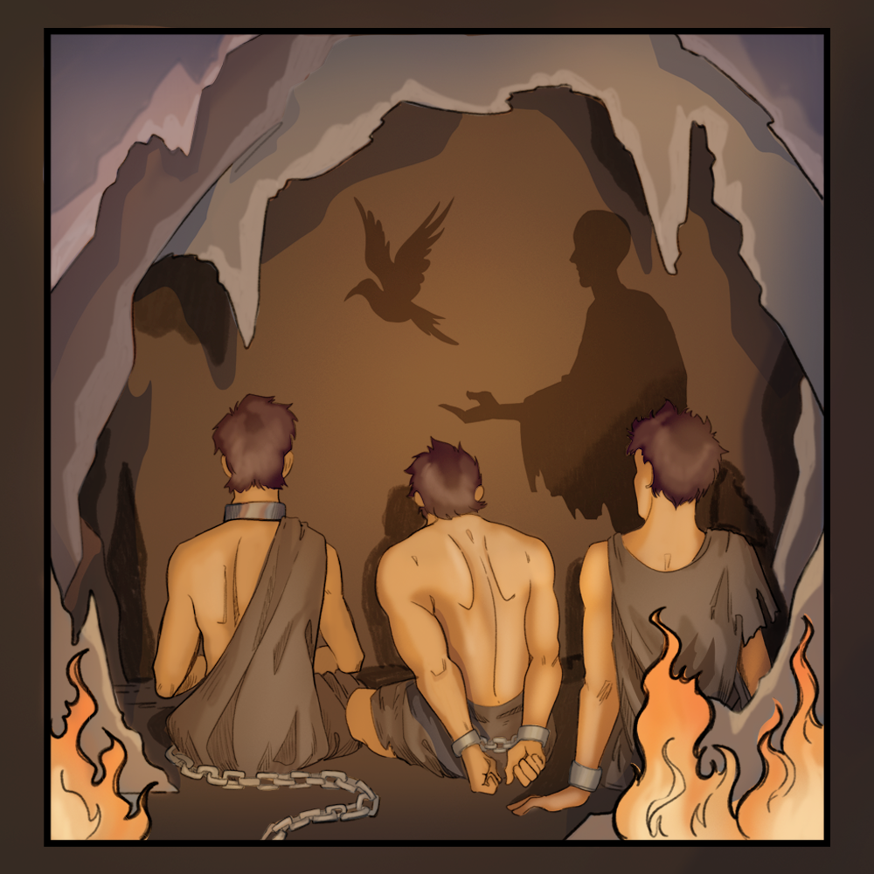
Seeing Through the Shadows
Illuminating Allegory and Symbolism

Slide 3
Essential Question
How can a fictional story tell a deeper truth about the real world?

Slide 4
Learning Objectives
Identify and interpret symbolism.
Demonstrate how allegories convey deeper meaning.

Slide 5
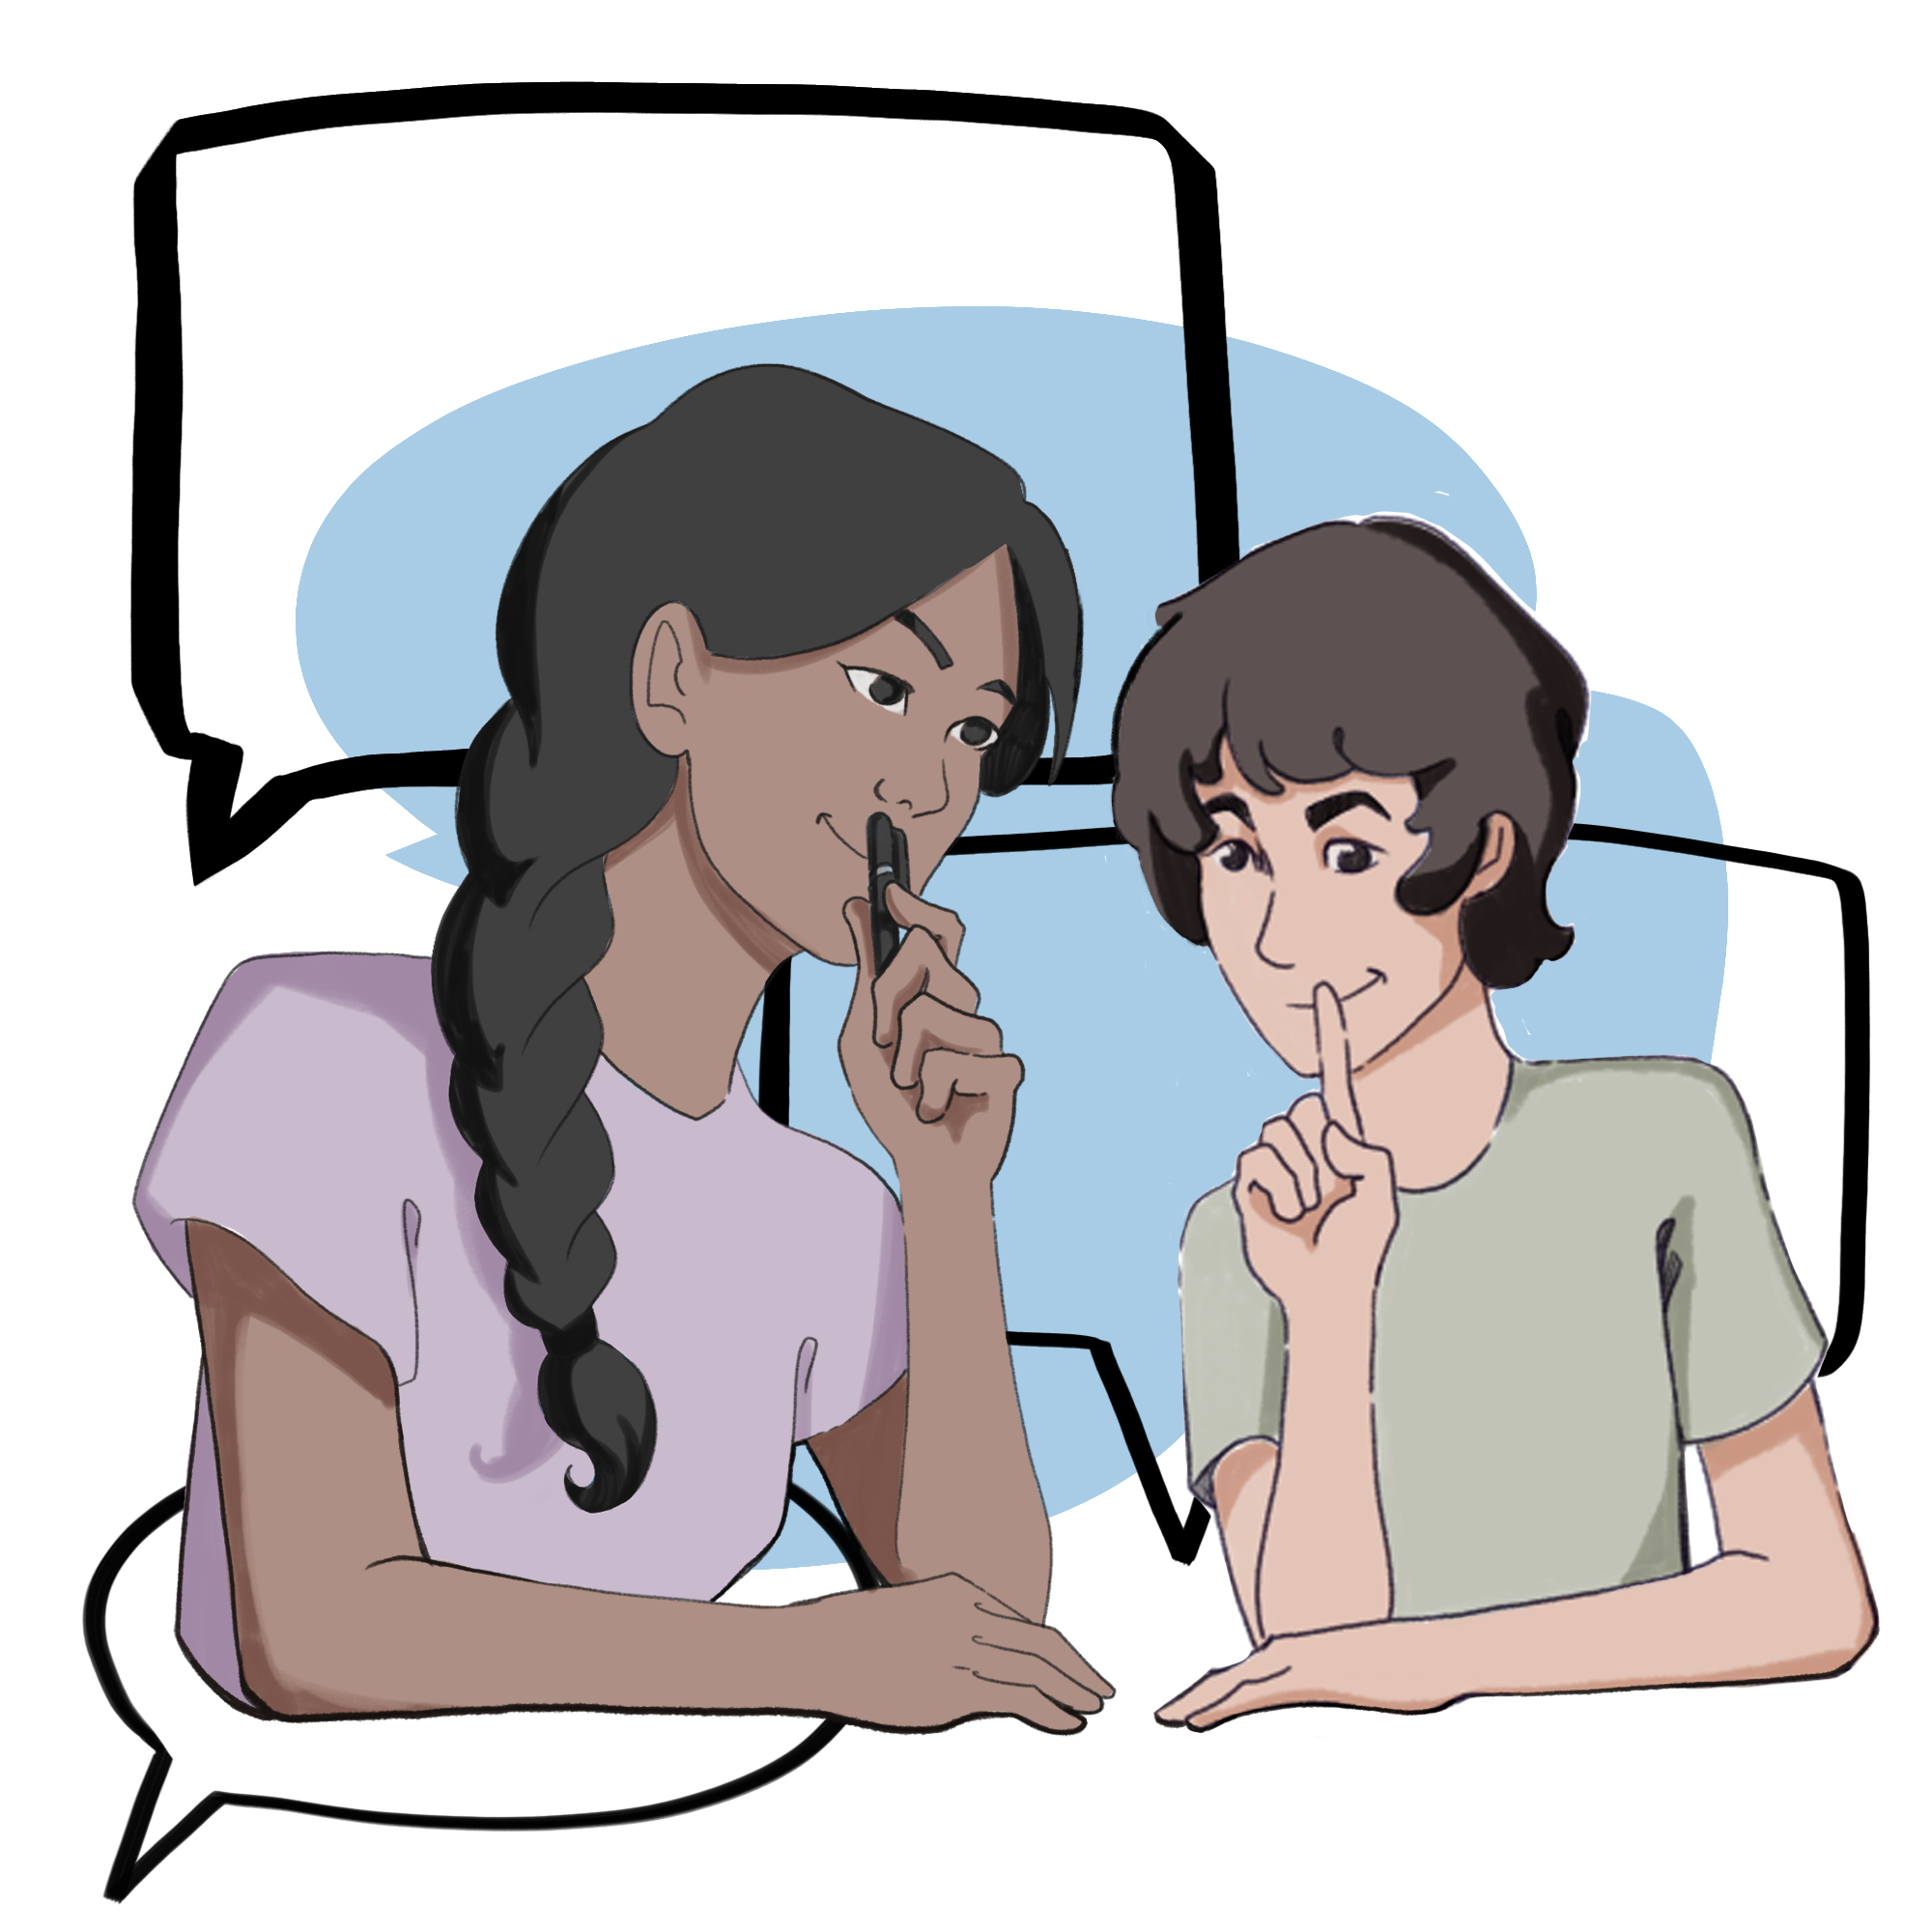
Shared Graphic Organizer
You are about to complete a Silent Discussion.
During this Silent Discussion, nobody speaks.
You are to communicate with your partner using your shared writing utensil.
  Write words or draw sketches.
  Ask clarifying questions.
Read what your partner wrote before responding.
Notes:
K20 Center. (n.d.). Silent discussion. Strategies. https://learn.k20center.ou.edu/strategy/5424

Slide 6
Shared Graphic Organizer
Step 1
See?
What Do You See?
Label the first column, “See?”
In this column, you are to write what you see in the painting on the next slide.
Remember, this is to be a Silent Discussion.
Notes:
K20 Center. (n.d.). Silent discussion. Strategies. https://learn.k20center.ou.edu/strategy/5424

Slide 7
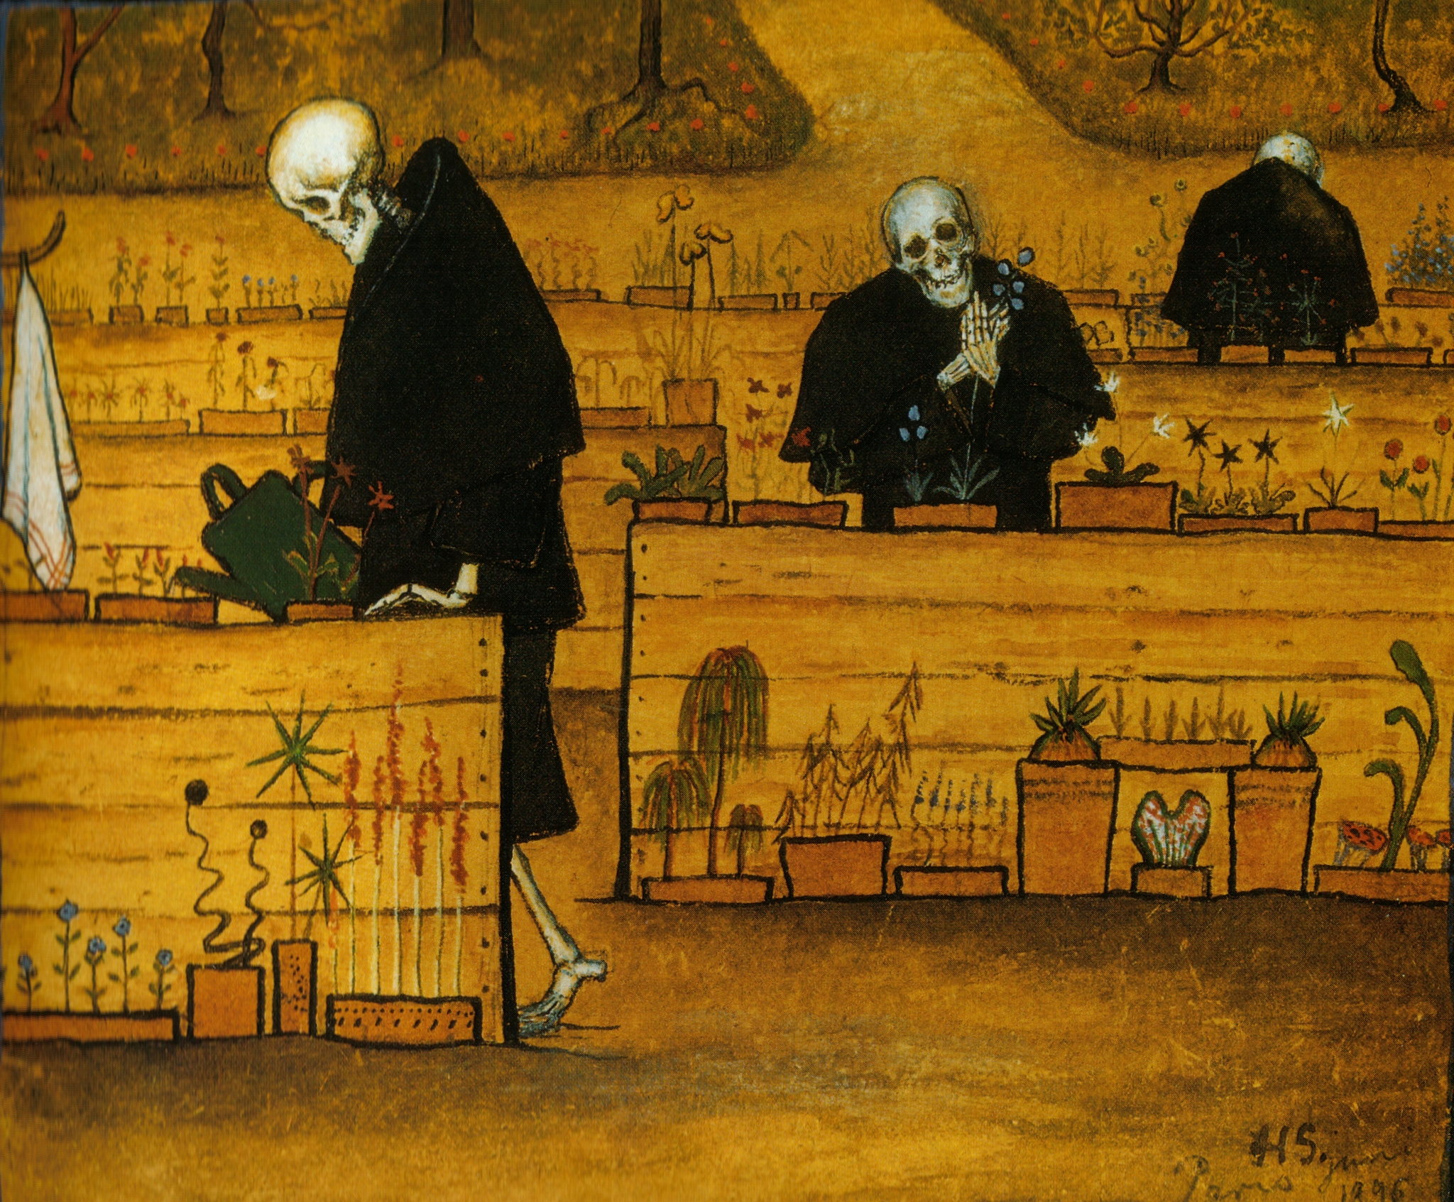

Step 1: See?
What do you see?
2-Minute Timer
Notes:
Simberg, H. (1896). The garden of death [Painting]. Wikipedia. https://en.wikipedia.org/wiki/The_Garden_of_Death
K20 Center. (2021, September 21). K20 Center 2 minute timer. [Video]. YouTube. https://www.youtube.com/watch?v=HcEEAnwOt2c

Slide 8
Shared Graphic Organizer
Step 2
Meaning?
What Do You Think It Means?
Label the second column, “Meaning?”
In this column, you are to write what you think the meaning is behind this painting. Write all of your ideas.
Remember, this is to be a Silent Discussion.
Notes:
K20 Center. (n.d.). Silent discussion. Strategies. https://learn.k20center.ou.edu/strategy/5424

Slide 9
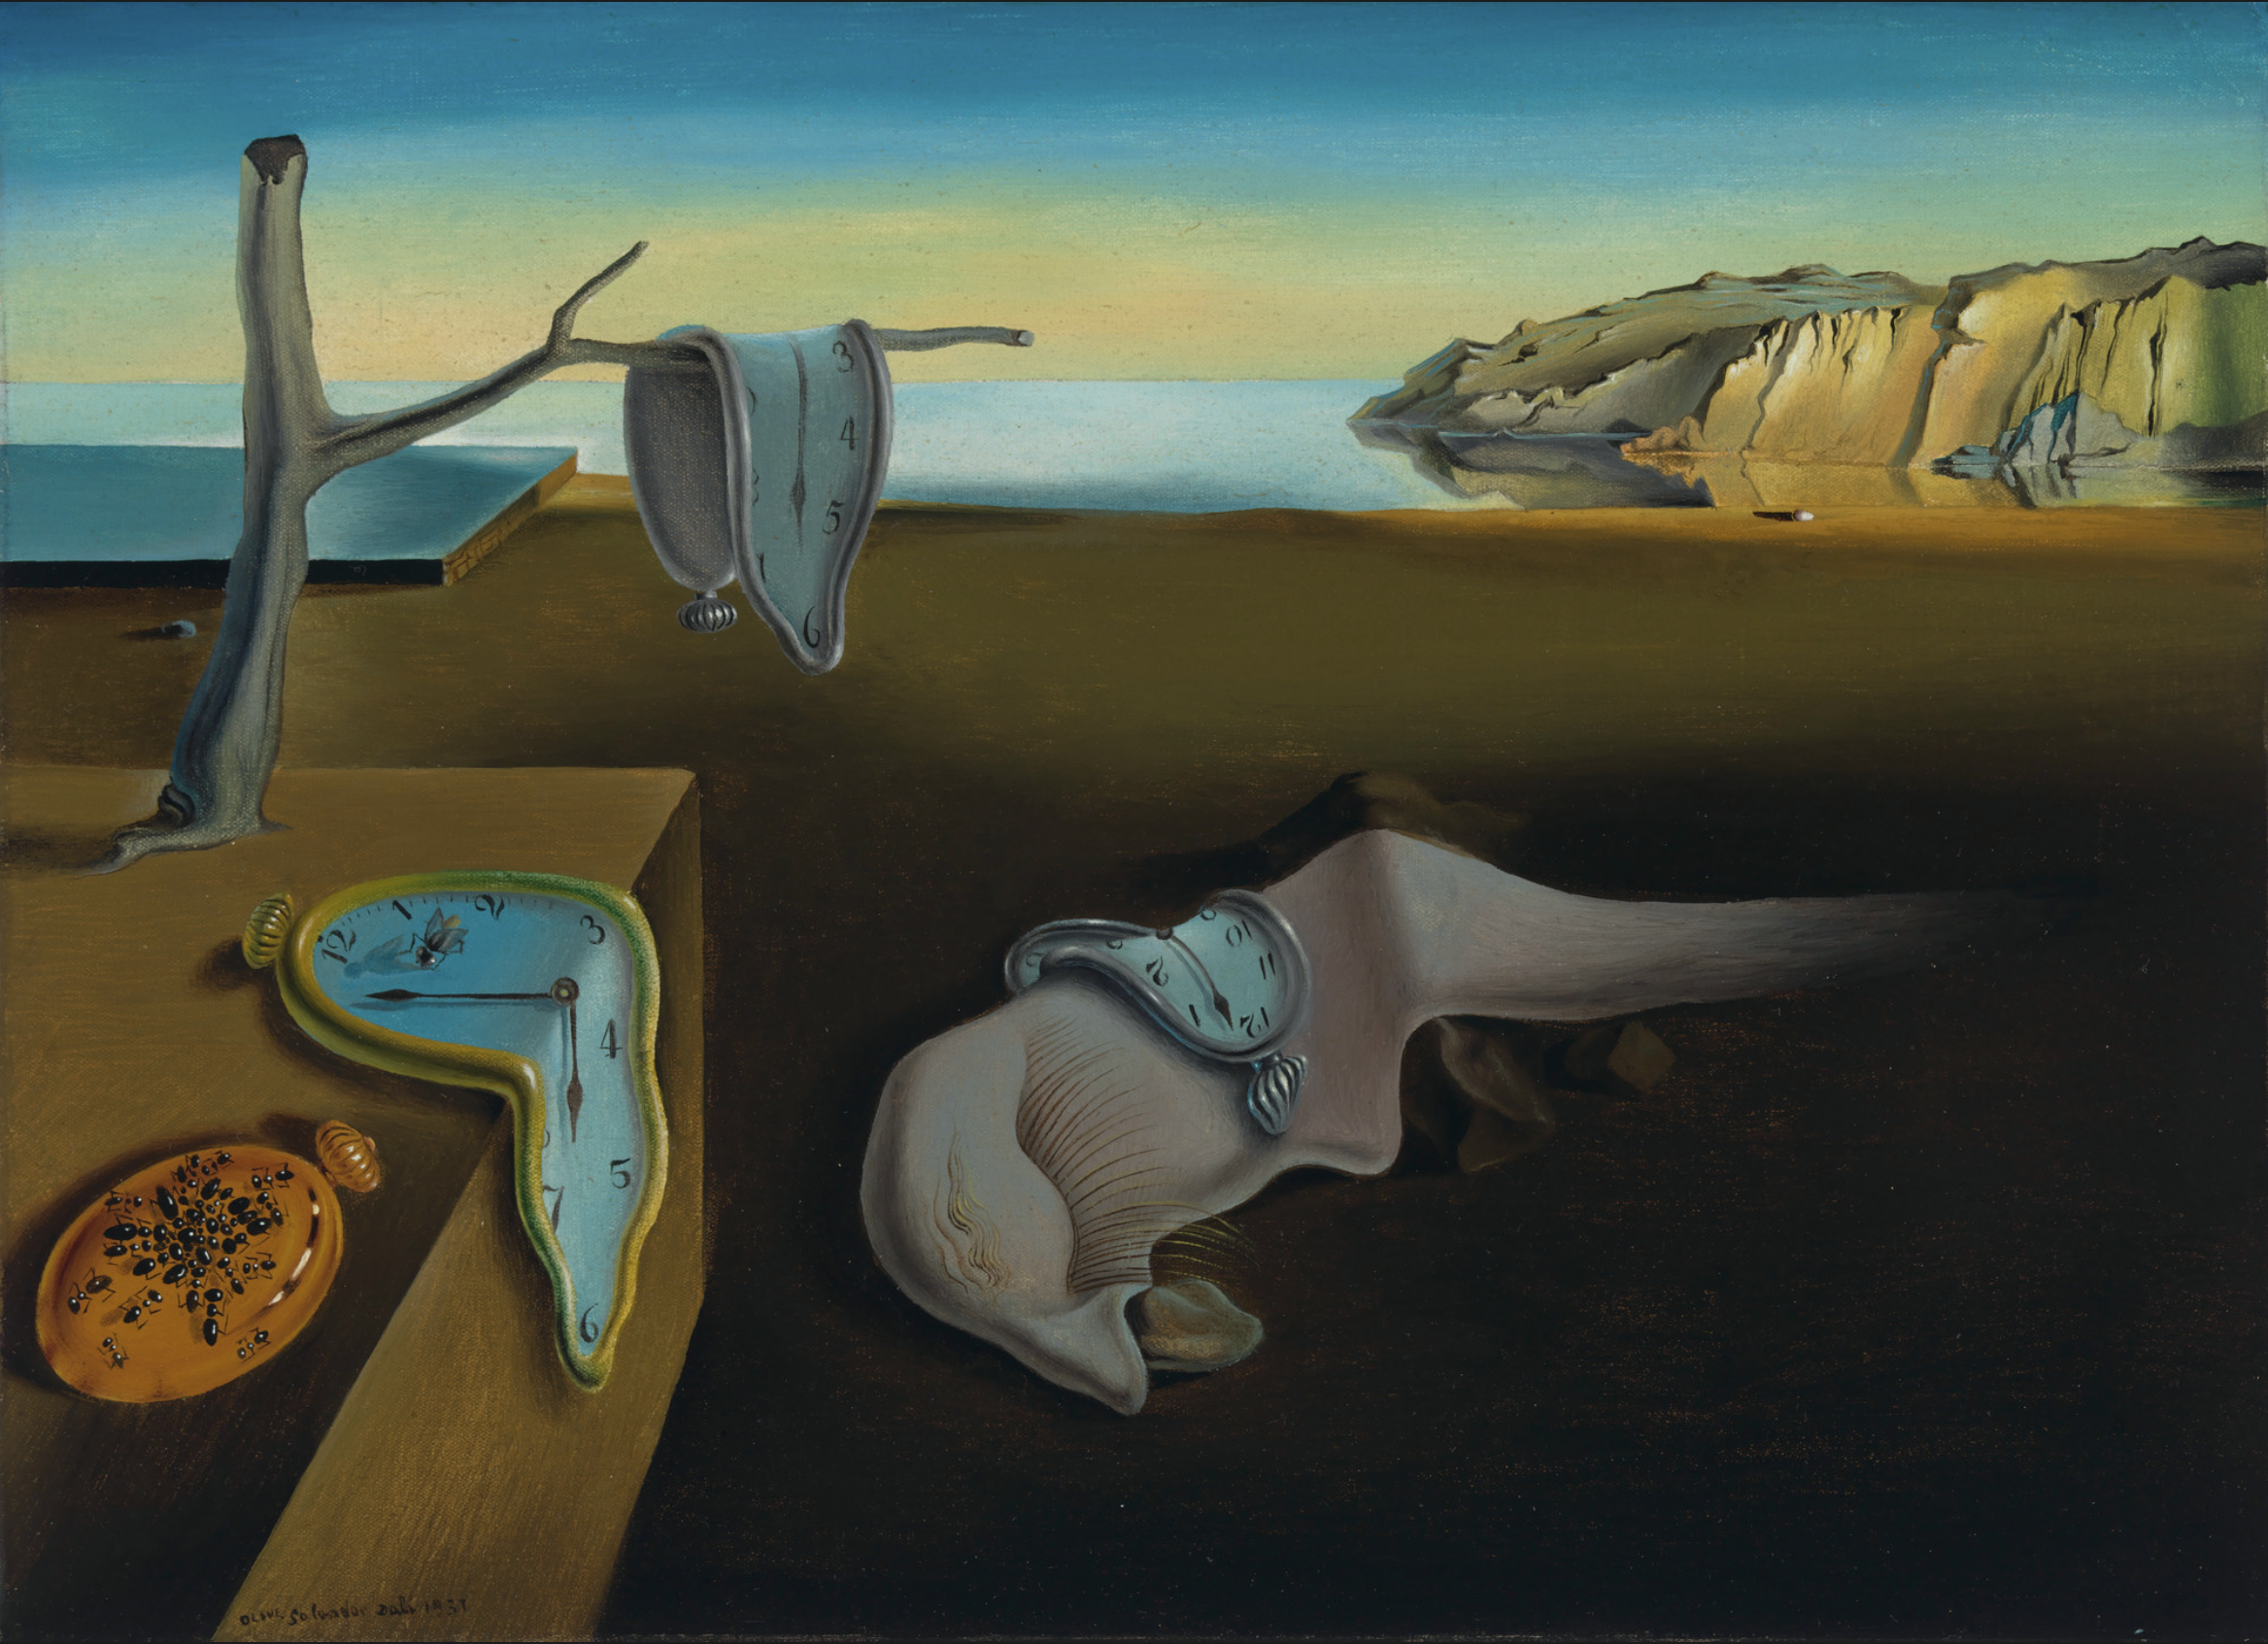
Meaning: Discussion
Some Examples:
“Time feels different depending on what we are experiencing.”
“Memory does not work like a photograph.”
“Nothing lasts forever.”
The Persistence of Memory
by Salvador Dalí
Notes:
Dalí, S. (1931). The persistence of memory [Painting]. The Museum of Modern Art. New York, NY, United States. https://www.moma.org/collection/works/79018

Slide 10
Step 2: Meaning?
What do you think the meaning is?
2-Minute Timer
Notes:
Simberg, H. (1896). The garden of death [Painting]. Wikipedia. https://en.wikipedia.org/wiki/The_Garden_of_Death
K20 Center. (2021, September 21). K20 Center 2 minute timer. [Video]. YouTube. https://www.youtube.com/watch?v=HcEEAnwOt2c

Slide 11

Shared Graphic Organizer
Step 3: What do you think the meaning behind this painting is?
Look at what you have written
and then narrow down your list to one statement.
Remember, this is to be a Silent Discussion.
1-Minute Timer
Notes:
K20 Center. (n.d.). Silent discussion. Strategies. https://learn.k20center.ou.edu/strategy/5424
Simberg, H. (1896). The garden of death [Painting]. Wikipedia. https://en.wikipedia.org/wiki/The_Garden_of_Death

Slide 12
Step 3
What is the meaning behind this painting?
Choose one person to share the meaning and your reasoning.
Notes:
Simberg, H. (1896). The garden of death [Painting]. Wikipedia. https://en.wikipedia.org/wiki/The_Garden_of_Death

Slide 13
The Garden of Death
Artist: Hugo Simberg
Date: 1896
The Finnish artist described this
as “the place where the dead
end up before going to Heaven”.
The mixed symbols of life and death, such as smiling skeletons and the flowers they tend, may encourage viewers to think of death as not so scary.
Notes:
Simberg, H. (1896). The garden of death [Painting]. Wikipedia. https://en.wikipedia.org/wiki/The_Garden_of_Death
Tuschka, A. (2022, January 30). Hugo Simberg - The garden of death. https://www.the-artinspector.com/post/hugo-simberg-the-garden-of-death

Slide 14

Discussion
Why are stories important?
How do people add deeper meaning to stories?

Slide 15
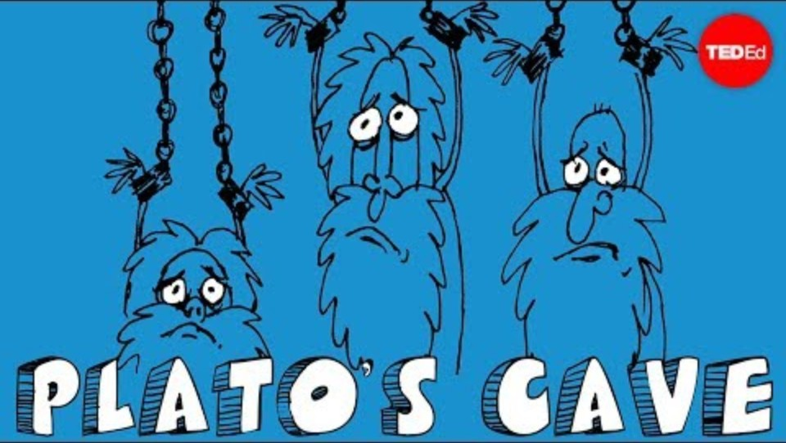
Plato’s Allegory of the Cave
Notes:
TED-Ed. (2015, March 17). Plato’s Allegory of the Cave - Alex Gendler. [Video]. YouTube. https://www.youtube.com/watch?v=1RWOpQXTltA

Slide 16
Discussion
Now that you have watched the video…
Why are stories important?
How do people add deeper meaning to stories?

Slide 17

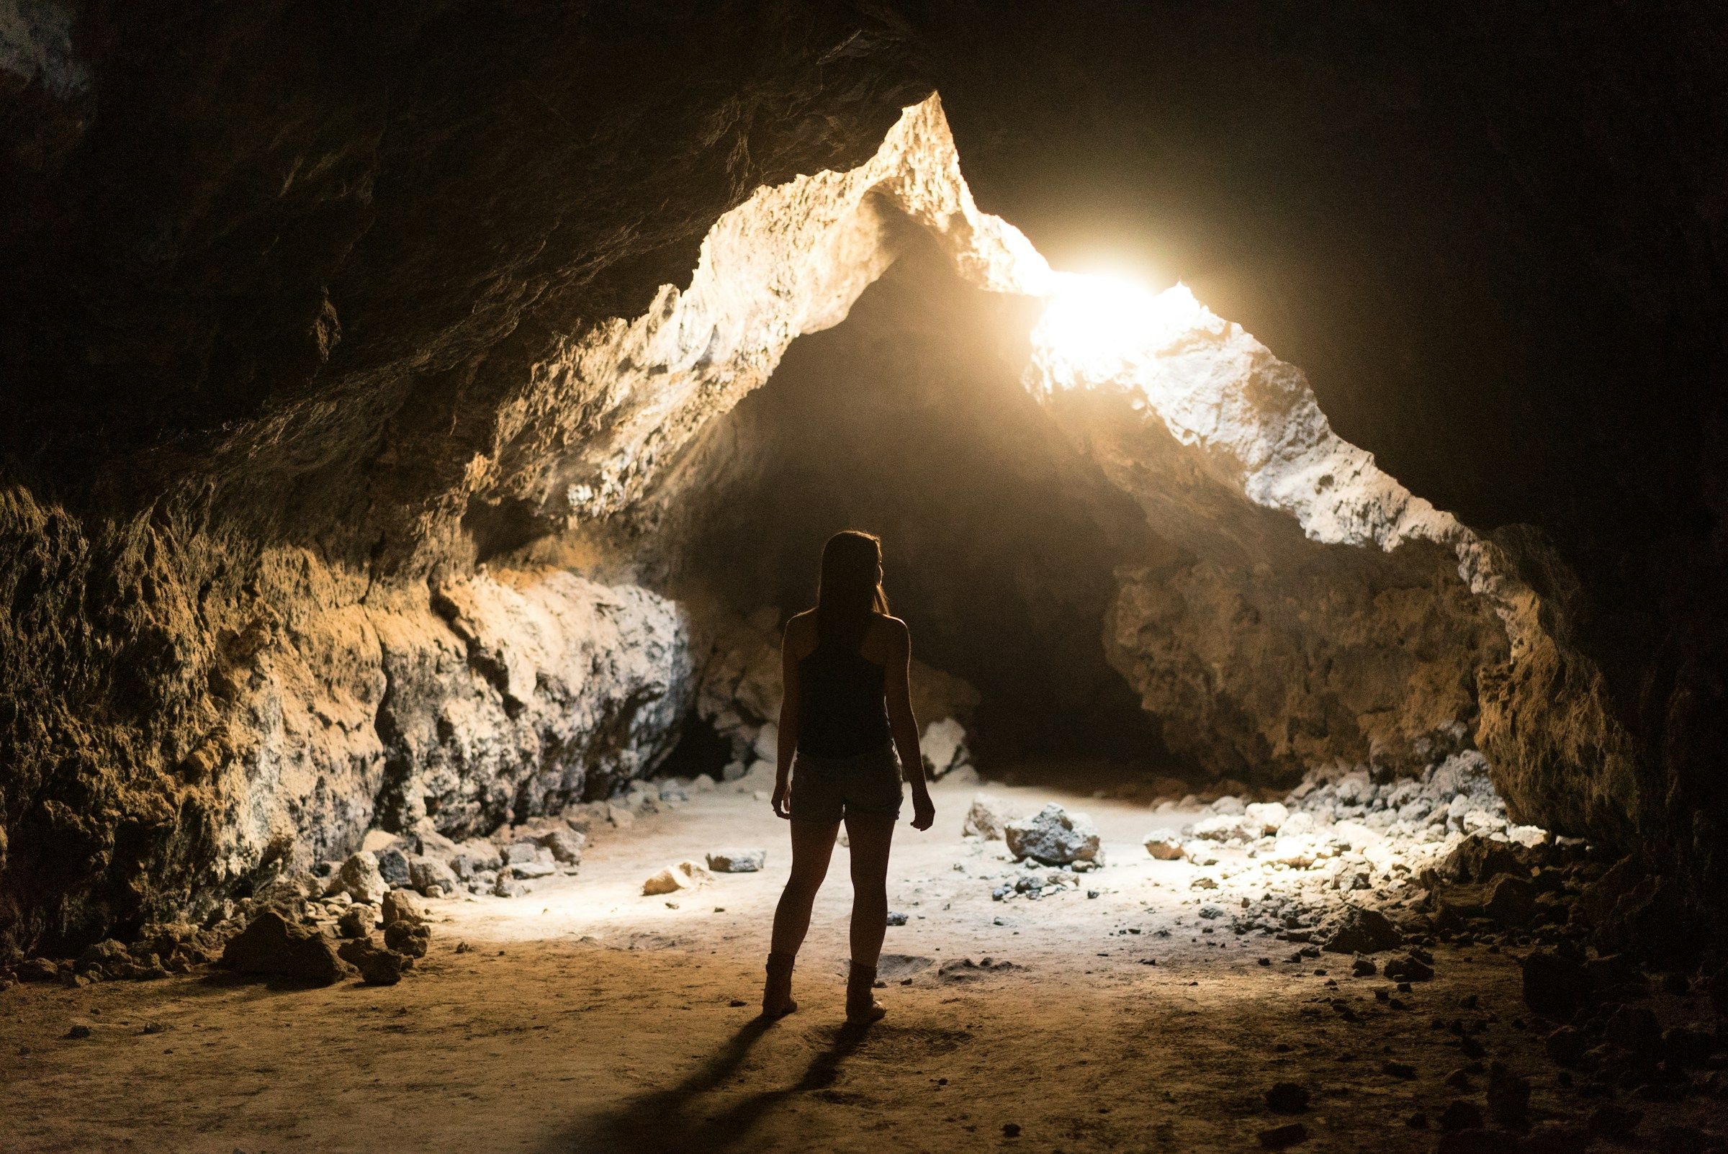


CUS and Discuss
Focus on allegory and
annotate the following:
Circle definition
Underline types
Star examples
Remember: Symbolism is a literary device in which a writer uses one thing to represent something more abstract.
For example, a skull could symbolize death.
Notes:
K20 Center. (n.d.). CUS and discuss. Strategies. https://learn.k20center.ou.edu/strategy/162
Sortino, J. (2016, March 30). Woman standing inside cave [Photograph]. Unsplash. https://unsplash.com/photos/woman-standing-inside-cave-lRA_WTczjgw

Slide 18

Allegory Tracker
Use what you have annotated
to try to complete your
Allegory Tracker handout.
Describe symbol using your
own words.
What is an allegory?
What did the symbols from the “Allegory of the Cave” represent?
10-Minute Timer
Notes:
K20 Center. (2021, September 21). K20 Center 10 minute timer. [Video]. YouTube. https://www.youtube.com/watch?v=9gy-1Z2Sa-c

Slide 19
Allegory Tracker: Key Terms
Symbol:
Allegory:

Slide 20
Allegory Tracker: Key Terms
Symbol: a writer uses one thing to represent something more abstract
  Example: A rose often symbolizes love or beauty.
Allegory: a story that conveys a hidden meaning through the use of symbolic characters and events
  Example: The movie Inside Out (2015) can be an allegory for emotional development and the necessity of sadness in a healthy inner life.

Slide 21
Allegory Tracker: The Allegory of the Cave
What do these symbols represent?
The cave:
The shadows:
The world outside the cave:
The others in the cave:

Slide 22
Allegory Tracker: The Allegory of the Cave
What do these symbols represent?
The cave: a world of illusion, mistake for reality
The shadows: false representations mistake for truth
The world outside the cave: reality as it truly is
The others in the cave: people who accept the false reality without question

Slide 23
Allegory Tracker: Theme
What is the meaning of “The Allegory of the Cave?”
Write a theme statement.
Make sure to write a complete sentence that is universal (applies to people in general).

Slide 24
Allegory Tracker: Reflection
What is the relationship between symbolism and allegory?
Notes:
K20 Center. (n.d.). Why-Lighting. Strategies. https://learn.k20center.ou.edu/strategy/128

Slide 25
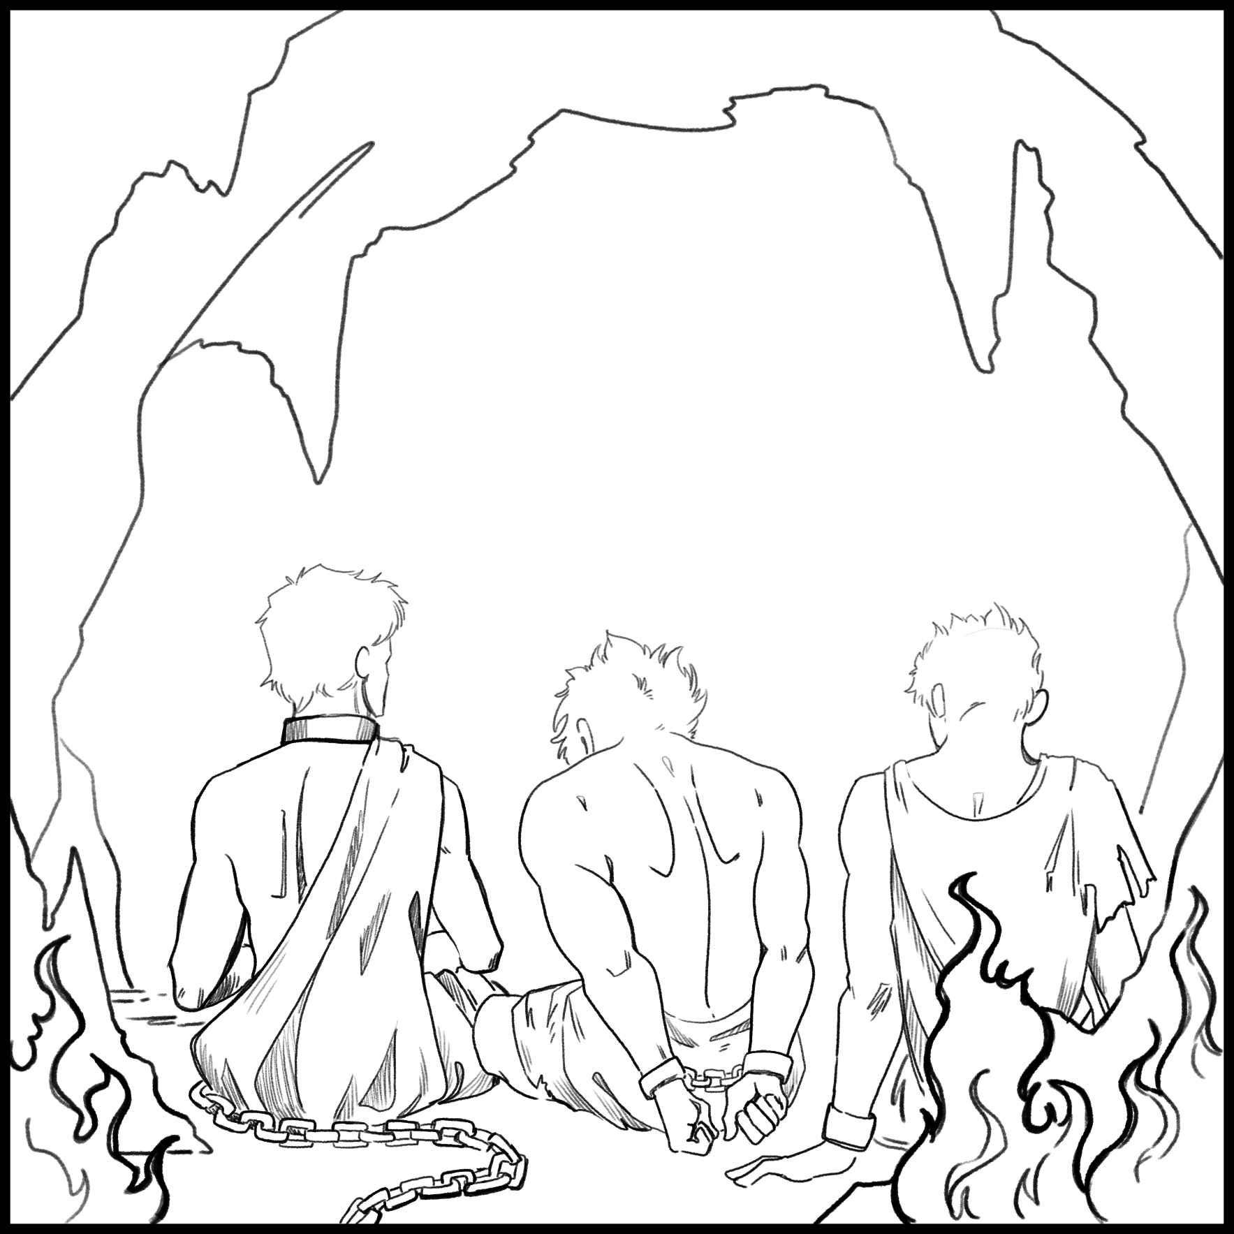
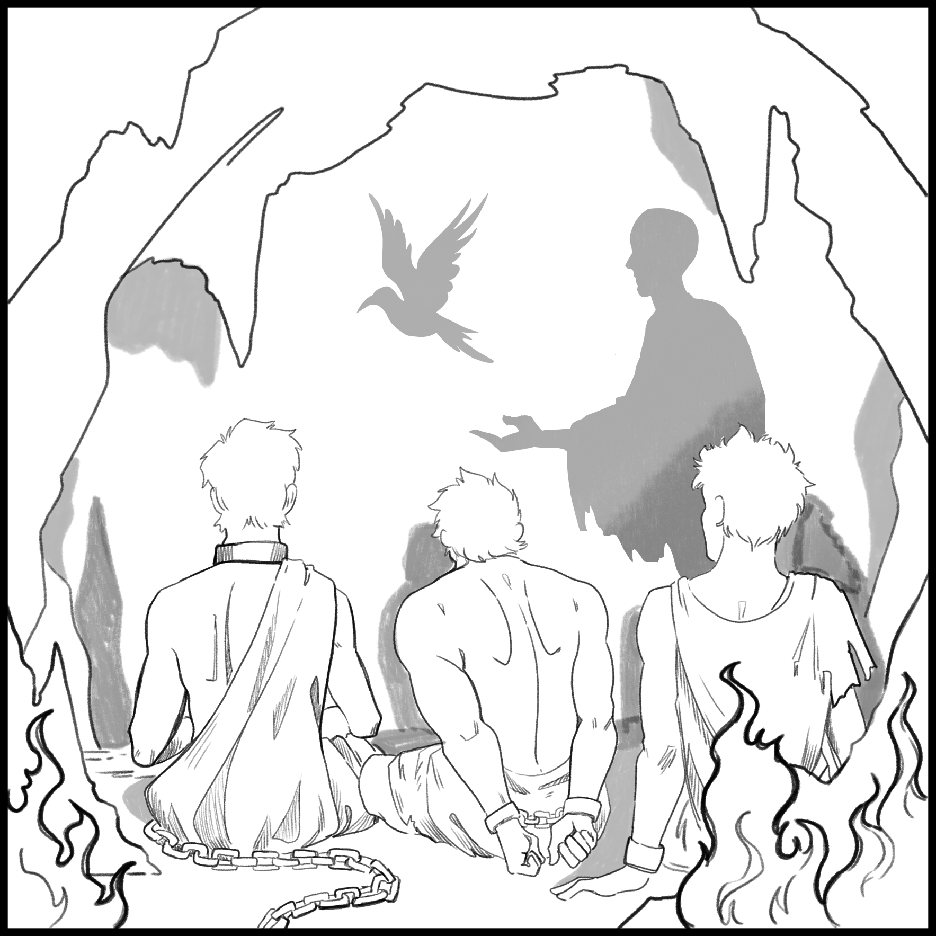
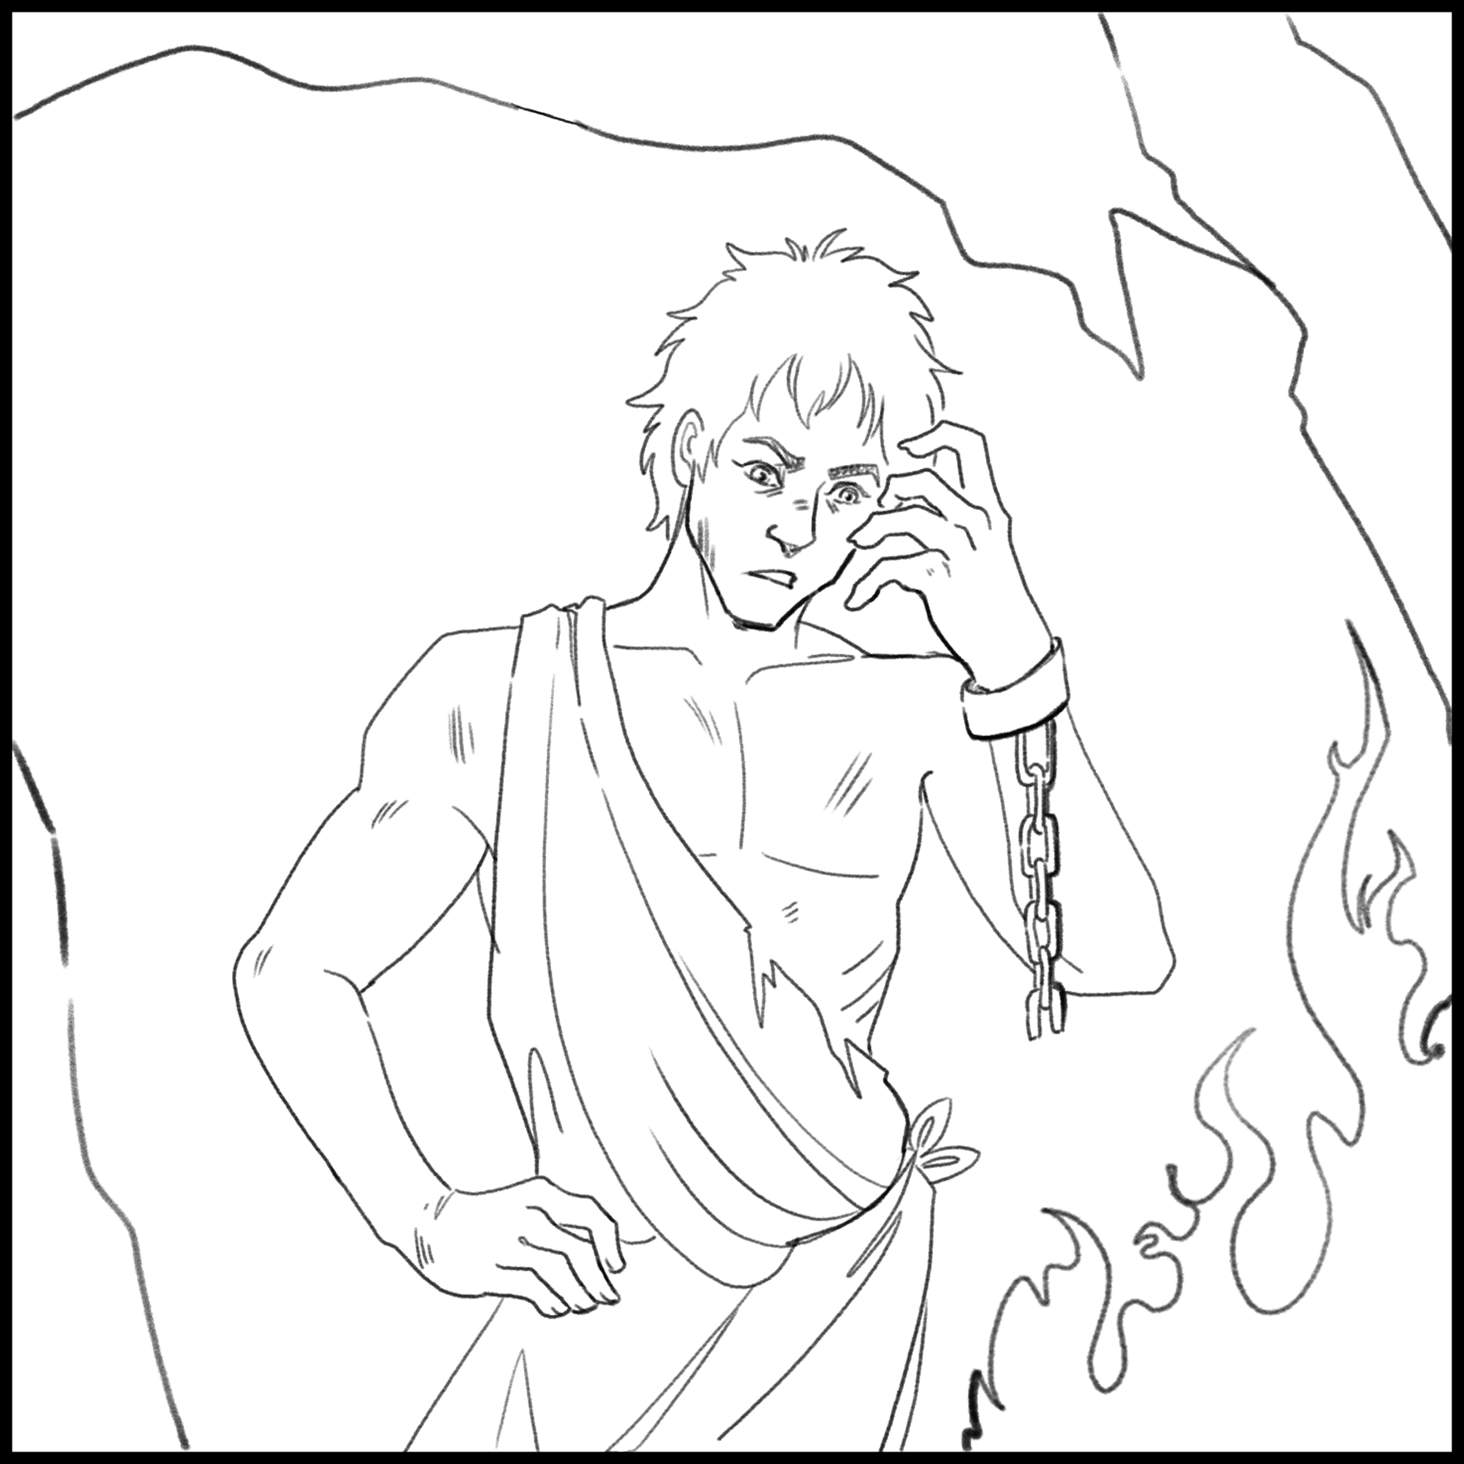
Allegorical Storyboard Preparation
Create a six-frame storyboard that tells a short story.
  A storyboard is a sequence of images with text, visually similar to a comic strip,
  that is used to summarize the
  key elements of a full story.
Use symbolic characters, objects,
and events to develop your allegory.
This is summarizing text.
This is summarizing text.
This is summarizing text.
This is summarizing text.
This is summarizing text.
This is summarizing text.

Slide 26
Storyboard: Sample
A group has been chained to face the cave wall their whole lives.
They believe the shadows from the fire are real because that’s all they have ever seen.
One prisoner is set free and is confused by the fire. What’s real: the objects or the shadows?

Slide 27
Storyboard Planning
Let’s make a plan!
Who is your audience?
What do you want your audience to understand?
How do you plan to visually tell your story?
What symbols do you plan to use? What do they each represent?

Slide 28
Storyboard: Reflection
On the back of your Storyboard, answer the following:
Which symbols did you include, and what does each symbol represent?
What is the theme of your allegory?
  Write this as a complete theme statement.
How do your symbols combine to convey the meaning of your allegory?

