Slide 1
Sweet and Savory Writing
English Language Arts

Slide 2
Essential Questions:
What makes writing appealing to a reader?
How can we, as writers, paint a picture in our readers’ minds?

Slide 3
Lesson Objectives:
Enhance your writing by:
Choosing precise words, including figurative language, that convey specific meaning and tone
Applying different methods of support, such as facts, reasons, examples, and sensory details

Slide 4
What’s in the Bag?
Grab a piece of paper and find a partner.
Get a brown paper bag with something in it.
Partner 1: describe what is in the bag (without looking at it) Partner 2: draw what is described.
Check to see if the drawing is accurate.
Trade bags with another pair.
Repeat the process with roles switched.
Notes:
Image Source: OpenClipart. (2014, March 6). Paper bag vector image. Free SVG. https://freesvg.org/paper-bag-vector-image

Slide 5
Think About It…
Visual imagery is an important part of descriptive writing.
How has this activity helped you visualize the object being described?
Notes:
Image Soucre: Dukesy68. (2016, May 27). Man scratching head. Wikimedia Commons. https://en.wikipedia.org/wiki/File:Man-scratching-head.gif

Slide 6
Sensory Details/Descriptive Language Rotation
Spend a few minutes at each station interacting with the objects.
For each object, fill out sensory details and descriptive words/phrases on your handout.

Slide 8
What Did You Come Up With?
Share out your descriptors and sensory details with the class.
As I fill in the class chart, add details to your own chart.

Slide 9
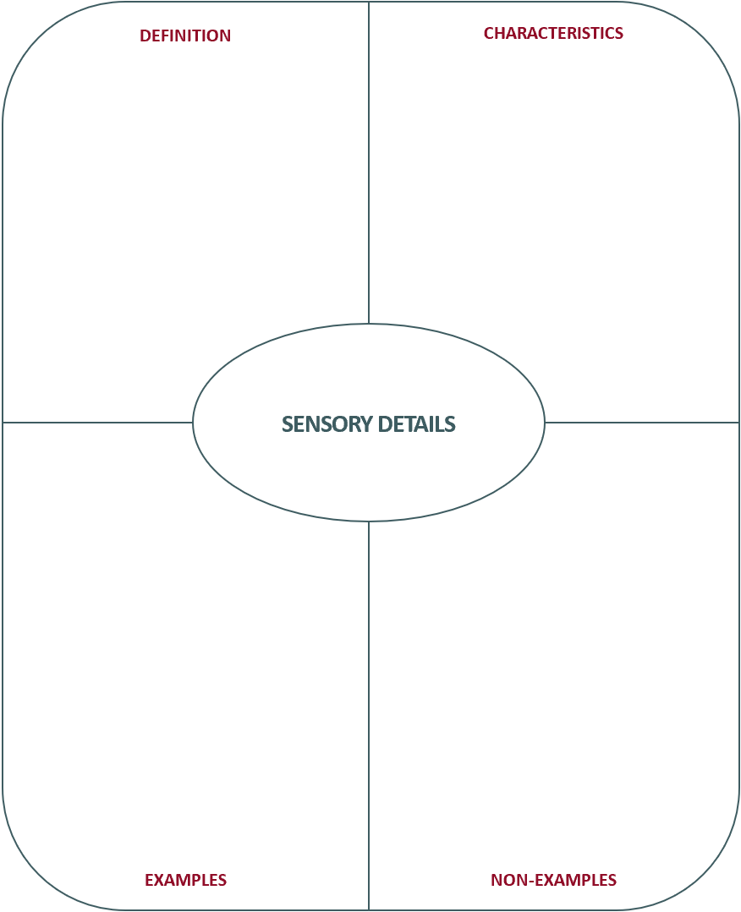
Frayer Model

Slide 10
Examples and Non-Examples
Work alone or with a partner to read and analyze the excerpts on your handout.
As you read:
Look for instances of descriptive and sensory language.
Rate the effectiveness of each excerpt regarding the use of descriptive and sensory language.
Rewrite weak examples (or non-examples) to make them more descriptive.

Slide 11
Excerpt 1
I like to go to the beach. There is a lot of sand and even some trees there. People play games on the beach, and some people like to swim. I used to go to the beach very often.
Notes:
Image Source: LillyCantabile. (n.d.). Beach, beach party, outdoor, free photo. Needpix.com. https://www.needpix.com/photo/1569433/beach-beach-party-outdoor-dancing-dance-sunny-island-coconut-trees-party

Slide 12
Excerpt 2
The sweet smell of sugar seems to call me in the evenings. The lure of its deliciousness is hard to resist. When the temptation is too much to handle, I tiptoe into the kitchen, past the judgmental eyes of the photos hanging on the wall, and over the cracking sounds of the hardwood floors. The sight of those beautifully rounded treats only increases the pounding of my heart and salivating in my mouth. “M” means mine; all mine! The taste of its succulent, melting goodness on my tongue causes all my senses to celebrate. Mmm, good!

Slide 13
Excerpt 3
As daylight breaks, restless winds sneak into my room causing little bumps to form on my arms. I have no choice but to wake from my dream. The bright reflection caused by the white, fluffy substance blanketing my backyard forces my eyes to squint, as I throw open the window curtains. Squeals and muffled laughter from the playful kids next door catch my attention. I rush down the stairs to put on my gear, and I run out into the bitter cold to join them. But after playing for an hour, I’m persuaded to come back inside. The brisk air that grabs at my lungs, and the numbness of my toes in my boots have won. But the delicious aroma of Mom’s hot chocolate comforts me. It is soothingly warm as it melts down my throat and tastes like heaven on my lips.

Slide 14
Excerpt 4
The weather outside is changing now that fall is here.

Slide 15
Now It’s Your Turn To Write!
Choose a type of writing: poem, narrative, descriptive short story, etc.
Brainstorm sensory details.
Write a rough draft.
Trade your writing with a partner.
After receiving feedback from your partner, revise your writing to create a final draft.

Slide 16
Share Out
As your classmates share, listen and take note of the descriptive and sensory language.
What did you notice?

Slide 17
Draw What You Hear
Draw images to show what you hear in the descriptive writing as your classmates share out.
Notes:
Image Source: OpenClipart. (2016, January 28). Hand holding pencil. Free SVG. https://freesvg.org/hand-holding-pencil

Slide 18
Before You Submit
Take the opportunity to color-code the descriptive writing in your final draft.
Sight
Sound
Touch
Smell
Taste
Notes:
Image Source: Shani77. (n.d.). Highlighter icons, highlighter, highlight, free photo. Needpix.com. https://www.needpix.com/photo/1709642/highlighter-icons-highlighter-highlight-color-highlighter-icons-highlighter-symbol-marker-icon-marker-yellow

