Slide 2
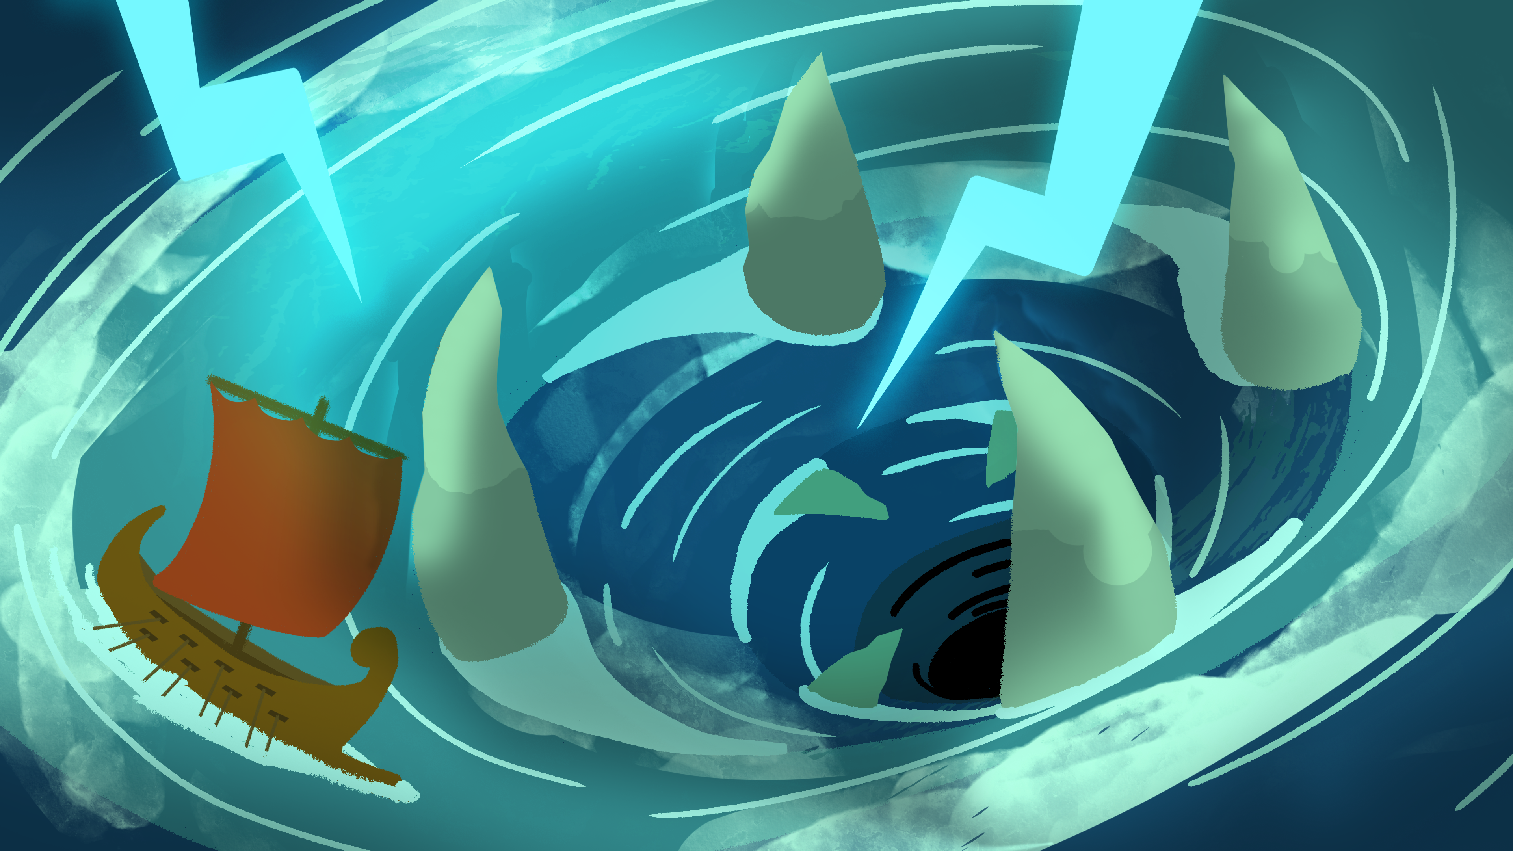
Twists and Turns
Weaving a Foundation for The Odyssey

Slide 3

Caption This
View the image.
Create a funny or clever caption for the image.
Add your caption below the image in your group’s color.
Notes:
K20 Center. (n.d.). Caption this. Strategies. https://learn.k20center.ou.edu/strategy/82

Slide 4
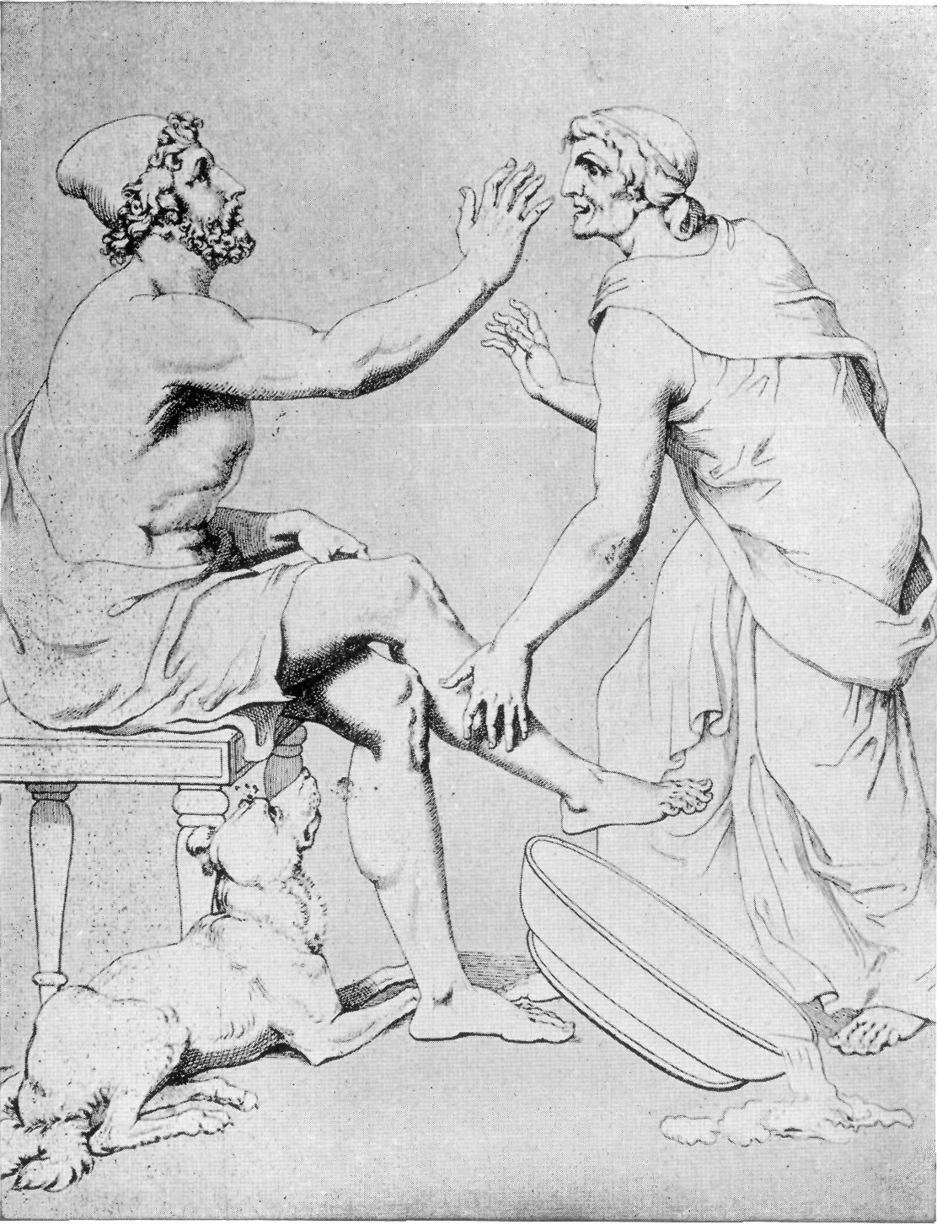
Caption This
Example captions:
  “Talk to the hand!”
  “Are you pulling my leg, bro?”
  Dog: “Hey, watch my bowl!”
Notes:
K20 Center. (n.d.). Caption this. Strategies. https://learn.k20center.ou.edu/strategy/82

Slide 5
Caption This
Walk around and read the captions
Choose your favorite caption and mark it with a sticker or a star.
Notes:
K20 Center. (n.d.). Caption this. Strategies. https://learn.k20center.ou.edu/strategy/82

Slide 6
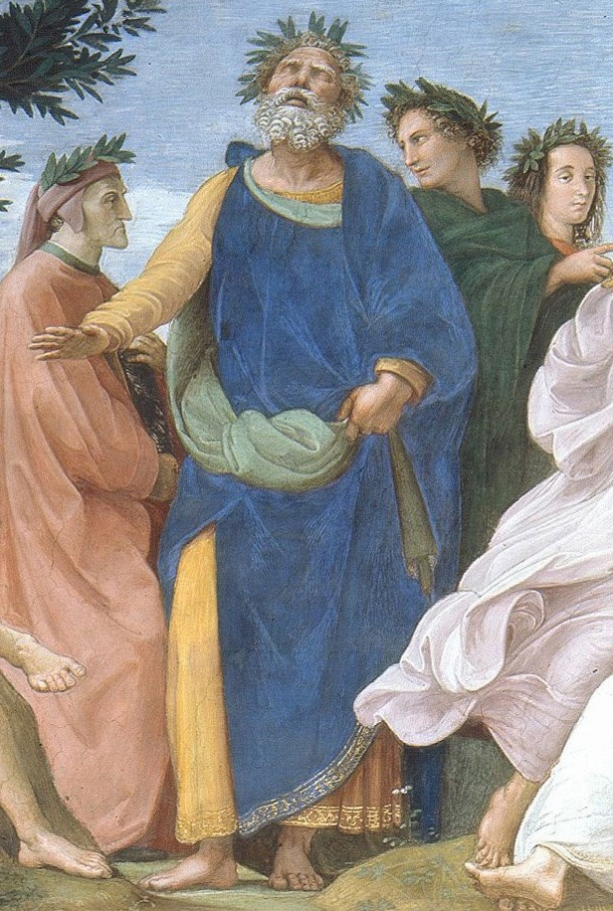
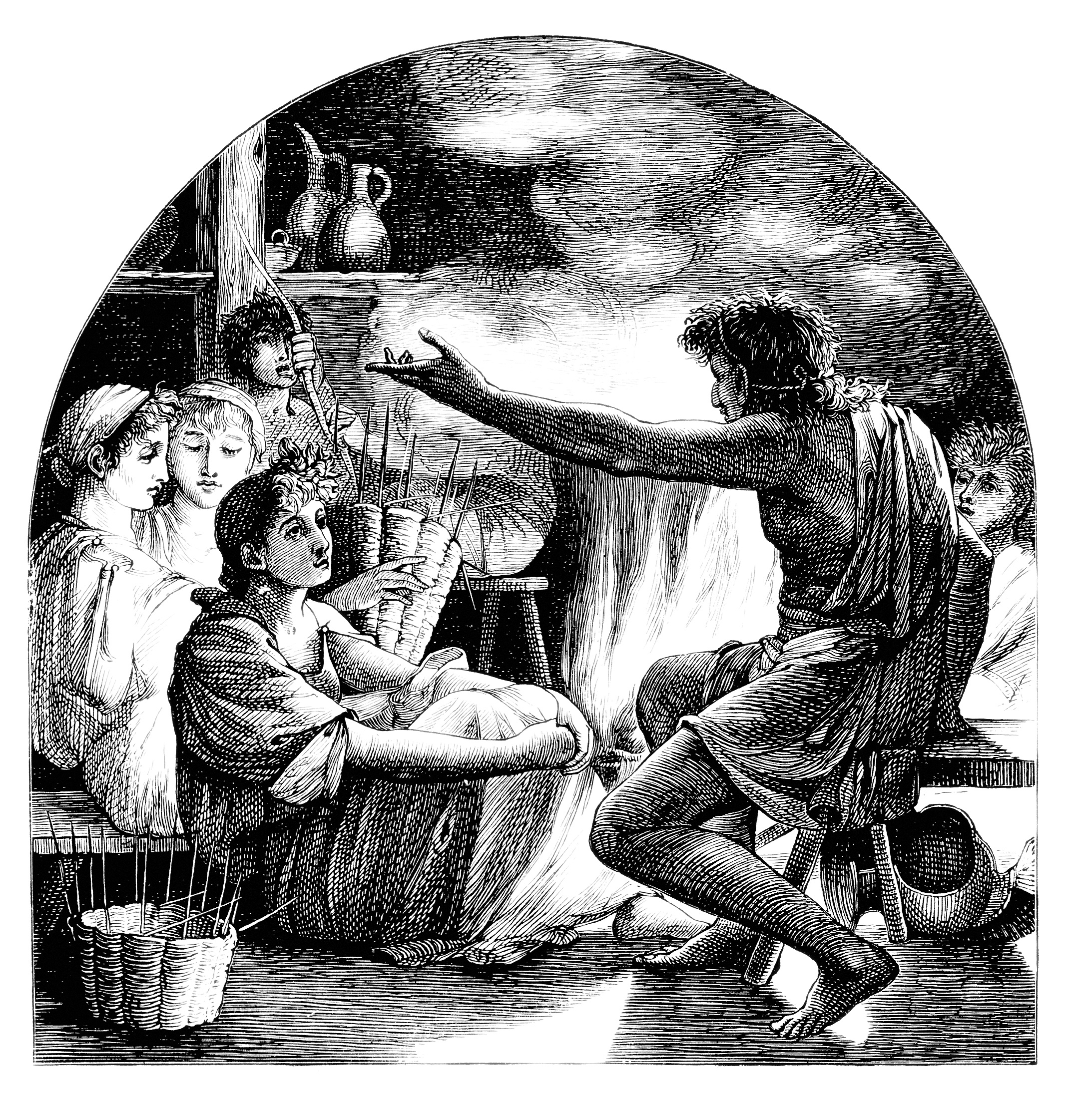
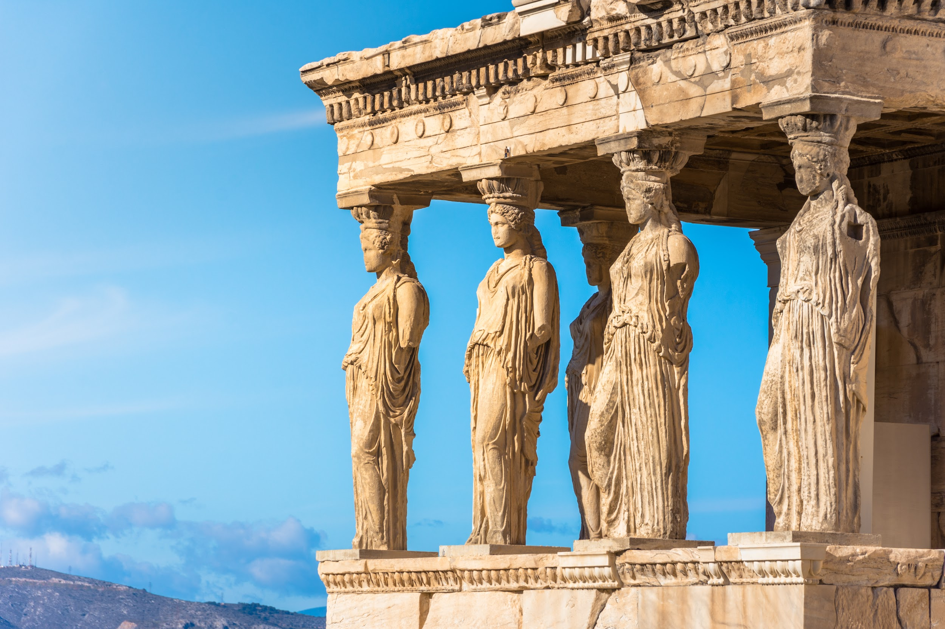
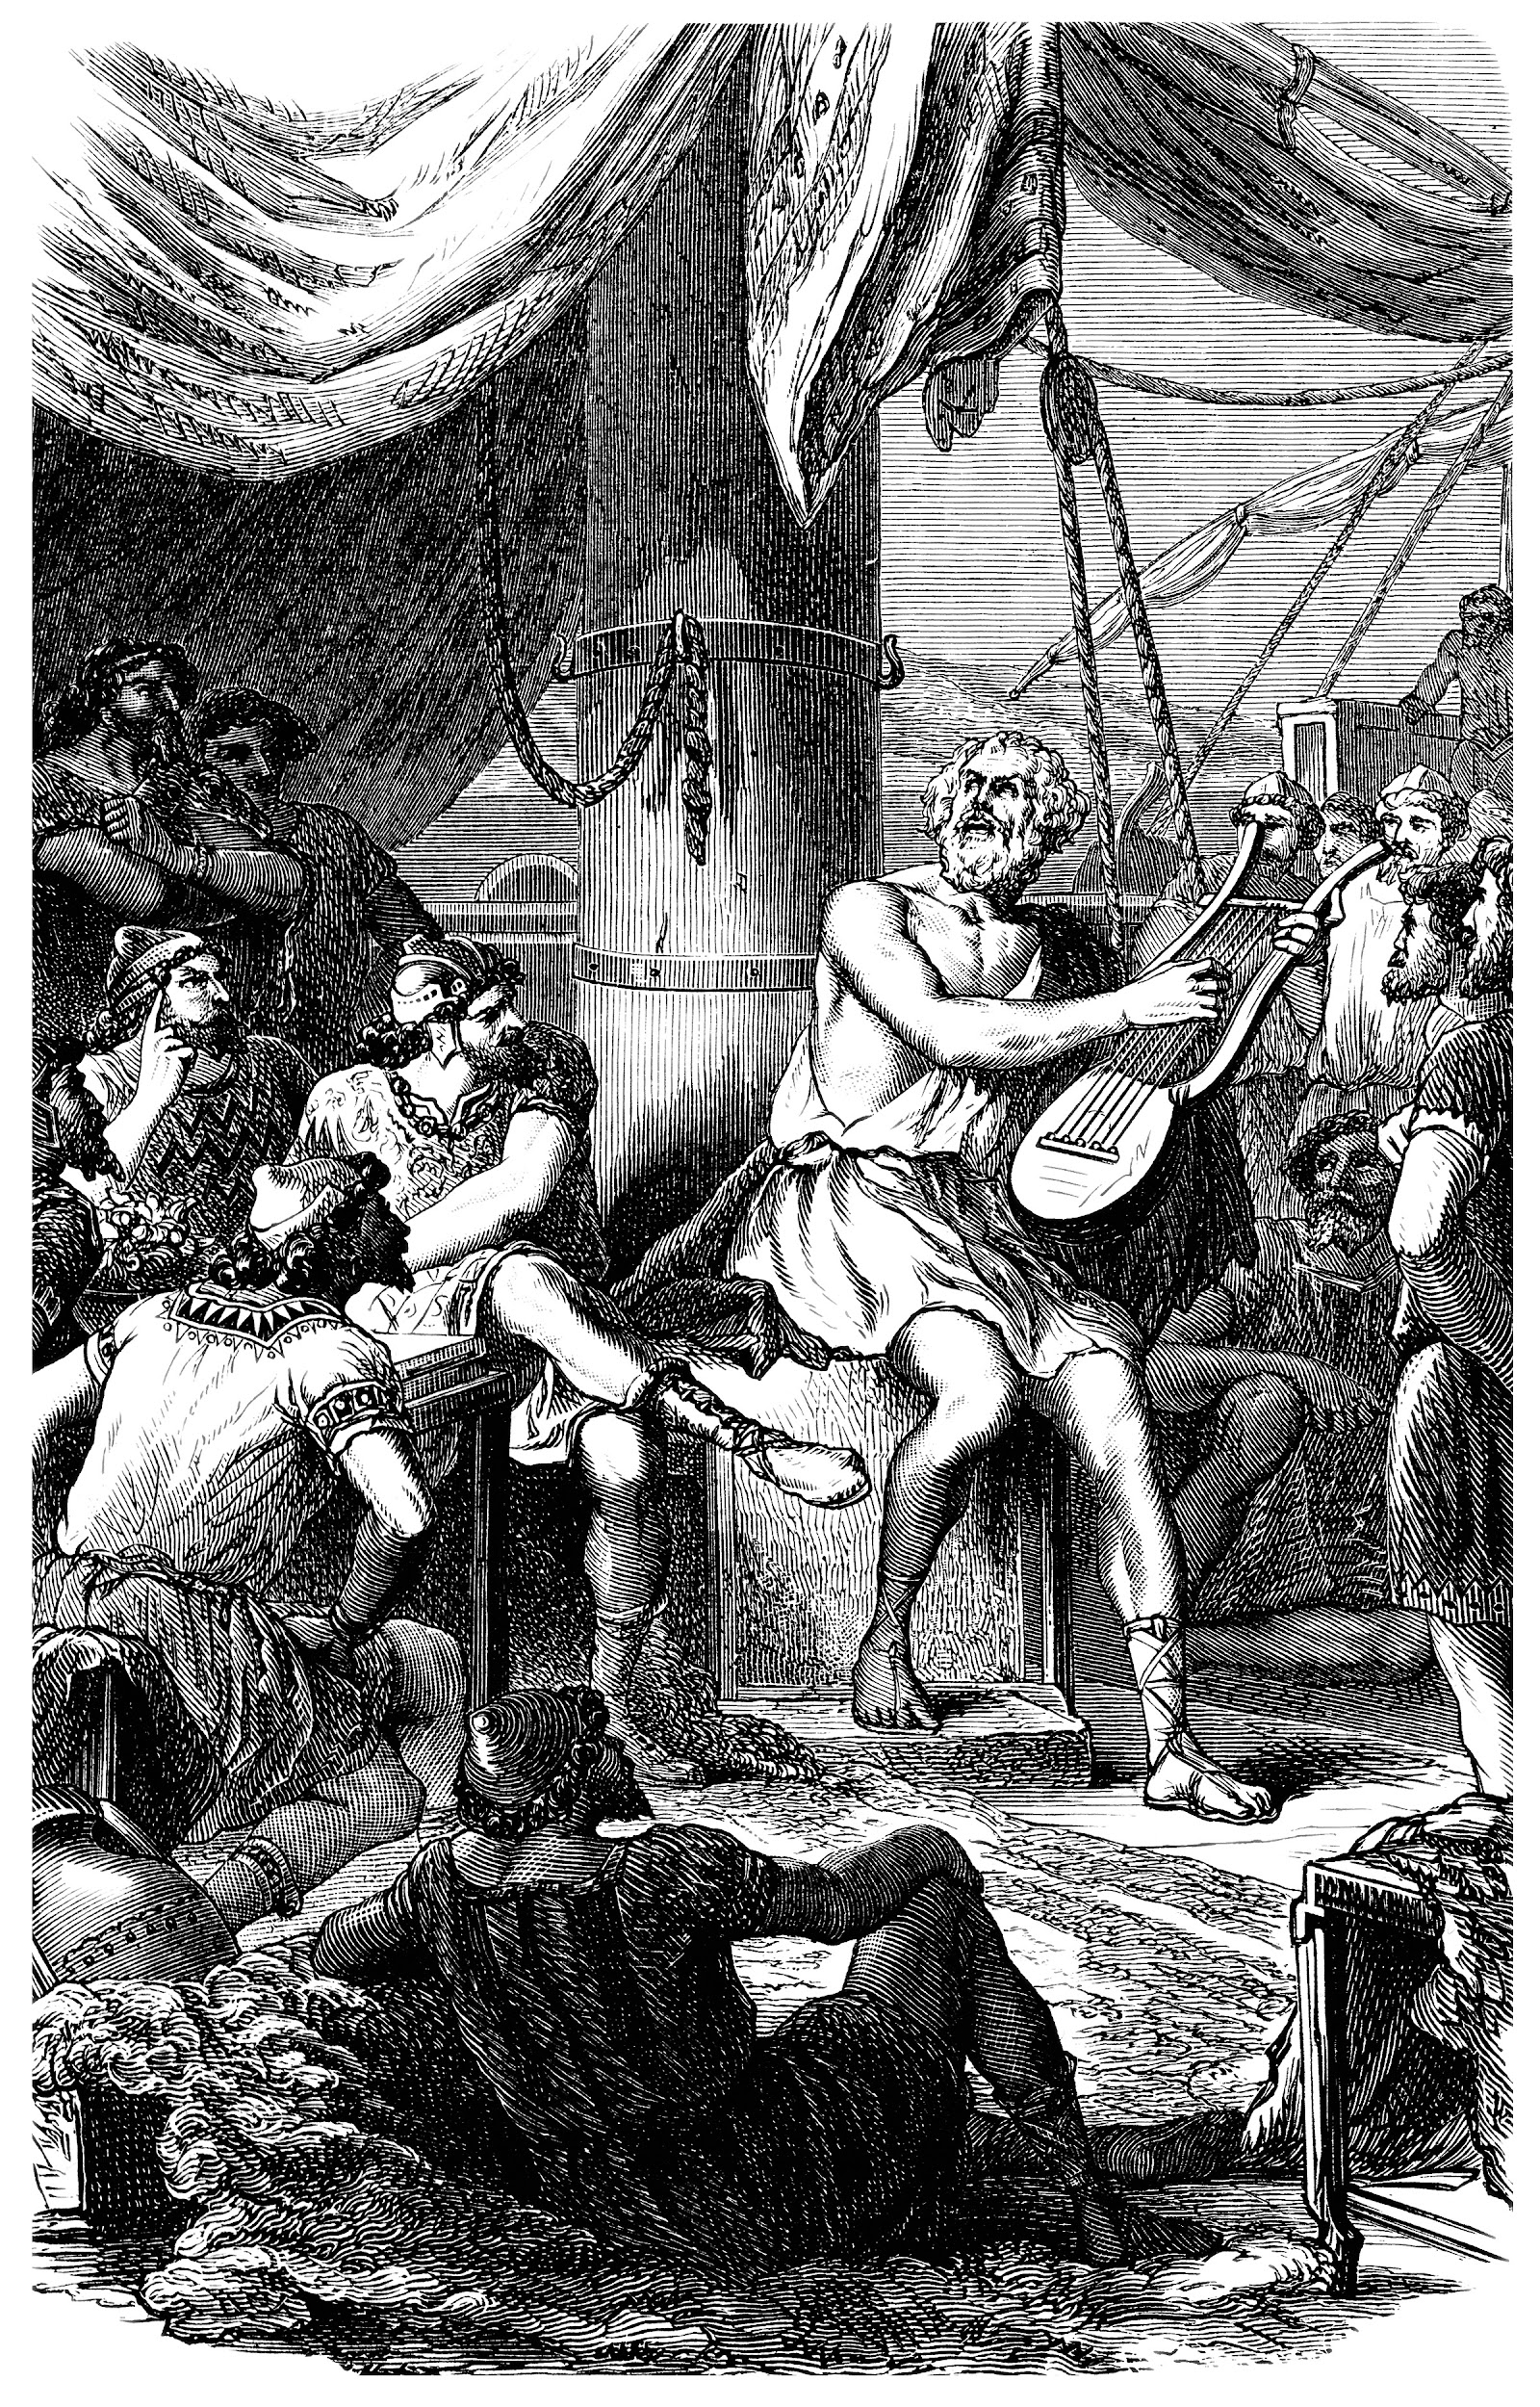
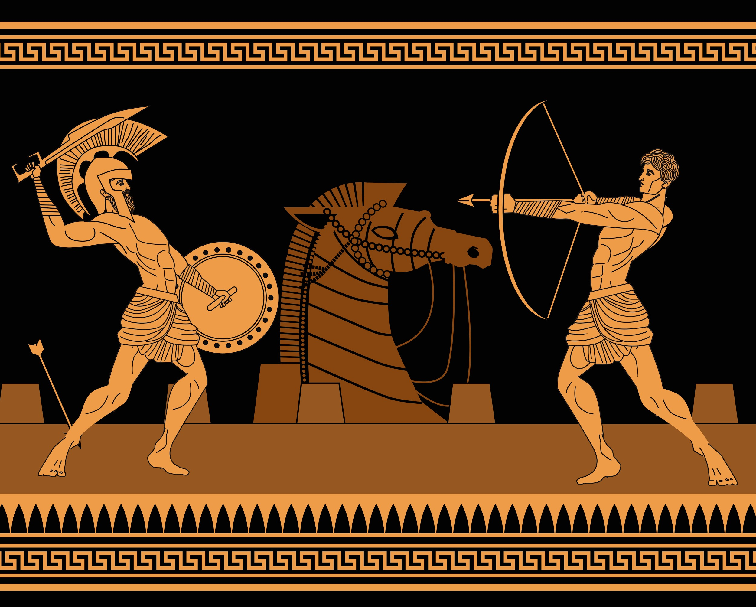
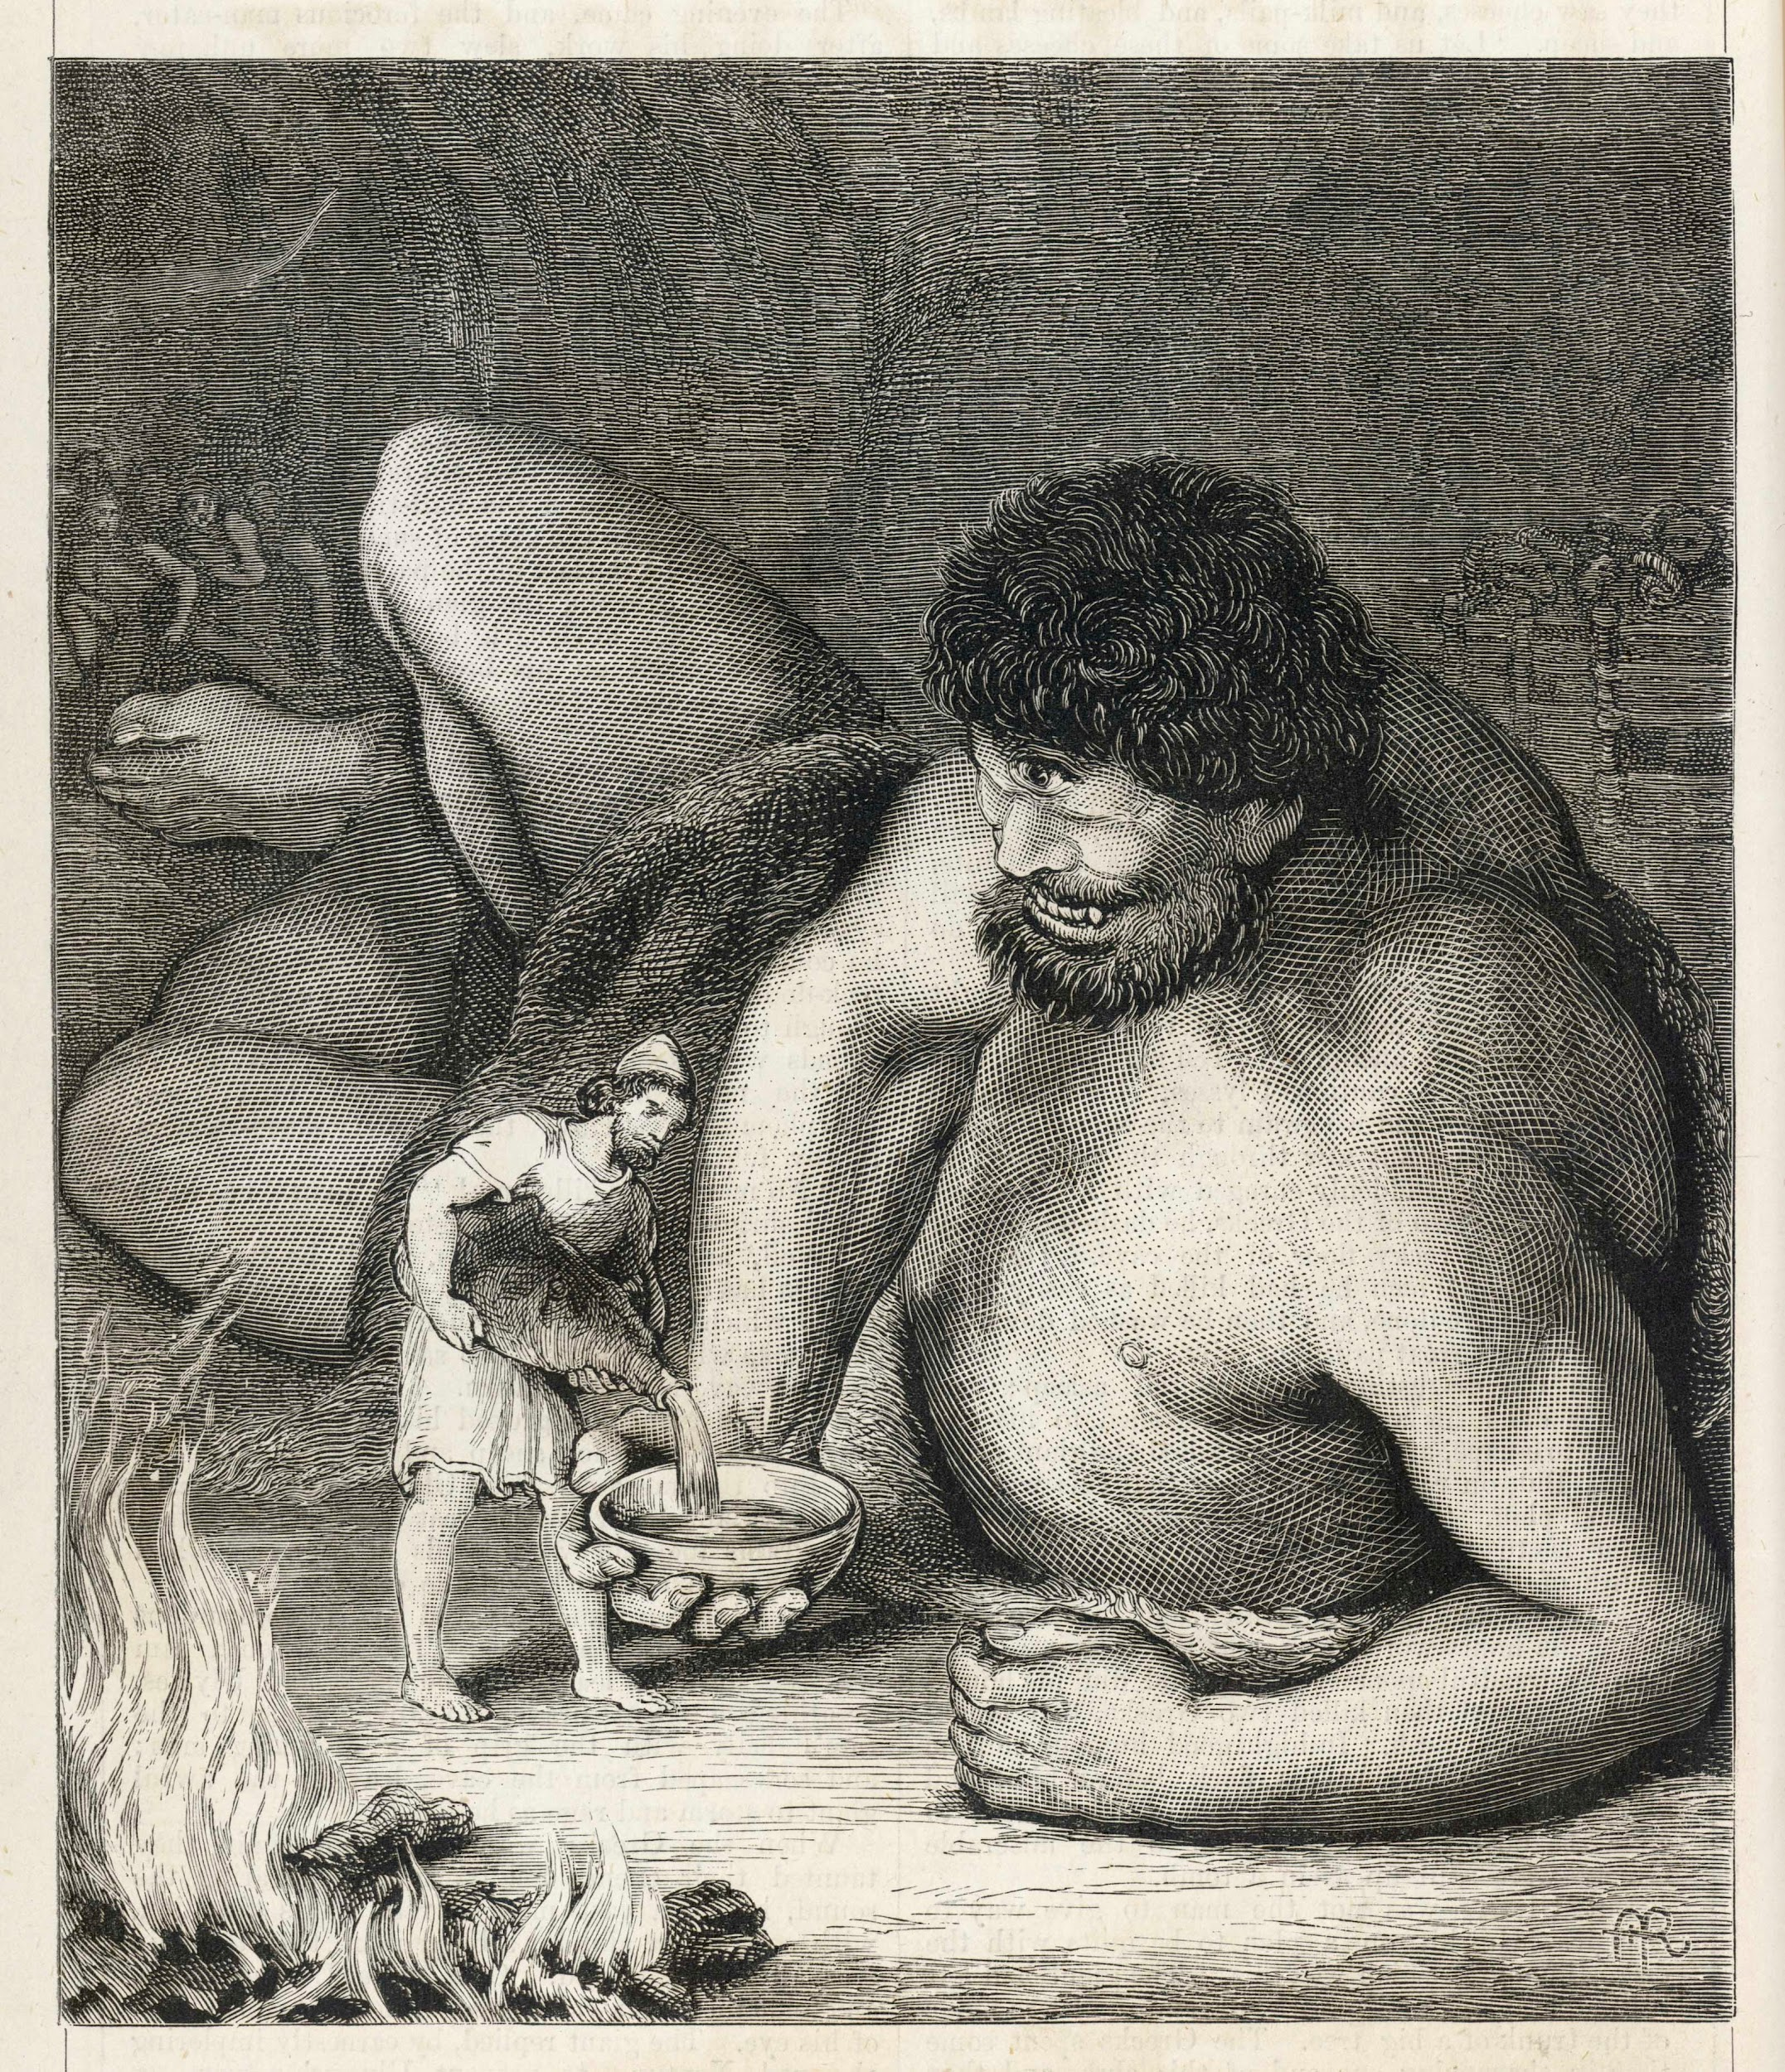
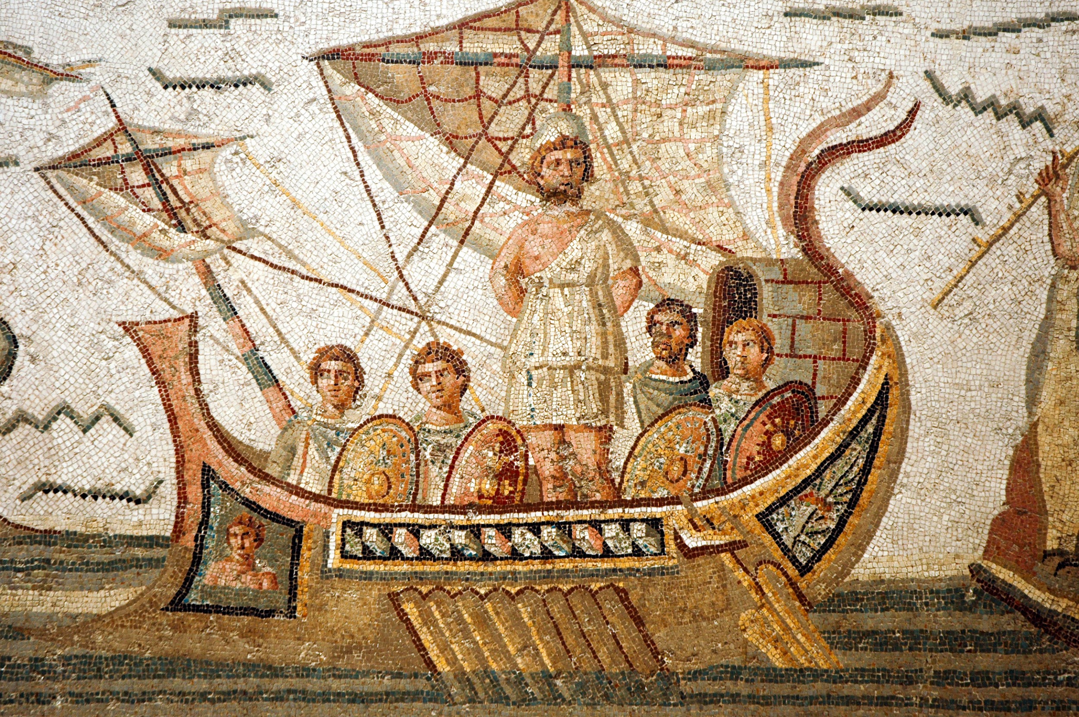
Caption This
Notes:
Archivist. (n.d.). Odyssey - Polyphemus [Image]. Adobe Stock. https://stock.adobe.com/images/odyssey-polyphemus/162342057
Fotokon. (n.d.). Mosaic scene from Homer’s Odyssey in Bardo Museum, Tunisia [Image]. Adobe Stock. https://stock.adobe.com/images/mosaic-scene-from-homer-s-odyssey-in-bardo-museum-tunisia/41470645?prev_url=detail
Guilane-Nachez, E. (n.d.). Antiquity: Story-teller - conteur [Image]. Adobe Stock. https://stock.adobe.com/images/antiquity-story-teller-conteur/44888883
Guilane-Nachez, E. (n.d.). Ancient Greece: Homer (Homère) [Image]. Adobe Stock. https://stock.adobe.com/images/ancient-greece-homer-homere/52892281
gatsi. (n.d.). Karyatides statues, Erehtheio, on the Acropolis in Athens, Greece [Image]. Adobe Stock. https://stock.adobe.com/images/karyatides-statues-erehtheio-on-the-acropolis-in-athens-greece/186420010
Matiasdelcarmine. (n.d.). Orange and black figures pottery amphora painting of troy war with achilles fighting [Image]. Adobe Stock. https://stock.adobe.com/images/orange-and-black-figures-pottery-amphora-painting-of-troy-war-with-achilles-fighting/365530055
Sanzio da Urbino, R. (1509–1510). The Parnassus [Painting]. Wikipedia. https://en.wikipedia.org/wiki/Homer#/media/File:Cropped_image_of_Homer_from_Raphael%27s_Parnassus.jpg

Slide 7
Objectives
Investigate the cultural, historical, and literary contexts of The Odyssey.
Make connections between elements of ancient Greek culture and The Odyssey.

Slide 8
Essential Question
What connections can we make between the values, beliefs, and traditions of ancient Greek society and the characters and themes in The Odyssey?

Slide 9
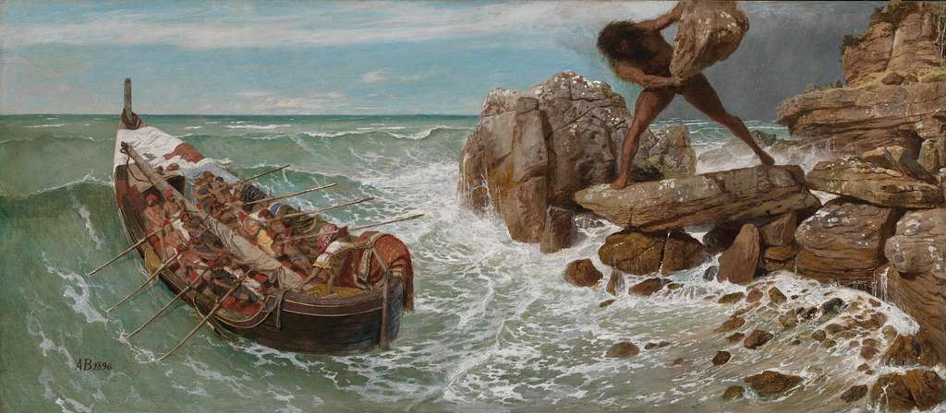
Introducing The Odyssey
Notes:
Böcklin, A. (1896). Odysseus und Polyphemus [Painting]. Wikipedia. https://en.wikipedia.org/wiki/Odysseus_and_Polyphemus_(B%C3%B6cklin)#/media/File:Arnold_B%C3%B6cklin_-_Odysseus_und_Polyphemus_(1896).jpg

Slide 10

Anchor Charts
A visual guide that helps communicate key ideas and concepts. These posters should:
  Be visually appealing and easy to follow
  Include illustrations that communicate the ideas
  Be easy to read and understand
Notes:
K20 Center. (n.d.). Anchor charts. Strategies. https://learn.k20center.ou.edu/strategy/58

Slide 11
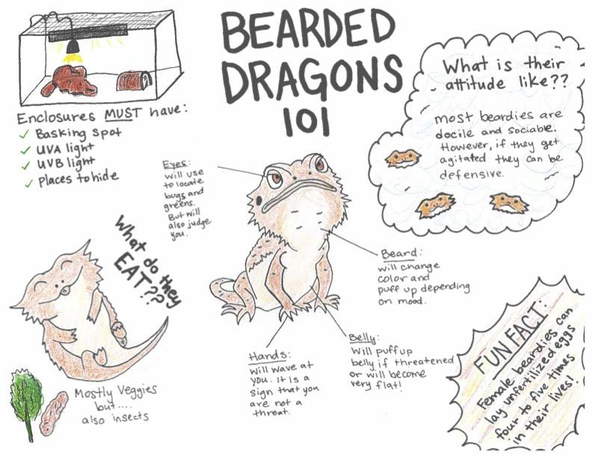
Anchor Chart Example
Notes:
K20 Center. (n.d.). Anchor charts. Strategies. https://learn.k20center.ou.edu/strategy/58

Slide 12
Anchor Charts
Work with your group to find the information on your research card.
Include images as instructed.
Make sure your chart is easy to read and visually appealing.
Notes:
K20 Center. (n.d.). Anchor charts. Strategies. https://learn.k20center.ou.edu/strategy/58

Slide 13
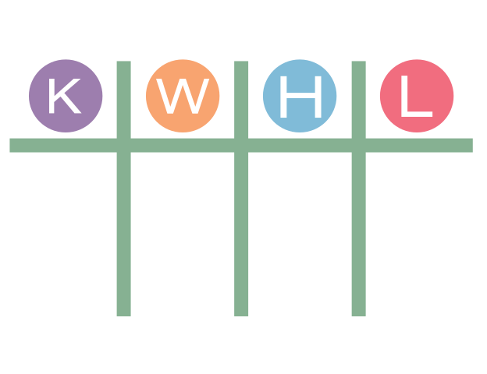
K-W-L
Work on your own organizer. For each poster:
  First, read the title/topic only and fill out the “K” column.
  Then, read all the information on the poster.
  Finally, fill out the “W” and “L” columns.
When you have finished, move on to another poster.
Notes:
K20 Center. (n.d.). KWHL graphic organizer. Strategies. https://learn.k20center.ou.edu/strategy/127

Slide 14

K20 Timer
Notes:
https://www.youtube.com/watch?v=m3zT2IxZQaw

Slide 15
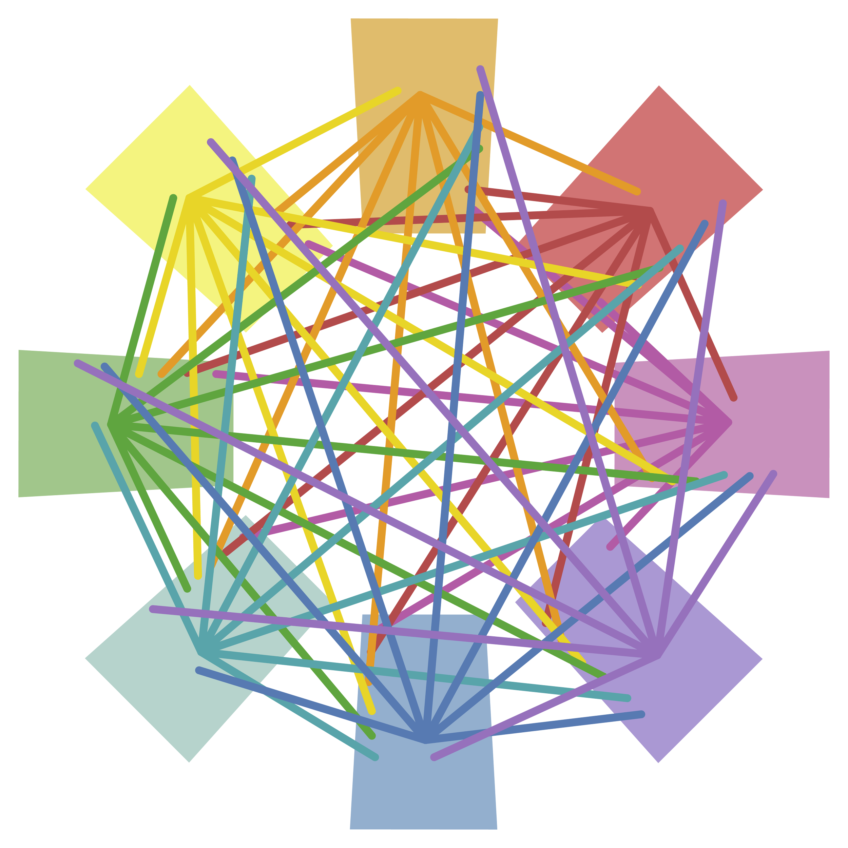
Detective Board
Discuss connections group members remember from reading the posters. Revisit posters as needed.
When you’ve identified a connection, use your group’s yarn to connect the points, taping the yarn to each poster.
Make at least one connection per group member.
Notes:
K20 Center. (n.d.). Detective board. Strategies. https://learn.k20center.ou.edu/strategy/3530

Slide 16
Detective Board
Connections to look for:
  A might have led to/inspired B.
  A and B are similar or have similar themes.
  People/characters/places that appear multiple times.
  Traditions or customs that influence stories, characters, etc.
Notes:
K20 Center. (n.d.). Detective board. Strategies. https://learn.k20center.ou.edu/strategy/3530

Slide 17
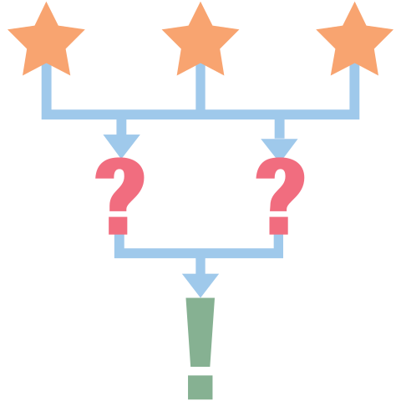
3-2-1
On your own paper, write down:
  3 things you learned from the lesson
  2 questions you still have
  1 thing you found the most interesting
Notes:
K20 Center. (n.d.). 3-2-1. Strategies. https://learn.k20center.ou.edu/strategy/117

