Slide 2
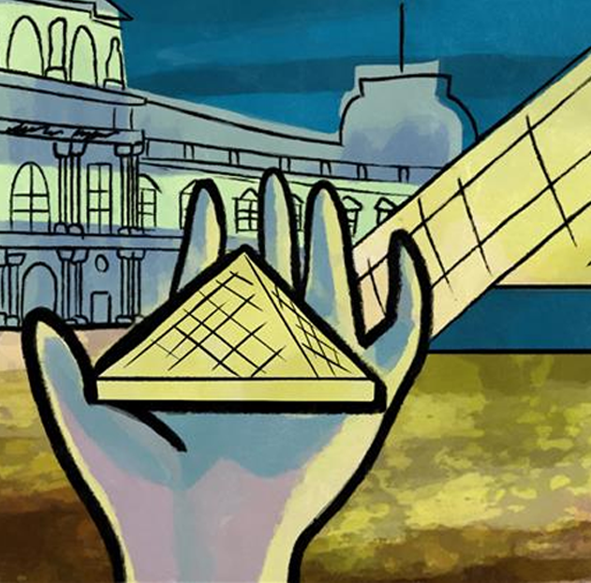
Scaling the Skyline
Similar 3D Shapes

Slide 3
Essential Question
How can we compare and measure similar 3D figures?

Slide 4
Lesson Objectives
Discover how the measurements of similar 3D figures relate.
Use the measurements of similar 3D figures to solve problems.

Slide 5
Would You Rather…
Read each question and move to one side of the room to indicate your preference. Discuss your reasons with those on the same side and choose a speaker to explain to the class.

Slide 6
Would You Rather…
Have the ability to fly, or be invisible?

Slide 7
Would You Rather…
Have a lazy day at home, or an adventurous day out?

Slide 8
Would You Rather…
Live without the Internet, or
without air conditioning?

Slide 9
Would You Rather…
Buy two 5-inch pizzas for $10,
or one 10-inch pizza for $20?

Slide 10
Similar vs. Congruent
Congruent figures are identical in shape and size.
Similar figures have the same shape and proportional sizes.

Slide 11
Investigating Similar Figures
Navigate to the GeoGebra Activity at: https://k20.ou.edu/df.
Use the tools to measure the sides of the shapes, find the surface area and volume, and record your findings.
Fill out the rest of the table and answer the reflection questions.
Notes:
K20 Center. (n.d.). GeoGebra. Tech Tools. https://learn.k20center.ou.edu/tech-tool/2352

Slide 12
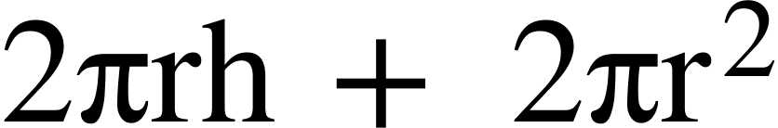
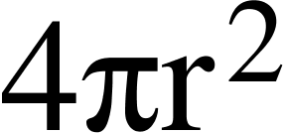
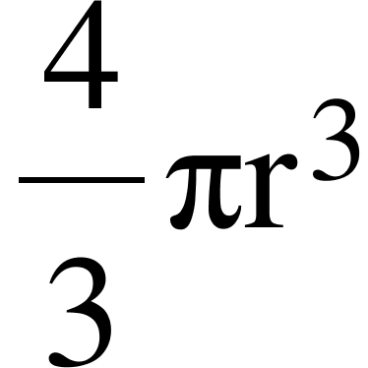
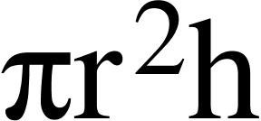
Useful Formulas
Cylinders
Surface Area =
Volume =
Spheres
Surface Area =
Volume =

Slide 13
Reflection
How did you know that all of the cylinders (or all of the spheres) were similar to each other?
What do you notice about the ratios of the length (radius, height) as compared to the ratios of the surface areas? Why do you think this happens?

Slide 14
Reflection
What do you notice about the ratios of the length (radius, height) as compared to the ratios of the volume? Why do you think this happens?
If you were to multiply the radius of a sphere by 4, what would you multiply the surface area by? What would you multiply the volume by?

Slide 15
What’s the Rule?
Find another group and discuss your answers to the reflection questions. Work together to write a rule for how the ratios of similar figures change from perimeter to area to volume.

Slide 16
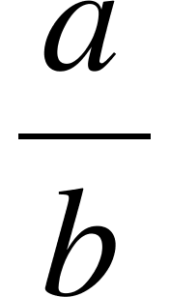
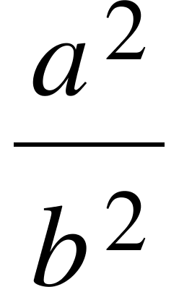
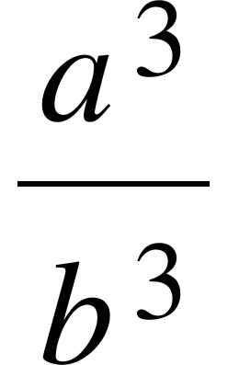
What’s the Rule?
If the ratio of the sides of two similar figures is then:
  The ratio of their perimeters is:
  The ratio of their areas is:
  The ratio of their volumes is:
Notes:
Click or advance the slide to reveal each answer individually.

Slide 17
Example 1
The first square has an area of 6 cm², and the length of the second square is twice as large. What is the area of the second square?

Slide 18
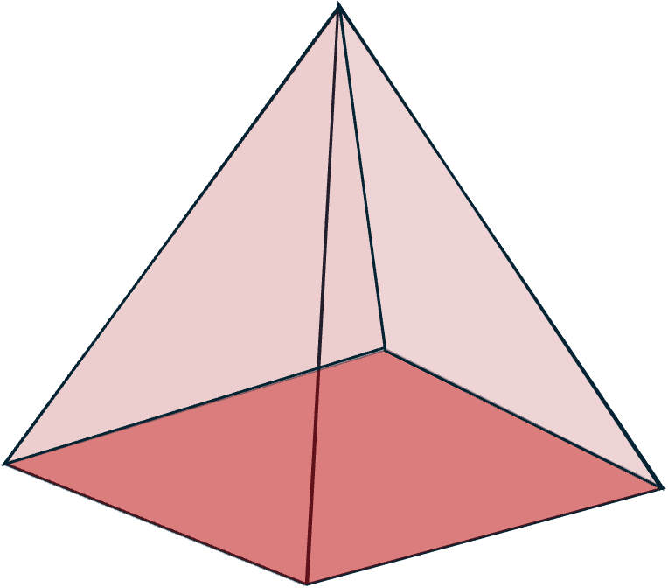
Example 2
You are given two similar square pyramids. One has a volume of 108 in³ and the height of the other is three times shorter. What is the volume of the smaller pyramid?

Slide 19
Example 3
The surface area of Cube A is 52 mm² and the surface area of Cube B is 13 mm² . What is the ratio of their volumes (A:B) ?

Slide 20
Bonus Question
Can you name two common 3-dimensional shapes that are always similar to every other shape of the same name? Why are they always similar?

Slide 21
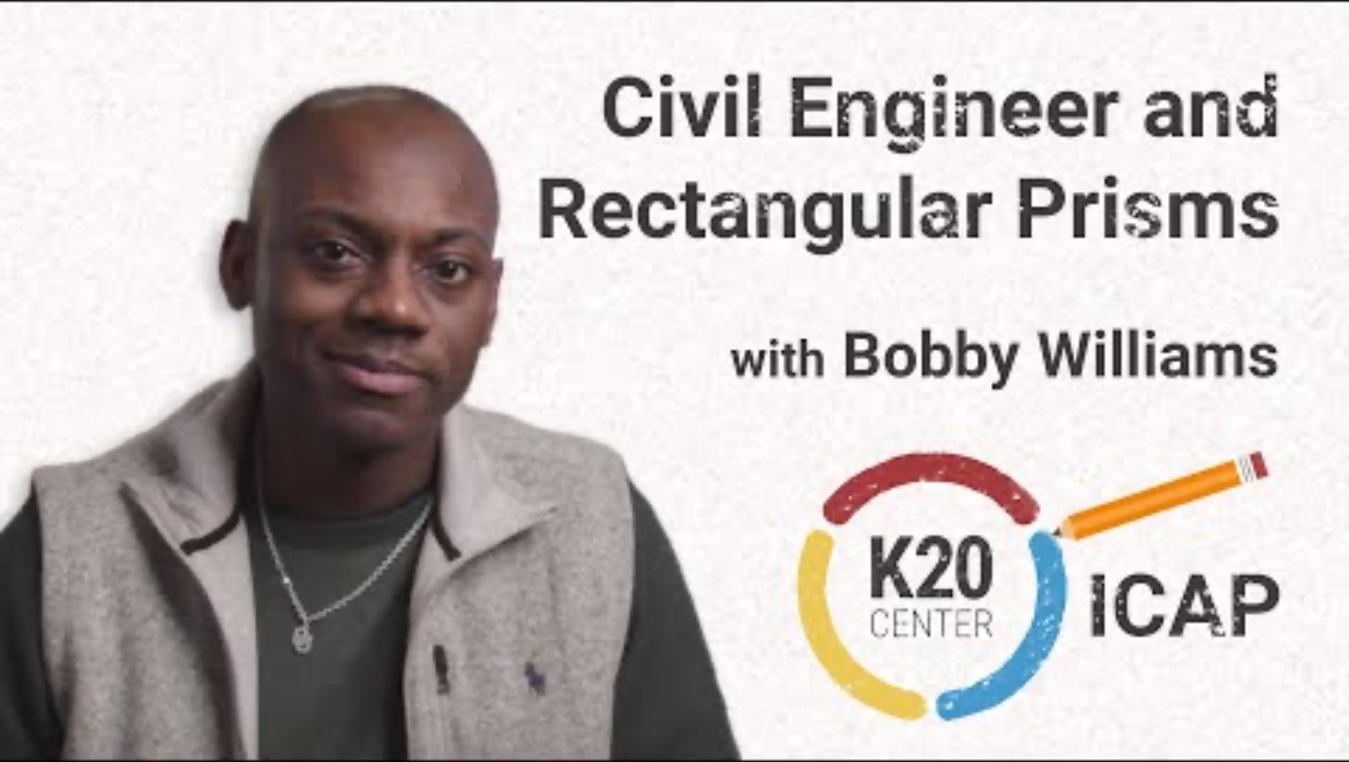
Civil Engineer and Rectangular Prisms
Notes:
K20 Center. (2024). Civil Engineer and Rectangular Prisms [Video file]. https://www.youtube.com/watch?v=qrQ2Mrg6Vg0

Slide 22
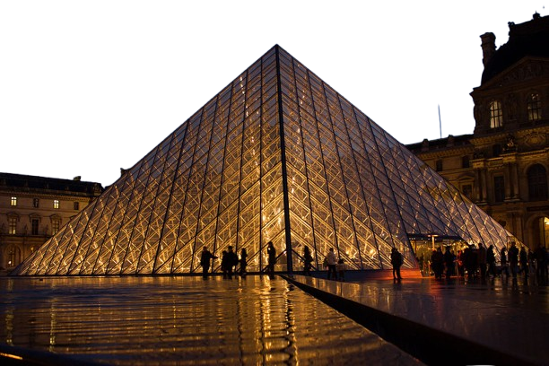
You’re the Engineer
You’re a civil engineer who has been asked to design and build a new building. The client has told you they want the building to be modeled after the Louvre in Paris, but three times bigger. Submit a proposal with details about the building and the cost involved.
Notes:
Wikimedia Foundation. (2025, December 18). Louvre Pyramid. Wikipedia. https://en.wikipedia.org/wiki/Louvre_Pyramid

Slide 23

Exit Ticket
Answer the question on your exit ticket. Show the work that led to your answer.
Notes:
K20 Center. (n.d.). Bell ringers and exit tickets. Strategies. https://learn.k20center.ou.edu/strategy/125

