Slide 2
Trees in the Wind
Growth and Development of Organisms

Slide 3
Essential Question
How does the environment influence plant growth and development?

Slide 4
Lesson Objective
Use evidence and scientific thinking to explain how certain animal behaviors and plant parts help them reproduce successfully.

Slide 5

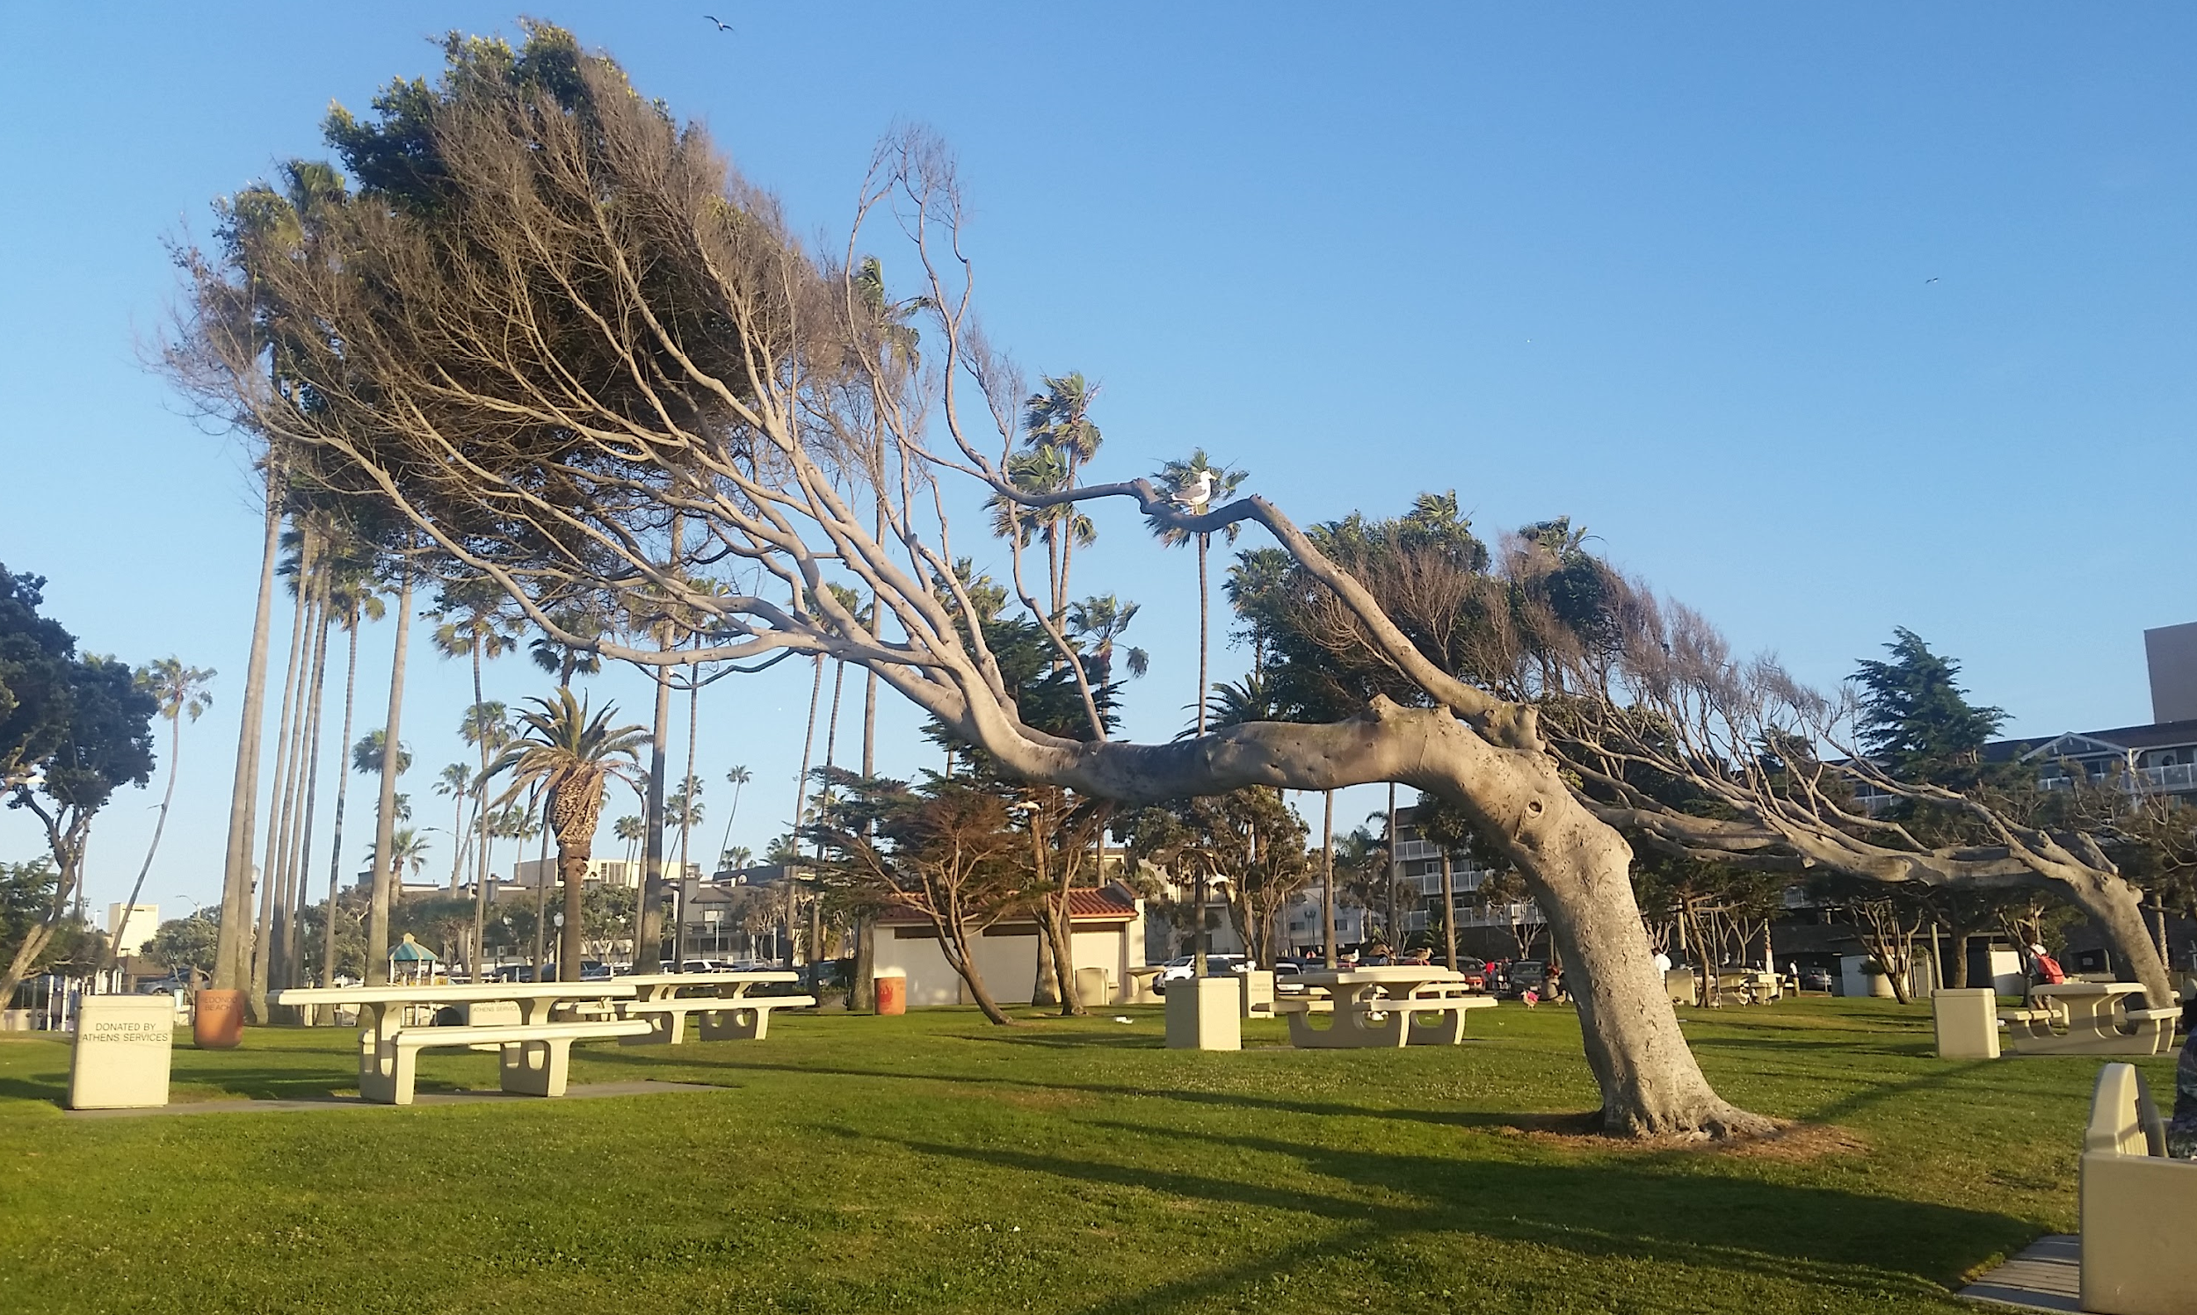
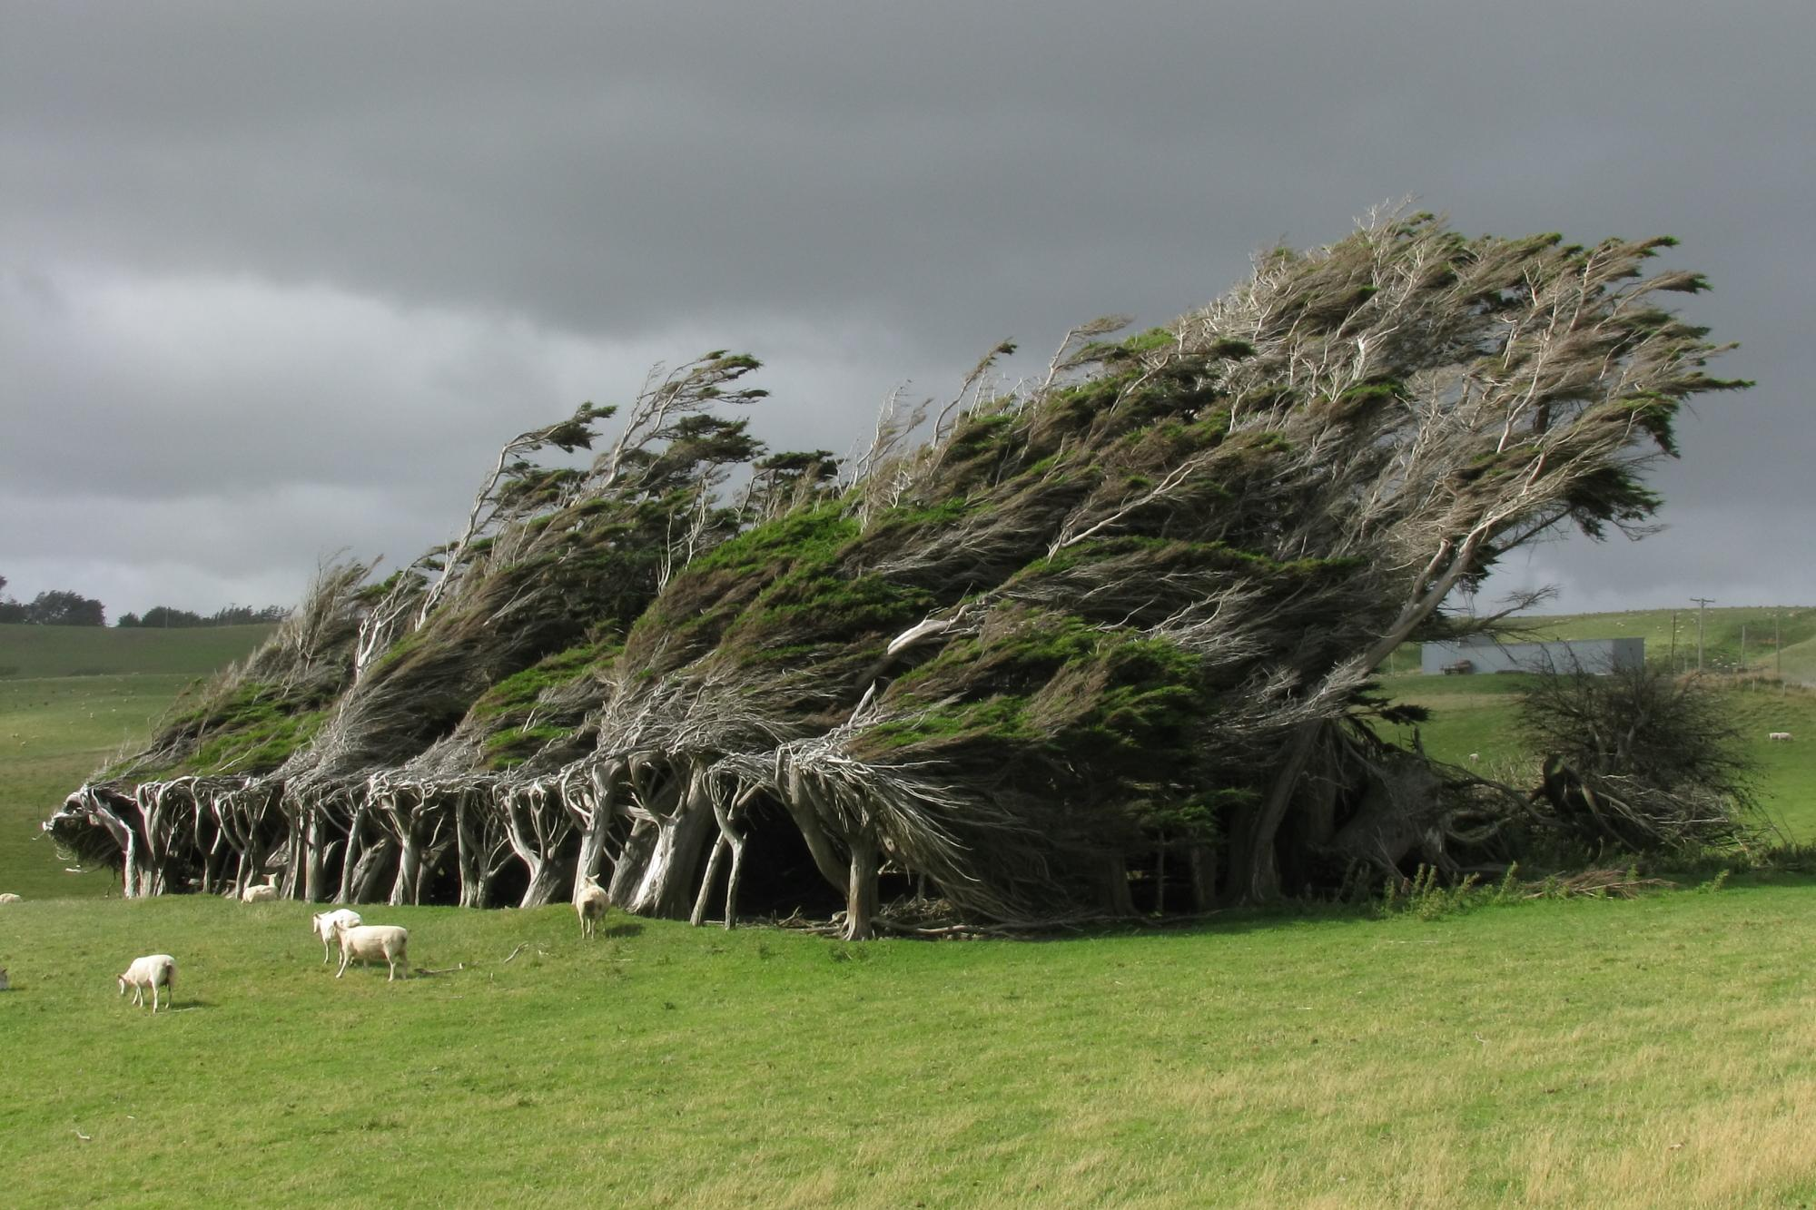
I Notice, I Wonder
Notes:
K20 Center. (n.d.). I notice, I wonder. Strategies. https://learn.k20center.ou.edu/strategy/180

Slide 6
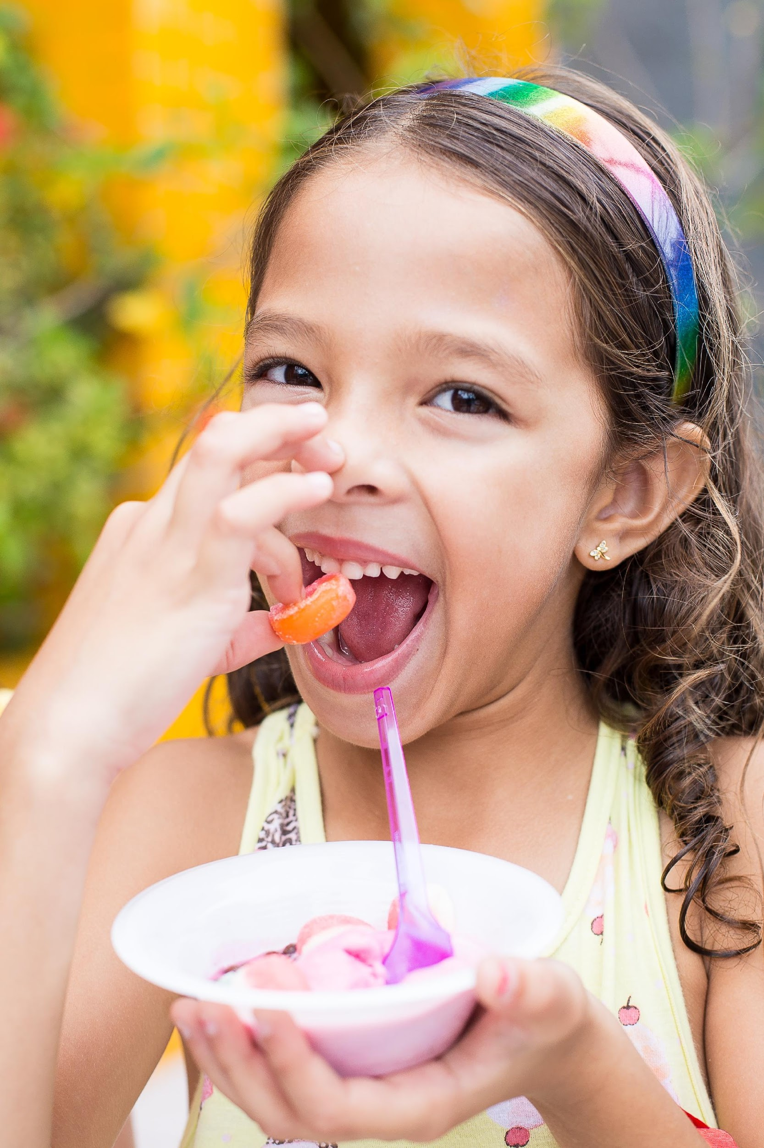
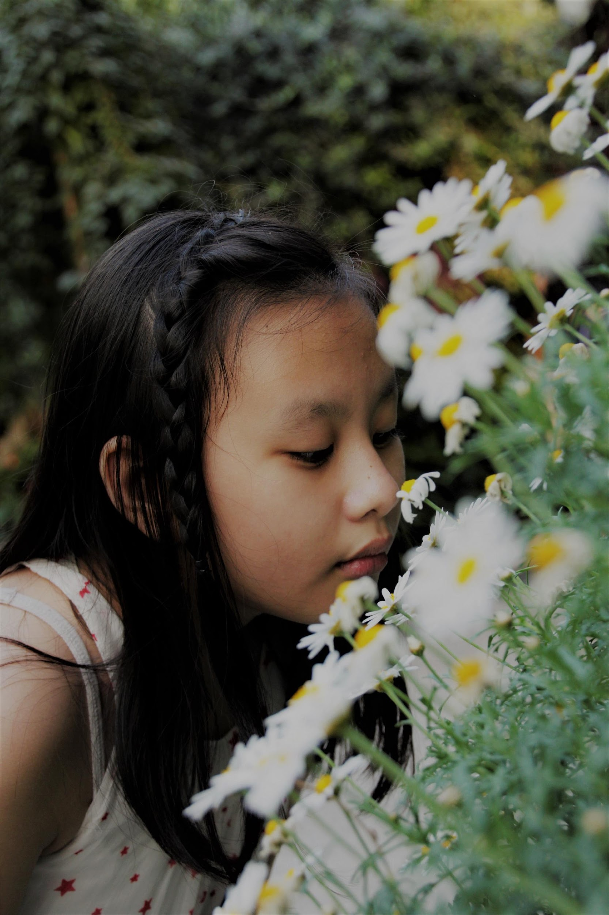

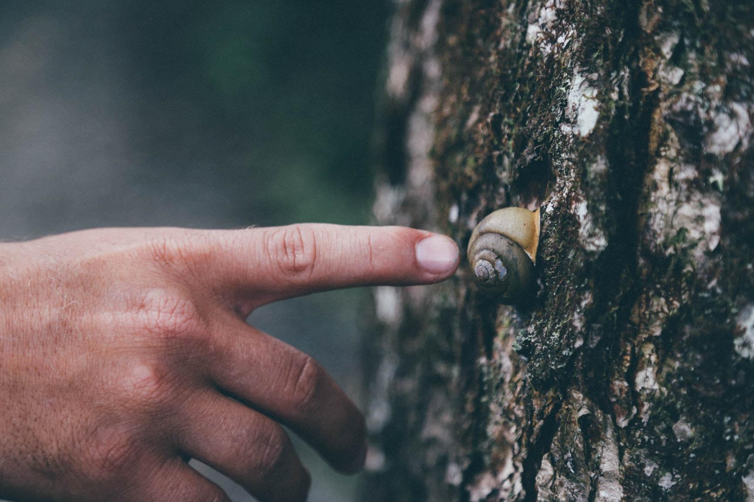

Are you sure you know what caused that?
Observations
Inferences
Descriptions of events or objects based on our five senses
Conclusions we make based on observations, reasoning, and other things we already know
Notes:
Photo by Patricia Prudente on Unsplash: https://unsplash.com/photos/LqaLgCnnh3Y
Photo by Henry Be on Unsplash: https://unsplash.com/photos/bAFiBDMeiVI
Photo by Aung Soe Min on Unsplash: https://unsplash.com/photos/BU8VGYRxPRs
Photo by Nine Köpfer on Unsplash: https://unsplash.com/photos/iPbwEiWkVMQ
Photo by Seth Doyle on Unsplash: https://unsplash.com/photos/jJfreew6A84

Slide 7
I Notice, I Wonder
Notice | Wonder
Notes:
K20 Center. (n.d.). I notice, I wonder. Strategies. https://learn.k20center.ou.edu/strategy/180

Slide 8
Answering our “Wonder” questions
In your small groups, select a plant phenomenon to explore. Examples include but are not limited to:
Plants that turn red in sunlight.
The exploding “touch-me-not” (Impatiens capensis).
Mimosa pudica sensitive plants.

Slide 9
Answering our “Wonder” questions
Write an initial explanation for how the environment might cause the phenomenon you chose.
In your group, go online to research the information on the Explore Notes handout.
  You can try to answer some of our other “Wonder” questions if you finish your Explore Notes early.
  Use the back of the handout if you need more space.

Slide 10

How I Know It
3
Write everything you know about how the environment affects plant growth inside the circle.
Draw an arrow from each fact inside to the outside.
Write where you learned that information by the arrow outside the circle.
1
2
3
1
2
Notes:
K20 Center. (n.d.). How I know it. Strategy. https://learn.k20center.ou.edu/strategy/144

Slide 11
How I Know It
While your classmates present:
Add anything new you learn about how the environment affects plants.
Include the evidence they describe.
Notes:
K20 Center. (n.d.). How I know it. Strategy. https://learn.k20center.ou.edu/strategy/144

Slide 12
How the Environment Affects Plants
What have we learned?
Are we missing anything?
What “wonders” have we not covered?

Slide 13

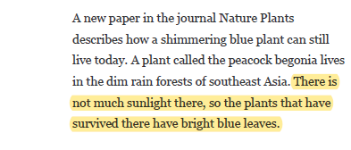
How the Environment Affects Plants
As you read, “Why-Light” anything that describes how the environment affects plants.
Highlight the most important information.
Every time you highlight something, write why you highlighted it in the margin.
The amount of sunlight can change leaf color
Notes:
K20 Center. (n.d.). Why-lighting. Strategies. https://learn.k20center.ou.edu/strategy/128

Slide 14
How the Environment Affects Plants
Based on the class research, in what ways can the environment affect plants?

Slide 15
How the Environment Affects Plants
Select an environmental factor to investigate
  Use your Plant Growth Observations handout to record your data.
Look at all the information on your “How I Know It” sheet.
  Mark the information that is most important to understand how the environment affects plants.
  Add any additional information or final thoughts from your own plant-growing experiences.
Notes:
ANNOTATION
Students might highlight, circle, or otherwise mark the ideas which they feel are the most important effects of the environment on plant growth.
They might further refine their lists by deciding which sources of evidence are most reliable (e.g., readings, peer presentations, etc.).
If students have not evaluated the quality of scientific information, this would be a good opportunity to work on that science practice.

Slide 16
Summarizing Your Research
Look at all the information on your “How I Know It” sheet.
Choose the information that is most important to understand how the environment affects plants.
Highlight, circle, or mark the information you deem most important.
Decide which of your sources is most reliable.
  How do we evaluate whether or not a source is reliable?
Notes:
SUMMARY GRAPHIC ORGANIZER
The "How I Know It" graphic organizers may have become quite cluttered with information by this point in the lesson.
Students could create new graphic organizers that only contain the most important effects of the environment on plant growth from the most reliable sources.

Slide 17
Summarizing Your “How I Know It”
Look at all the information on your “How I Know It” sheet.
Choose the information that is most important to understand how the environment affects plants.
Rewrite only these facts on a blank “How I Know It” sheet.
How do we evaluate whether or not a source is reliable?
Notes:
SUMMARY GRAPHIC ORGANIZER
The "How I Know It" graphic organizers may have become quite cluttered with information by this point in the lesson.
Students could create new graphic organizers that only contain the most important effects of the environment on plant growth from the most reliable sources.

Slide 18

I Used to Think…but Now I Know
I used to think…
But now I know…
Notes:
K20 Center. (n.d.). I used to think . . . but now I know. Strategies. https://learn.k20center.ou.edu/strategy/137

Slide 19
How the Environment Affects Plants
Look back at your initial explanation for how the environment might cause the phenomenon you chose.
Now write a final explanation based on everything you have learned.
Use evidence from your “How I Know It” sheet and importance science ideas to support your explanation.

Slide 20
How Genes Affect Plants
Predict how a plant’s genes might help create the phenomenon you studied.
Predict how the environment and genes could work together to create the phenomenon.

