Slide 1
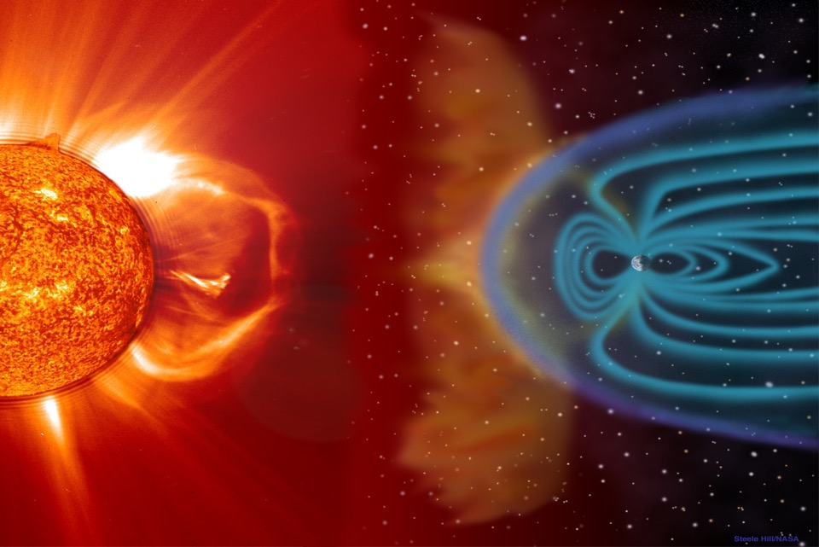

Notes:
Have students write a caption on a post-it. As the EAS alert is playing, pass out sheet that the group will use to combine their lists on.

Slide 2
What would you do?
You get home from work, turn on the TV, and the news people are urging the public to prepare for a “Carrington Class” solar flare. Although the newscasters aren’t explaining the space weather very well, the threat is very clear: The entire northern hemisphere may be without ALL electronics AND power for up to a year. You have 12 hours to get ready for 1800s style living. You frantically start preparing.
Using the worksheet, write down the first three things you do to get ready.

Slide 3
How can understanding potential dangers influence the decisions
we make in our everyday lives?

Slide 4
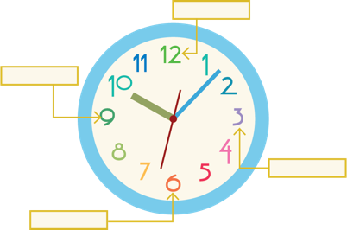
Billy
Find your 12:00 partner and compare your lists.
Do not look at other groups’ lists!
Eliminate one item from your partner’s list you feel is least important.
Combine your two lists into one list of 4 items you feel are most important to prepare for the upcoming solar bombardment.

Slide 5
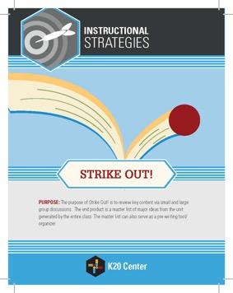
Identifying Big Ideas
When I say, pass your list of 4 to
another group.
When you get another group’s list, strike through the item you and your partner feel is least important.
We will pass all the lists at one time, and only pass when instructed to do so.
Each list will go to two different groups, then it will return to you with two items marked out.

Slide 6
Reclaiming Big Ideas
Look at your original list.
It should only have two items left on
it that is not stricken through.
You are now allowed to reclaim ONE item that has been marked out.
Place a star next to the item you are reclaiming.
Notes:
Talk with the class about what they would do. This usually sparks some lively conversations. Tell them that this is a REAL threat and could happen ANY TIME!!!!

Slide 7
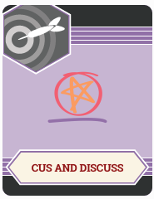

2012 Close call article
Read this peer-reviewed scientific journal article.
C.U.S. and Discuss the article:
Circle new words.
Underline details/evidence to support main ideas.
Star main ideas

Slide 8
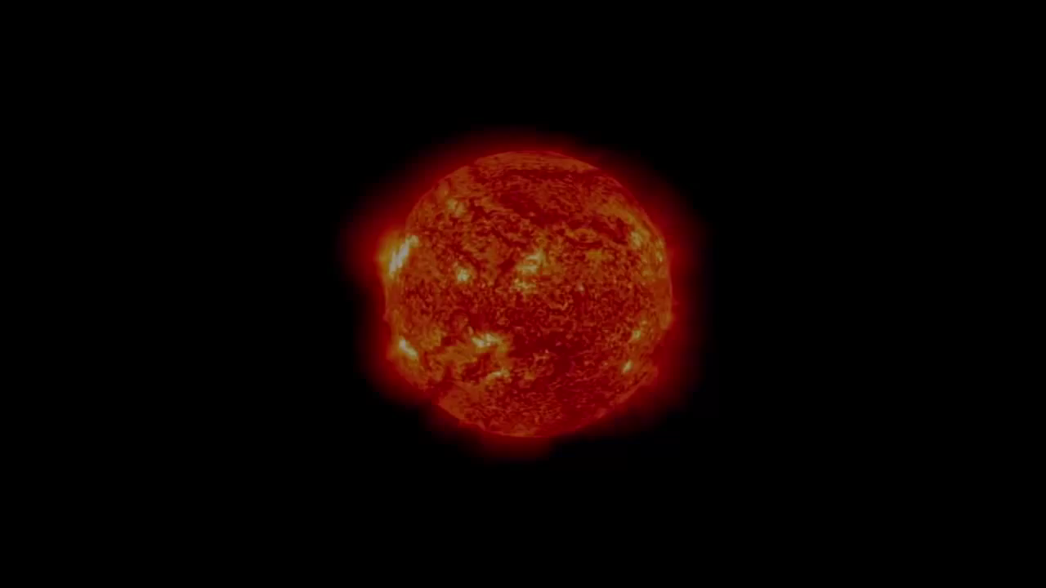
Coronal Mass Ejections (CME)
Notes:
If embedded video doesn’t play, go to link here: https://www.youtube.com/watch?v=7ukQhycKOFw

Slide 9
2012 Close call article AGAIN
Read this peer-reviewed scientific journal article.
C.U.S. and Discuss the article:
Circle new words.
Underline details/evidence to support main ideas.
Star main ideas

Slide 10
Billy
Stay with your 12:00 partner.
Notes:
Hand out rubric.

Slide 11
Coronal Mass Ejection Research
Your goal: make a persuasive presentation about CMEs. It could be (but not limited to):
  A PSA over CMEs and what the public should do
  News/Radio broadcast as if a CME is occurring
  Commercial pitching a survival item for a CME
  Quick documentary over CMEs (preferably a la Blair Witch Project, Cloverfield, The Office, Spinal Tap, etc.)
  No matter what, it should be persuasive and factual
Keep the presentations around 5 minutes.
Do research over CMEs and put together your presentation

Slide 12

How can understanding potential dangers influence the decisions we make in our everyday lives?

Slide 13
Metacognitive Cards
Look over the list of activities done in the lesson
Reflect over how the activity helped you learn
This is not what you learned, but how helpful it was, and what part of the activity was most helpful to you learning

