Slide 2
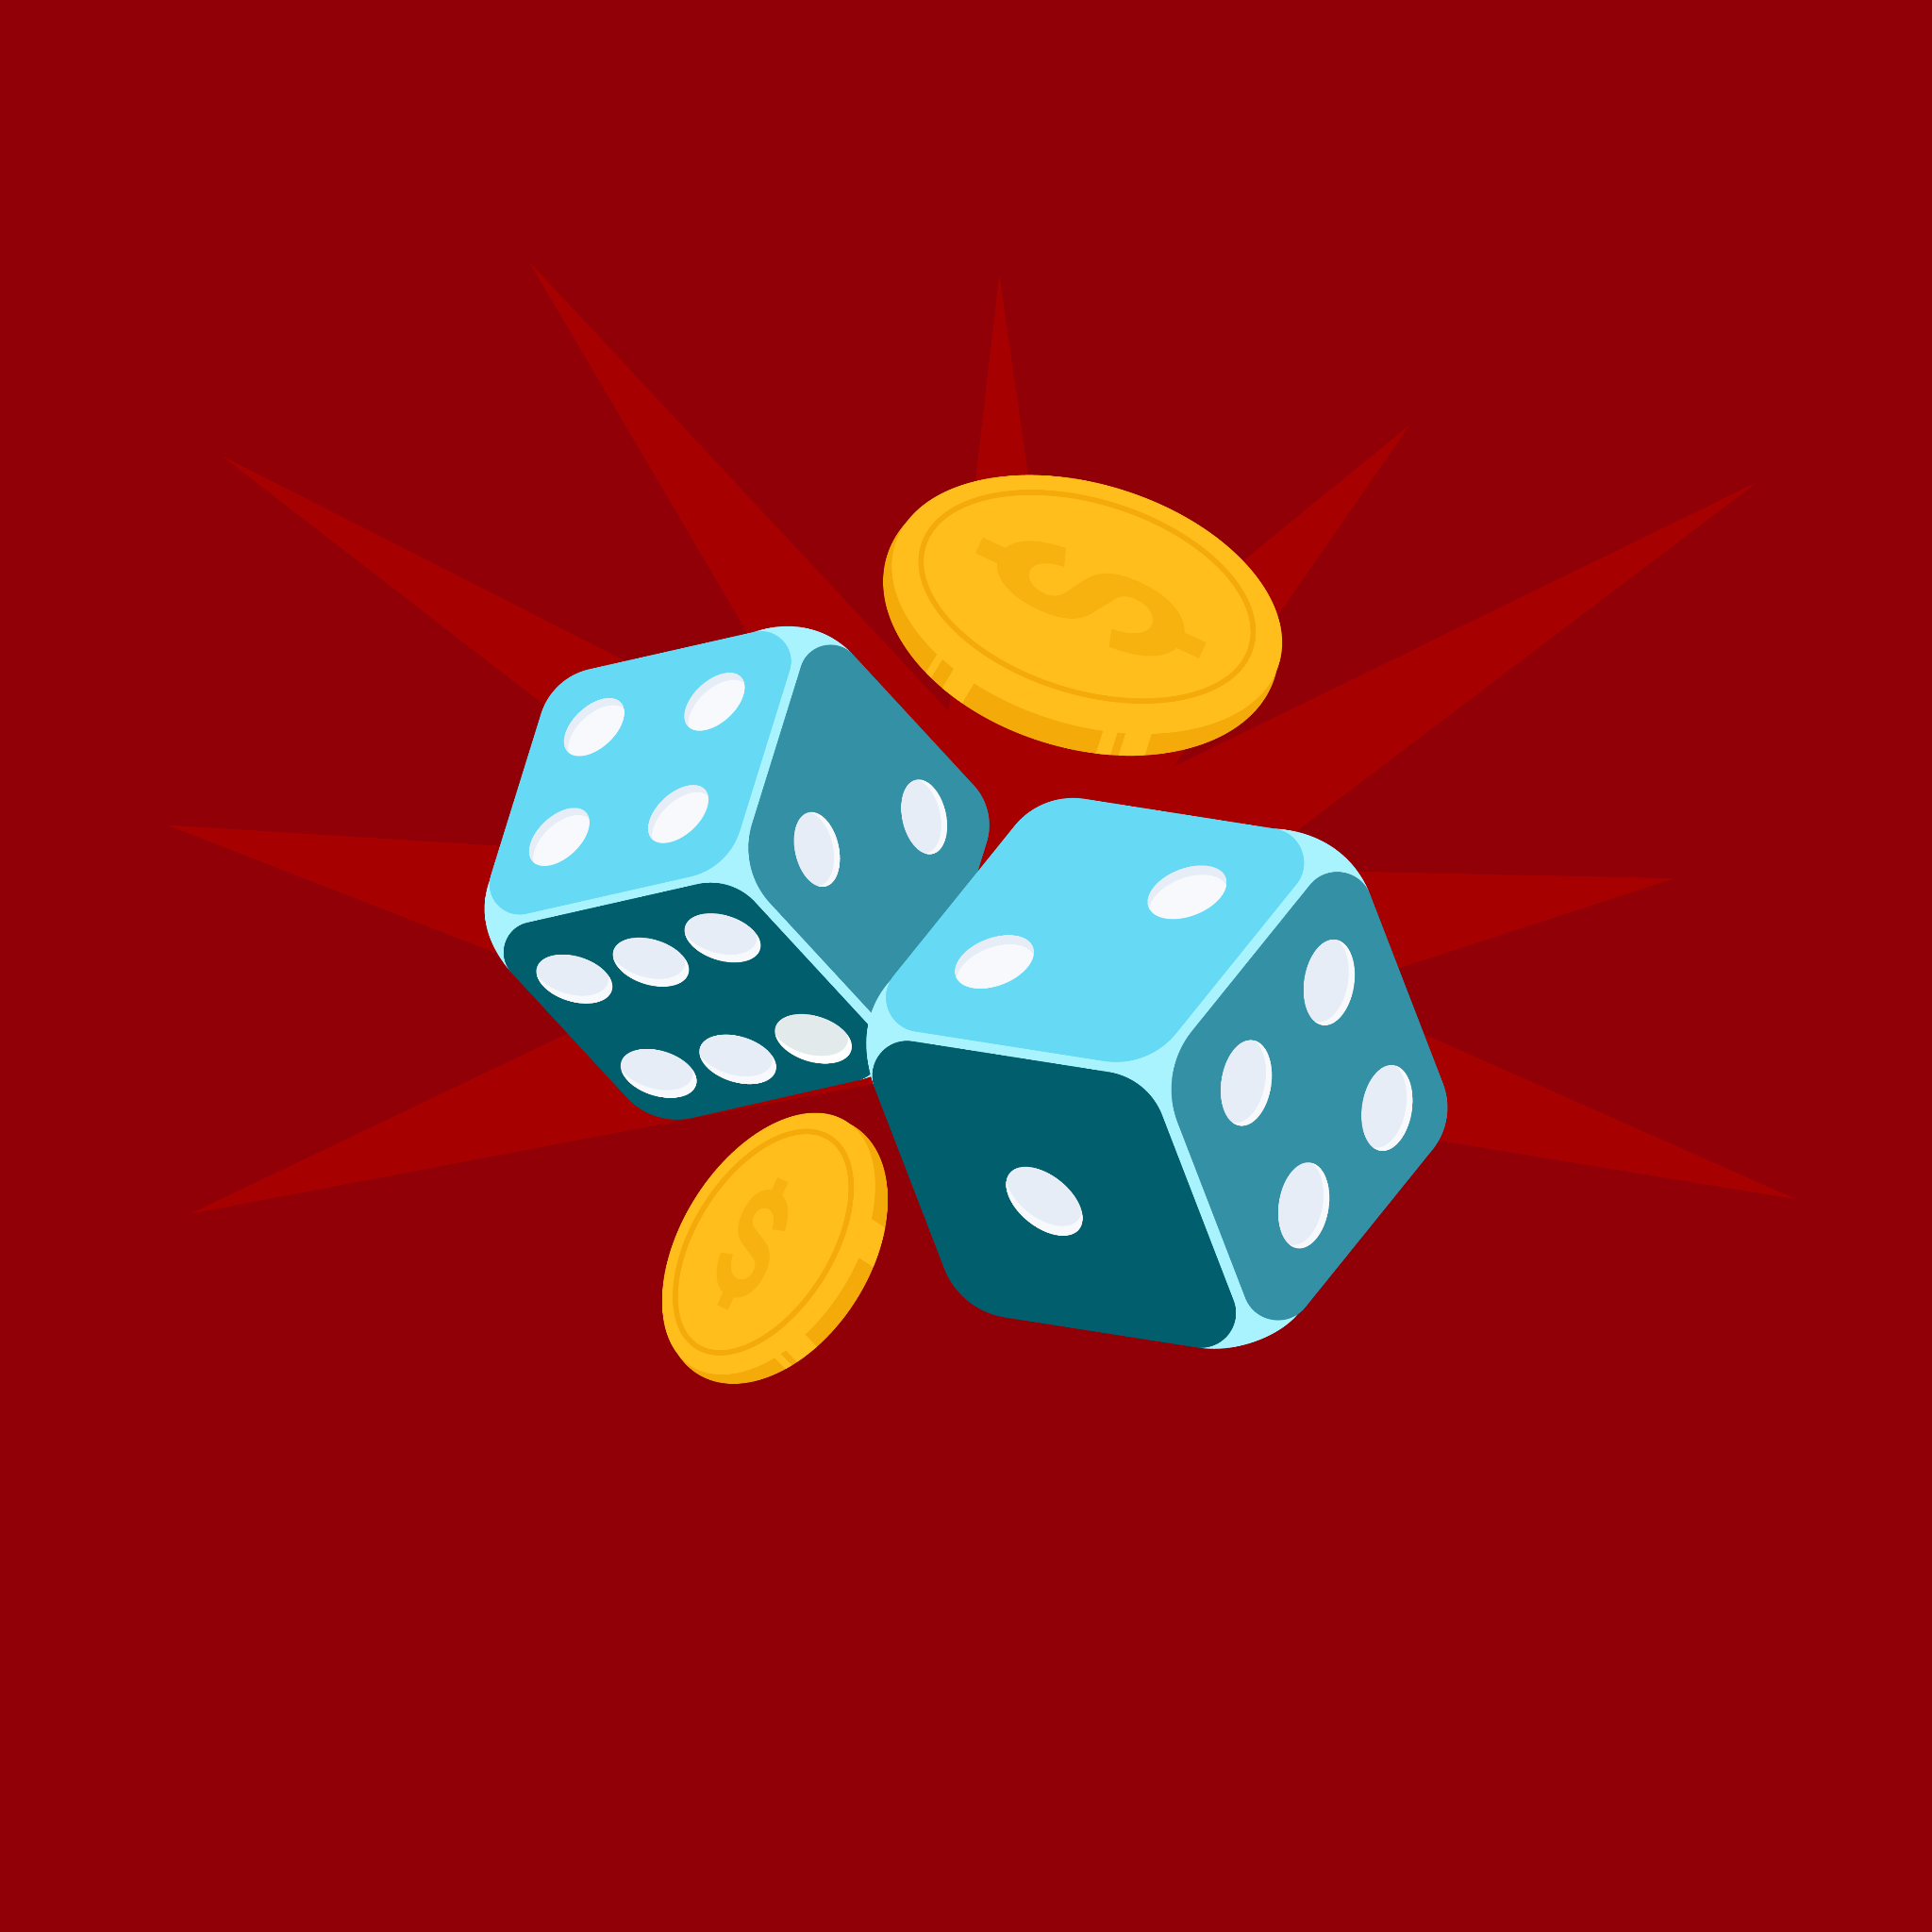
Take a Chance with Probability
Experimental vs. Theoretical Probability

Slide 3
Essential Question
When does probability change from theoretical to experimental?

Slide 4
Objective
Compare theoretical probability to experimental probability by conducting repeated trials and analyzing data.

Slide 5

The 21 Challenge
The goal is to get as close to 21 without going over.
You will get one card facing up and one facing down.
Based on your card facing up, determine if you want to hit (add a card) or stand (stick with the cards you have).
You win if your total is higher than the teacher's without going over 21. You bust (lose) if you go over 21.

Slide 6
The 21 Challenge
Ace = 1 or 11
Jack, Queen, & King = 10
How to add examples:
  If you have an Ace and a 3: 1 + 3=4 or 11+3=14
  If you have a two Queens = 10 +10=20
Notes:
pull out jokers

Slide 7
Station | Description
Skittles | Predict the probability of picking a certain color.
Coin Flip | Flip a coin to calculate the probability of heads or tails.
Dice Roll | Roll the dice to determine the probability of landing on a specific number
Spinner | Spin the spinner to determine the probability of landing on a section.
Hoop | Toss the ball into a hoop to determine the probability of your successes or misses.

Slide 8
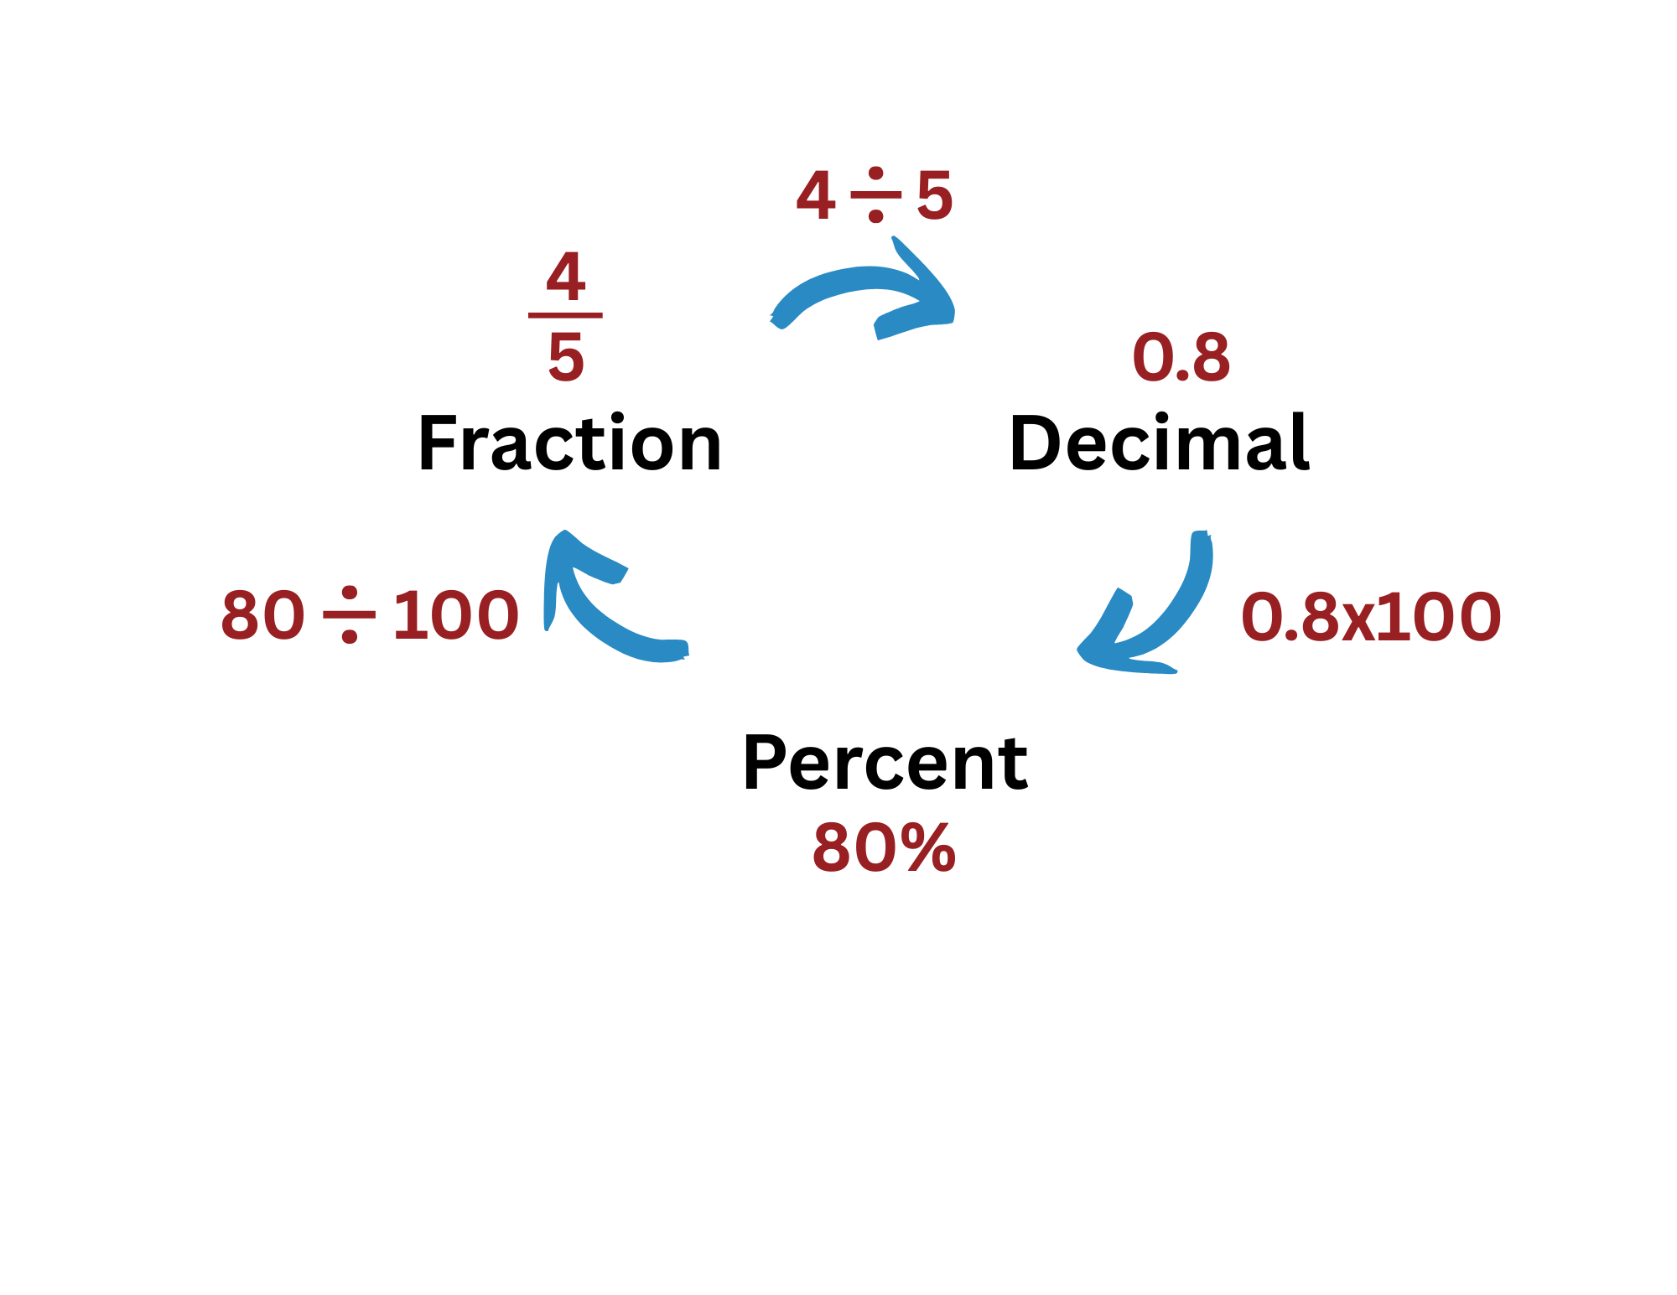
Converting a Fraction to a Decimal
Take the numerator (top number) of your fraction and divide it by your denominator (bottom number).

Slide 9
Converting a Decimal to Percent
Take the new decimal and multiply by 100.

Slide 10
Station Calculations
Return back to your handout:
Calculate the fraction, decimal, and percentage
Respond to the corresponding follow-up questions

Slide 11
Theoretical vs. Experimental
Probability | Based on | Occurs | Formulas
Theoretical | possible results or math predictions | Before an Experiment | # of favorable outcomes total possible outcomes
Experimental | actual results from trials or data collected | After an Experiment | # of times the event occurs total number of trials

Slide 12
Reflect
What is one example of when you found theoretical probability from the station activity?
What is one example of when you found experimental probability from the station activity?

Slide 13
Example Problem
If you flip a coin four times, what is the best prediction possible for the number of times it will land on heads?
Is this theoretical or experimental probability?

Slide 14
Example Problem
Jeanette's Pie Shop recently asked their customer which pie was their favorite. Of the last 14 customers, four picked blackberry as their favorite. What is the probability that the next customer will also pick blackberry?
Is this theoretical or experimental probability?

Slide 15

Probability Scenario
With your group:
Create a theoretical or experimental probability scenario and solve it.
Let your teacher review your problem.
Add only your title and scenario to the poster.
Notes:
K20 Center. (n.d.). Gallery walk/carousel. Strategies. https://learn.k20center.ou.edu/strategy/118

Slide 16
Gallery Walk
With your group, visit the other posters around the room.
Summarize the scenario.
Identify the type of probability (Theoretical or Experimental).
Find the probability as a fraction, decimal, and percentage.
Notes:
K20 Center. (n.d.). Gallery walk/carousel. Strategies. https://learn.k20center.ou.edu/strategy/118

Slide 17

Climatologist
Career-Focused – Climatologist with Monica Maddox
Notes:
K20 Center. (2026). Career-Focused - Climatologist with Monica Maddox . [Video]. YouTube. https://www.youtube.com/watch?v=Am10w_ksBQg

Slide 18

I Notice, I Wonder
What were some things you noticed about climatology? Skills? Educational background?
What were some things you wondered about climatology? Skills? Educational background?
Notes:
K20 Center. (n.d.). I notice, I wonder. Strategies. https://learn.k20center.ou.edu/strategy/180

Slide 19
I Notice, I Wonder
You are a meteorologist studying the weather patterns around your hometown. According to past data, when the weather is under conditions like today’s, storms are produced 85% of the time. Is this experimental or theoretical probability?
Notes:
K20 Center. (n.d.). I notice, I wonder. Strategies. https://learn.k20center.ou.edu/strategy/180

Slide 20

Gist
In 28 words or less, describe the reasoning for your card placement. Be sure to use the vocabulary learned in this lesson.
Notes:
K20 Center. (n.d.). Gist. Strategies. https://learn.k20center.ou.edu/strategy/3289

