Slide 2
Trolleys and Tribulations
A lesson on Ethical Frameworks and Integrity

Slide 3
The Trolley Problem
There is a runaway trolley barreling down the railway tracks. Ahead, on the tracks, there are five people tied up and unable to move. The trolley is headed straight for them. You are standing some distance off in the train yard, next to a lever. If you pull this lever, the trolley will switch to a different set of tracks. However, you notice that there is one person tied up on the sidetrack. You have two options:
Do nothing, and the trolley kills the five people on the main track.
Pull the lever, diverting the trolley onto the sidetrack where it will kill one person.
Which is the most ethical choice?
Notes:
Trolley Problem

Slide 4
The Trolley Problem gets more complicated…..
There is a runaway trolley barreling down the railway tracks. Ahead, on the tracks, there are five people tied up and unable to move. The trolley is headed straight for them. You are standing on a bridge overlooking the track, so you can’t get to the lever to divert the track in time to save the five people. You are standing on the bridge with a very big guy. If you push this big guy over the bridge and onto the tracks, it will stop the train before the five people will be hit. Unfortunately, the big guy will be killed.
Should you do it?
Should you push the big guy over?
What is the most ethical decision?

Slide 5
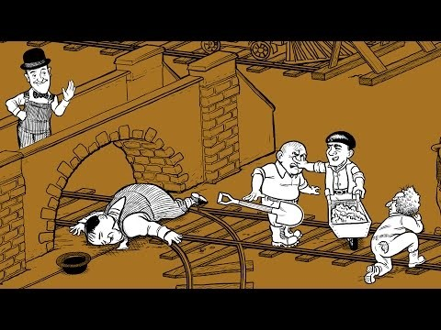
The Trolley Problem

Slide 6
Q & A: The Trolley Problem
What decision would you make about the runaway trolley?
Would you push the big guy off the bridge to save others?
Why do most people say they would not?
Is there a moral or ethical dilemma in killing someone to save others?
How is the Trolley Problem a no-win situation?

Slide 7
How would they react?
A typical interpretation of the Trolley Problem is this:
Consequentialist or Utilitarianist – Would pull the lever or throw the fat man over. This act would save the greatest number of people
Deontologist – Would not pull the lever or throw the fat man because doing so would be deliberately harming someone.
Virtuist – This one is a bit more complicated. Most interpretations say a Virtuist would pull the lever because that is the brave and compassionate thing to do. However, in the big guy scenario, the Virtuist would most likely not throw the man over the bridge because this would deprive him of his own moral agency. For a Virtuist, the “why” is more important than the decision itself.
Notes:
Discussion stuff

