Slide 2
How would you pay for this life event?
A. Funeral Expenses
Notes:
Image source: McCoy, S. (2003 March). Space Shuttle Columbia funeral. Wikimedia Commons. https://commons.wikimedia.org/wiki/File:Space_Shuttle_Columbia_funeral_-g.jpg

Slide 3
Or This?
Notes:
Image source: Souza, P. (2013 May 26). President Obama tours tornado damage in Moore, Oklahoma: ‘we’ve got your back’. The White House Archives. https://obamawhitehouse.archives.gov/blog/2013/05/26/president-obama-tours-tornado-damage-moore-oklahoma-weve-got-your-back

Slide 4
Or This?
Notes:
Image source: HNMU. (2008 April). Students assisting surgery. Wikimedia Commons. https://commons.wikimedia.org/wiki/File:Students_assisting_surgery.JPG

Slide 5
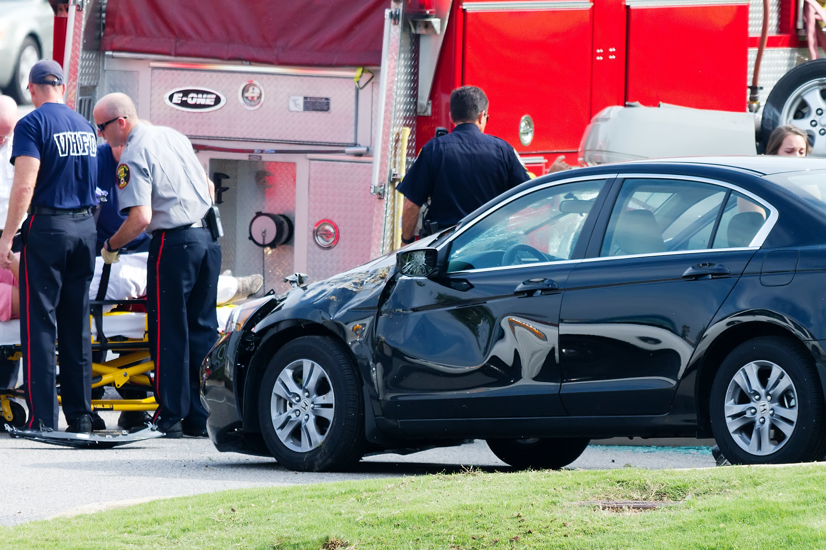
Or This?
Notes:
Image source: Castillo, R. (2011 July). Car accident @ vestavia hills. Flickr. https://www.flickr.com/photos/digitizedchaos/5913304617/

Slide 6
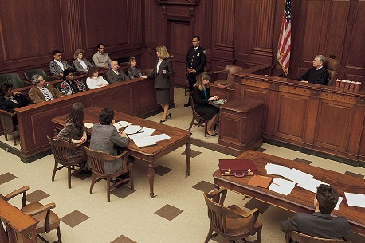
Or This?
Notes:
Image source: Rathke, S. (2013 October). Civil trial. Flickr. https://www.flickr.com/photos/stephenrathke/10212699024/

Slide 7
Or This?
Notes:
Image source: N.a. (2017 January). Walking. PxHere. https://pxhere.com/en/photo/521906

Slide 8
Are You Covered?
A Lesson for Personal Financial Literacy
Standard 11: Insurance

Slide 9
Essential Question
How can having insurance protect you from risks?

Slide 10
TAKE THE QUIZ: How much do you know about insurance coverage?
Label your paper with letters A through H.
As we revisit each slide, write down which type of insurance would help pay for this major life event.
Answer the additional two questions (G & H) on slide 10 to complete your quiz.

Slide 11
Take the Quiz: What Do You Know About Insurance Coverage?
Label your paper with the letters A through H.
As we revisit each slide, write down which type of insurance would help pay for each major life event.
Answer two additional questions (G & H) on slide 10 to complete your quiz.

Slide 12
A. Funeral expenses
Notes:
Image source: McCoy, S. (2003 March). Space Shuttle Columbia funeral. Wikimedia Commons. https://commons.wikimedia.org/wiki/File:Space_Shuttle_Columbia_funeral_-g.jpg

Slide 13
B. Moore Tornado, 2013
Notes:
Image source: Souza, P. (2013 May 26). President Obama tours tornado damage in Moore, Oklahoma: ‘we’ve got your back’. The White House Archives. https://obamawhitehouse.archives.gov/blog/2013/05/26/president-obama-tours-tornado-damage-moore-oklahoma-weve-got-your-back

Slide 14
C. Major surgery
Notes:
Image source: HNMU. (2008 April). Students assisting surgery. Wikimedia Commons. https://commons.wikimedia.org/wiki/File:Students_assisting_surgery.JPG

Slide 15
D. Car accident with injuries
Notes:
Image source: Castillo, R. (2011 July). Car accident @ vestavia hills. Flickr. https://www.flickr.com/photos/digitizedchaos/5913304617/

Slide 16
E. Being sued by another person or company
Notes:
Image source: Rathke, S. (2013 October). Civil trial. Flickr. https://www.flickr.com/photos/stephenrathke/10212699024/

Slide 17
F. An injury at work that causes permanent disability
Notes:
Image source: N.a. (2017 January). Walking. PxHere. https://pxhere.com/en/photo/521906

Slide 18
Final Questions
G. How do you guarantee that insurance will pay you when one of these life events occurs?
H. Does insurance pay for the entire cost of an event?

Slide 19
Answer Key—Check Your Work
Life Insurance or a burial policy
Homeowner's Insurance
Health Insurance
Auto Insurance
Liability Insurance
Disability Insurance
G. You must pay your premiums on time so that your insurance will remain active. Premiums are a payment to the policy holder’s insurance company. Premiums can be paid monthly, quarterly, or annually.
H. Usually an insurance policy has a deductible—this is money that you must pay first out of your own pocket before insurance will pay the rest of the total amount.

Slide 20
Types of Insurance
Health Insurance
Life Insurance
Homeowner’s Insurance
Auto Insurance
Disability Insurance
Renter’s Insurance
Liability Insurance
Notes:
Image source: Cheap Full Coverage Auto Insurance. (2014, July 30). Insurance. Flickr. https://www.flickr.com/photos/pictures-of-money/17121703798/

Slide 21
Insurance Project
With your group, research websites to understand your insurance type better.
Create a presentation that includes:
A sales pitch or oral presentation about the insurance researched.
A brochure, flyer, or advertisement that functions as a sales pitch for your insurance.
Notes:
Pass out the rubric

Slide 22
Evaluate
Your grade for this lesson will be based on:
Completion of graphic organizer and research.
Oral presentation and brochure, flyer, or advertisement.

