Slide 2
Trig-O-Nom-E-Tree!
Using Clinometers and Trig Ratios To Measure Unknown Heights

Slide 3
Essential Question
How can you determine the height of an object without actually measuring it?

Slide 4
Lesson Objective
Students will learn how to use clinometer and trigonometric ratios to solve problems involving right triangles.

Slide 5
Think - Pair - Share
How can you determine the height of a tree or building without actually measuring it?
First, individually write down your own thoughts.
Second, share with a partner and create a claim to present to the class.
Lastly, write your claim on the board.

Slide 6
Discussion
What is a clinometer?
How can it be used to determine the height of objects?

Slide 7
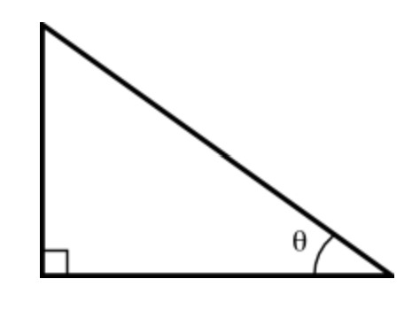
SOH - CAH - TOA
What is the breakdown of the catch phrase SOH-CAH-TOA?
Use the right triangle to help define it.

Slide 8
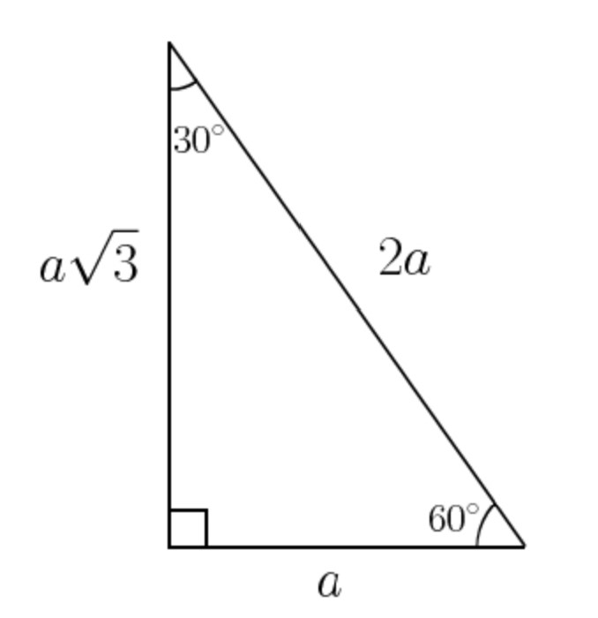
Connection - Clinometer to Right Triangle
Where do you see right triangle connections in your clinometer?
How does the clinometer help with measuring trig ratios?
How can you use trig ratios to measure heights of objects?

Slide 9
Exploring Heights Around the School
Don’t know how to measure? Follow these steps:
Find the angle of elevation from the student to the top of an object and the distance from the object to the student as they are standing looking through the clinometer at the object.
Record the height of the student using the clinometer.
Using special right triangles, find the height of the object.

Slide 10
What? So What? Now What?
What? What did you do in this lesson?
So What? What mathematics did you use and why do you think it was important?
Now What? What will you take away from this lesson?

