Slide 2
The Three Vinegar Tasters
East Asian Religions

Slide 3
Essential Questions
What impact does religion have on a society?
What can we learn about a culture from its religion?

Slide 4
Learning Objective
Analyze the origins of Confucianism, Buddhism, and Taoism.

Slide 5
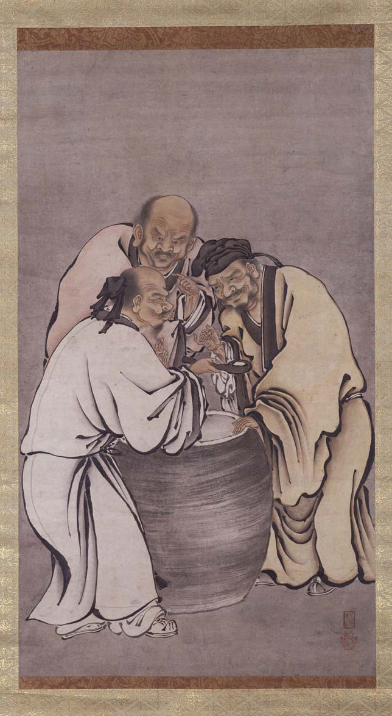
I Think:
What do you see?
What do you think is taking place?
In what part of the world is this painting set?
What do you think the image is about?
Author Unknown—Traditional (5 June 2016). Vinegar Tasters. Wikipedia. Retrieved from https://en.wikipedia.org/wiki/File:Vinegar_tasters.jpg
Notes:
K20 Center. (n.d.). I think/we think. Strategies. https://learn.k20center.ou.edu/strategy/141
The three vinegar tasters [Painting]. (16th century). Wikipedia. https://en.wikipedia.org/wiki/Vinegar_tasters

Slide 6
We Think:
Come to a consensus or agreement of what the group thinks about the painting and its meaning.
Author Unknown—Traditional (5 June 2016). Vinegar Tasters. Wikipedia. Retrieved from https://en.wikipedia.org/wiki/File:Vinegar_tasters.jpg
Notes:
K20 Center. (n.d.). I think/we think. Strategies. https://learn.k20center.ou.edu/strategy/141
The three vinegar tasters [Painting]. (16th century). Wikipedia. https://en.wikipedia.org/wiki/Vinegar_tasters

Slide 7
The Three Vinegar Tasters
The three vinegar tasters are Buddha, Lao Zi, and Confucius.
Each founder represents a major religion or philosophy in East Asia— Confucianism, Buddhism, and Taoism (Daoism).
The vinegar represents the bitterness or disappointments in life.
Each founder reacts to the vinegar differently.
Author Unknown—Traditional (5 June 2016). Vinegar Tasters. Wikipedia. Retrieved from https://en.wikipedia.org/wiki/File:Vinegar_tasters.jpg
Notes:
The three vinegar tasters [Painting]. (16th century). Wikipedia. https://en.wikipedia.org/wiki/Vinegar_tasters

Slide 8

Jigsaw Activity
In each group of three:
  Ones read Confucianism.
  Twos read Buddhism.
  Threes read Taoism.
Buddhism
Confucianism
Taoism
Notes:
K20 Center. (n.d.). Jigsaw. Strategies. https://learn.k20center.ou.edu/strategy/179

Slide 9

Why-Lighting
As you read about your assigned religion, highlight main ideas.
Jot down any notes in the margin as to why those main ideas might be important.
Notes:
K20 Center. (n.d.). Why-lighting. Strategies. https://learn.k20center.ou.edu/strategy/128

Slide 10

What is _______________?
Who is the founder of the religion and where did it begin?
This column should contain notes or bullet points that the group decides best answers each question.
What are the main beliefs?
Notes:
Pixel Perfect (3 March 2017). Vector Notepad. Pixabay. Retrieved from https://pixabay.com/photos/vector-notepad-notepad-5x8-notepad-2111645/

Slide 11
What is (Buddhism, Confucianism, or Taoism)?
What do we know about followers of this religion?
This column should contain notes or bullet points that the group decides best answers each question.
What impact has this belief made on modern society?
Notes:
Pixel Perfect (3 March 2017). Vector Notepad. Pixabay. Retrieved from https://pixabay.com/photos/vector-notepad-notepad-5x8-notepad-2111645/

Slide 12
Venn Diagram
With your group, fill out the Venn Diagram:
In each circle, write down only information that pertains to each of the religion.
Write down similarities between two of the religions where they interlock.
Write down similarities in the center space where all three religions interlock.
Confucianism
1
Buddhism
1
2
3
Taoism
1
2
2
Notes:
K20 Center. (n.d.). Venn diagram. Strategies. https://learn.k20center.ou.edu/strategy/2918

Slide 13
The Three Vinegar Tasters
Buddha tasted the bitterness of life (the vinegar) and had no expression. Why?
Confucius tasted the bitterness of life and made a scowling face. Why?
Lao Zi tasted the bitterness of life and smiled. Why?
Author Unknown—Traditional (5 June 2016). Vinegar Tasters. Wikipedia. Retrieved from https://en.wikipedia.org/wiki/File:Vinegar_tasters.jpg
Notes:
The three vinegar tasters [Painting]. (16th century). Wikipedia. https://en.wikipedia.org/wiki/Vinegar_tasters

Slide 14
We Re-Think:
How have these three religions influenced the culture of Asian people?
Author Unknown—Traditional (5 June 2016). Vinegar Tasters. Wikipedia. Retrieved from https://en.wikipedia.org/wiki/File:Vinegar_tasters.jpg
Notes:
The three vinegar tasters [Painting]. (16th century). Wikipedia. https://en.wikipedia.org/wiki/Vinegar_tasters

