Slide 2
Action, Reaction
Forces and Motion

Slide 3
Essential Question
How does our knowledge of energy transfer influence our daily lives?

Slide 4
Lesson Objectives
Examine and explain pieces of evidence to support Newton’s 3rd Law.
Identify real-world problems and create solutions to these problems using knowledge of the transfer of energy.
Apply scientific principles to design, modify, test, and compare devices created to solve a problem associated with collisions.

Slide 5
Bell Ringer
Have you ever experienced or witnessed a collision? You could think of a car collision, or any two objects impacting each other. What happened to the two objects when they collided?
Notes:
K20 Center. (n.d.). Bell ringers and exit tickets. Strategies. https://learn.k20center.ou.edu/strategy/125

Slide 6
I Notice, I Wonder…
Watch the video.
As you watch, write down things you notice, or observations, and things you wonder, or questions.
Notes:
K20 Center. (n.d.). I notice, I wonder. Strategies. https://learn.k20center.ou.edu/strategy/180
TODAY. (September 29, 2017). The new football helmet test that could save kids from concussions | Today [Video]. YouTube. https://www.youtube.com/watch?v=Aa53zQlnpe4&feature=youtu.be

Slide 7
Stations
Visit 3 stations and explore how different forces interact.
Use the Stations Journal to guide you through each activity and document your observations.
Make note of any patterns you notice.
Rotate stations when time is up.
Notes:
K20 Center. (2021, September 21). K20 Center 7 minute timer [Video]. https://www.youtube.com/watch?v=gWwvdLxwV9c

Slide 8
T-Chart
What did you learn about interacting forces at each station?
Record your responses on your Interacting Forces T-Chart.
Prepare to share your responses.
Notes:
K20 Center. (n.d.). T-Chart. Strategies. https://learn.k20center.ou.edu/strategy/86

Slide 9
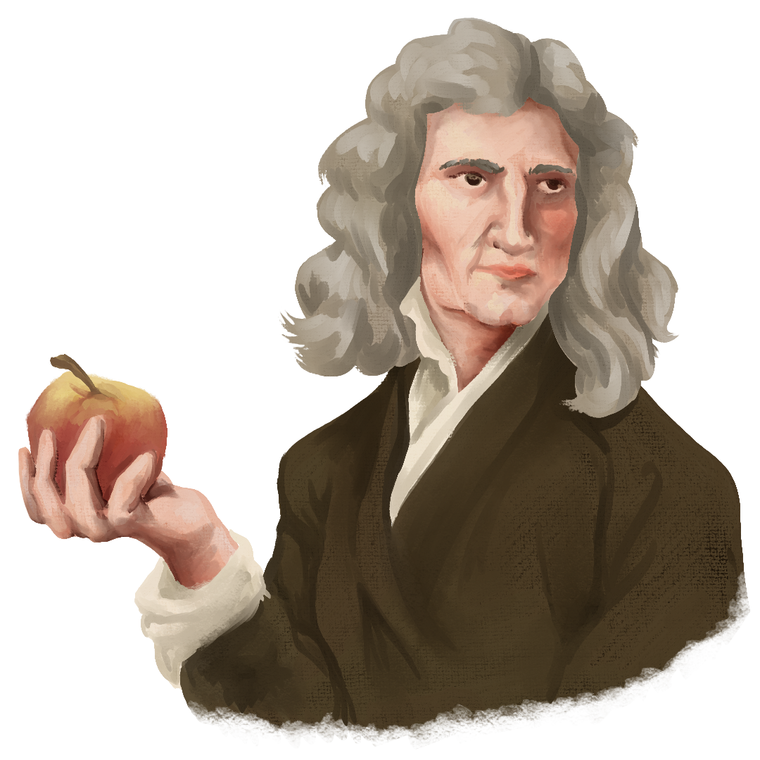
Newton’s 3rd Law
Isaac Newton was a physicist and mathematician in the late 1600s and early 1700s.
Newton’s 3rd Law states that for every action, there is an equal and opposite reaction.
ACTION
REACTION

Slide 10
Researching Helmet Design
Spend 10–20 minutes researching helmet design.
Examine the designs of helmets you’ve seen like football, baseball, and bicycle helmets.
Take notes on the structure and materials used for different helmet designs.

Slide 11
Designing Solutions
Work with your group to design a helmet for your fragile object.
Invent a helmet design with your group members. Label your design and list the materials you plan to use.
Have your design approved.
Build your helmet.
Test your design, provide feedback on your peers’ designs, and reflect on changes you could make to your design.
Make changes to your design.
Perform a final test of your design.

Slide 12
Public Service Announcement
A PSA is a message that creates awareness about a topic that concerns the health and well-being of the public.
Create a poster, video, or radio announcement about how to stay safe in the event of a collision.
You may choose any type of collision that involves the use of helmets as protection.

