Slide 2
Action, Reaction
8th Grade Science

Slide 3
Essential Question:
How does our knowledge of energy transfer influence our daily lives?

Slide 4
LessonObjectives
After this lesson, we will be able to complete the following:
Examine and explain evidence of Newton’s third law.
Identify real-world problems with solutions that require your understanding of the transfer of energy.
Apply scientific principles to design, modify, test, and compare devices to solve a collision-based problem.

Slide 5
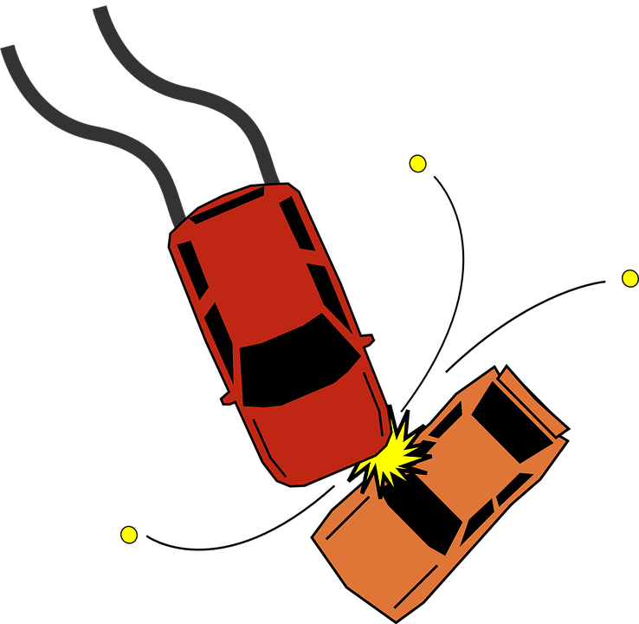
Bell Ringer
Have you ever witnessed a collision where two or more objects crashed into each other?
What happened to the objects when they collided?
Notes:
OpenClipart-Vectors (2013, October 15). Accident. Pixabay. Retrieved from https://pixabay.com/vectors/accident-collision-crash-152075/

Slide 6
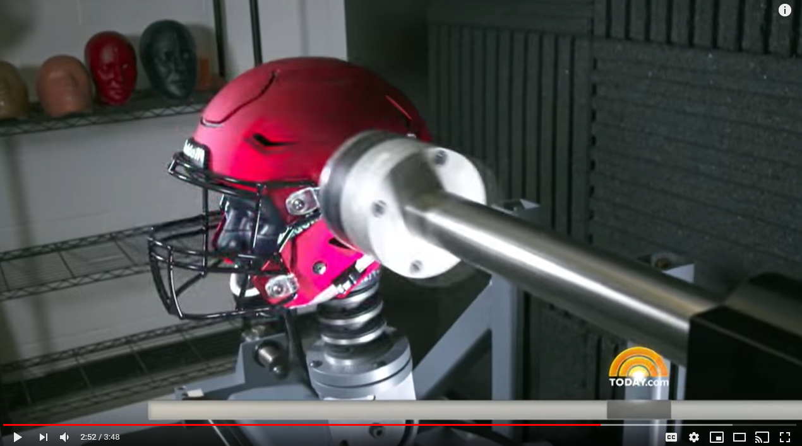
The New Football Helmet Test
TODAY (2017, September 29). The New Football Helmet Test That Could Save Kids From Concussions | TODAY. YouTube. Retrieved from https://youtu.be/Aa53zQlnpe4
While watching this video, write down things that you notice (observe) or wonder about (question).
Notes:
https://www.youtube.com/watch?v=Aa53zQlnpe4&feature=youtu.be

Slide 7
Stations
Work through three stations with interacting forces.
While you work, think about the patterns you notice.
Use the Stations handout to guide you and document your thinking.
Notes:
Allow students to have 5 to 7 minutes at each station.

Slide 8
Interacting Forces T-Chart
What We Discovered
Supporting Evidence
On the left side, summarize what you learned.
On the right side, create a diagram or provide other supporting evidence for what you learned.

Slide 9
What We Discovered
Supporting Evidence

Slide 10
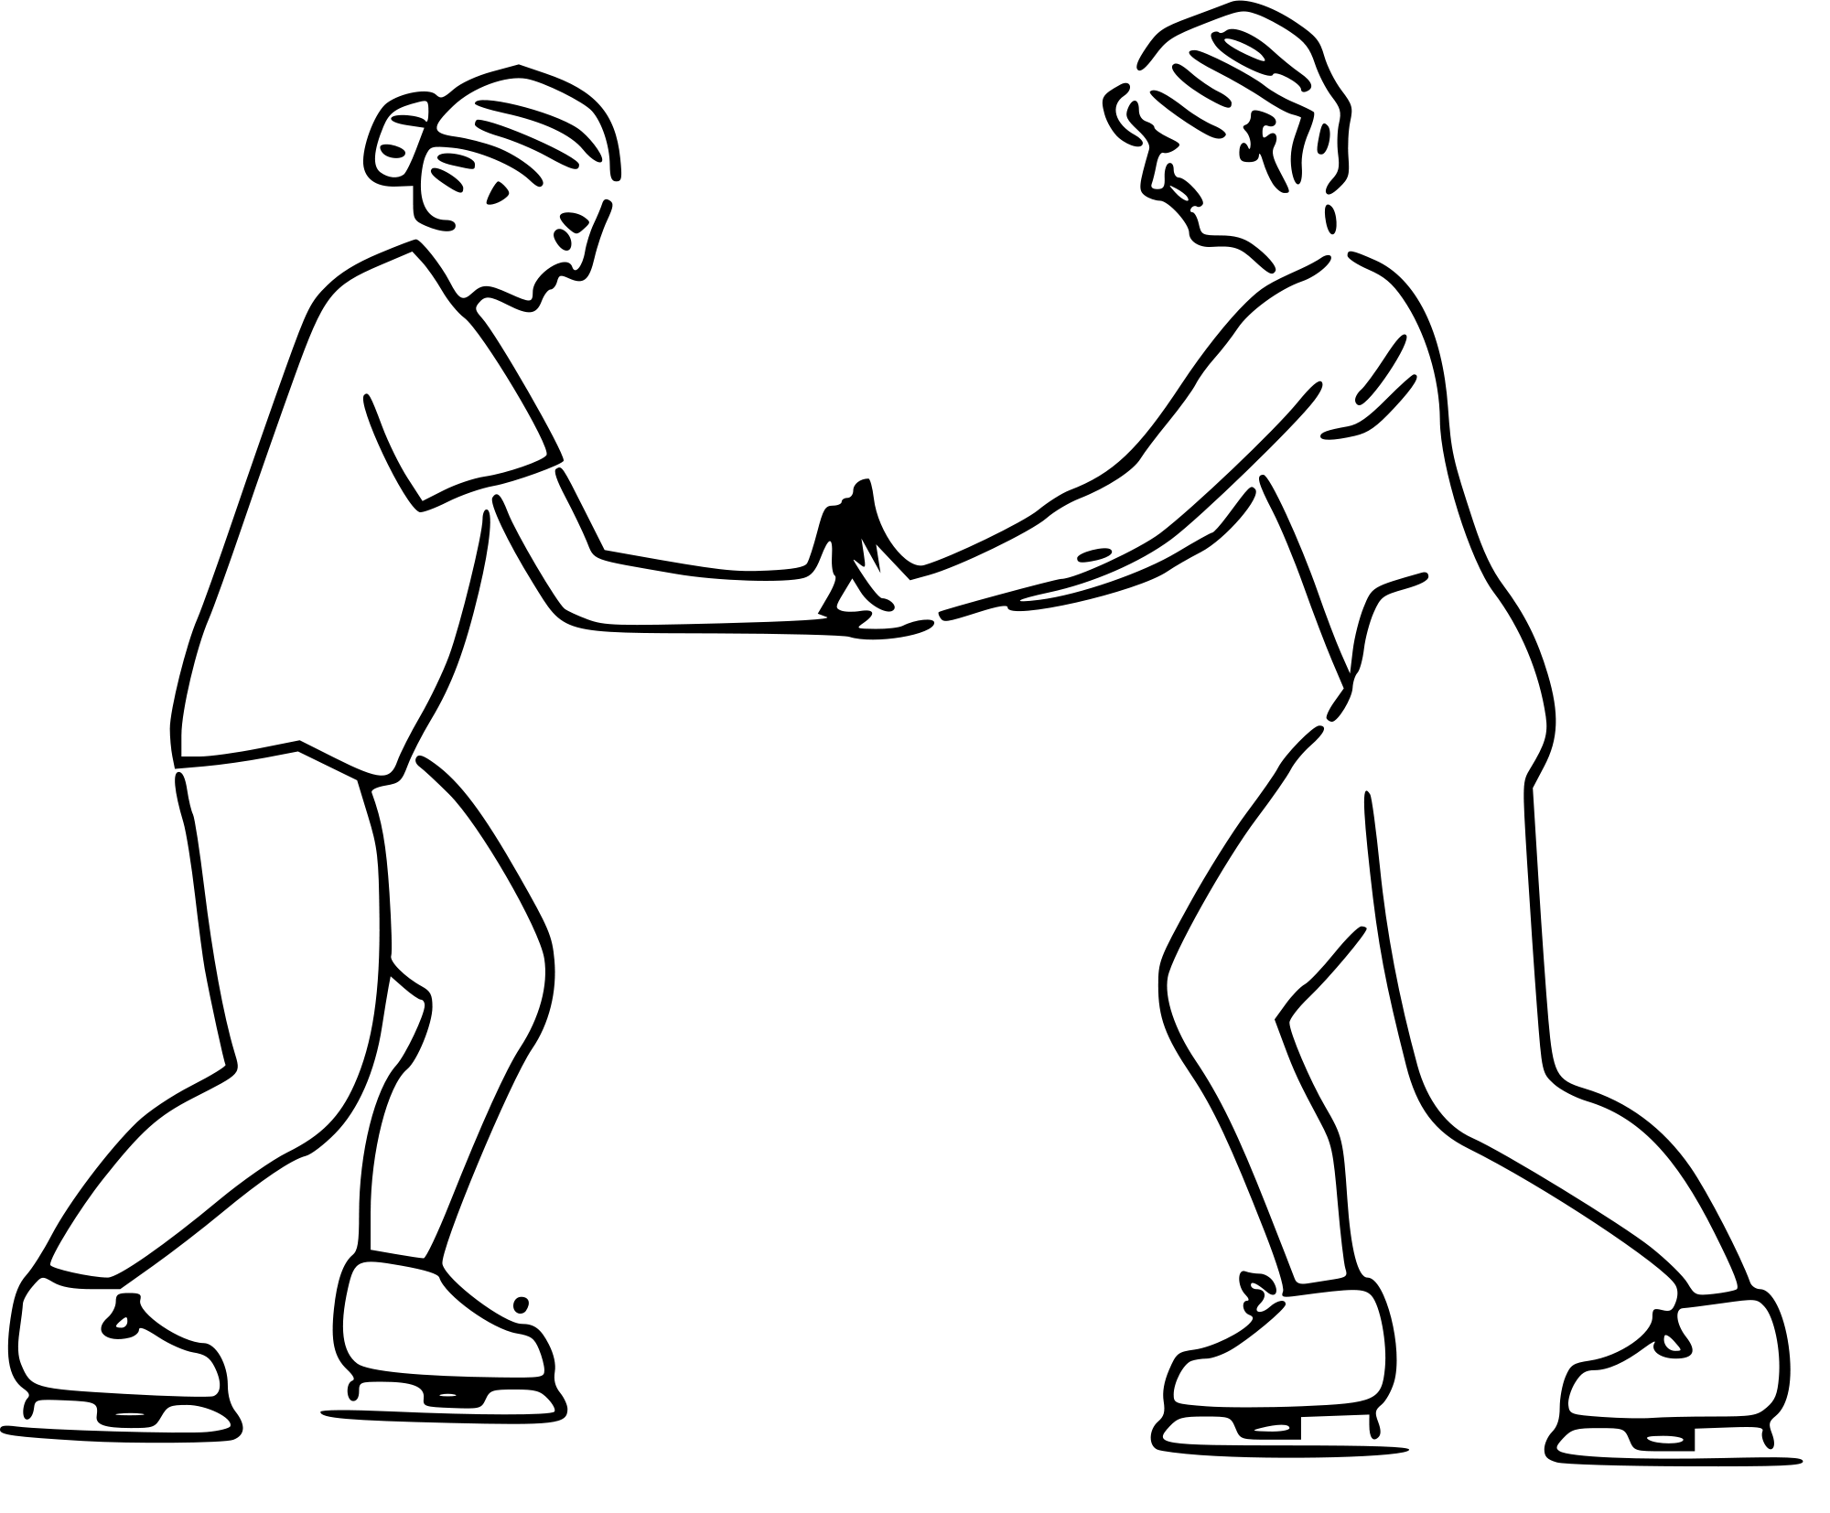
Newton’s Third Law of Motion
Isaac Newton was a physicist and mathematician who lived from 1642-1727.
Newton’s 3rd Law: For every action, there is an equal and opposite reaction.
Crowell, B. (2006, May 10). Skaters showing Newton's third law. Wikimedia Commons. Retrieved from https://commons.wikimedia.org/wiki/File:Skaters_showing_newtons_third_law.svg

Slide 11
Engineering a New Helmet
Research how helmets are designed.
Study different types: football, baseball, bicycle, and others.
Record notes about the structure and materials engineers use to make these helmets.
You have 10-20 minutes.

Slide 12
Designing Solutions
With your group, design a helmet for your object.
Engineer a design blueprint with your group. Draw and label your blueprint with the materials your helmet requires.
Show your blueprint to the teacher for approval.
Once approved, build your helmet as a group.
Test your helmet. Observe your peers’ tests and provide feedback. Reflect on how you could improve your design.
Make changes based on your own reflections and on peer feedback.
Test your helmet one more time.

Slide 13
Public Service Announcement
A Public Service Announcement (or PSA) is a broadcast meant to bring public attention to a health-related topic.
Create a poster, a video, or a radio PSA about how to stay safe in the event of a collision.
You can choose any type of collision that involves using helmets for protection.
Notes:
Freepik. (n.d.). Microphone. Flaticon. https://www/flaticon.com/free-icon/microphone_1186562

