Slide 2
What’s In Your Water?
7th Grade Geography

Slide 3
Objective
By the end of this lesson, students will understand the impact of water pollution in India and in their own community.
Essential Question
Does clean water impact more than just our personal use?

Slide 4
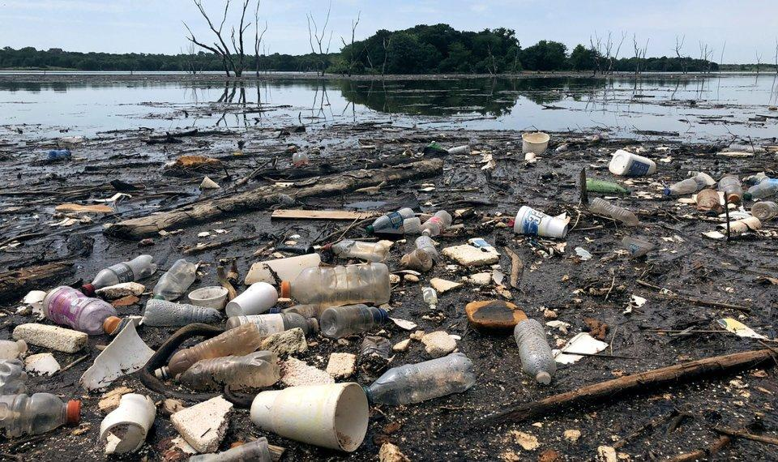
What does water pollution look like?
Image source: Shlotthauer, K. (2018). Trash piles up at Arcadia Lake--Edmond's main source of drinking water [Image]. The Oklahoman. Retrieved from https://oklahoman.com/article/5599714/trash-piles-up-at-arcadia-lake
Notes:
Ask students Image Source: Shlotthauer, K. (2018). [Photo Image] Trash piles up at Arcadia Lake--Edmond's main source of drinking water. The Oklahoman. Retrieved from https://oklahoman.com/article/5599714/trash-piles-up-at-arcadia-lake
to think about what they’re seeing in the picture. Ask them to pay attention to all the parts, the color of the water, the different types of debris they’re seeing, etc.

Slide 5
It’s OPTIC-al
O: Observations about the picture.
P: Parts that seem important or significant.
T: Title of the picture (find it or create one).
I: Interpretation of the picture’s message.
What does this picture tell us?
C: Conclusion you draw.
What do you predict about the future based on this picture?

Slide 6
It’s OPTIC-al
Go to your area matching your group number. Take your “It’s OPTICAL” graphic organizer.
Fill out the parts of O-P-T-I-C listed on the large poster next to your picture.
On your graphic organizer, write a short description of the picture you just analyzed.
Notes:
Make sure all the pictures have been numbered 1-6 so they can match the picture to the correct box on their graphic organizer.

Slide 7
Carousel/Gallery Walk
Rotate clockwise to each picture around the room.
At each new picture, look at what your classmates wrote for their OPTIC descriptions. Then, with your group, write your own description on your personal graphic organizer.
Once you have looked at each picture, work with your group to fill out the conclusion portion of the graphic organizer together.
Notes:
Time students at each picture and tell them not to rotate until you direct them to.

Slide 8
Categorical Highlighting
As you read, look for information to help you respond to the following questions:
What is contributing to the pollution of the Ganges River?
What efforts have been made to clean up Ganges River?
Highlight any information in the reading that answers these questions.
Once you have finished reading, share what you highlighted with your partner. Together, discuss the questions and what answers you found.

Slide 9
Two-Minute Paper
For the next two minutes, respond to the following questions on notebook paper:
What role do you play in water conservation and water pollution?
What impact does water conservation and water pollution have beyond just our personal use?
Image source: Shlotthauer, K. (2018). Trash piles up at Arcadia Lake--Edmond's main source of drinking water [Image]. The Oklahoman. Retrieved from https://oklahoman.com/article/5599714/trash-piles-up-at-arcadia-lake
Notes:
Image source: Shlotthauer, K. (2018). [Photo Image] Trash piles up at Arcadia Lake--Edmond's main source of drinking water. The Oklahoman. Retrieved from https://oklahoman.com/article/5599714/trash-piles-up-at-arcadia-lake

Slide 10
Director of OWRB, Julie Cunningham
K20 Center. (2020, February 13). ICAP - What's in your Water. YouTube. Retrieved from https://youtu.be/P4BAvdIznV4

Slide 11
Two-Minute Paper
Go back to your Two-Minute Paper. Add to your paper a response to the following question:
How can we support efforts to clean, protect, and
conserve our water and water sources?

