Slide 2
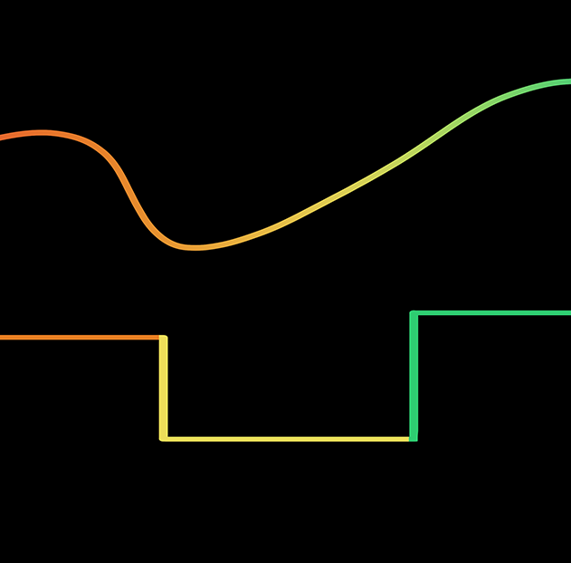
Signal Wars:
Analog vs. Digital Showdown
Waves and Their Application for Information Transfer

Slide 3

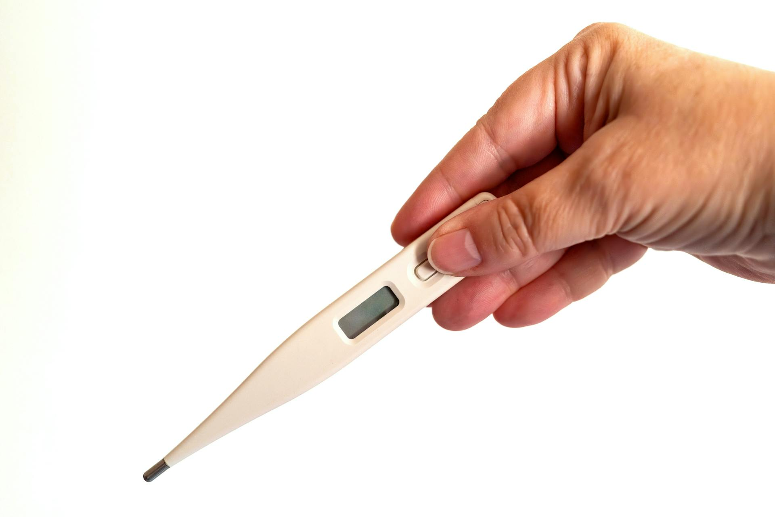

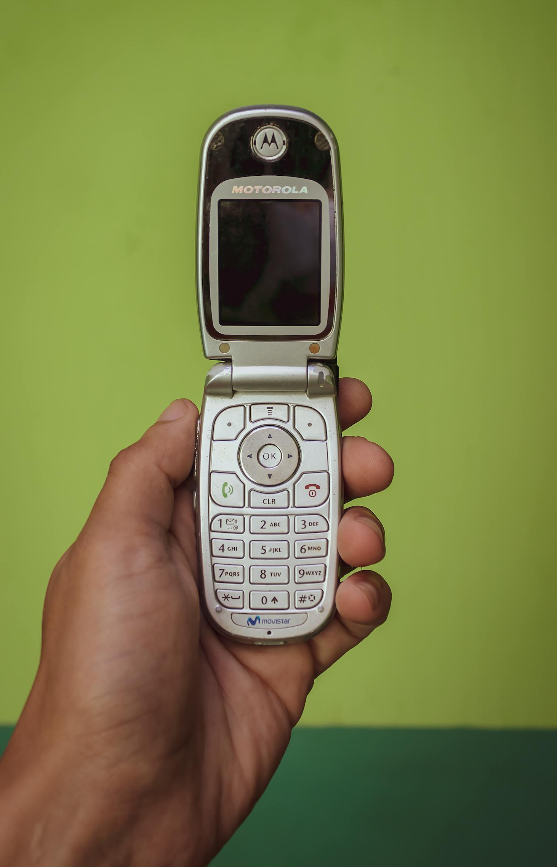
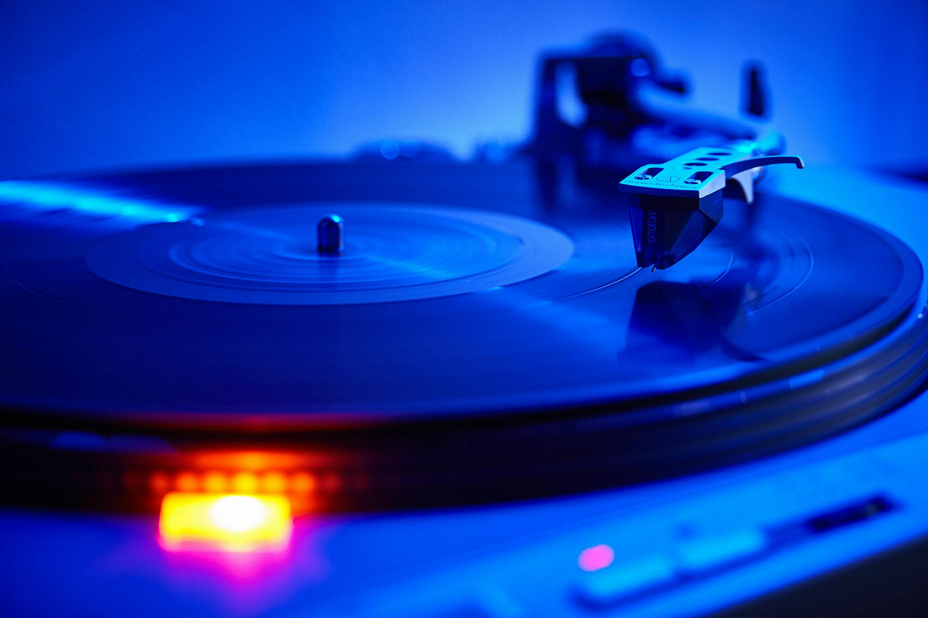
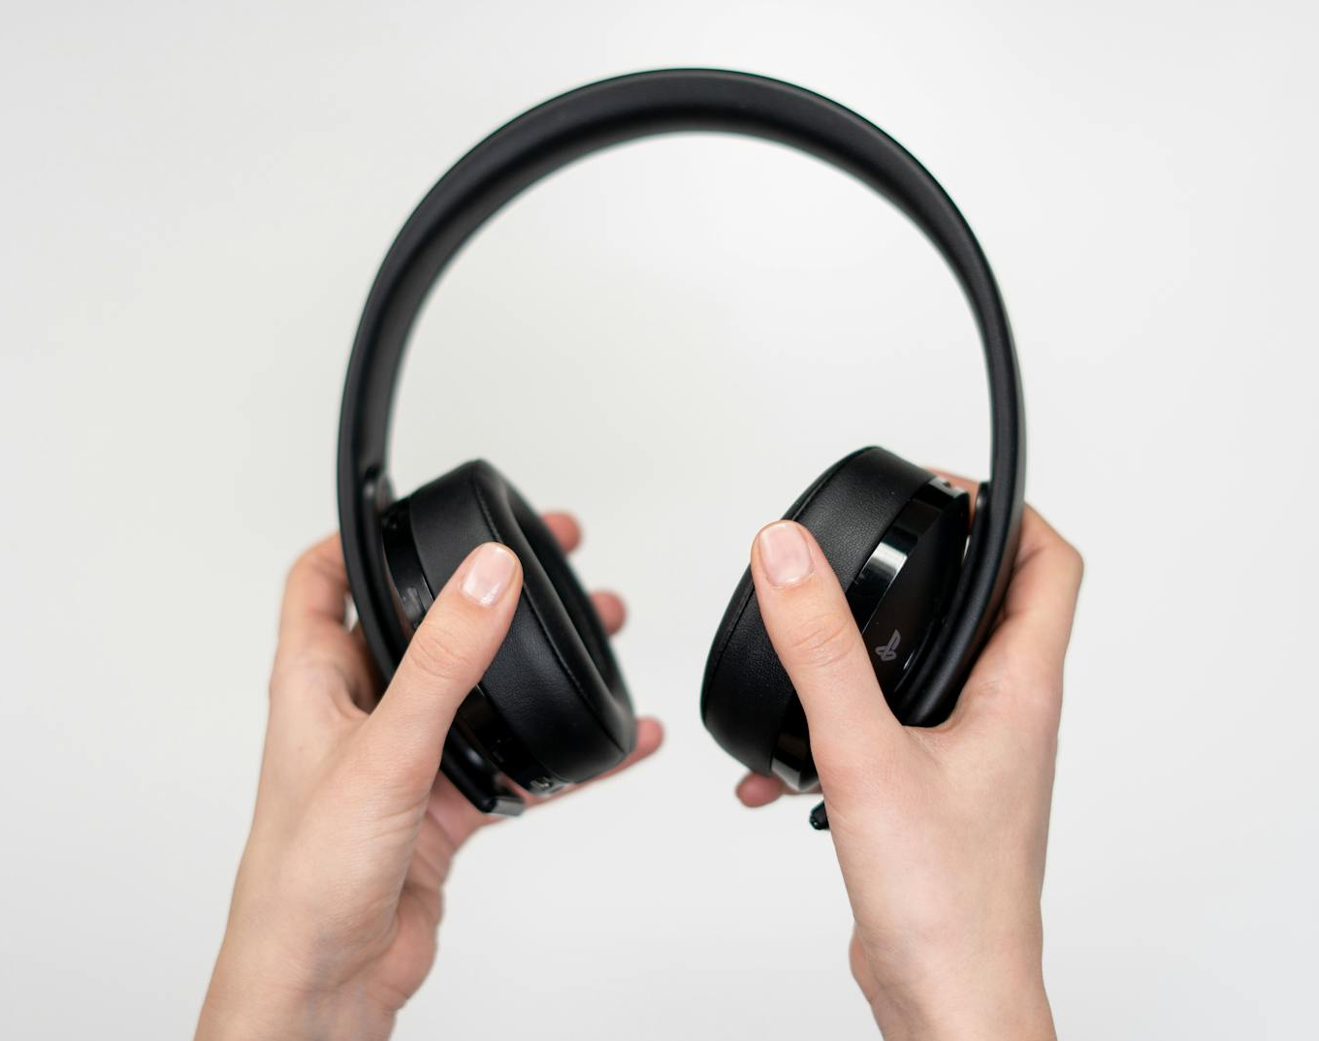
Thinking About
Technology
What do you notice?
What do you wonder?
Notes:
Arturo Añez. (2022, October 8). Person holding old cellphone [Photograph]. Pexels. https://www.pexels.com/photo/a-person-holding-old-cellphone-14127221/
Cottonbro studio. (2020, February 25). Cordless headphones [Photograph]. Pexels. https://www.pexels.com/photo/person-holding-black-cordless-headphones-3945669/
Nofi, A. (2020, October 11). Vinyl record on turntable [Photograph]. Pexels. https://www.pexels.com/photo/a-vinyl-record-on-a-turntable-5657556/
Podrex, A. (2021, May 4). Person playing Playstation VR [Photograph]. Pexels. https://www.pexels.com/photo/person-in-purple-shirt-playing-playstation-vr-7773805/
Sikunov, R. (2023, March 1). Close up of clock [Photograph]. Pexels. https://www.pexels.com/photo/close-up-of-clock-16231038/
Vogel, G. (2024, October 18). Digital thermometer [Photograph]. Pexels. https://www.pexels.com/photo/hand-holding-a-digital-thermometer-on-white-background-29007236/

Slide 4
Essential Questions
How are waves used in communication?
Why does modern technology tend to use digital signals rather than analog signals?

Slide 5
Learning Objectives
Identify modern communication devices that use digital signals.
Explain how waves can be used for communication.
Defend the claim that digital signals are more reliable than analog signals.

Slide 6
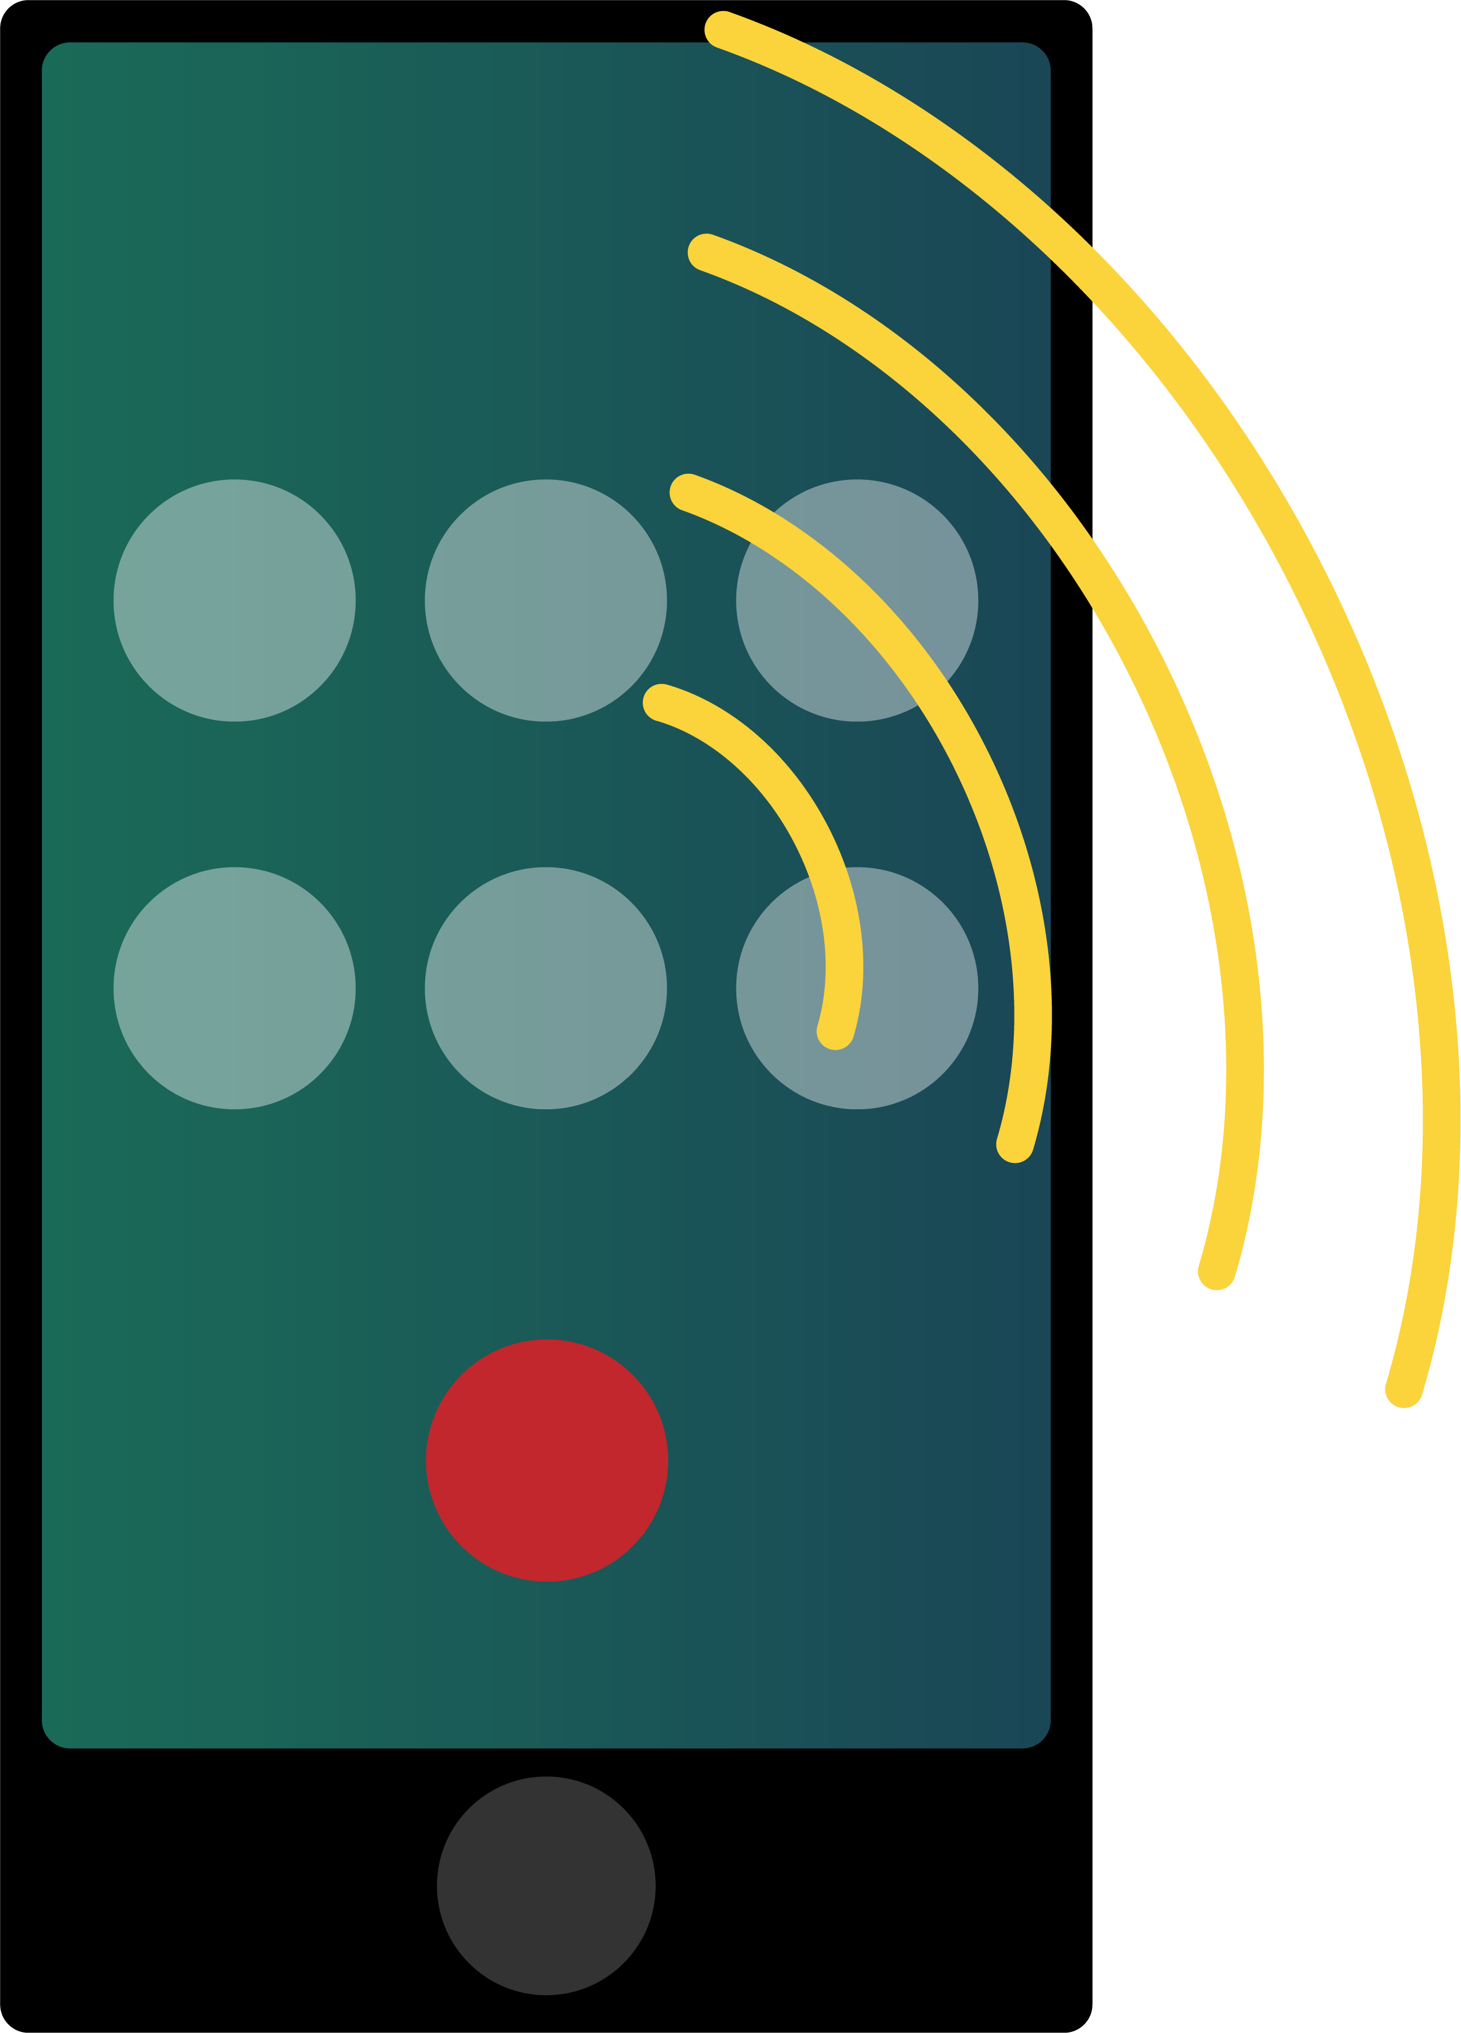
Telephone Game
Form a line.
Whisper what you heard to the
next person in line.
The last person announces the phrase.

Slide 7
Telephone Game
What was the original phrase?
Signals are energy.

Slide 8
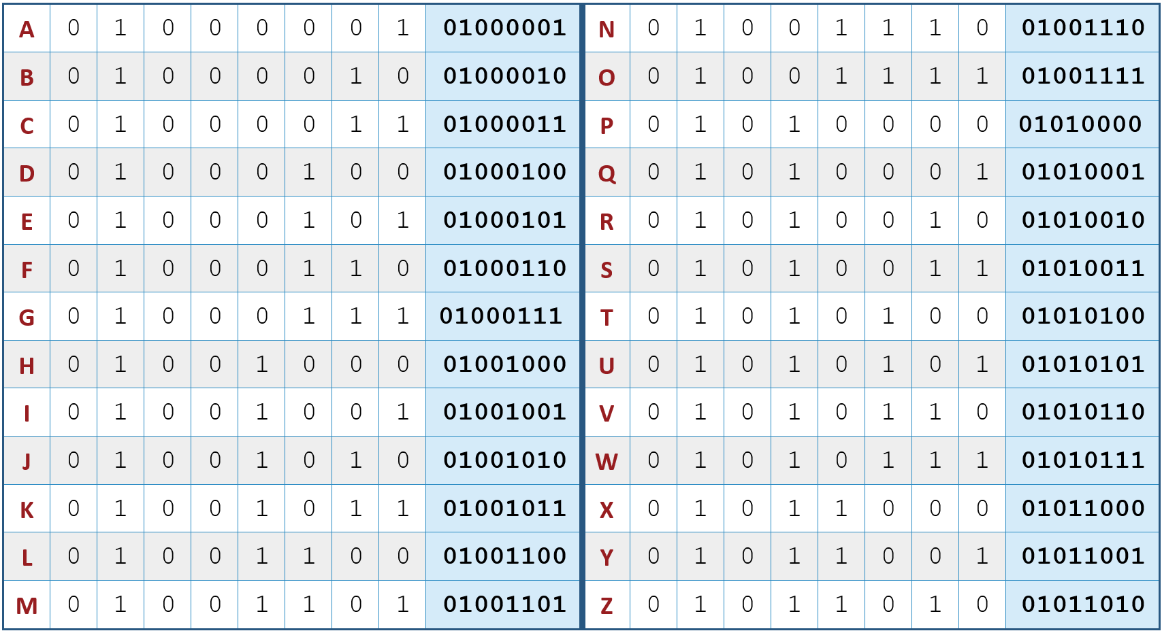
Decoding Game
Use the Binary Decoder to
decode the letter on each card.
  Be sure to record your results in order.
  There are 26 cards, including 2 spaces.
Pass the card to the next person along the path.
When everyone agrees, announce the
decoded message as a whole class.

Slide 9
Decoding Game
What was the coded message?
TECHNOLOGY TRANSFERS SIGNALS.

Slide 10
Reflection
What was the difference between the two ways of communication?
Which version was more accurate?

Slide 11
Analog vs. Digital
Analog waves are smooth and flow like a curvy line, like music playing through a speaker.
Digital waves are clear steps or values, using numbers (usually 0s and 1s) to represent information, like music stored on your phone.

Slide 12
Analog vs. Digital
Term | Definition | Tools/Equipment
 | Represents data in continuous waves | microphones, vinyl records, guitar pickups, speakers, traditional radio receivers, traditional televisions, landline telephones, etc.
 | Represents data as a sequence of values (1s and 0s) | computers, smartphones, touchscreen devices, digital thermometers, automated blood pressure cuffs, etc.

Slide 13
Analog vs. Digital
As you watch the
following video,
complete the
Venn Diagram
on your Note Catcher.
Be sure to leave space to add additional information.
Both

Slide 14
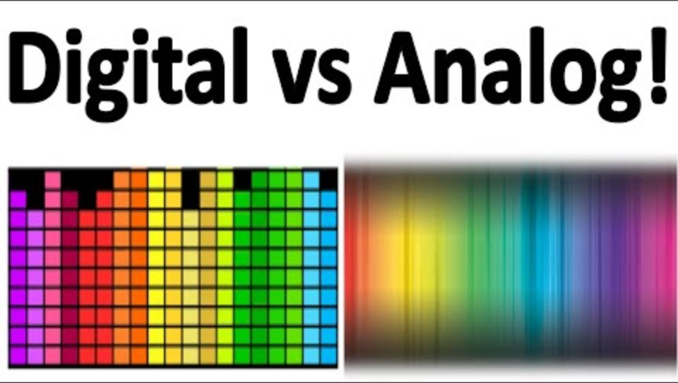
Analog vs. Digital: Venn Diagram
Digital vs. Analog: What’s the Difference? What Does It Matter?
Notes:
Basics Explained. (2021, September 10). Digital vs analog. What’s the difference? Why does it matter? [Video]. YouTube. https://www.youtube.com/watch?v=ZWdT-6Ld71Q

Slide 15
Analog vs. Digital
Both
Continuous gradient
Uses binary code
Transfers signals
Precise information
Limited information
Reliable
A drawn picture
Represents data in waves
Pixels used to represent a picture
Smooth waves
Square waves

Slide 16
Analog vs. Digital
Both
Has more detail in the information that is being relayed but can degrade over time, especially when used frequently
May lose small details, but important details usually remain clear
Types of
technology
Has the ability to
be updated
Easier to store

Slide 17

Build the Robot
Work together and follow
the directions to build the robot.
Use the top cup to indicate your progress.
  Red: We need help.
  Yellow: We are working.
  Green: We are done.
Notes:
Sirrob01. (2014, July 23). Cartoon robot [Illustration]. Wikimedia Commons. https://commons.wikimedia.org/wiki/File:Cartoon_Robot.svg

Slide 18
Deconstruct and Improve
Gently take apart the robot.
(Undo your build.)
Design a new and improved,
digital version of the robot.
  What did this robot do?
  What could your robot do better?
Create a presentation about your improved design.
Notes:
Sirrob01. (2014, July 23). Cartoon robot [Illustration]. Wikimedia Commons. https://commons.wikimedia.org/wiki/File:Cartoon_Robot.svg

Slide 19
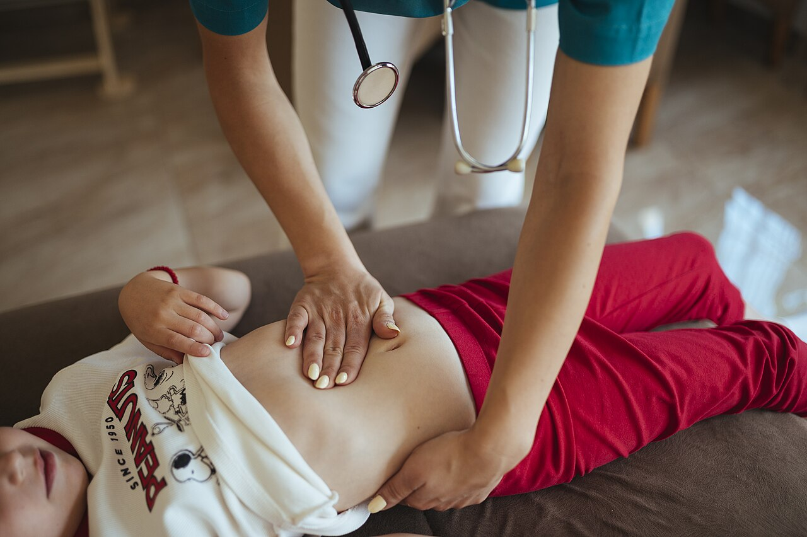
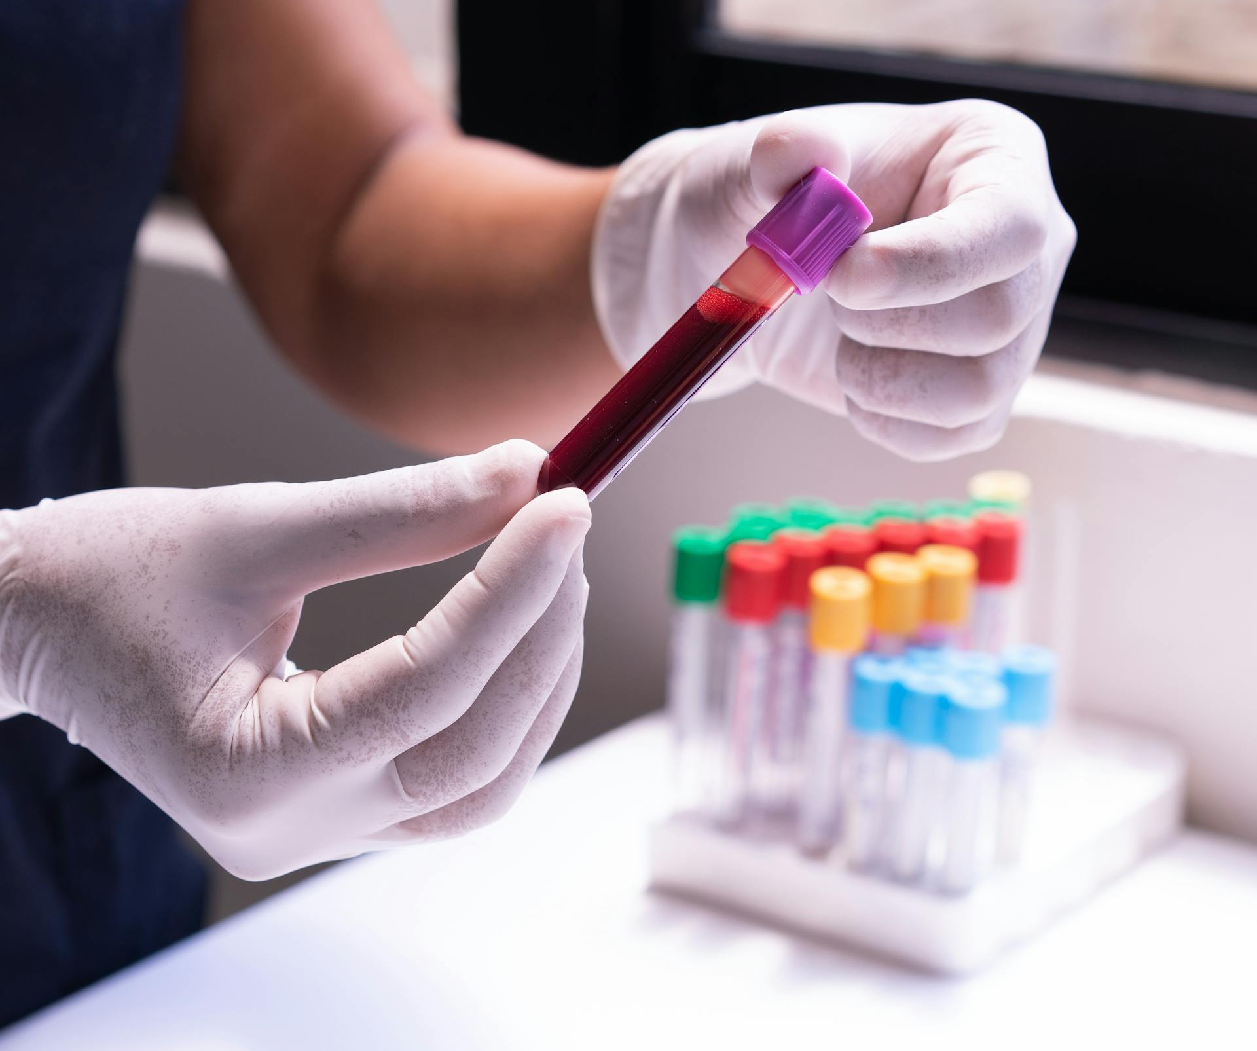
Looking Within
To help doctors understand what’s
going on—things they can’t see by
just looking at you—they may:
Complete a physical exam
Run lab tests (collect a sample of blood,
urine, tissue, …)
Order diagnostic imaging
(X-rays, MRI, CT scan, …)
Notes:
Los Muertos Crew. (2021, May 30). Blood sample in a test tube [Photograph]. Pexels. https://www.pexels.com/photo/person-holding-a-blood-sample-in-a-test-tube-8460346/
Shixart1985. (2025, June 15). Pediatric check-up [Photograph]. Wikimedia Commons. https://commons.wikimedia.org/wiki/File:Pediatric_check-up_with_a_doctor_examining_a_child%27s_abdomen_during_a_clinic_visit.jpg

Slide 20
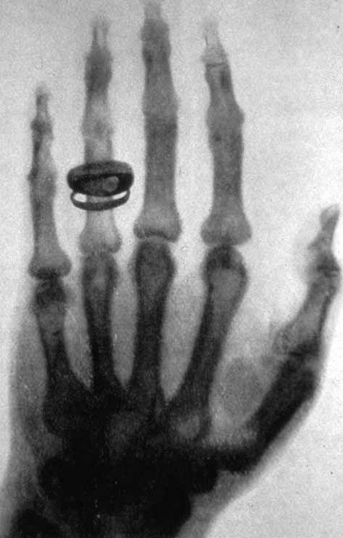
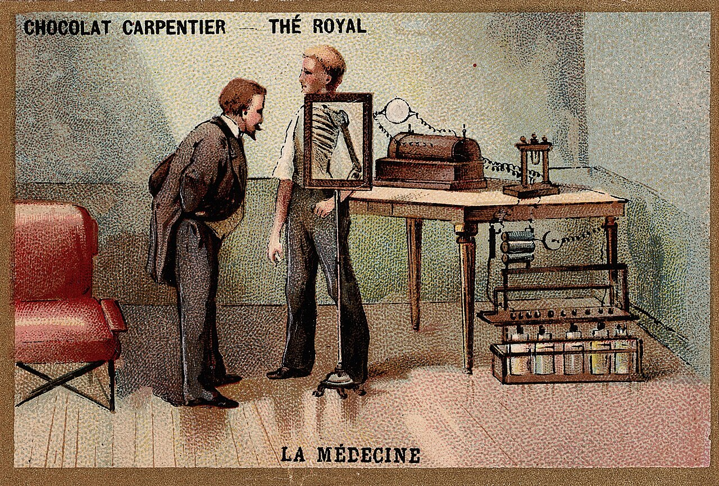
Analog X-ray Images
Before digital X-ray images:
Discovered by German physicist:
Wilhelm Conrad Röntgen
Used photographic film for images
Required chemical processing
in darkrooms
Viewed films on light boards
Notes:
Röntgen, W.C. (1896, January 23). X-ray of Albert von Kölliker's hand [Image]. Wikimedia Commons. https://commons.wikimedia.org/wiki/File:X-ray_by_Wilhelm_R%C3%B6ntgen_of_Albert_von_K%C3%B6lliker%27s_hand_-_18960123-02.jpg
Wellcome Library. (1900). Wilhelm Conrad Roentgen looking into an X-ray screen placed [Chromolithograph]. Wikimedia Commons. https://commons.wikimedia.org/wiki/File:Wilhelm_Conrad_Roentgen_looking_into_an_X-ray_screen_placed_Wellcome_L0027361.jpg

Slide 21
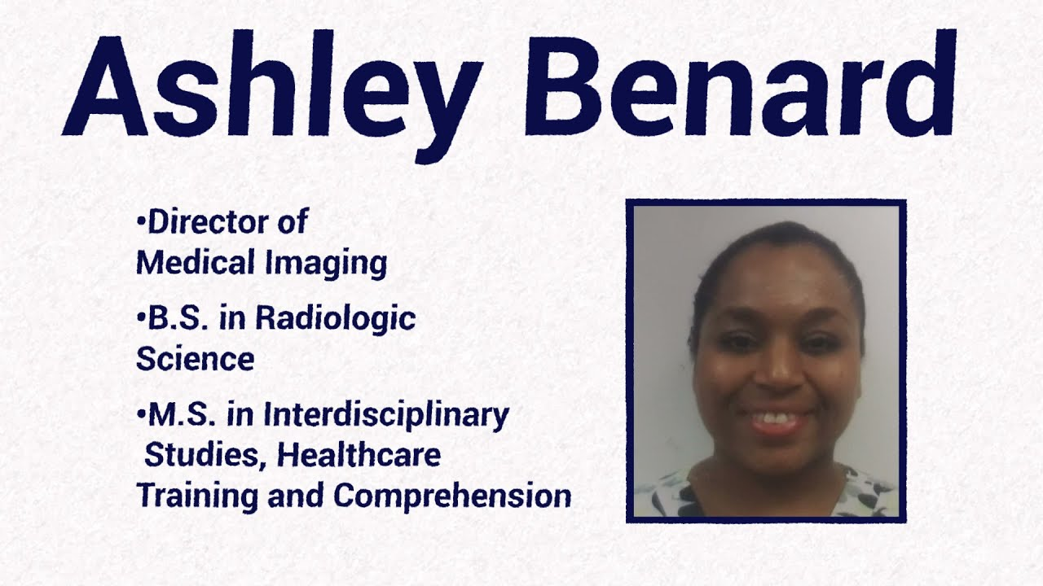
Director of Medical Imaging
Notes:
K20 Center. (2021, May 10). Director of medical imaging for community health centers, inc [Video]. YouTube. https://www.youtube.com/watch?v=7kW5Lb89nqU

Slide 22
Medical Imaging
What do you think are some of the advantages and some of the disadvantages of moving from analog to digital medical equipment?

Slide 23
Group Presentations
Share your new and improved robot!
Be respectful.
Be ready for brief Q&A.
Q
A

