Slide 1
Blue or Gray?
Perspectives in the Civil War

Slide 2
Essential Questions
Why do people fight?
What is worth fighting for?

Slide 3
Lesson Objectives
Describe various perspectives and motives of persons involved in the U.S. Civil War.
Understand the impact and contributions of specific groups during the conflict.

Slide 4
Historical Mingle
You will receive a card with a photo and biographical information.
Assume the role of this real Civil War figure.
Take 2–3 minutes to read through your role.
Notes:
K20 Center. (n.d.). Historical Mingle. Strategies. https://learn.k20center.ou.edu/strategy/184

Slide 5
Historical Mingle
The goal of this activity is to “meet” new people who also lived through the Civil War.
You should:
Get up from your seat
Meet with someone else
Introduce yourself
Talk about yourself and your experiences in the Civil War
Notes:
K20 Center. (n.d.). Historical Mingle. Strategies. https://learn.k20center.ou.edu/strategy/184

Slide 6
Questions to Ask
“What do you do?”
“Where are you from originally?”
“What have your experiences been like during the Civil War?”
“For which side are you fighting?”
“Have you seen any battles?“
“Can you vote? If so, which presidential candidate did you vote for?”
Notes:
K20 Center. (n.d.). Historical Mingle. Strategies. https://learn.k20center.ou.edu/strategy/184
YouTube. (n.d.). K20 2-minute timer. YouTube. https://www.youtube.com/watch?v=HcEEAnwOt2c&list=PL-aUhEQeaZXLMF3fItNDxiuSkEr0pq0c2&index=4

Slide 7
Discussion
Use the Historical Roles Graphic Organizer to fill in information about each person in the Historical Mingle.
We will discuss each person individually.
As we discuss, if you portrayed this person in the activity, share out information about your person and which side they may have taken in the war.

Slide 8
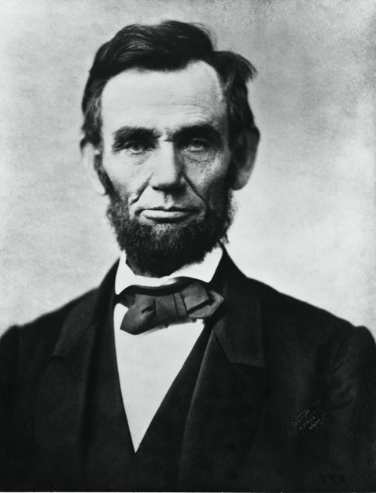
Abraham Lincoln
Who had this role?
What have you done?
How do you feel about the Civil War?
Why do you feel this way about the war?
Gardner, A. (1863, Nov. 8). Abraham Lincoln, the sixteenth president of the United States. Retrieved from https://commons.wikimedia.org/wiki/File:Abraham_Lincoln_November_1863.jpg
Notes:
Gardner, A. (1863, Nov. 8). Abraham Lincoln, the sixteenth president of the United States. Retrieved from https://commons.wikimedia.org/wiki/File:Abraham_Lincoln_November_1863.jpg

Slide 9
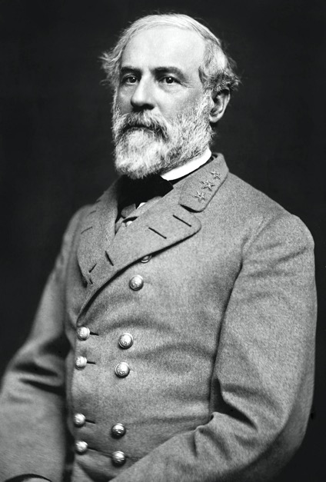
General Robert E. Lee
Who had this role?
What have you done?
How do you feel about the Civil War?
Why do you feel this way about the war?
Vannerson, J. (1864, March). Portrait of Gen. Robert E. Lee, officer of the Confederate Army. The Library of Congress Prints & Photographs Online Catalog. Retrieved from https://commons.wikimedia.org/wiki/File:Robert_Edward_Lee.jpg
Notes:
Vannerson, J. (1864, March). Portrait of Gen. Robert E. Lee, officer of the Confederate Army. The Library of Congress Prints & Photographs Online Catalog. Retrieved from https://commons.wikimedia.org/wiki/File:Robert_Edward_Lee.jpg

Slide 10
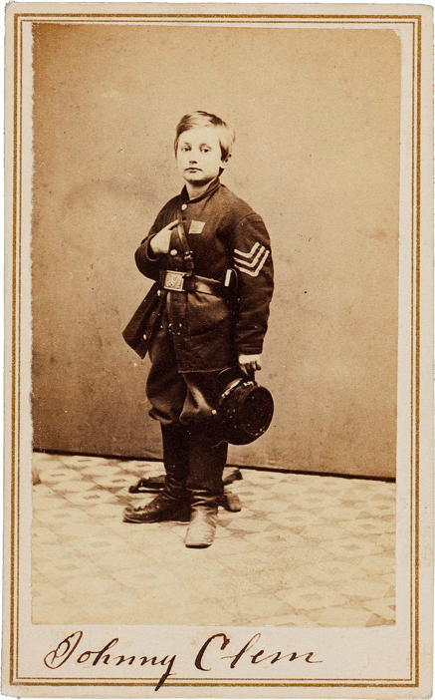
John Lincoln Clem
Who had this role?
What have you done?
How do you feel about the Civil War?
Why do you feel this way about the war?
Heritage Auctions. (1865). Civil War Union signed carte de viste of drummer boy Johnny Clem. Wikimedia Commons. Retrieved from https://commons.wikimedia.org/wiki/File:John_Clem_signed_CDV.jpg
Notes:
Heritage Auctions. (1865). Civil War Union signed carte de viste of drummer boy Johnny Clem. Wikimedia Commons. Retrieved from https://commons.wikimedia.org/wiki/File:John_Clem_signed_CDV.jpg

Slide 11
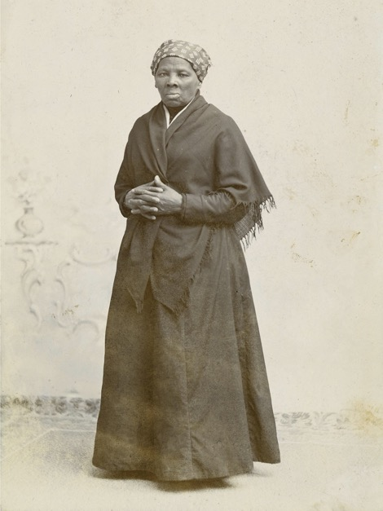
Harriet Tubman
Who had this role?
What have you done?
How do you feel about the Civil War?
Why do you feel this way about the war?
Squyer, H.S. (1885). Portrait of Harriet Tubman. National Portrait Gallery. Retrieved from https://commons.wikimedia.org/wiki/File:Harriet_Tubman_by_Squyer,_NPG,_c1885.jpg
Notes:
Squyer, H.S. (1885). Portrait of Harriet Tubman. National Portrait Gallery. Retrieved from https://commons.wikimedia.org/wiki/File:Harriet_Tubman_by_Squyer,_NPG,_c1885.jpg

Slide 12
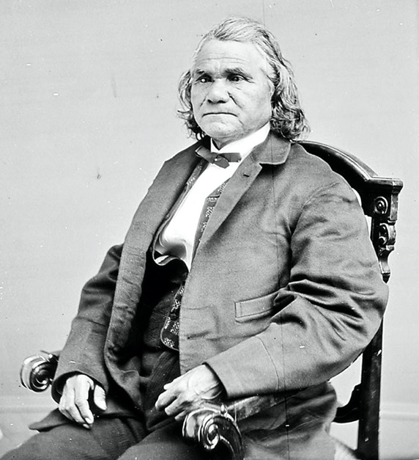
Stand Watie
Who had this role?
What have you done?
How do you feel about the Civil War?
Why do you feel this way about the war?
N.a. (n.d.). Portrait of Stand Watie as leader of the Treaty Party of the Cherokee Nation. Wikimedia Commons. Retrieved from https://en.wikipedia.org/wiki/Stand_Watie#/media/File:Stand_Watie.jpg
Notes:
N.a. (n.d.). Portrait of Stand Watie as leader of the Treaty Party of the Cherokee Nation. Wikimedia Commons. Retrieved from https://en.wikipedia.org/wiki/Stand_Watie#/media/File:Stand_Watie.jpg

Slide 13
George Kye
Who had this role?
What have you done?
How do you feel about the Civil War?
Why do you feel this way about the war?
Why do we think there is no known photo of George Kye?
What does this tell us about society?
No Known Photo
N.a. (2006 August). Man silhouette. Wikimedia Commons. Retrieved from https://commons.wikimedia.org/wiki/File:Man_silhouette.svg
Notes:
N.a. (2006 August). Man silhouette. Wikimedia Commons. Retrieved from https://commons.wikimedia.org/wiki/File:Man_silhouette.svg

Slide 14
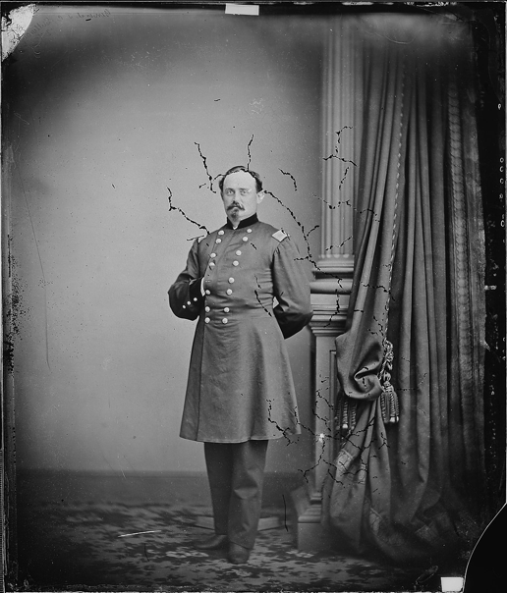
Michael Corcoran
Who had this role?
What have you done?
How do you feel about the Civil War?
Why do you feel this way about the war?
Brady, M. (1865). Gen. Michael Corcoran. U.S. National Archives and Records Administration. Retrieved from https://commons.wikimedia.org/wiki/File:Gen._Michael_Corcoran_-_NARA_-_528494.jpg
Notes:
Brady, M. (1865). Gen. Michael Corcoran. U.S. National Archives and Records Administration. Retrieved from https://commons

Slide 15
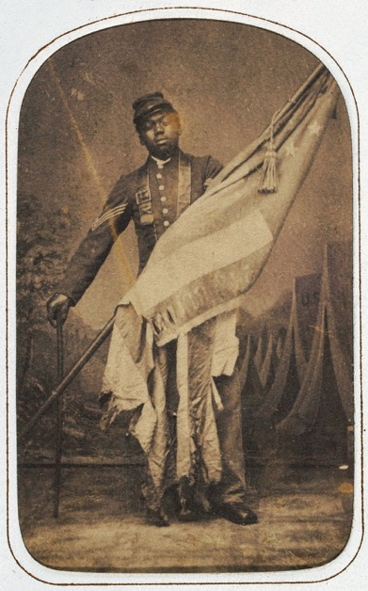
William Harvey Carney
Who had this role?
What have you done?
How do you feel about the Civil War?
Why do you feel this way about the war?
Ritchie, J. (c. 1864). William Harvey Carney. National Museum of African American History & Culture. Retrieved from https://commons.wikimedia.org/wiki/File:William_Harvey_Carney_c1864.jpg
Notes:
Ritchie, J. (c. 1864). William Harvey Carney. National Museum of African American History & Culture. Retrieved from https://commons.wikimedia.org/wiki/File:William_Harvey_Carney_c1864.jpg

Slide 16
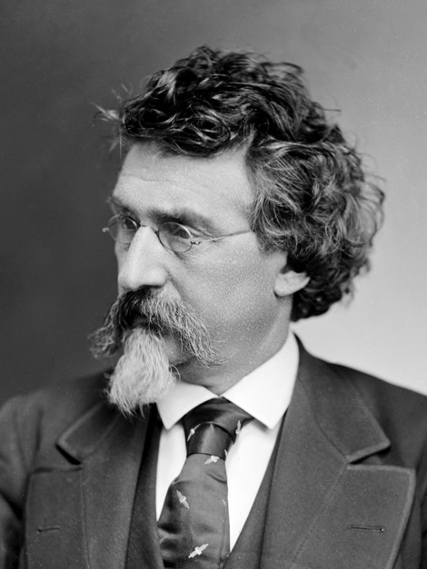
Mathew Brady
Who had this role?
What have you done?
How do you feel about the Civil War?
Why do you feel this way about the war?
N.A. (1875). Mathew Brady. Brady-Handy Photograph Collection, Library of Congress. Retrieved
from https://commons.wikimedia.org/wiki/File:Mathew_Brady_circa_1875.png
Notes:
N.A. (1875). Mathew Brady. Brady-Handy Photograph Collection, Library of Congress. Retrieved from https://commons.wikimedia.org/wiki/File:Mathew_Brady_circa_1875.png

Slide 17
Mary Jane Richards
Who had this role?
What have you done?
How do you feel about the Civil War?
Why do you feel this way about the war?
Why do we think there is no known photo of Mary Jane Richards?
What does this tell us about society?
No Known Photo
N.a. (2006 August). Man silhouette. Wikimedia Commons. Retrieved from https://commons.wikimedia.org/wiki/File:Man_silhouette.svg
Notes:
N.a. (2006 August). Man silhouette. Wikimedia Commons. Retrieved from https://commons.wikimedia.org/wiki/File:Man_silhouette.svg

Slide 18
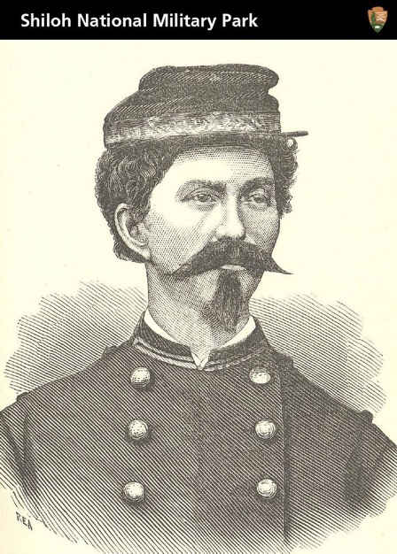
Loreta Janeta Velázquez
Who had this role?
What have you done?
How do you feel about the Civil War?
Why do you feel this way about the war?
Why is this the only image we have of Loreta Janeta Velázquez?
TradingCardsNPS. (2012, May 18). Civil War Soldier, Spy, and Author. Wikimedia Commons. Retrieved from https://commons.wikimedia.org/wiki/File:Civil_War_Soldier,_Spy,_and_Author_(7223011484).jpg
Notes:
TradingCardsNPS. (2012, May 18). Civil War Soldier, Spy, and Author. Wikimedia Commons. Retrieved from https://commons.wikimedia.org/wiki/File:Civil_War_Soldier,_Spy,_and_Author_(7223011484).jpg

Slide 19
Analysis
Now that we have discussed each person, look at your graphic organizer.
Do you notice any similarities or trends?
Are there similarities between particular people and which side of the Civil War they fought for?
Circle, underline, or highlight any interesting connections you can find.

Slide 20
Analysis
Share what you found!

Slide 21
Why-Lighting Activity
With your partner read your assigned document.
You are the expert on this document.
Why-Light your document:
Highlight information you think is important.
Write in the margins why you highlighted this information.
Notes:
K20 Center. (n.d.). Why-Lighting. Strategies. https://learn.k20center.ou.edu/strategy/128

Slide 22
Jigsaw Activity
Work with your group—each person has read a different article.
Share your expertise with your group.
As others share, complete your Jigsaw graphic organizer, making notes over each reading.
Notes:
K20 Center. (n.d.). Jigsaw. Strategies. https://learn.k20center.ou.edu/strategy/179

Slide 23
Two-Voice Poem
Based on the Historical Mingle activity and your readings from the Jigsaw, write a Two-Voice Poem showcasing two different Civil War perspectives.
One of these perspectives should be from the point of view of a woman, immigrant, African American (free or enslaved), or Native American.
Remember to be factual and respectful in your representation.
Notes:
K20 Center. (n.d.). Two-Voice Poem. Strategies. https://learn.k20center.ou.edu/strategy/133

Slide 24
Exit Ticket
On a sheet of paper answer the following questions:
Why do people fight?
What is worth fighting for?
Notes:
K20 Center. (n.d.). Bell Ringers and Exit Tickets. Strategies. https://learn.k20center.ou.edu/strategy/125

