Slide 2
Blue or Gray?
Perspectives in the Civil War

Slide 3
Essential Questions
Why do people fight?
What is worth fighting for?

Slide 4
Lesson Objectives
Describe various perspectives and motives of persons involved in the U.S. Civil War.
Understand the impact and contributions of specific groups during the conflict.

Slide 5
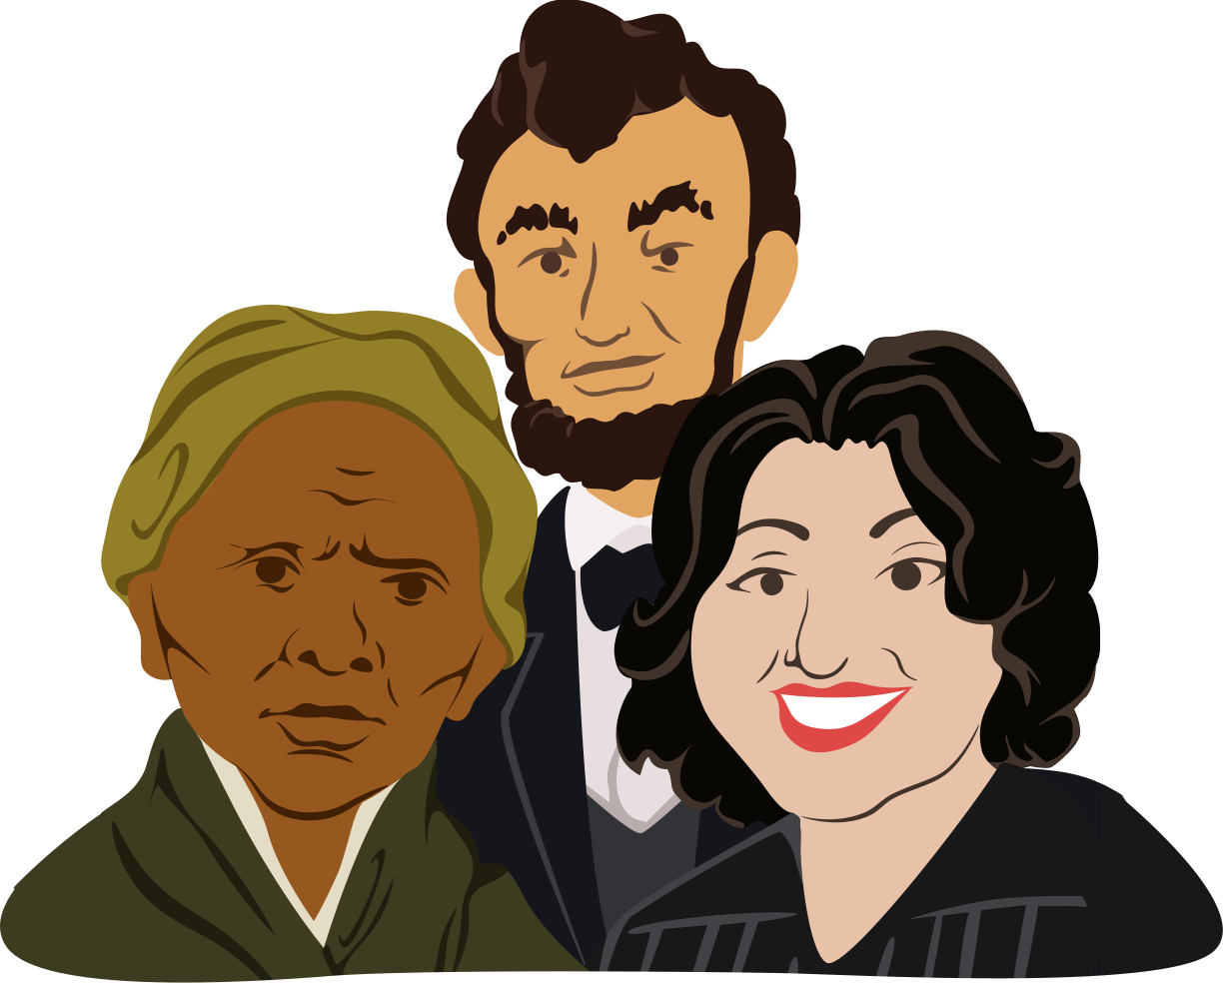
Historical Mingle
Read the biographical information on your card.
Assume the role of this real Civil War figure.
Take 2–3 minutes to read through your role.
Notes:
K20 Center. (n.d.). Historical mingle. Strategies. https://learn.k20center.ou.edu/strategy/184

Slide 6
Historical Mingle
“Meet” other people who also lived through the Civil War.
You should:
Get up from your seat
Meet with someone else
Introduce yourself
Talk about yourself and your experiences in the Civil War
Notes:
K20 Center. (n.d.). Historical mingle. Strategies. https://learn.k20center.ou.edu/strategy/184

Slide 7
Questions to Ask
“What do you do?”
“Where are you from originally?”
“What have your experiences been like during the Civil War?”
“For which side are you fighting?”
“Have you seen any battles?“
“Can you vote? If so, which presidential candidate did you vote for?”
Notes:
K20 Center. (n.d.). Historical mingle. Strategies. https://learn.k20center.ou.edu/strategy/184
K20 Center. (2021, September 21). K20 Center 2 minute timer [Video]. YouTube. https://www.youtube.com/watch?v=HcEEAnwOt2c&list=PL-aUhEQeaZXLMF3fItNDxiuSkEr0pq0c2&index=5

Slide 8
Discussion
Take notes about each person from the Historical Mingle using your Historical Roles Graphic Organizer.
During the discussion, share out information about the person you portrayed during the activity.
Include which side they may have taken during the war
Notes:
K20 Center. (n.d.). Historical mingle. Strategies. https://learn.k20center.ou.edu/strategy/184

Slide 9
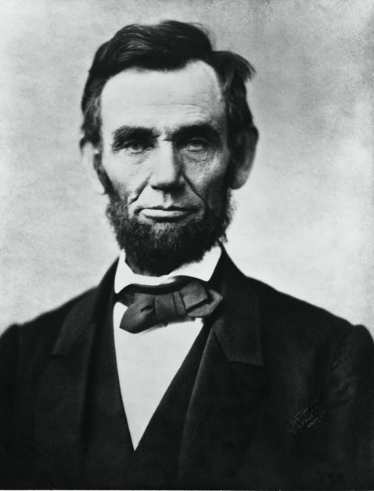
Abraham Lincoln
Who had this role?
What have you accomplished?
How do you feel about the Civil War?
Why do you feel this way about the war?
Notes:
Gardner, A. (1863). Abraham Lincoln November 1863 [Image]. Wikimedia Commons. https://commons.wikimedia.org/wiki/File:Abraham_Lincoln_November_1863.jpg

Slide 10
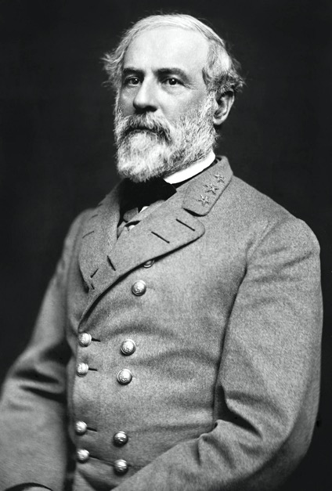
General Robert E. Lee
Who had this role?
What have you accomplished?
How do you feel about the Civil War?
Why do you feel this way about the war?
Notes:
Vannerson, J. (1864, March). Portrait of Gen. Robert E. Lee, officer of the Confederate Army [Image]. Wikimedia Commons. https://commons.wikimedia.org/wiki/File:Robert_Edward_Lee.jpg

Slide 11
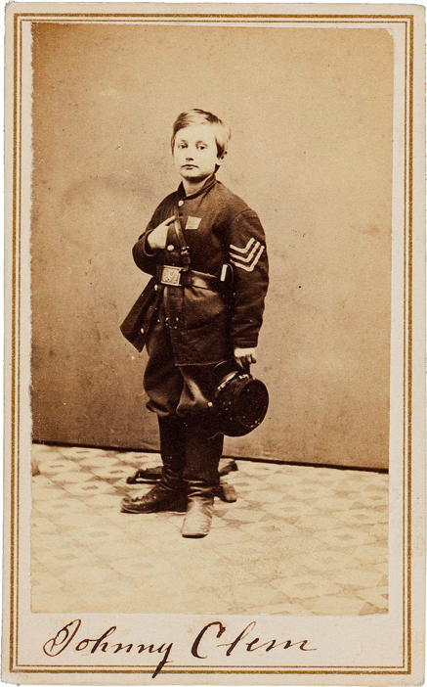
John Lincoln Clem
Who had this role?
What have you accomplished?
How do you feel about the Civil War?
Why do you feel this way about the war?
Notes:
Heritage Auctions. (1865). Civil War Union signed carte de viste of drummer boy Johnny Clem [Image]. Wikimedia Commons. https://commons.wikimedia.org/wiki/File:John_Clem_signed_CDV.jpg

Slide 12
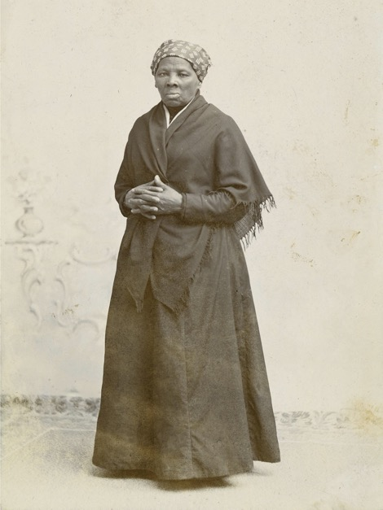
Harriet Tubman
Who had this role?
What have you accomplished?
How do you feel about the Civil War?
Why do you feel this way about the war?
Notes:
Squyer, H.S. (1885). [Portrait photograph of Harriet Tubman]. Wikimedia Commons. https://commons.wikimedia.org/wiki/File:Harriet_Tubman_by_Squyer,_NPG,_c1885.jpg

Slide 13
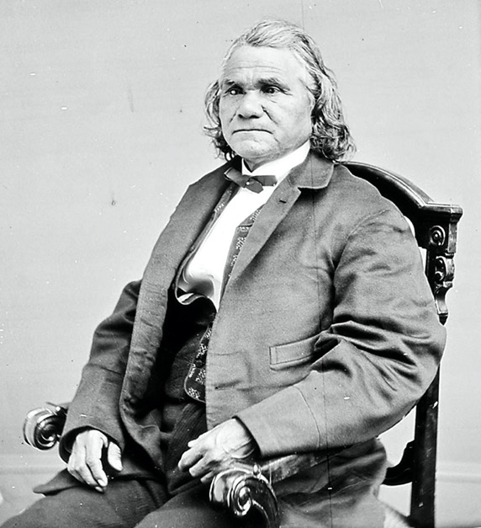
Stand Watie
Who had this role?
What have you accomplished?
How do you feel about the Civil War?
Why do you feel this way about the war?
Notes:
Isaac Stand Watie Degataga [Image]. (1871). Wikimedia Commons. https://commons.wikimedia.org/wiki/File:Stand_Watie.jpg

Slide 14
George Kye
Who had this role?
What have you accomplished?
How do you feel about the Civil War?
Why do you feel this way about the war?
Why do we think there is no known photo of George Kye?
What does this tell us about society?
No Known Photo
Notes:
liftarn. (2006, August 30). Man silhouette [Image]. Wikimedia Commons. https://commons.wikimedia.org/wiki/File:Man_silhouette.svg

Slide 15
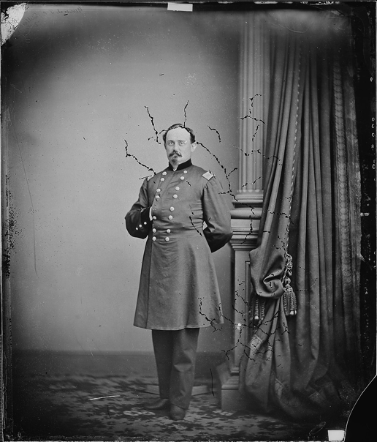
Michael Corcoran
Who had this role?
What have you accomplished?
How do you feel about the Civil War?
Why do you feel this way about the war?
Notes:
Brady, M. B. (1860). Gen. Michael Cocoran [Photograph]. Wikimedia Commons. https://commons.wikimedia.org/wiki/File:Gen._Michael_Corcoran_-_NARA_-_528494.jpg

Slide 16
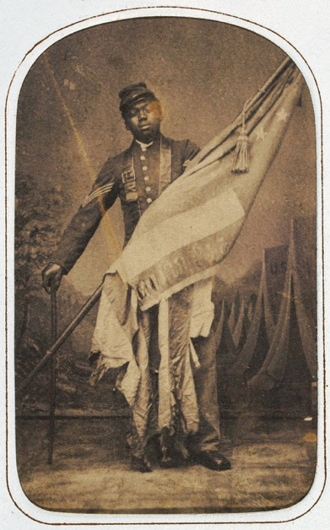
William Harvey Carney
Who had this role?
What have you accomplished?
How do you feel about the Civil War?
Why do you feel this way about the war?
Notes:
Ritchie, J. (ca. 1864). William Harvey Carney [Image]. Wikimedia Commons. https://commons.wikimedia.org/wiki/File:William_Harvey_Carney_c1864.jpg

Slide 17
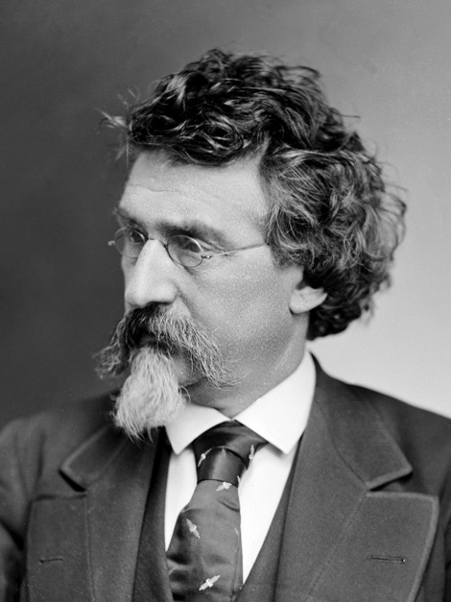
Mathew Brady
Who had this role?
What have you accomplished?
How do you feel about the Civil War?
Why do you feel this way about the war?
Notes:
Mathew Brady circa 1875 [Photograph]. (ca. 1875). Wikimedia Commons. https://commons.wikimedia.org/wiki/File:Mathew_Brady_circa_1875.png

Slide 18
Mary Jane Richards
Who had this role?
What have you accomplished?
How do you feel about the Civil War?
Why do you feel this way about the war?
Why do we think there is no known photo of Mary Jane Richards?
What does this tell us about society?
No Known Photo
Notes:
liftarn. (2006, August 30). Man silhouette [Image]. Wikimedia Commons. https://commons.wikimedia.org/wiki/File:Man_silhouette.svg

Slide 19
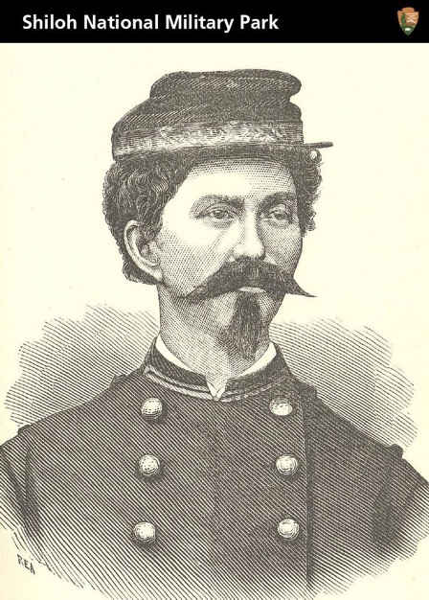
Loreta Janeta Velázquez
Who had this role?
What have you accomplished?
How do you feel about the Civil War?
Why do you feel this way about the war?
Why is this the only image we have of Loreta Janeta Velázquez?
Notes:
TradingCardsNPS. (2012, May 18). Civil War soldier, spy, and author [Image]. Wikimedia Commons. https://commons.wikimedia.org/wiki/File:Civil_War_Soldier,_Spy,_and_Author_(7223011484).jpg

Slide 20
Analysis
Read through the notes in your graphic organizer.
Do you notice any similarities or trends?
Are there similarities between particular people and for which side of the Civil War they fought?
Find and circle, underline, or highlight any interesting connections.

Slide 21
Analysis
Share the connections you found.

Slide 22
Why-Lighting Activity
With your partner, read your assigned document.
You are the expert on this document.
Why-Light your document:
Highlight information you think is important.
In the margins, write why you highlighted this information.
Notes:
K20 Center. (n.d.). Why-Lighting. Strategies. https://learn.k20center.ou.edu/strategy/128

Slide 23
Jigsaw Activity
Each person in your group has read a different article.
Share your expertise with your group.
As others share, take notes over each reading in your Jigsaw Graphic Organizer.
Notes:
K20 Center. (n.d.). Jigsaw. Strategies. https://learn.k20center.ou.edu/strategy/179

Slide 24
Two-Voice Poem
Based on the Historical Mingle activity and your readings from the Jigsaw activity, write a Two-Voice Poem that illustrates two different Civil War perspectives.
One perspective should be that of a woman, immigrant, African American (free or enslaved), or Native American.
Remember to be factual and respectful in your representation.
Notes:
K20 Center. (n.d.). Two-voice poem. Strategies. https://learn.k20center.ou.edu/strategy/133

Slide 25
Exit Ticket
Respond to the following questions:
Why do people fight?
What is worth fighting for?
Notes:
K20 Center. (n.d.). Bell ringers and exit tickets. Strategies. https://learn.k20center.ou.edu/strategy/125

