Slide 2
Impacts of Industrialization on Workers
8th Grade U.S. History and Government

Slide 3
Essential Questions
How did the industrialization of the American economy impact workers in the 19th and 20th centuries?
Should governments regulate businesses to protect the rights of workers?

Slide 4
Painting a Picture—Photographs
Using the photographs and the chart provided, take 5 minutes to look at each photo. Record your observations.
Next, with your group, share your observations. Working together, record your inferences. Be prepared to share with the whole class.

Slide 5
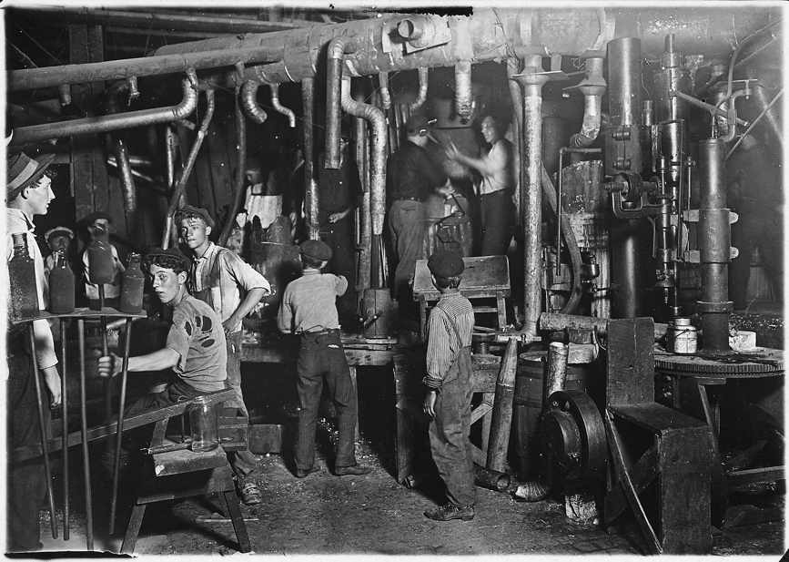
Photograph #1
Notes:
Library of Congress. (1908). 9 P.M. in an Indiana Glass Works, Aug. 1908. Location: Indiana. Library of Congress Prints and Photographs Division Washington, D.C. 20540 USA. Retrieved from https://hdl.loc.gov/loc.pnp/nclc.01166

Slide 6
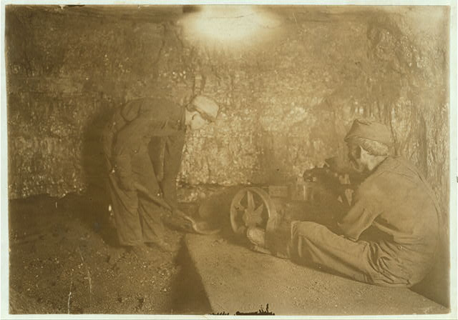
Photograph #2
Notes:
Library of Congress. (n.d.). National Child Labor Committee, No. 69. Man with punching machine to drill into coal. Boy shovels out 10 hrs. daily, Laura Mine, Red Star, W. Va. Location: Red Star, West Virginia.. Library of Congress Prints and Photographs Division Washington, D.C. 20540 USA. Retrieved from https://hdl.loc.gov/loc.pnp/nclc.01048

Slide 7
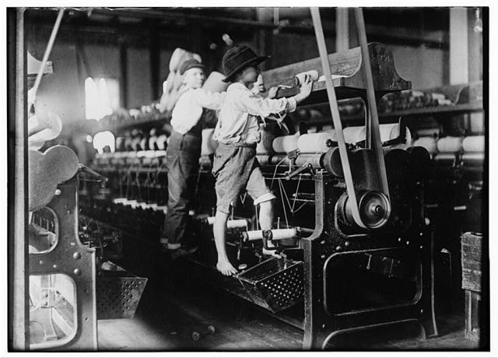
Photograph #3
Notes:
Library of Congress (1909, January 19). 488 Macon, Ga. Lewis W. Hine 1-19-1909. Bibb Mill No. 1 Many youngsters here. Some boys were so small they had to climb up on the spinning frame to mend the broken threads and put back the empty bobbins. Location: Macon, Georgia.. Library of Congress Prints and Photographs Division Washington, D.C. 20540 USA. Retrieved from https://hdl.loc.gov/loc.pnp/nclc.05394

Slide 8
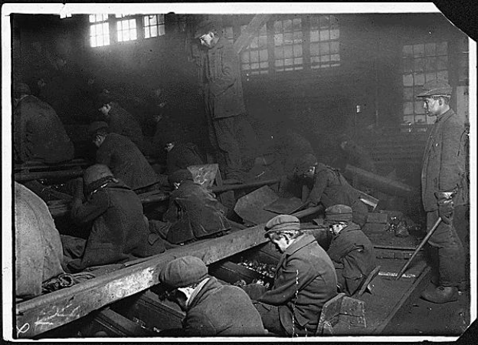
Photograph #4
Notes:
Hine, L. (1912.). View of the Ewen Breaker of the Pa. Coal Co. The dust was so dense at times as to obscure the view. This dust penetrated the utmost recesses of the boy's lungs. A kind of slave-driver sometimes stands over the boys, prodding or kicking them into obedience. S. Pittston, Pa.. National Archives Catalog. Retrieved from https://catalog.archives.gov/id/523378

Slide 9
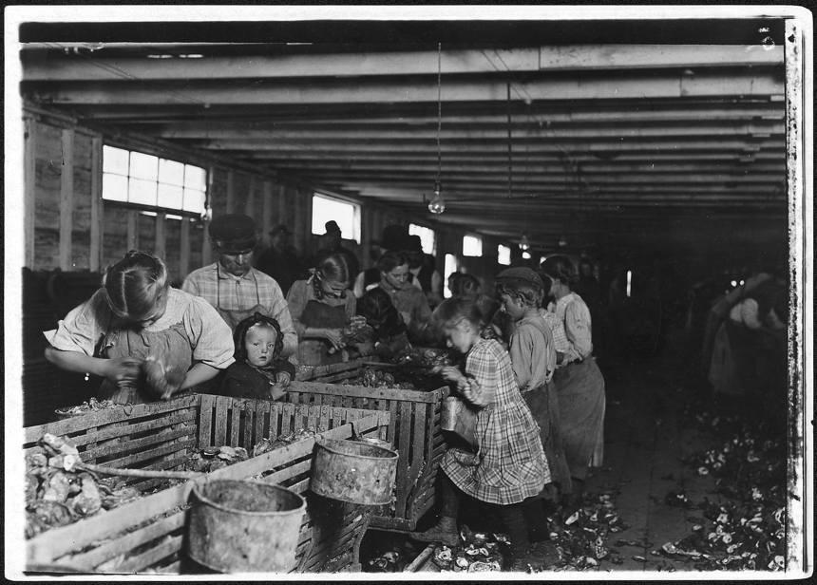
Photograph #5
Notes:
Hine, L. (1912.). Rosy, an 8 year old oyster shucker works steady all day from about 3 A.M. to 5 P.M. The baby will shuck as soon as she can handle the knife. Dunbar, La.. National Archives Catalog. Retrieved from https://catalog.archives.gov/id/523414

Slide 10
Painting a Picture—Document
Read excerpts from the report from Massachusetts lawmakers investigating the working conditions at the Lowell Mills.
As you read, highlight or underline things that concern you about the working conditions in the Lowell Mills.

Slide 11
Painting a Picture
Based on your inferences from the photos and the information from the text, respond to the following prompt in 2–3 sentences:
How did the industrialization of the American economy impact workers?

Slide 12
RAFT
Role - Worker
Audience - Business Owner or Congress
Format - Letter
Topic - Working conditions
If you were a factory working during the 1800s, what issues regarding your working conditions would you protest or fight to change?

Slide 13
Issues that Workers Protested
Issue | Resolution
Notes:
Type student answers into this slide.

Slide 14
Issues that Workers Protested
Issue | Resolution
low pay
long hours
dirty environment
dangerous environment
no sick/vacation days/weekends
child labor

Slide 15
Video Interview with AFL-CIO OK President
K20 Center. (2020, February 27). ICAP—Impacts of industrialization on workers [Video file]. Retrieved from https://youtu.be/XPpiKKsClTY
Notes:
https://youtu.be/XPpiKKsClTY

Slide 16
Issues that Workers Protested
Issue | Resolution
low pay
long hours
dirty environment
dangerous environment
no sick/vacation days/weekends
child labor
Notes:
Type student answers into this slide.

Slide 17
Issues that Workers Protested
Issue | Resolution
low pay | minimum wage laws
long hours | 40 hour work weeks + laws requiring breaks
dirty environment | laws requiring health inspections
dangerous environment | building codes, safety requirements
no time off | laws regulating time off - vacation, sick leave, parental leave, weekends etc.
child labor | laws preventing child labor

Slide 18
Class Discussion
Should governments regulate businesses to protect the rights of workers?

