Slide 2
Impact of Industrialization on Workers
The Industrial Revolution

Slide 3
Essential Questions
How did the early industrialization of the American economy impact workers in the 19th and 20th centuries?
Should governments regulate businesses to protect the rights of workers?

Slide 4
Learning Objectives
Explain the impact of industrialization on workers in the United States during the 19th and 20th centuries.
Consider the role that the government plays in regulating businesses and protecting labor rights within the United States.

Slide 5
Painting a Picture - Photographs
Using the photographs and the chart provided, take 5 minutes to look at each photo and record your observations.
Notes:
K20 Center. (n.d.). Painting a picture. Strategies. https://learn.k20center.ou.edu/strategy/1331
K20 Center. (2021, September 21). K20 Center 5-minute timer [Video]. YouTube. https://www.youtube.com/watch?v=EVS_yYQoLJg

Slide 6
Painting a Picture - Photographs
Next, with your group, use your observations and working together record your inferences.
What can you infer or conclude about how industrialization impacted workers?
Be prepared to share with the whole class.
Notes:
K20 Center. (n.d.). Painting a Picture. Strategies. https://learn.k20center.ou.edu/strategy/1331

Slide 7
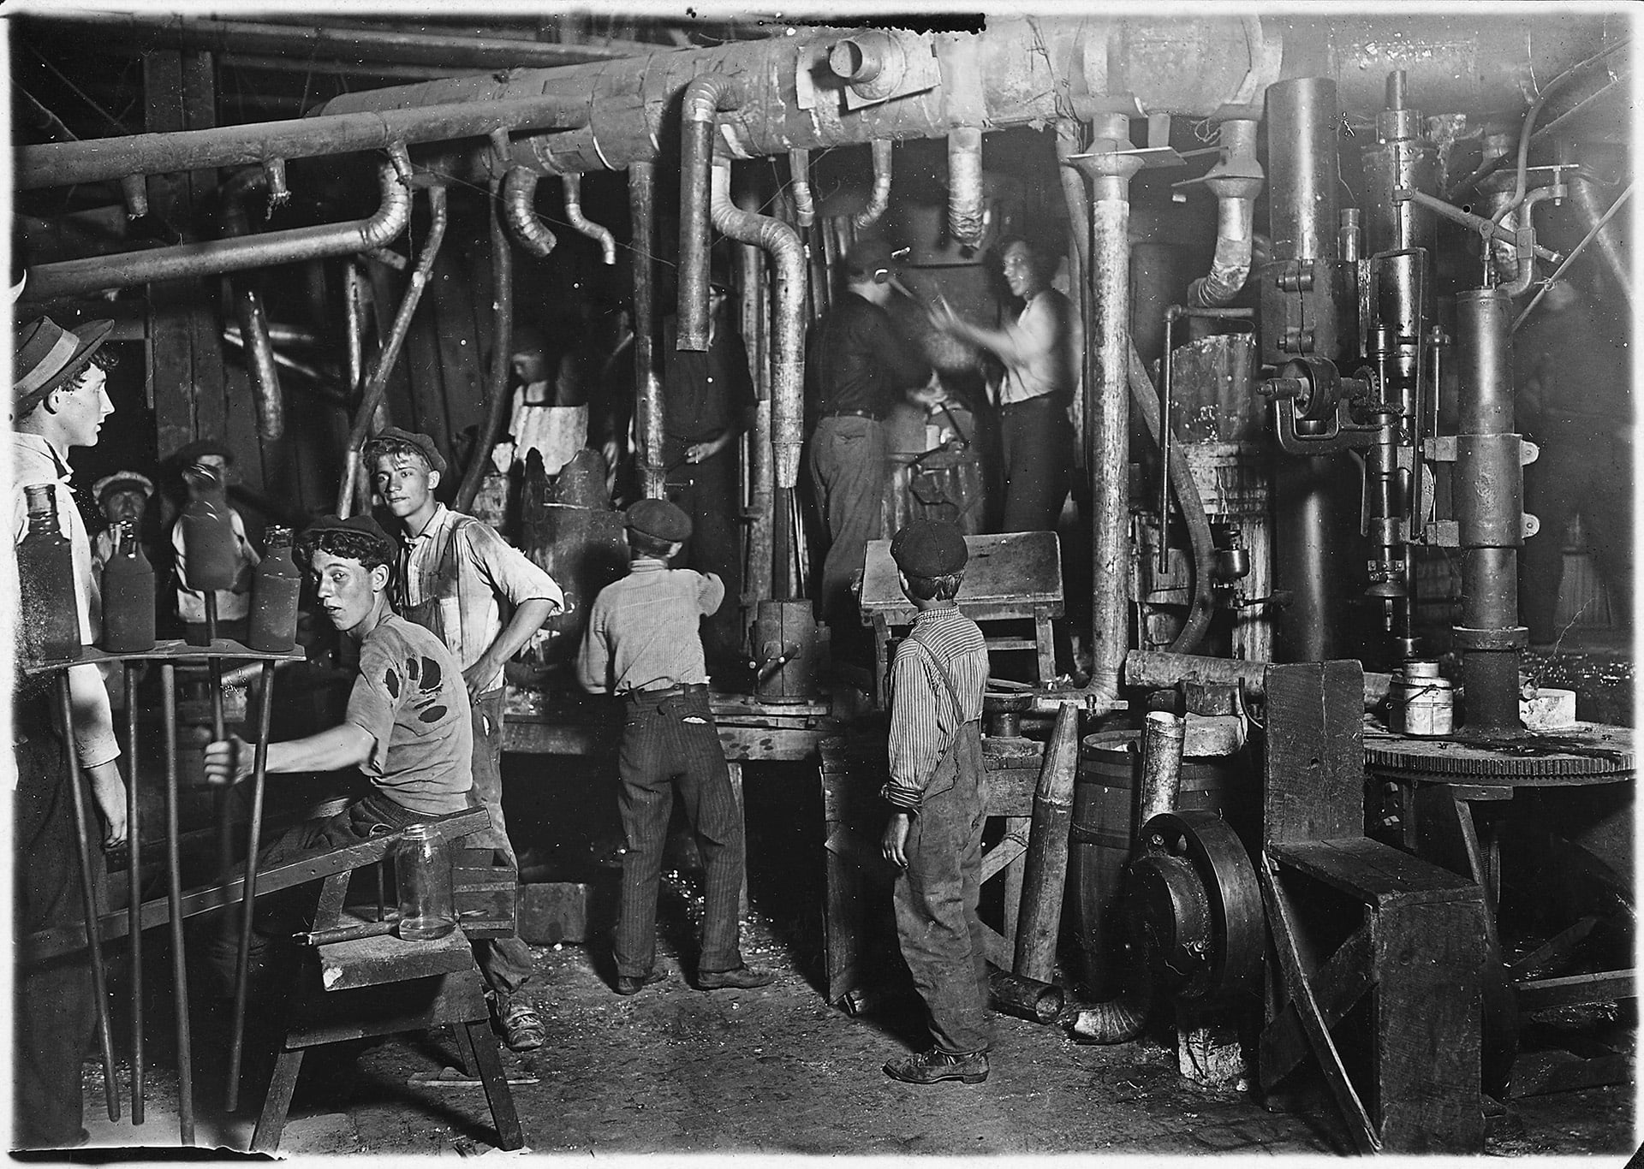
Photograph #1
Notes:
Hine, L. W. (1908). 9 P.M. in an Indiana Glass Works, Aug. 1908. Location: Indiana. National Child Labor Committee collection. Library of Congress Prints and Photographs Division. https://hdl.loc.gov/loc.pnp/nclc.01166

Slide 8
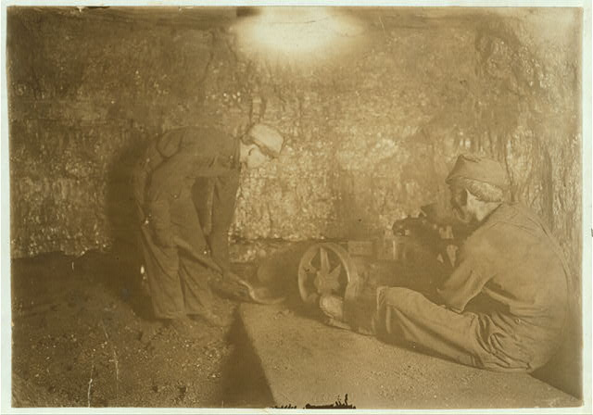
Photograph #2
Notes:
Hine, L. W. (n.d.). National Child Labor Committee, No. 69. Man with punching machine to drill into coal. Boy shovels out 10 hrs. daily, Laura Mine, Red Star, W. Va. Location: Red Star, West Virginia. Library of Congress Prints and Photographs Division Washington, D.C. 20540 USA. https://hdl.loc.gov/loc.pnp/nclc.01048

Slide 9
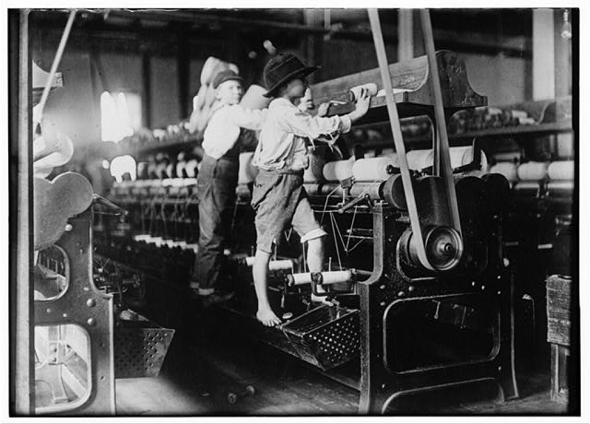
Photograph #3
Notes:
Hine, L. W. (1909). 488 Macon, Ga. Lewis W. Hine 1-19-1909. Bibb Mill No. 1 Many youngsters here. Some boys were so small they had to climb up on the spinning frame to mend the broken threads and put back the empty bobbins. Location: Macon, Georgia. Library of Congress Prints and Photographs Division Washington, D.C. 20540 USA. https://hdl.loc.gov/loc.pnp/nclc.05394

Slide 10
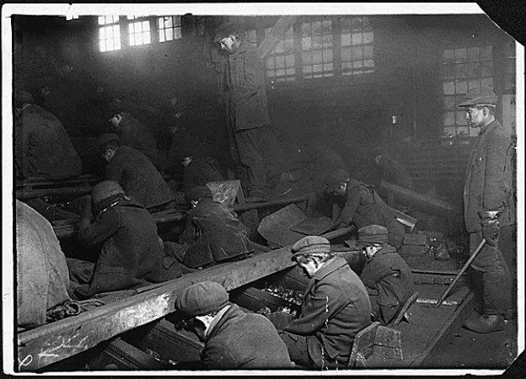
Photograph #4
Notes:
Hine, L. W. (1912). View of the Ewen Breaker of the Pa. Coal Co. Supervisor stands over “breaker boys.” S. Pittston, Pennsylvania, 1/10/1911. National Child Labor Committee Photographs taken by Lewis Hine, ca. 1912 - ca. 1912, Record Group 102: Records of the Children's Bureau, 1908 - 2003, National Archives. https://catalog.archives.gov/id/523378.

Slide 11
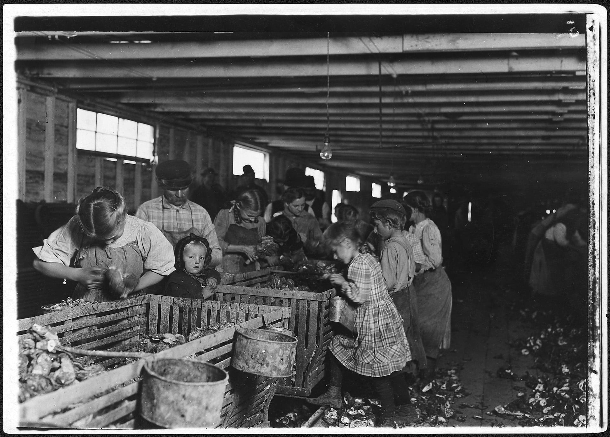
Photograph #5
Notes:
Hine, L. W. (1912). Rosy, an 8 year old oyster shucker works steady all day from about 3 A.M. to 5 P.M. The baby will shuck as soon as she can handle the knife. Dubar, LA, March 1911. National Child Labor Committee Photographs taken by Lewis Hine, ca. 1912 - ca. 1912, Record Group 102: Records of the Children's Bureau, 1908 - 2003, National Archives. https://catalog.archives.gov/id/523414.

Slide 12
Lowell Mills Working Conditions
Read excerpts of the report from Massachusetts lawmakers who investigated the working conditions at the Lowell Mills.
Focus on the working conditions at Lowell Mills as you read.

Slide 13
Categorical Highlighting
Get back in your original group.
As a group, reread the article.
As you read, highlight or underline things that concern you about the working conditions in the Lowell Mills.
Notes:
K20 Center. (n.d.). Categorical highlighting. Strategies. https://learn.k20center.ou.edu/strategy/192

Slide 14
Impact of Industrialization
Based on your inferences from the photos and the information from the text, respond to the following prompt in 2–3 sentences. Include evidence to support your claim:
How did the early industrialization of the American economy impact workers?

Slide 15
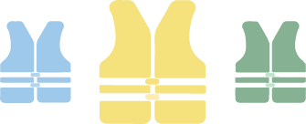
RAFT
Role - Worker
Audience - Business owner or Congress
Format - Letter
Topic - Working conditions
If you had been a factory worker during the 1800s, what issues regarding your working conditions would you protest or fight to change?
Notes:
K20 Center. (n.d.). RAFT. Strategies. https://learn.k20center.ou.edu/strategy/158

Slide 16
RAFT
If you had been a factory worker during the 1800s, what issues regarding your working conditions would you protest or fight to change?
Include the following in your letter to the business or Congress:
Identify 3 specific issues;
Explain how to improve working conditions;
Write in the voice of a worker.
Notes:
K20 Center. (n.d.). RAFT. Strategies. https://learn.k20center.ou.edu/strategy/158

Slide 17
Workers’ Protested Issues
Issue | Resolution
Notes:
Type student answers into this slide.

Slide 18
Workers’ Protested Issues
Issue | Resolution
low pay
long hours
dirty environment
dangerous environment
no sick/vacation days/weekends
child labor

Slide 19
Impacts of Industrialization on Workers
https://youtu.be/XPpiKKsClTY
Notes:
K20 Center. (2020, March 3). ICAP-Impacts of industrialization on workers [Video]. YouTube. https://youtu.be/XPpiKKsClTY

Slide 20
Workers’ Protested Issues
Issue | Resolution
low pay
long hours
dirty environment
dangerous environment
no sick/vacation days/weekends
child labor

Slide 21
Workers’ Protested Issues
Issue | Resolution
low pay | minimum wage laws
long hours | 40-hour work weeks + laws requiring breaks
dirty environment | laws requiring health inspections
dangerous environment | building codes, safety requirements
no time off | laws regulating time off—vacation, sick leave, parental leave, weekends, etc.
child labor | laws preventing child labor

Slide 22
I Think, We Think
Divide your paper into two columns. Title one column “I Think” and the other column “We Think.”
In the “I Think” column, respond to the following question:
Should the government regulate businesses to protect the rights of workers?

Slide 23
I Think, We Think
In your pairs, discuss your individual responses to the following question:
Should the government regulate businesses to protect the rights of workers?
Together, complete the “We Think” column.
Be prepared to share out your responses!

