Slide 2
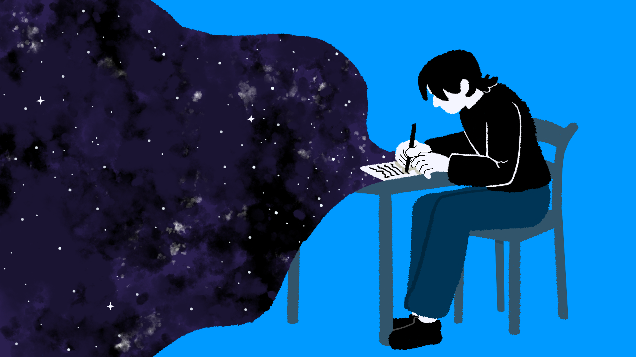
The Purpose in Our Stars
Exploring Word Choice and Meaning through The Fault in Our Stars

Slide 3
Essential Question
How can your word choice create a specific effect in writing?

Slide 4
Learning Objective
Use knowledge about grief and loss to communicate with a character from The Fault in Our Stars.

Slide 5
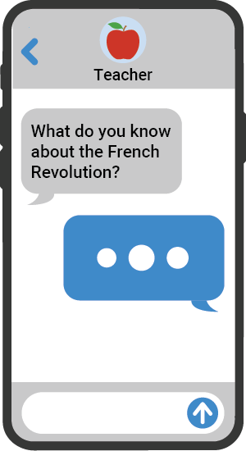

Quick Write
On a piece of paper, individually respond to the following question:
What is one moment from The Fault in Our Stars that impacted you? Why did it impact you?
Notes:
K20 Center. (n.d.). Quick write. Strategies. https://learn.k20center.ou.edu/strategy/1127

Slide 6
Identifying Themes
Read the quote you received.
Move near the poster labeled with the theme or topic you believe your quote most relates to.
  Love
  Loss
  Identity
  Meaning of life

Slide 7

Analyzing Word Choice
With the group at your poster, discuss the following questions:
Who is the speaker of your quote?
What is the quote describing or referencing?
What about the quote made you think it relates to this theme or topic?
Which specific words and phrases used by the author illustrate the theme you chose?
Notes:
K20 Center. (2021, September 21). K20 Center 8 minute timer [Video]. YouTube. https://www.youtube.com/watch?v=R-21YM7Ey7k

Slide 8
Reflect
Recall your Quick Write response.
  What theme did your selected moment represent?
  How did that moment reflect that theme?
Respond to these questions on your Quick Write paper.

Slide 9

Talking To A Friend
Imagine you are writing a letter to a character from the novel after they have experienced loss.
As you read the article, highlight information that could help you communicate with that character.
  Write why you highlighted a piece of information in the margins.
Highlight at least 4 pieces of information.
Notes:
K20 Center. (n.d.). Why-Lighting. Strategies. https://learn.k20center.ou.edu/strategy/128

Slide 10
Planning a Letter
Imagine that you are writing a letter to a character from the novel: Hazel, Augustus, or another character of your choice.
Complete the handout to plan your letter.
Especially consider how you want the letter to feel. Do you want the letter to feel sympathetic, funny, inspiring, or something else?

Slide 11
Writing a Letter
Use your completed Letter Planning handout to write a letter to your chosen character.
In your letter, include:
  One piece of advice from the article
  One specific moment from the novel that shows why the character needs to hear what you have to say
  Two paragraphs

Slide 12
Share with a Partner
Identify one sentence in your letter where you used specific words to create a desired effect (humor, sympathy, compassion, etc.).
With your partner:
  Share your sentence
  Explain the effect you intended to create and why you chose that effect
  Ask for feedback about whether or not you achieved that effect with your word choice and why or why not.

