Slide 2

The Power of Perspective
Perspective and Purpose in Writing

Slide 3
Essential Questions
How does perspective influence how a topic is presented?
How does understanding perspective influence our interpretation of a text?

Slide 4
Learning Objectives
Analyze how an author’s perspective shapes the presentation of the topic.
Compare perspectives across texts using textual evidence.

Slide 5

Painting a Picture
Observations:
  What do you see?
Inferences:
  What do you think is happening?
Notes:
K20 Center. (n.d.). Painting a picture. Strategies. https://learn.k20center.ou.edu/strategy/1331

Slide 6
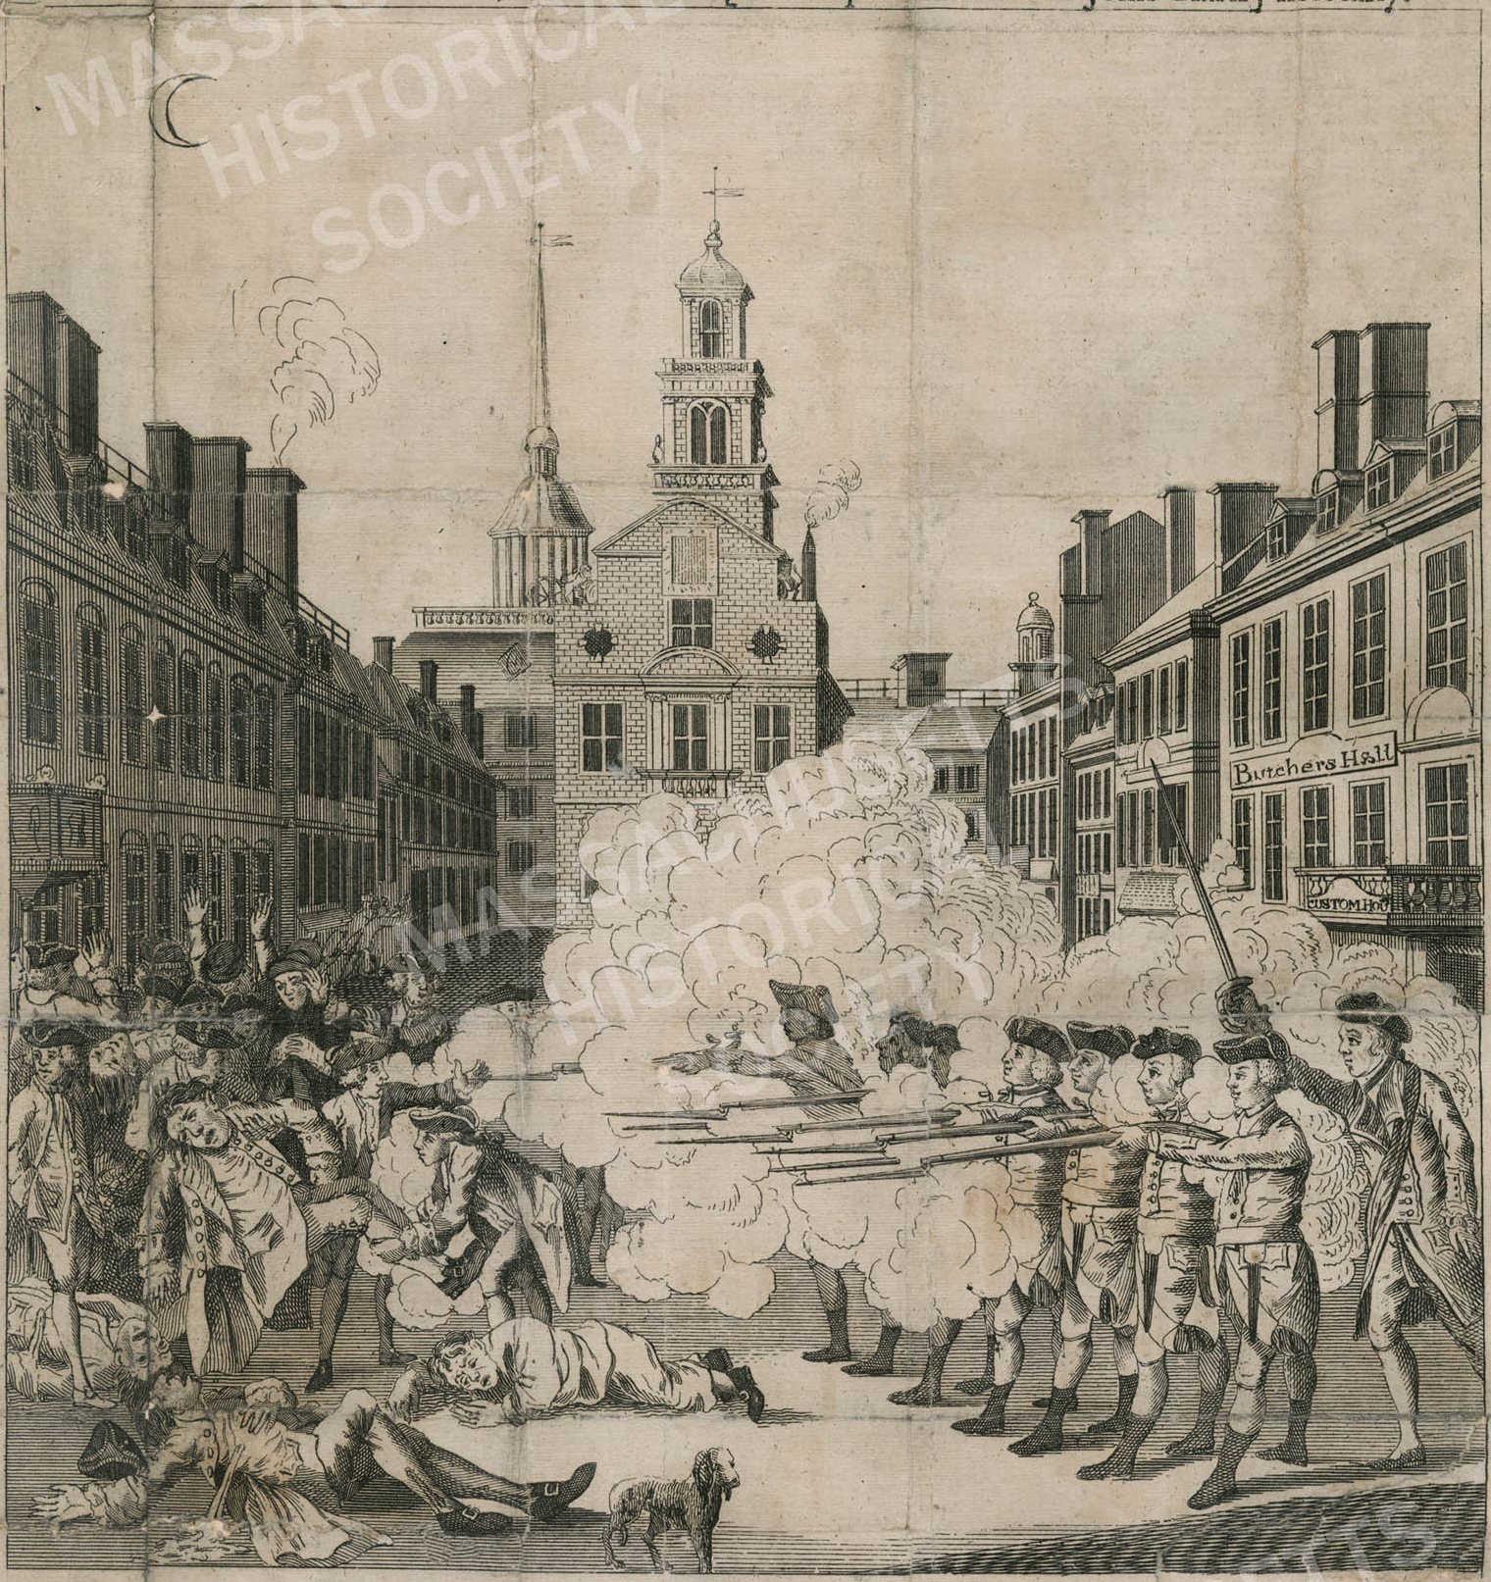
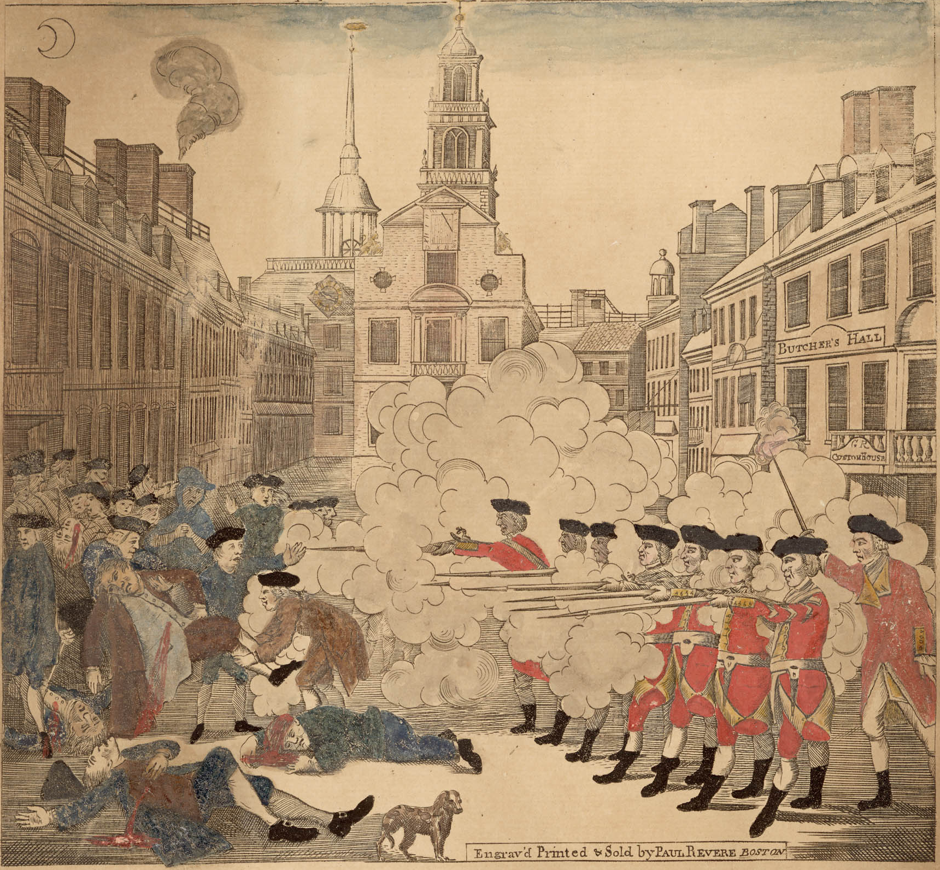
Notes:
The fruits of arbitrary power: Or the bloody massacre. (1770). Massachusetts Historical Society. https://www.masshist.org/database/3023
Revere, P. (1770). The bloody massacre perpetrated in King Street, Boston on March 5th 1770 by a party of the 29th regiment. Massachusetts Historical Society. https://www.masshist.org/database/2

Slide 7
Painting a Picture: Discussion
Observations:
  What do you see?
Inferences:
  What do you think is happening?
Conclusion:
  What is the purpose of these images?
Notes:
K20 Center. (n.d.). Painting a picture. Strategies. https://learn.k20center.ou.edu/strategy/1331

Slide 8
Painting a Picture: Reflection
Use your observations and inferences
from these sources to answer the following.
What conclusion(s) could you make about
the Boston Massacre?
How do you think the Boston Massacre was portrayed to influence public opinion?
Notes:
K20 Center. (n.d.). Painting a picture. Strategies. https://learn.k20center.ou.edu/strategy/1331

Slide 9
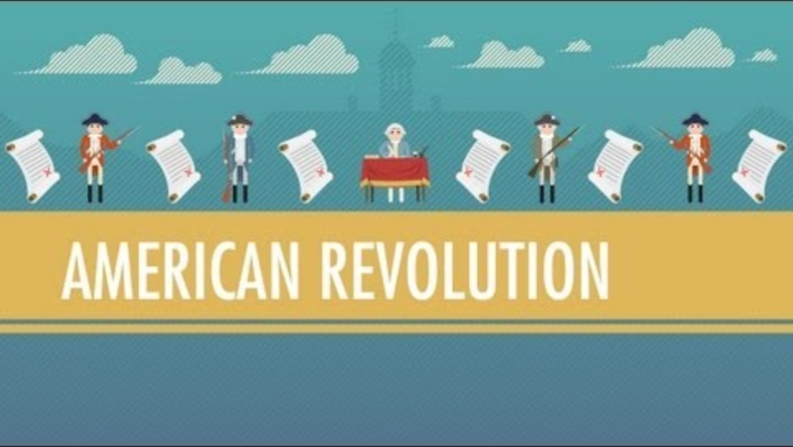
Tea, Taxes, and The American Revolution
Notes:
CrashCourse. (2012, August 2). Tea, Taxes, and The American Revolution. [Video]. YouTube. https://www.youtube.com/watch?v=HlUiSBXQHCw

Slide 10
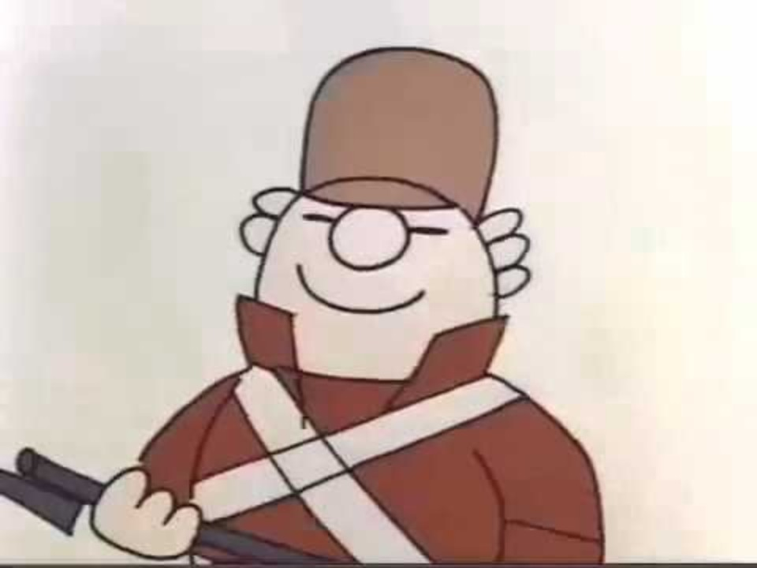
Shot Heard Round the World
Notes:
Dr. Gerard Jabbow. (2011, January 6). School House Rock Shot Heard Round the World. [Video]. YouTube. https://www.youtube.com/watch?v=Y6ikO6LMxF4

Slide 11


Contrasting Perspectives: Part 1
Read the three news headlines and articles.
With a partner, complete the
Analyzing Views table with
the differing perspectives:
  British
  Native American
  American Colonist
10-Minute Video
Notes:
K20 Center. (n.d.). Inverted pyramid. Strategies. https://learn.k20center.ou.edu/strategy/173
K20 Center. (2021, September 21). 10-minute timer. [Video]. YouTube. https://www.youtube.com/watch?v=9gy-1Z2Sa-c

Slide 12

Contrasting Perspectives: Part 2
Find another pair and compare your
Analyzing Views tables.
Then work as a group to answer
the Comparing Perspectives
questions.
Be ready to share your responses with reasoning.
15-Minute Video
Notes:
K20 Center. (n.d.). Inverted pyramid. Strategies. https://learn.k20center.ou.edu/strategy/173
K20 Center. (2021, September 21). 15-minute timer. [Video]. YouTube. https://www.youtube.com/watch?v=m3zT2IxZQaw

Slide 13
Contrasting Perspectives: Share
How do the three perspectives differ
in how they describe the conflict?
Which perspective focuses most on liberty? Which focuses most on order or protection? Explain.
How does each author’s perspective influence what details are included?
Why might each group view the conflict differently?
Notes:
K20 Center. (n.d.). Inverted pyramid. Strategies. https://learn.k20center.ou.edu/strategy/173

Slide 14

Card Sort
Each group has the following set of cards:
  4 category cards
  4 definition cards
Sort your set into the following four categories:
  Historical Perspective
  Cultural Perspective
  12 example cards
  Ethnic Perspective
  Global Perspective
Notes:
K20 Center. (n.d.). Card sort. Strategies. https://learn.k20center.ou.edu/strategy/147

Slide 15
Card Sort: Reflection
Which card was most difficult to sort? Why?
Choose one example (numbered) card and explain how perspective shapes the focus of the statement.
Notes:
K20 Center. (n.d.). Card sort. Strategies. https://learn.k20center.ou.edu/strategy/147

Slide 16
Card Sort (Sample Responses)
Historical Perspective
This perspective focuses on events, ideas, or actions shaped by the time in which they occurred.
  Card #1
  Card #5
  Card #11
Notes:
K20 Center. (n.d.). Card sort. Strategies. https://learn.k20center.ou.edu/strategy/147

Slide 17
Card Sort (Sample Responses)
Cultural Perspective
This perspective focuses on traditions, values, customs, or beliefs shared by a group.
  Card #4
  Card #6
  Card #9
Notes:
K20 Center. (n.d.). Card sort. Strategies. https://learn.k20center.ou.edu/strategy/147

Slide 18
Card Sort (Sample Responses)
Ethnic Perspective
This perspective focuses on experiences tied to shared ancestry, heritage, or identity.
  Card #2
  Card #8
  Card #12
Notes:
K20 Center. (n.d.). Card sort. Strategies. https://learn.k20center.ou.edu/strategy/147

Slide 19
Card Sort (Sample Responses)
Global Perspective
This perspective focuses on worldwide impact, international relationships, or effects across nations.
  Card #3
  Card #7
  Card #10
Notes:
K20 Center. (n.d.). Card sort. Strategies. https://learn.k20center.ou.edu/strategy/147

Slide 20
Contrasting Perspectives
Reflect on what you now know about different perspectives:
  Historical Perspective
  Cultural Perspective
Highlight key words and phrases in the three news articles that reveal each author’s perspective.
  Ethnic Perspective
  Global Perspective

Slide 21
Contrasting Perspectives (Sample Responses)
Perspective | British | Native American | American Colonist
Key Words or Phrases That Reveal Perspective | treacherous impact treason overseas investments stability | Sovereignty Neutrality forced to choose sides territory | Liberty and Freedom King’s Tyranny Individual liberties unite to resist

Slide 22
Evidence-Based Response
On a piece of notebook paper, explain
how perspective affects the way the
American Revolution is presented.
  Use evidence from at least two of the articles.
  Write a short paragraph for your response.

Slide 23
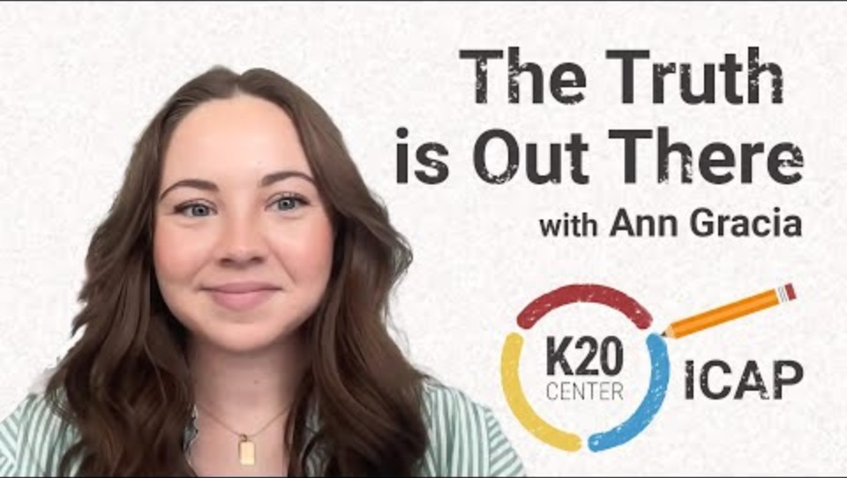
The Truth is Out There
Notes:
K20 Center. (2024, July 25). The truth is out there. [Video]. YouTube. https://www.youtube.com/watch?v=NphSY4EGUgc

Slide 24
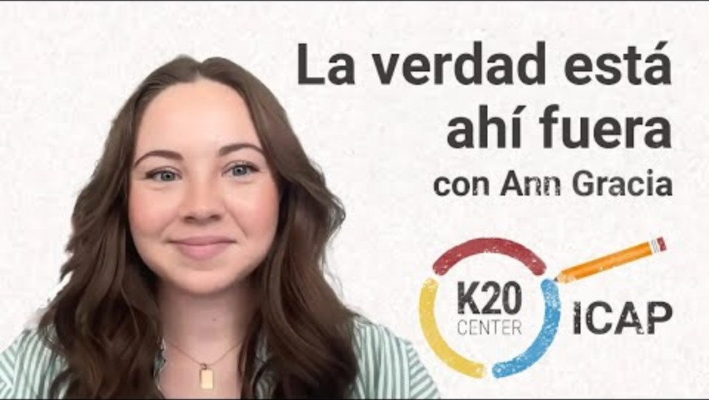
La verdad está ahí fuera
Notes:
K20 Center. (2024, July 26). La verdad está ahí fuera. [Video]. YouTube. https://www.youtube.com/watch?v=LjAV81Ux3cQ

Slide 25

Think-Pair-Share
Think to yourself about the following:
How do journalists use their perspective to decide what information to include, emphasize, or leave out when reporting a story?
How could understanding perspective influence our interpretation of a journalist's story?
Be ready to share your thoughts.
Notes:
K20 Center. (n.d.). Think-pair-share. Strategies. https://learn.k20center.ou.edu/strategy/139

Slide 26
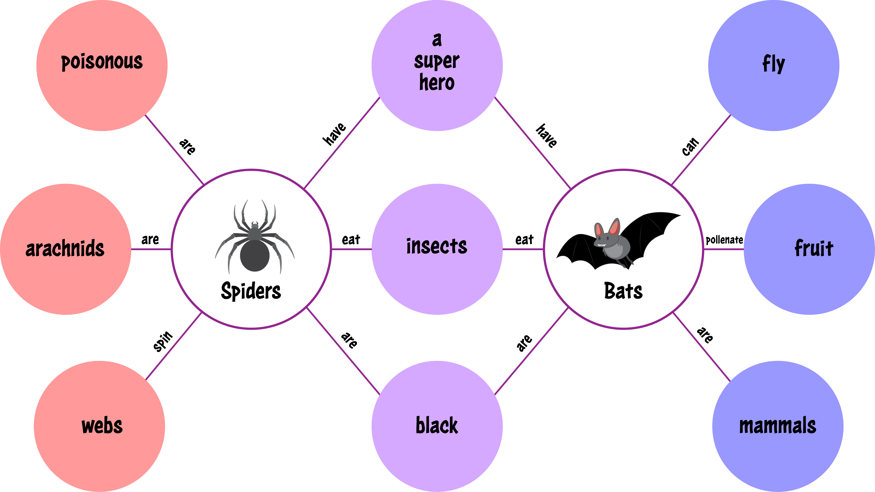
Double Bubble Map
Go to AllSides.com.
Select the “Headline Roundups” tab.
Find two articles about the same topic.
  Look for contrasting perspectives.
Compare and contrast the articles to complete your Double Bubble Map.
Notes:
K20 Center. (n.d.). Double bubble map. Strategies. https://learn.k20center.ou.edu/strategy/3035

Slide 27
Double
Bubble Map
Write what is unique to Article 1.
Name of Article 1
Name of Article 2
Write what the articles have in common.
Write what is unique to Article 2.
Notes:
K20 Center. (n.d.). Double bubble map. Strategies. https://learn.k20center.ou.edu/strategy/3035

