Slide 2
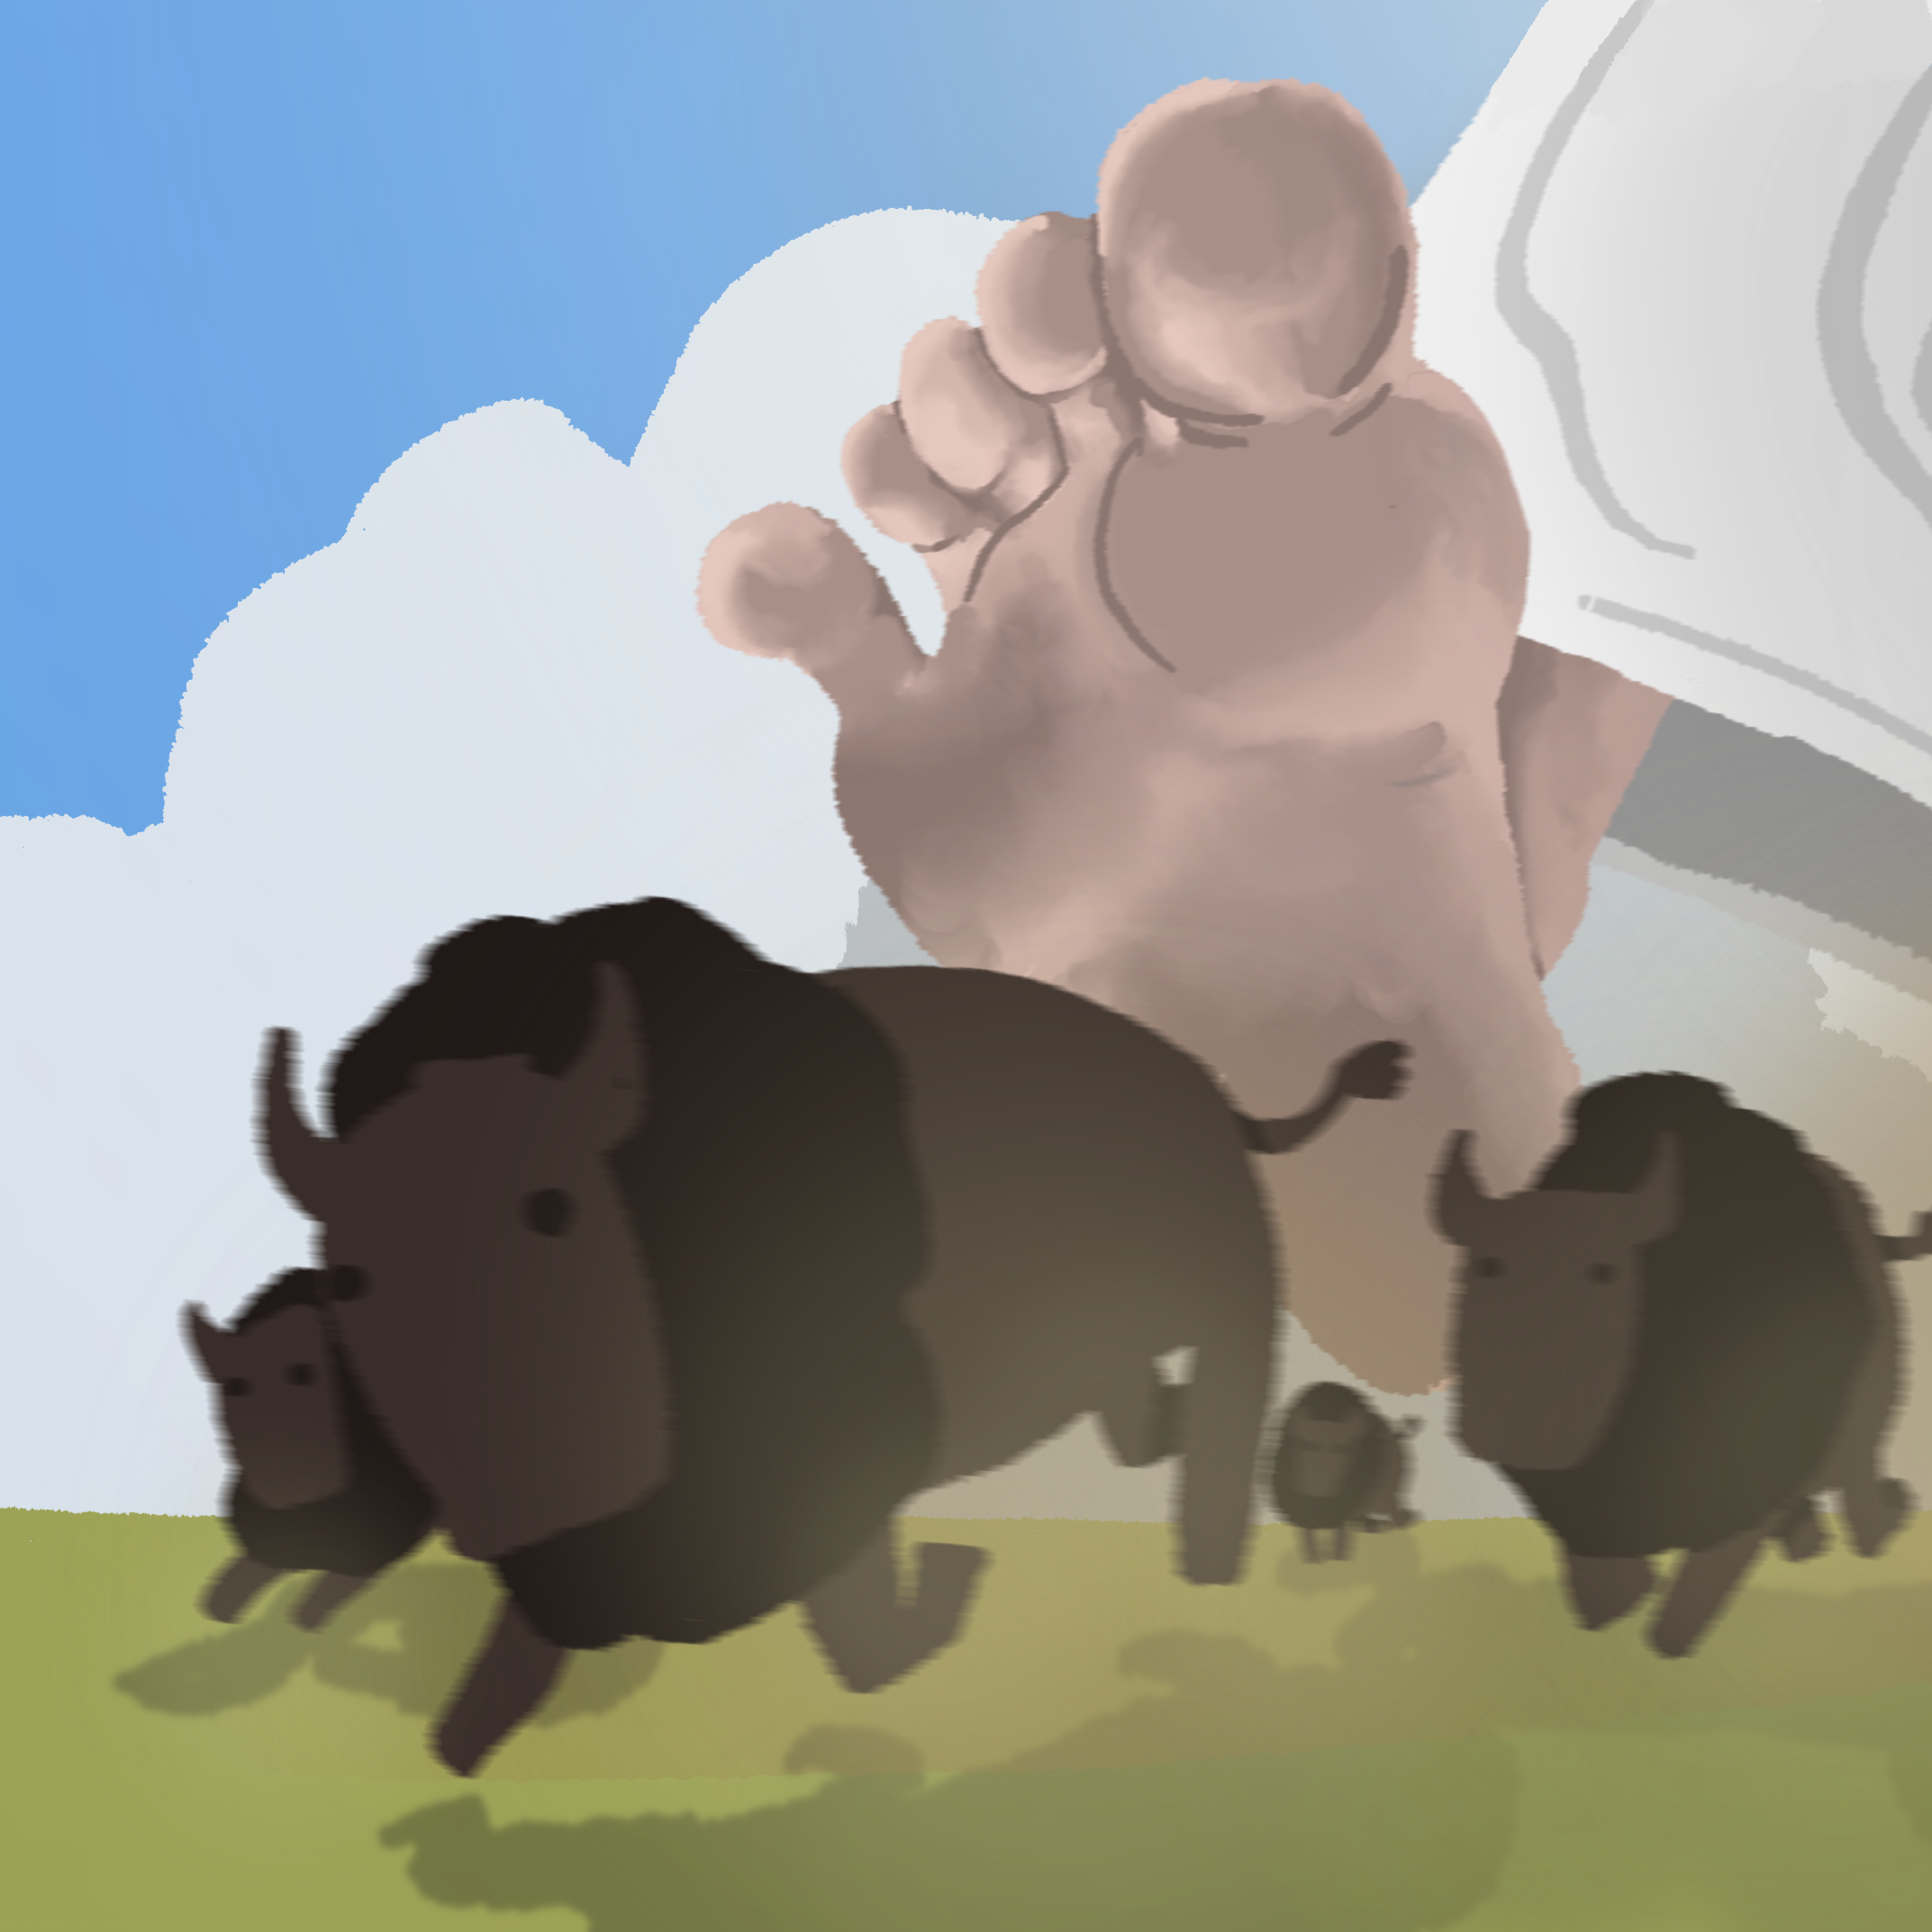
Manifest Destiny
U.S. Territorial Expansion

Slide 3
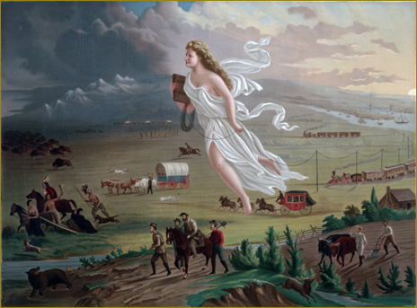
American Progress by John Gast, 1872
Notes:
John Gast, American Progress, 1872. Chromolithograph published by George A, Crofutt. Prints and Photographs Division, Library of Congress. Retrieved from: https://upload.wikimedia.org/wikipedia/commons/f/fd/American_Progress_%28John_Gast_painting%29.jpg

Slide 4
American Progress by John Gast, 1872
#1
#2
#5
#3
#4
Notes:
John Gast, American Progress, 1872. Chromolithograph published by George A, Crofutt. Prints and Photographs Division, Library of Congress. Retrieved from: https://upload.wikimedia.org/wikipedia/commons/f/fd/American_Progress_%28John_Gast_painting%29.jpg

Slide 5
Essential Questions
How was the concept of Manifest Destiny used to motivate and justify U.S. territorial expansion?
How did Manifest Destiny impact multiple groups of people differently?

Slide 6
Learning Objectives
Explain the concept of Manifest Destiny.
Analyze how Manifest Destiny impacted the people of the United States.

Slide 7
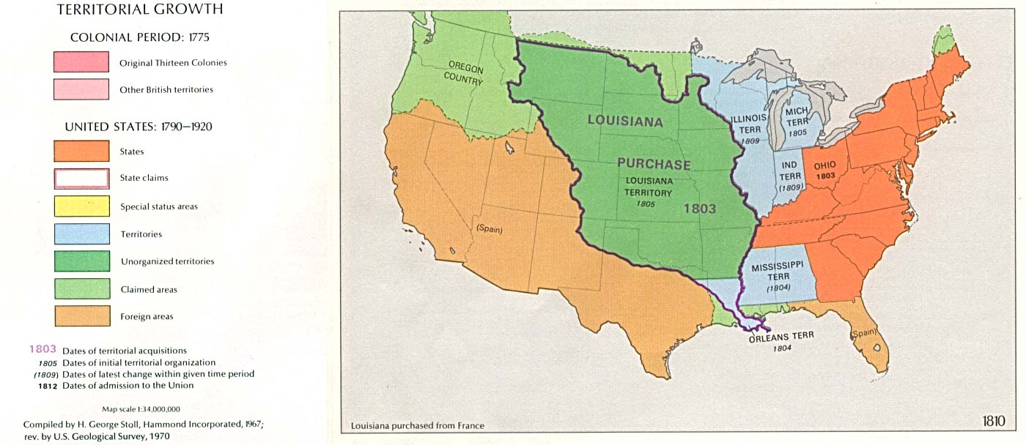
The United States in 1810
Notes:
U.S. Territorial Growth Map 1810. The National Atlas of the United States of America (Arch C. Gerlach, editor). Washington, D.C.:U.S. Dept. of the Interior, Geological Survey, 1970. Retrieved from: https://www.gifex.com/fullsize-en/2009-09-18 8526/United_States_Territorial_Growth_Map_1810.html

Slide 8
Manifest Destiny is…
Notes:
Record students’ definitions of Manifest Destiny on this slide if desired.

Slide 9
Manifest Destiny is…
A 19th-century belief that the United States had the right or duty to expand across the North American continent to the Pacific Ocean, spreading U.S. culture and government.
A belief used to both motivate and justify American expansion.

Slide 10
Discuss
Who might oppose the idea of Manifest Destiny?

Slide 11
Discuss
How did the United States use Manifest Destiny to motivate and justify its expansion into lands already inhabited and governed by other peoples?

Slide 12
Push and Pull Factors
Push factors are reasons people leave an area.
Pull factors are reasons people move to an area.

Slide 13

Push and Pull Factors
With a partner, identify and discuss examples of push and pull factors that influence migration.

Slide 14
Discuss
What push and pull factors influenced migration during the era of Manifest Destiny

Slide 15

Two Voice Poem
Use the template to create a poem that contrasts the perspectives of one person who supported Manifest Destiny and one person who opposed it.
Include details from the lesson’s sources to support both perspectives.

