Slide 2
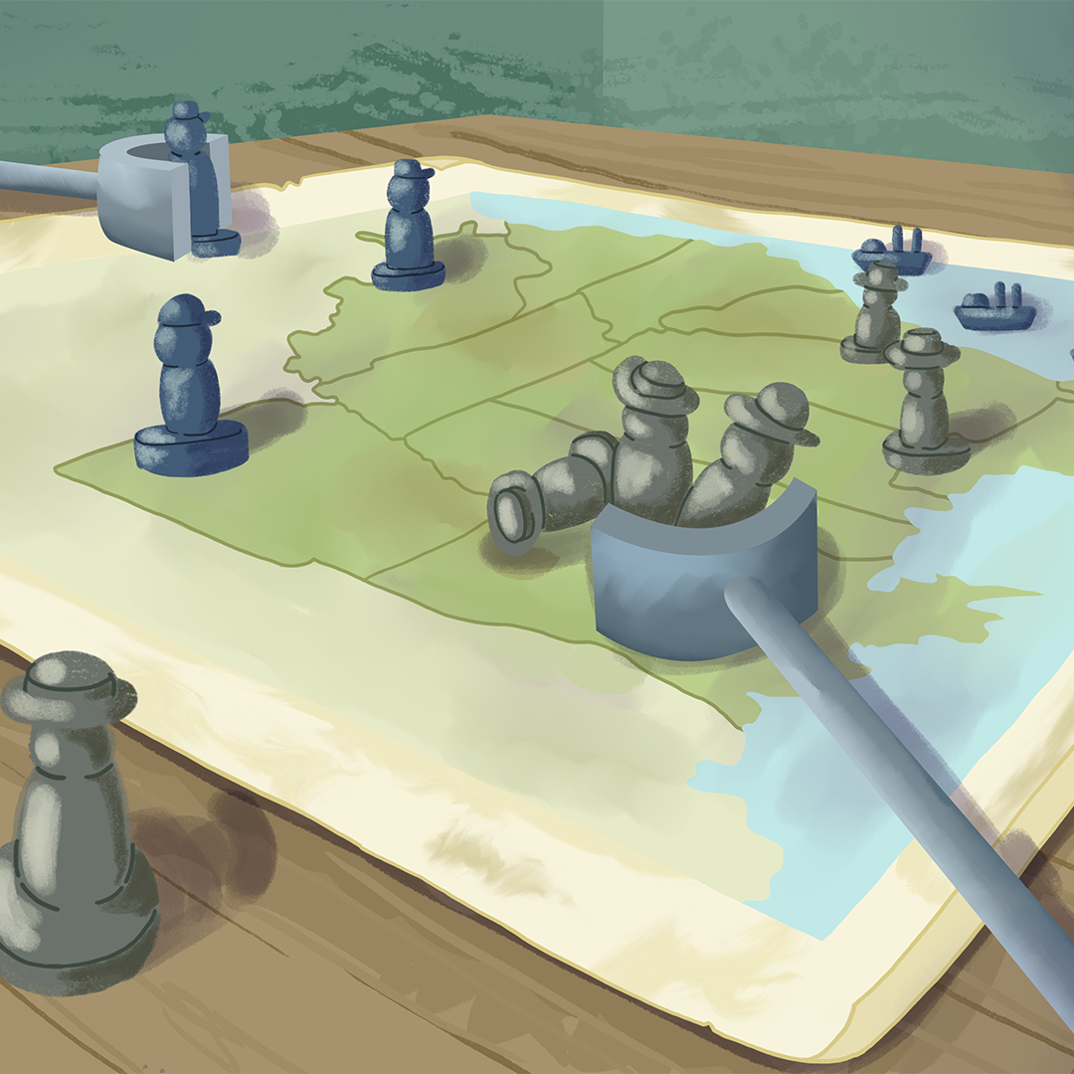
Advancing All Units: How Strengths and Weaknesses Shaped Civil War Strategy
The Civil War

Slide 3
Essential Questions
What were the key strengths and weaknesses of the Union and the Confederacy during the American Civil War?
How did those strengths and weaknesses shape the strategies each side used?

Slide 4
Learning Objectives
Compare the key strengths and weaknesses of the Union and the Confederacy during the American Civil War.
Explain how the military strategies used by both sides affected the outcome of the war.

Slide 5
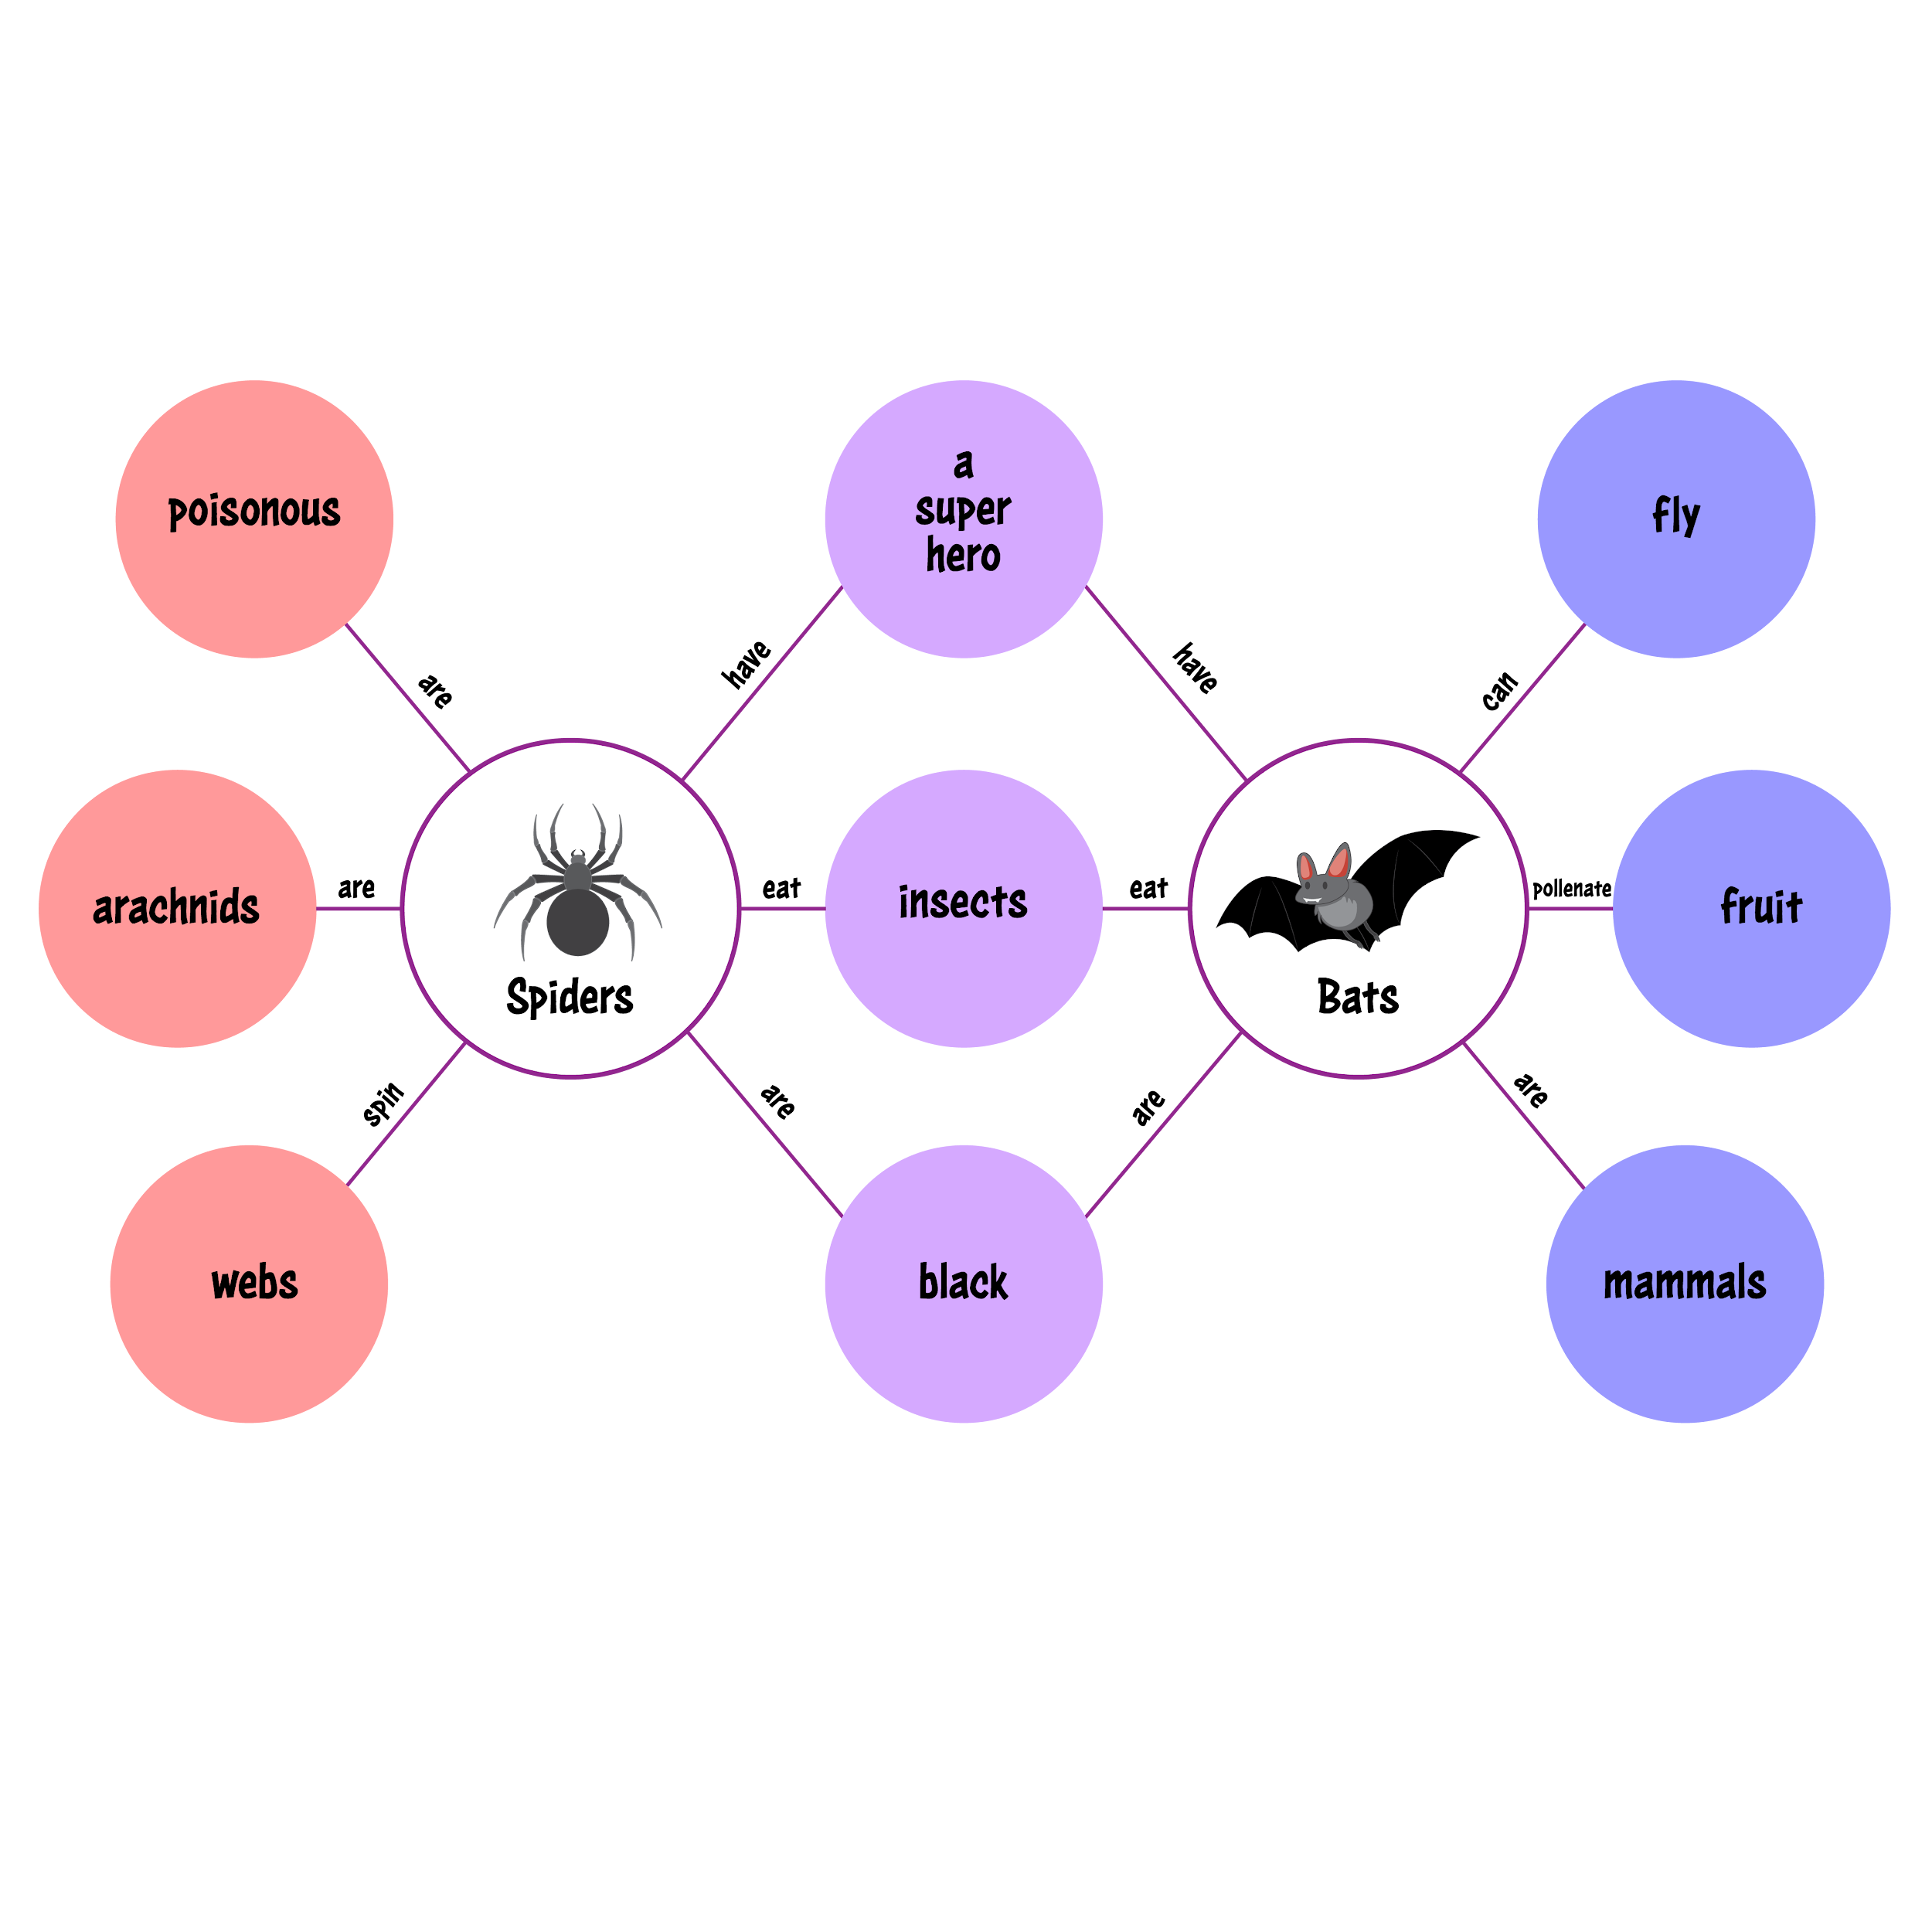
Double Bubble Map
Work with your partner to list what you already know about the Union and the Confederacy.
Write differences in the outer circles and similarities in the inner circle.
Notes:
K20 Center. (n.d.). Double bubble map. Strategies. https://learn.k20center.ou.edu/strategy/3035

Slide 6

Card Sort
In your groups, take out all your cards. Place the category cards at the top of your table Union Strengths, Union Weaknesses, Confederacy Strengths, and Confederacy Weaknesses at the top of your table.
Thinking about the strengths and weaknesses of the Union and the Confederacy, work together to sort the rest of the cards into each category you think they fit under.
Notes:
K20 Center. (n.d.). Card Sort. Strategies. https://learn.k20center.ou.edu/strategy/147

Slide 7

Why-Lighting
While reading your article, highlight any information that helps you answer the following prompts:
What strengths and weaknesses did the Union and Confederacy have?
How did those strengths and weaknesses influence the strategies both sides used?
Notes:
K20 Center. (n.d.). Why-lighting. Strategies. https://learn.k20center.ou.edu/strategy/128

Slide 8
Reflect
Turn to the person next to you and discuss the information you highlighted and how it answers the prompts:
What strengths and weaknesses did the Union and Confederacy have?
How did those strengths and weaknesses influence the strategies both sides used?

Slide 9
Highlighting War Strategies
Step 1: Choose a strategy used by the Union or Confederacy that you think was one of the most effective strategies you have learned about in this lesson.
Step 2: You must include the following in each section of your trifold:
2–3 drawings, images, or symbols that relate to the questions asked.
2–4 sentences as a response to the questions asked.

Slide 10
Highlighting War Strategies
With your partner, take turns sharing your trifolds and discussing the following prompts:
What did you add to your trifold? Why did you pick those things?
How do your choices show that this strategy was effective during the Civil War?

Slide 11


Friends Without Pens
Round 1: Discuss the following prompt with your partner.
In what ways did the strengths and weaknesses of the Union and Confederacy influence their military strategies?
Round 2: Individually write down a response to the prompt on your piece of notebook paper.
Notes:
K20 Center. (n.d.). Friends Without Pens. Strategies. https://learn.k20center.ou.edu/strategy/4438
K20 Center. (2021, September 21). 4-Minute Timer [Video]. YouTube. https://www.youtube.com/watch?v=kpCsfuvzQeY

