Slide 1
K20 LEARN logo slide

Slide 2
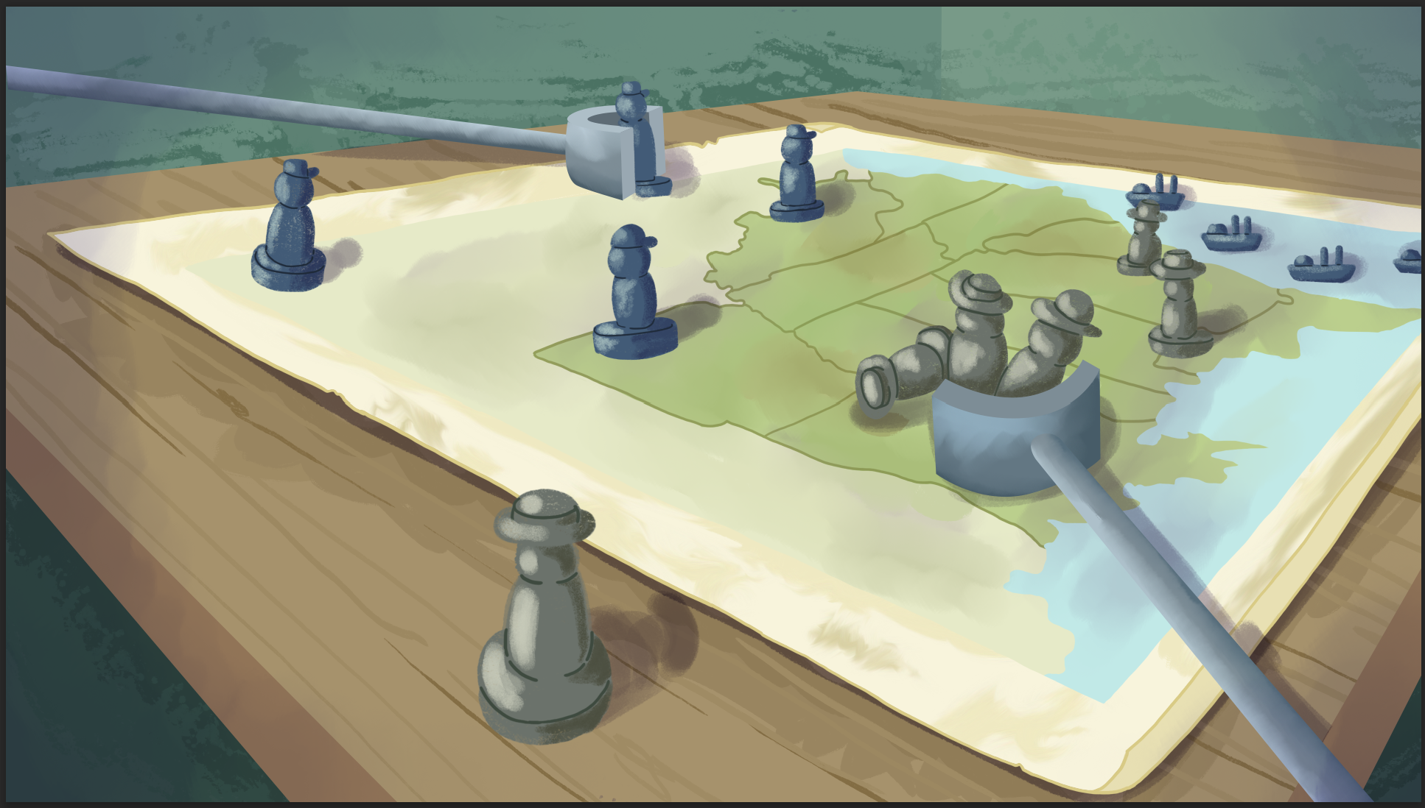
Advancing All Units: How Strengths and Weaknesses Shaped Civil War Strategy
The Civil War

Slide 3
Essential Questions
What were the key strengths and weaknesses of the Union and the Confederacy during the American Civil War?
How did those strengths and weaknesses shape the strategies each side used?

Slide 4
Learning Objectives
Compare the key advantages and disadvantages of the Union and the Confederacy during the American Civil War.
Explain how the military strategies used by both sides affected the outcome of the war.

Slide 5
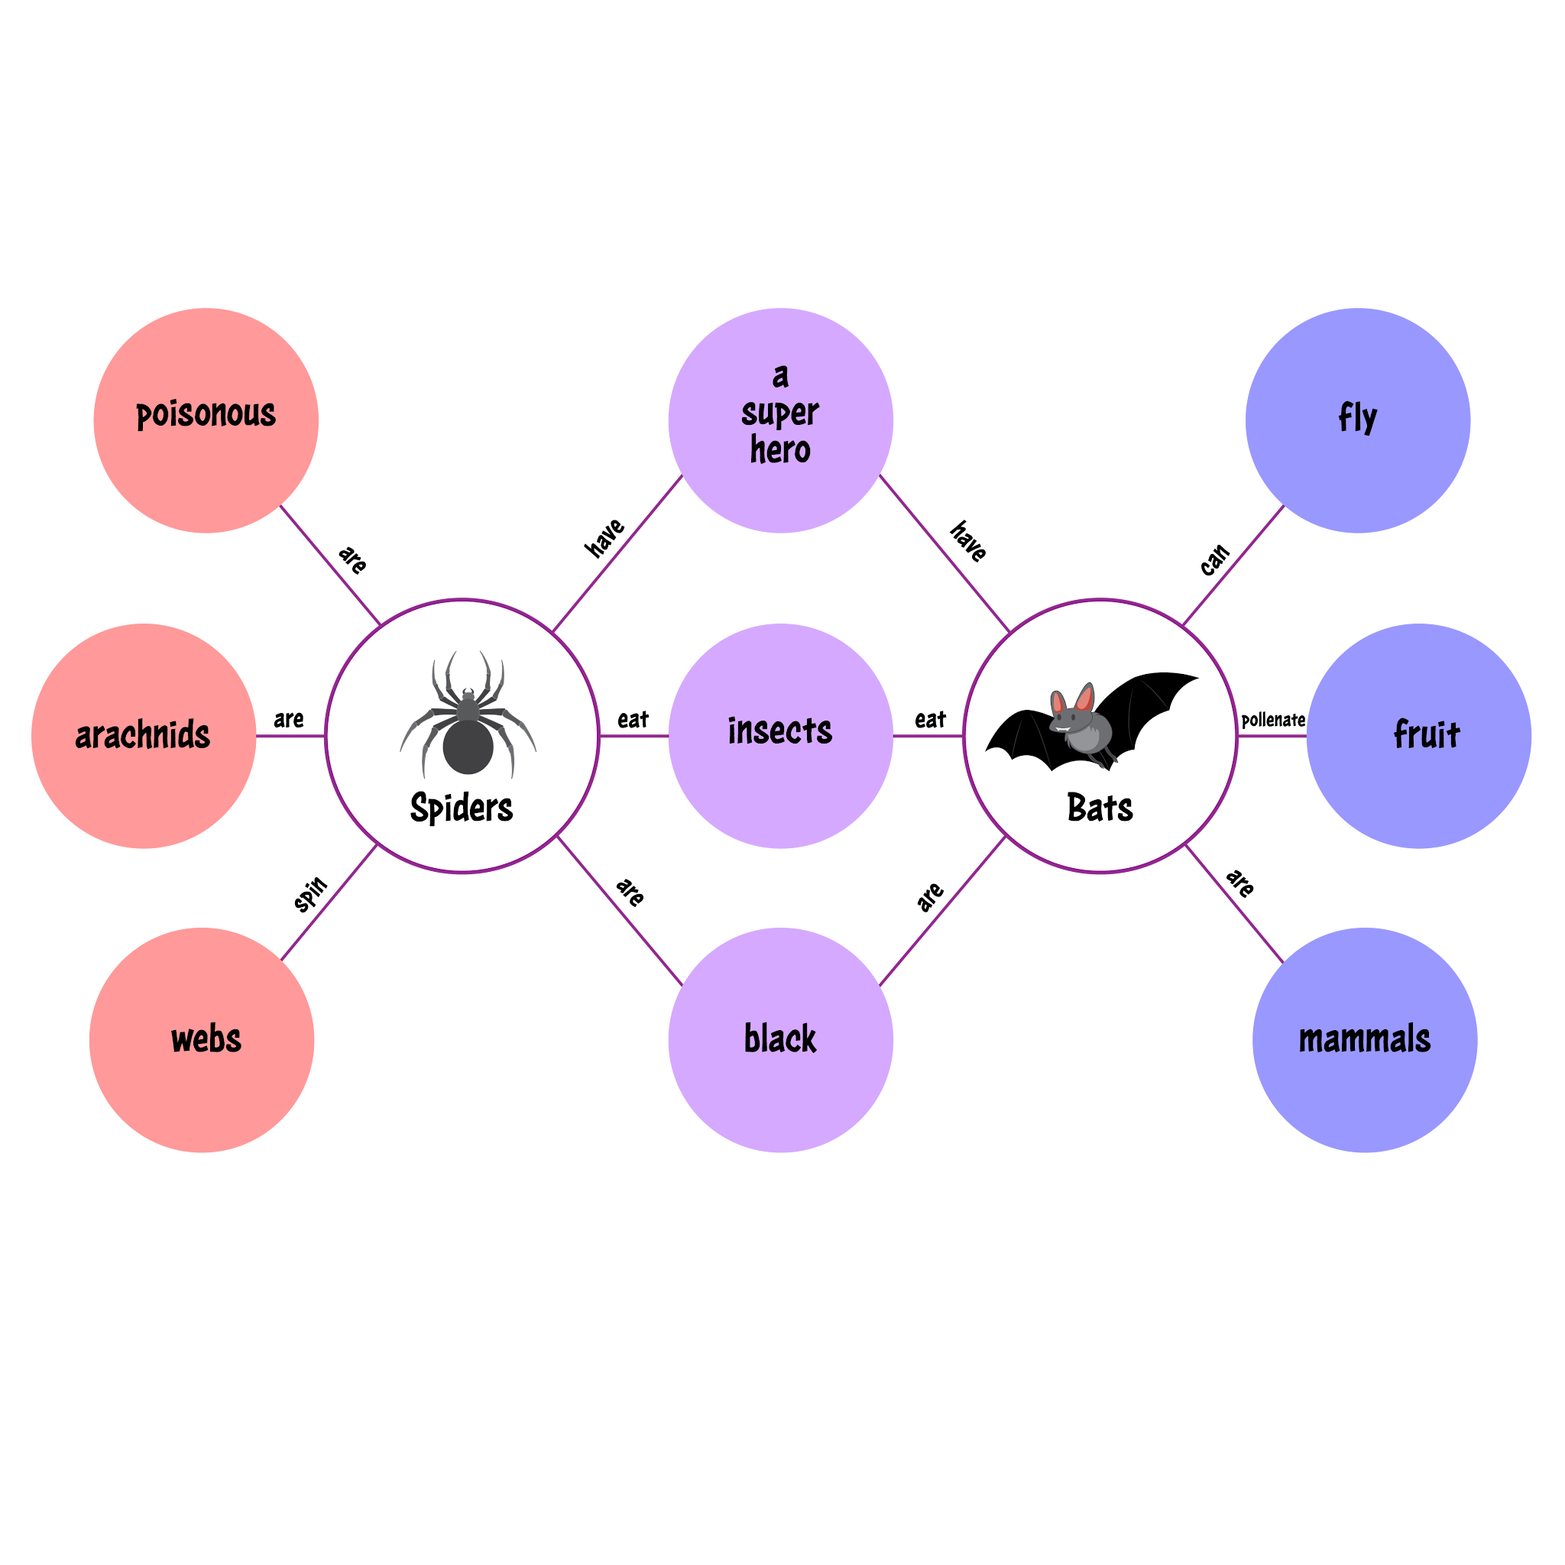
Double Bubble Map
Work with your partner to list what you already know about the Union and the Confederacy.
Write differences in the outer circles and similarities in the inner circle.

Slide 6

Card Sort
In your groups, take out all of your cards placing the category cards “Union Strengths,” “Union Weaknesses,” “Confederacy Strengths” and “Confederacy Weaknesses” at the top of your table.
Thinking about the strengths and weaknesses of the Union and the Confederacy, work together to sort the rest of the cards into each category you think they fit under.

Slide 7

Why-Lighting
While reading your article, highlight any information that helps you answer the answer the following prompts.
What are some strengths and weaknesses of the Union and Confederacy?
How did those strengths and weaknesses shape the strategies each side used?

Slide 8
Reflect
Turn to the person next to you a discuss the information you highlighted and how it answers the prompts.
What are some strengths and weaknesses of the Union and Confederacy?
How did those strengths and weaknesses shape the strategies each side used?

Slide 9
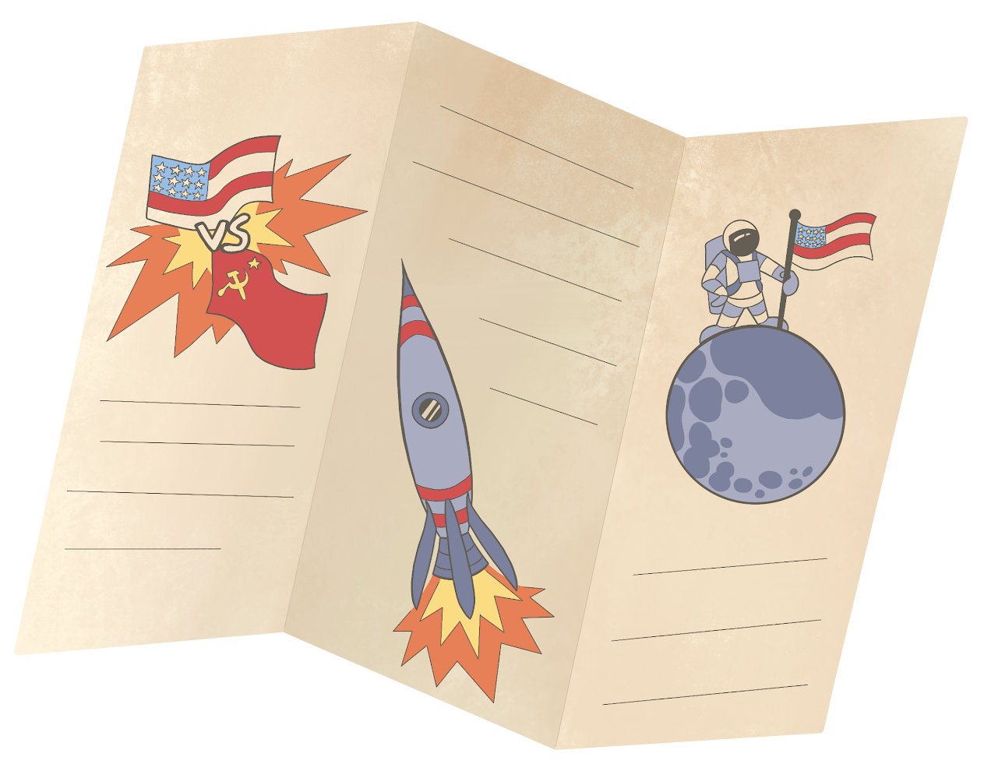
History in Three Panels Part 1
Step 1: Consider the military strategies you learned about in this lesson. Choose a strategy used by the Union or Confederacy that you think was effective.
Step 2: You must include the following in each section of your trifold:
  2–3 drawings of images or symbols that relate to the questions asked
  2–4 sentences as a response to the questions asked

Slide 10
History in Three Panels Part 2
With your partner, take turns sharing your trifolds and discussing the following prompts:
What did you add to your trifold? Why did you pick those things?
How do your choices show that this strategy was effective during the Civil War?

Slide 11


Friends Without Pens
Round 1: Discuss the following prompt with your partner.
In what ways did the Union and Confederacy strengths and weaknesses influence their military strategies?
Round 2: Individually write down a response to the prompt on your piece of notebook paper.

