Slide 2
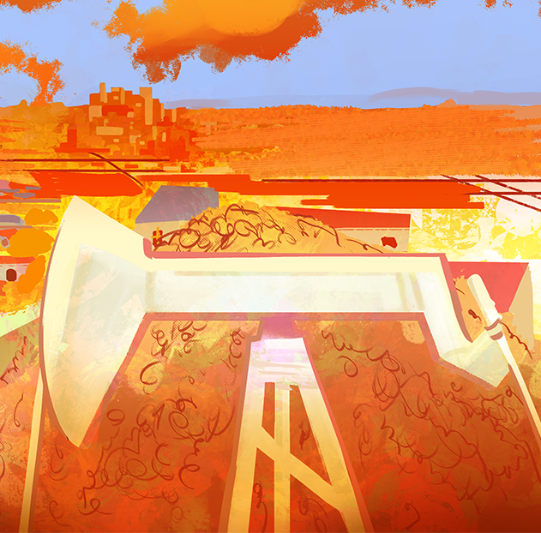
From Prairie to Prosperity
Oklahoma’s Oil Boom Era

Slide 3
Essential Questions
In what ways did the rise of the oil industry impact jobs, communities, and identity for people in Oklahoma?
How has Oklahoma been impacted and transformed by the oil industry throughout the state’s history?

Slide 4
Learning Objectives
Explain how the growth of the oil industry created new employment opportunities in Oklahoma.
Describe the impact of the Oil Boom on the agriculture industry and Oklahoma as a whole throughout the 20th century.
Consider how the oil industry is still influencing the state of Oklahoma today.

Slide 5

I Notice, I Wonder
Review the image on the next slide.
Share your thoughts on the image with the class by responding to the following prompts:
  What do you notice about this image?
  What does this image make you wonder?

Slide 6
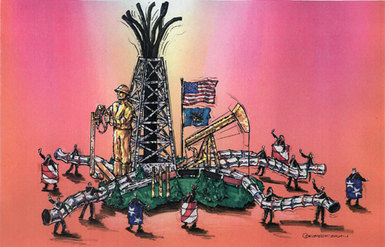
What do you notice about this image?
What does this image make you wonder?
Notes:
Luckovich, M. (n.d.). [Cartoon depicting a float acknowledging Oklahoma’s oil heritage]. American Oil and Gas Historical Society. https://aoghs.org/petroleum-pioneers/first-oklahoma-oil-well/

Slide 7


Card Sort: Boom, Bust, or Both
Lay out the three category cards: “Boom,” “Bust,” or “Both.”
Sort each of the remaining cards into one of the three categories that best fits each card.
Notes:
K20 Center. (n.d.). Card sort. Strategies. https://learn.k20center.ou.edu/strategy/147
K20 Center. (2021, September 21). K20 Center 5 minute timer [Video]. YouTube. https://www.youtube.com/watch?v=EVS_yYQoLJg

Slide 8
Economic Boom
An economic boom is a period of rapid economic growth within a location, leading to a variety of benefits for both businesses and the affected population as a whole.
Examples include:
Increased population
More job opportunities
Greater production overall from businesses or cities

Slide 9
Economic Bust
An economic bust is a period of rapid economic decline, usually following an economic boom, that causes businesses to fail, people to lose their jobs, and a significant slowdown of a location’s development.
Examples include:
Higher unemployment
Lower production or output
Increased bankruptcy
Decreased economic activity due to lower incomes or savings

Slide 10

Oil Booms and Busts
Independently read the article “Oil Booms and Busts.”
Discuss the following topics with your partner:
  Examples of economic growth in Oklahoma
  Types of job opportunities in Oklahoma created by the Oil Boom
  Prosperity of Oklahoma
  Communities’ dependence on oil
  Environmental concerns
  Wealth gaps in Oklahoma
Notes:
K20 Center. (2021, September 21). K20 Center 10 minute timer [Video]. YouTube. https://www.youtube.com/watch?v=9gy-1Z2Sa-c

Slide 11

K20 ICAP - Petroleum Engineering and Trigonometry
Notes:
K20 Center. (2023, September 18). K20 ICAP- Petroleum engineering and trigonometry [Video]. YouTube. https://www.youtube.com/watch?v=vNBCiu7Tgns

Slide 12

Mirror, Microscope, Binoculars
Respond to the following prompts on your handout:
Mirror: What have I learned so far about the impact of the oil boom on Oklahoma’s economy?
Microscope: What are some energy companies or careers in Oklahoma that I am interested in learning more about?
Binoculars: How has the oil industry affected the natural environment?
Notes:
K20 Center. (n.d.). Mirror, microscope, binoculars. Strategies. https://learn.k20center.ou.edu/strategy/3020

Slide 13


Two-Minute Paper
Choose one of the following prompts.
Respond to your chosen prompt in two minutes.
  Why do you think boom and bust cycles happen in industries like oil, and how do these economic cycles affect people’s lives and communities?
  How does the oil industry create both opportunities and problems for a state like Oklahoma? Give examples of each.
Notes:
K20 Center. (n.d.). Two-minute paper. Strategies. https://learn.k20center.ou.edu/strategy/152
K20 Center. (2021, September 21). K20 Center 2 minute timer [Video]. YouTube. https://www.youtube.com/watch?v=HcEEAnwOt2c

