Slide 2
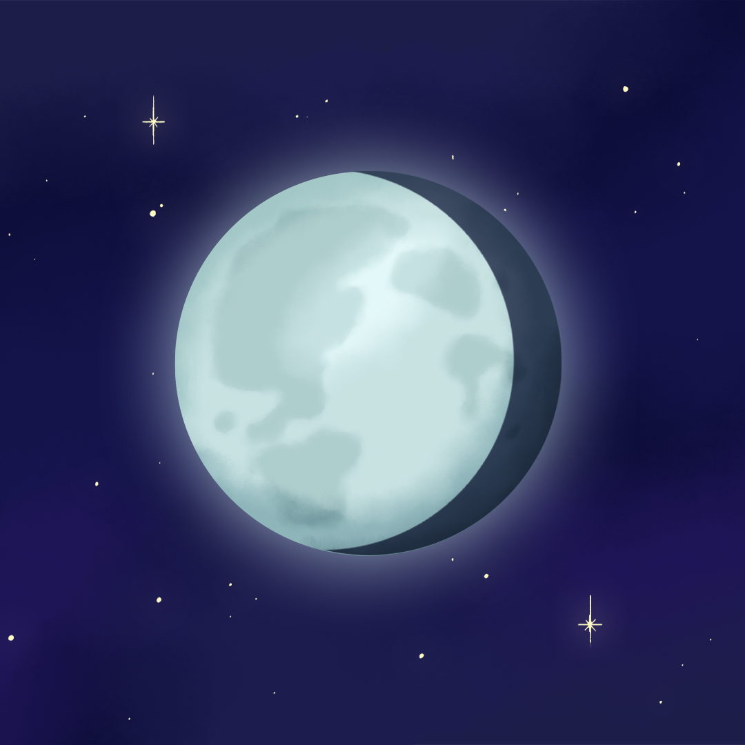
It’s Just a Phase!
Phases of the Moon and the Effects on Earth

Slide 3
Essential Question
Why does the moon look different every night if it’s the same moon?

Slide 4
Lesson Objectives
Model the moon phases.
Predict the patterns associated with moon phases and how the sun and Earth interact with the moon.

Slide 5
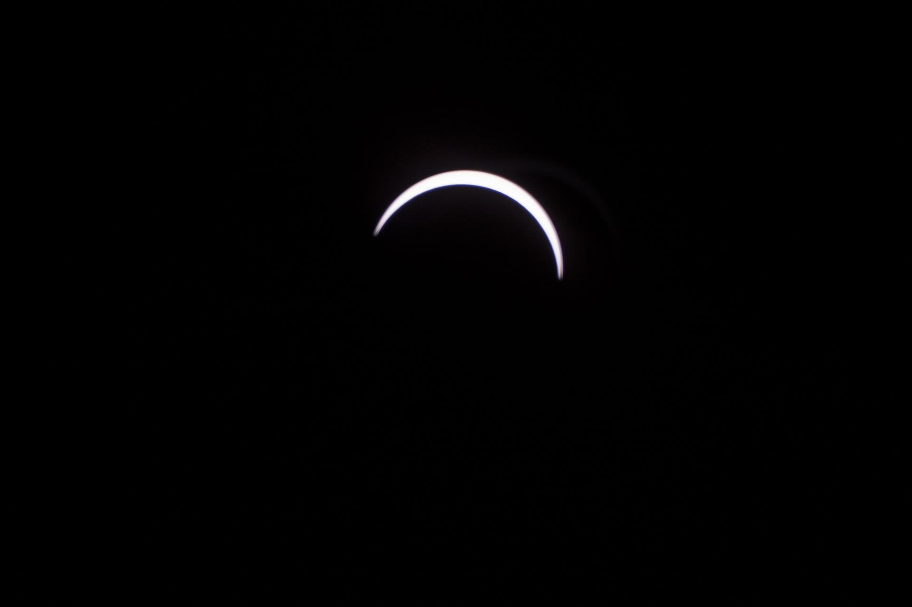
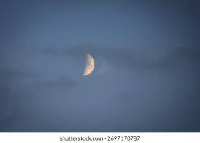
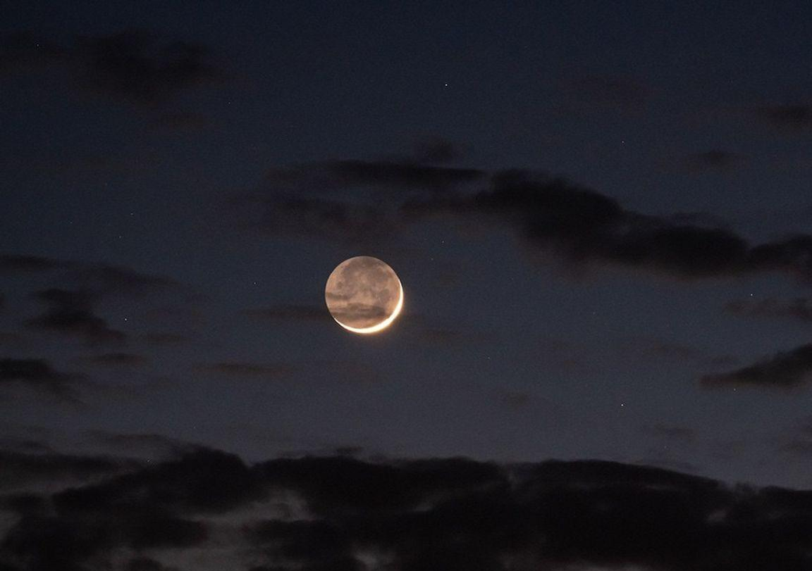
I Notice, I Wonder
Notes:
Half moon night sky capturing lunar [Photograph]. (n.d.). Shutterstock. https://www.shutterstock.com/image-photo/half-moon-night-sky-capturing-lunar-2697170787
K20 Center. (n.d.). I notice, I wonder. Strategies. https://learn.k20center.ou.edu/strategy/180
Levay, Z. (n.d.). Though the moon is in a crescent phase in this photograph, most of the darkened, Earth-facing side of the moon is still dimly visible, illuminated by sunlight reflecting off our planet [Photograph]. National Aeronautics and Space Administration. https://science.nasa.gov/moon/moon-phases/#h-our-wobbly-moon
Thomas, C. (2017, August 21). The moon is seen passing in front of the Sun during a total solar eclipse on Monday, August 21, 2017, from onboard a NASA Gulfstream III aircraft flying 25,000 feet above the Oregon coast [Photograph]. National Aeronautics and Space Administration. https://science.nasa.gov/resource/the-moon-blocks-the-sun/

Slide 6
Moon Phases Wheel
Cut out both the large Wheel A and Wheel B.
Cut out the viewing window section in Wheel A.
Place Wheel A on top of Wheel B and attach them with a brad in the center of the wheels.
Draw the moon phase on each section of Wheel B.
Rotate Wheel A on top of Wheel B to see each moon phase.

Slide 7
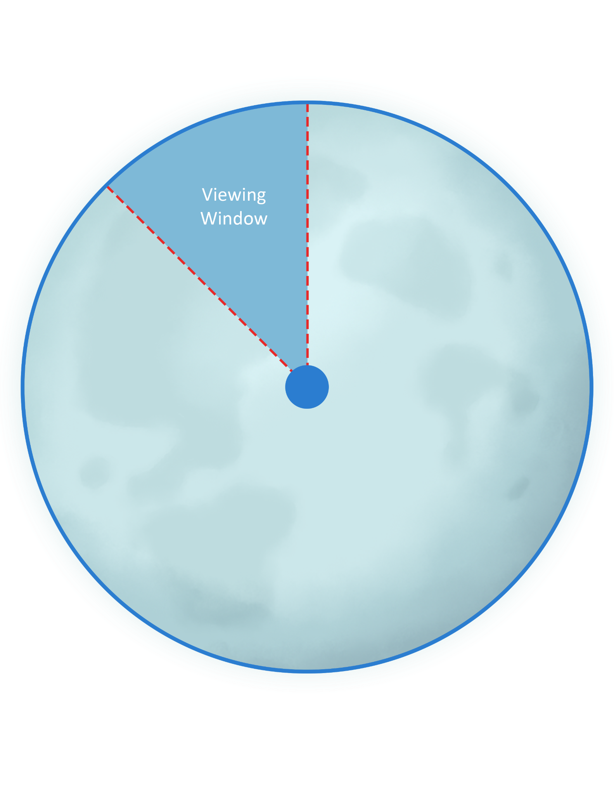
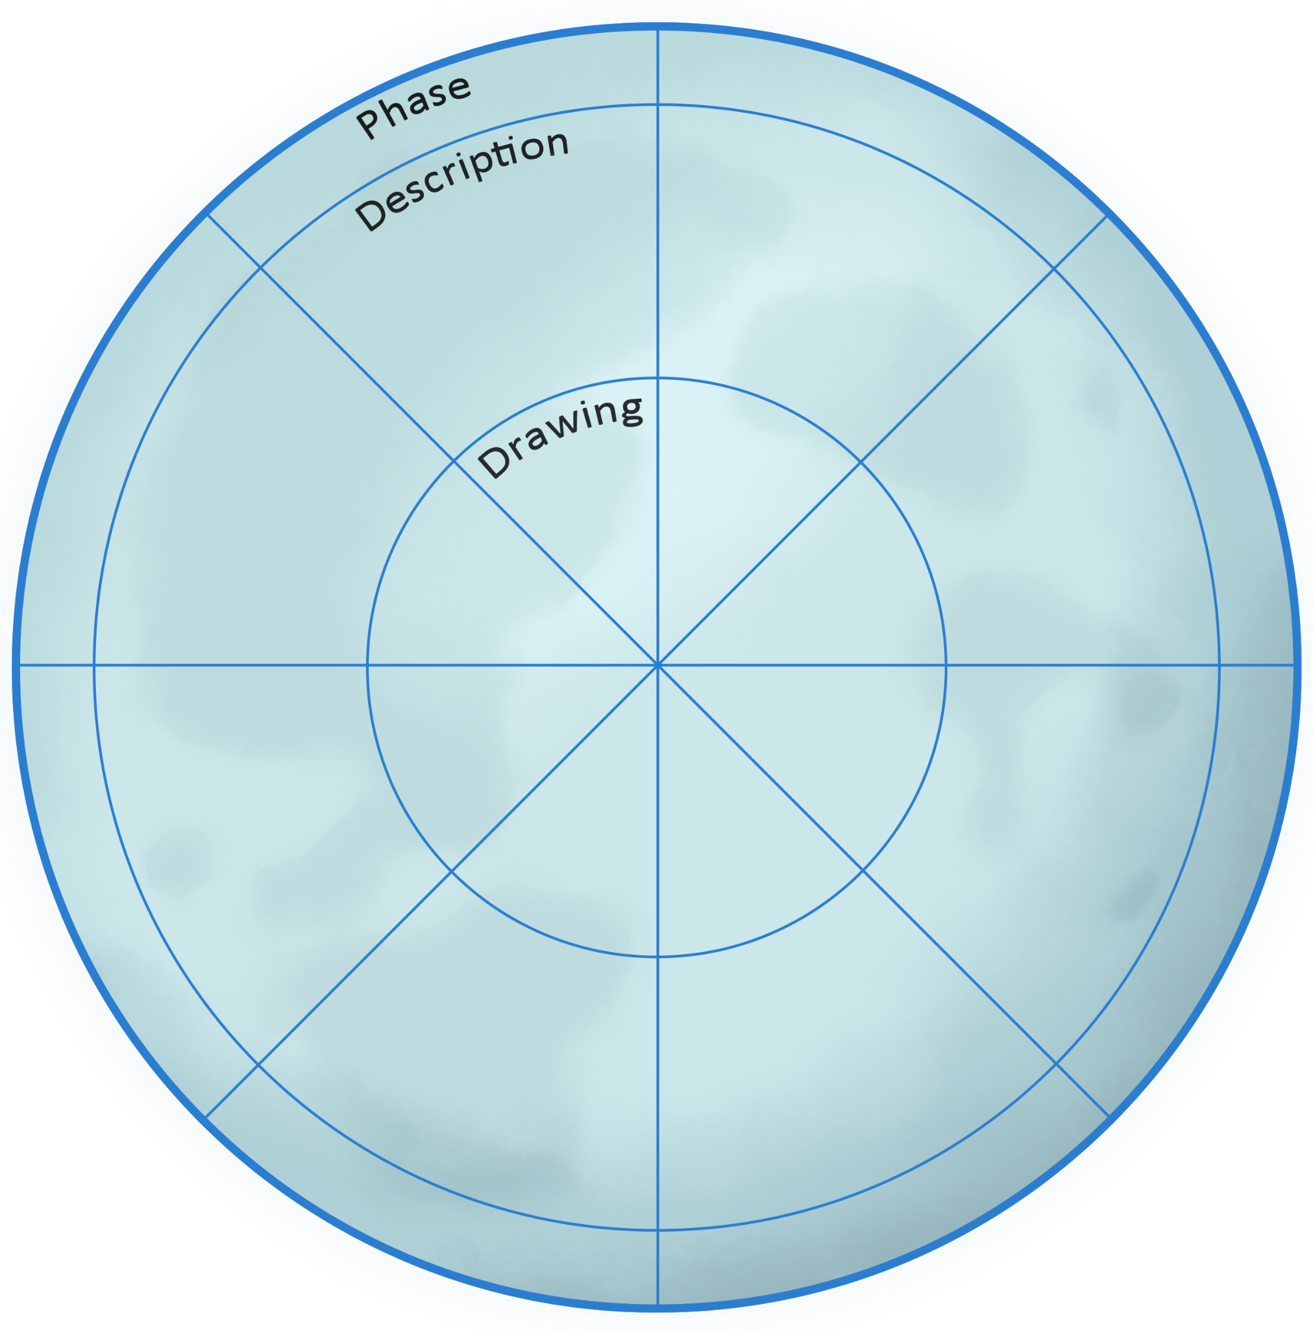
Moon Phases Wheel

Slide 8
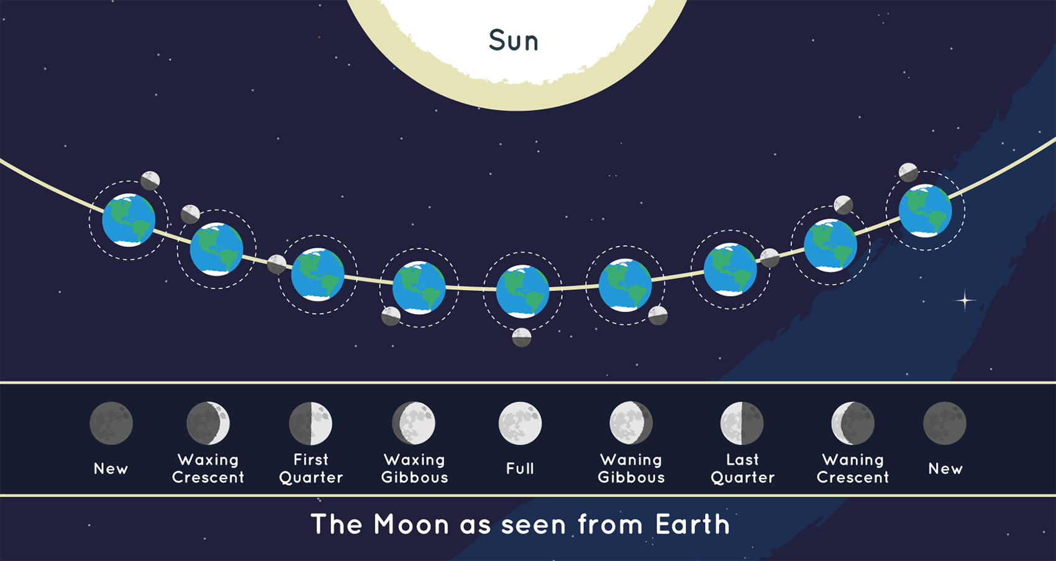
Keep in Mind: Moon Phases
The moon takes 30 days to complete one full orbit around the sun.
There are 8 phases in the moon cycle.
The Earth and the moon are in sync during orbit, so we always see only one side of the moon.
Waxing: Growing of the illumination
Waning: Shrinking of the illumination (illumination getting smaller)
Crescent: Thin slice of light

Slide 9
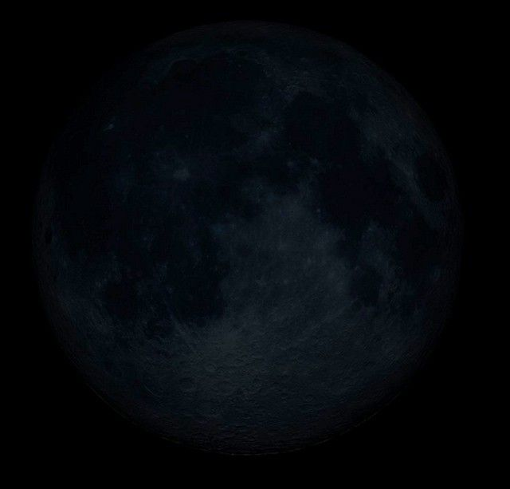
New Moon
The sunlight is shining on the far side, opposite our view of the moon.
The moon appears completely dark because the unlit side is facing Earth.

Slide 10
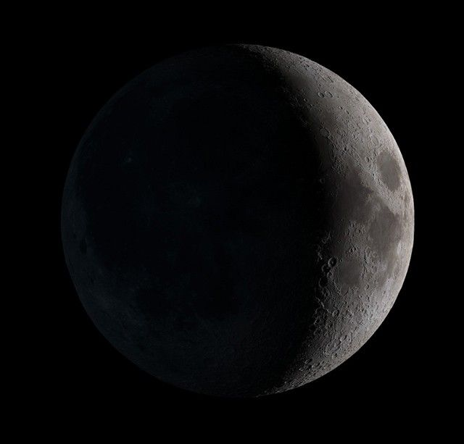
Waxing Crescent Moon
The right edge of the sphere is illuminated as a crescent.
The moon appears to “grow” into view.

Slide 11
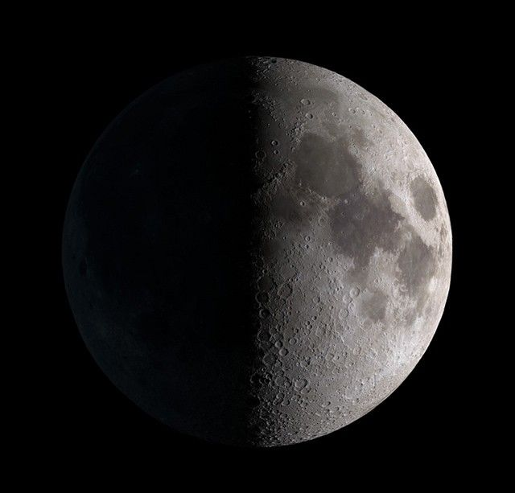
First Quarter Moon
The right half of the sphere is illuminated.
The moon is ¼ of the way through the moon cycle.

Slide 12
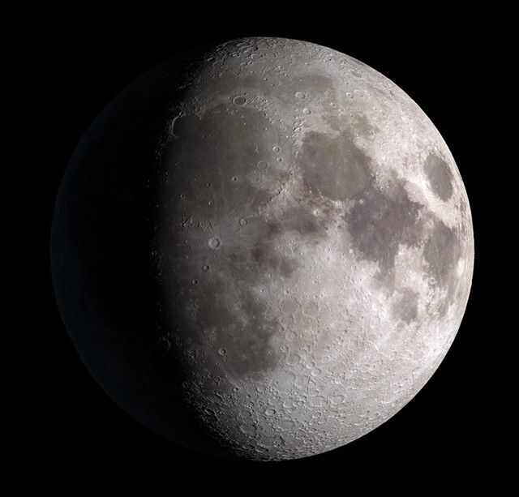
Waxing Gibbous Moon
The surface is more illuminated.
The moon appears brighter.

Slide 13
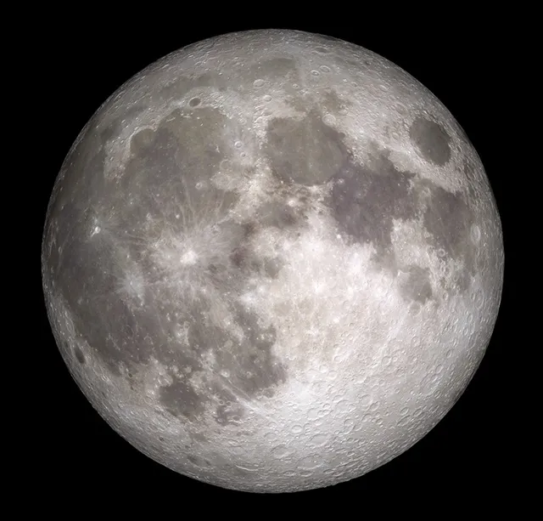
Full Moon
The moon is directly opposite the sun, as viewed from Earth. Half of the moon is fully illuminated.
The moon appears completely lit up on the side we see from Earth.

Slide 14
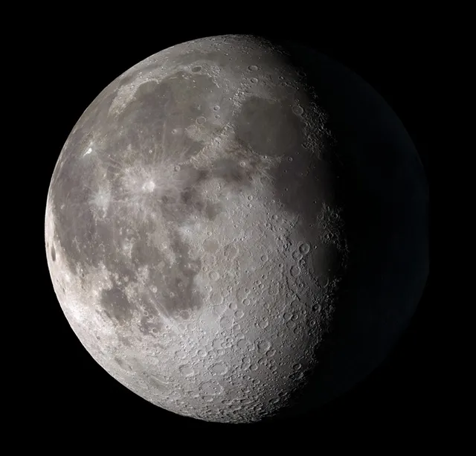
Waning Gibbous Moon
Less of the moon’s surface is illuminated.
The moon appears to “shrink” in view as it begins to move back toward the sun.

Slide 15
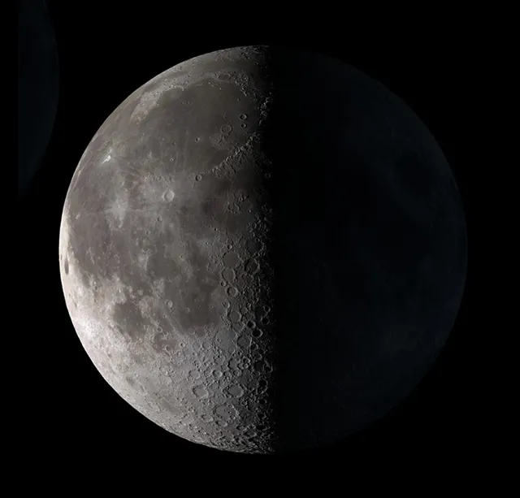
Last Quarter (3rd Quarter) Moon
The moon is ¾ of the way around from its original position. The opposite side from the first quarter is illuminated.
The moon is ¾ through the moon cycle.

Slide 16
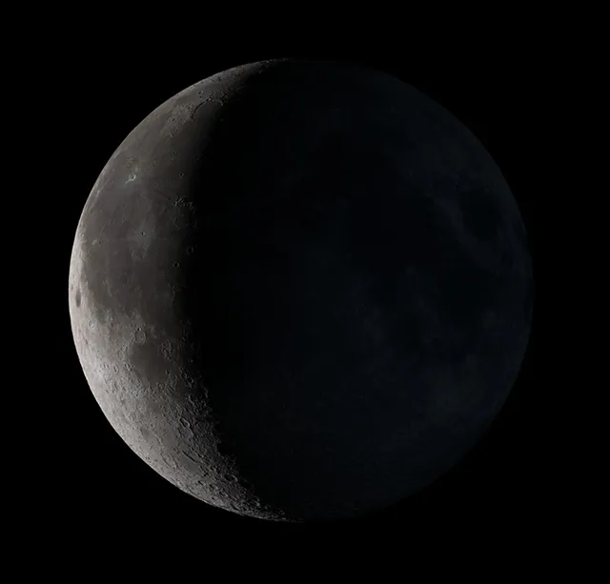
Waning Crescent Moon
The illuminated surface of the sphere is growing smaller.
The moon appears to be “shrinking” further as the moon is facing back toward the sun.

Slide 17
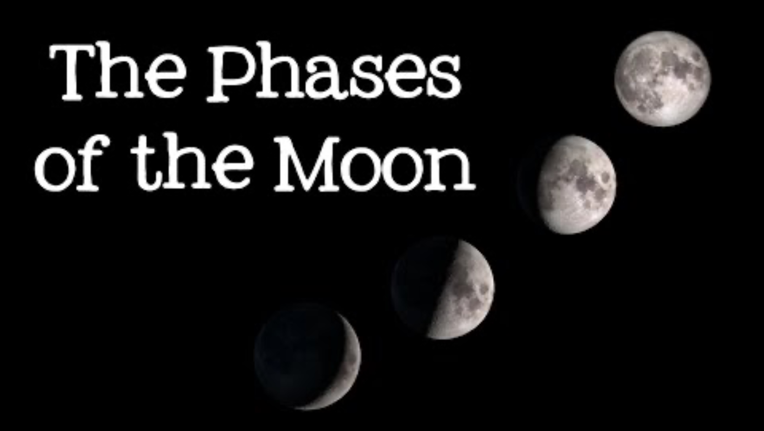
The Phases of The Moon
Notes:
Free School. (2016, February 5). Phases of the moon: Astronomy and space for kids [Video]. YouTube. https://www.youtube.com/watch?v=f4ZHdzl6ZWg

Slide 18
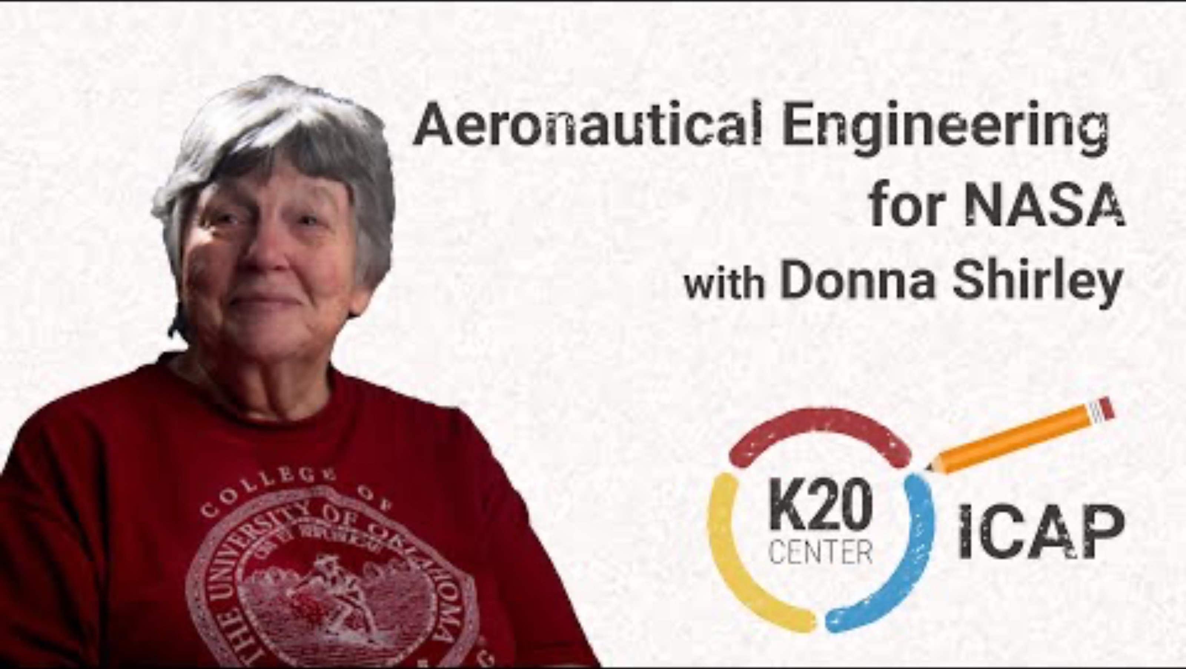
Aeronautical Engineering for NASA–Moonward Bound–Donna Shirley
Notes:
K20 Center. (2025, June 4). K20 ICAP – Aeronautical engineer for NASA [Video]. YouTube. https://www.youtube.com/watch?v=rYT3JoJDh9E

Slide 19

Boards Up
You will have 15 seconds to respond to the provided prompts on the proceeding slides.
Notes:
Teacher’s Note: Set a timer for 15 seconds using the K20 Center’s timer: https://timer.k20center.ou.edu/
K20 Center. (n.d.). Boards up. Strategies. https://learn.k20center.ou.edu/strategy/5243

Slide 20
Question 1
Quietly answer the following question on your board:
What does the moon have each night?

Slide 21
Question 2
Quietly answer the following question on your board:
How many moon phases are there?

Slide 22
Question 3
Quietly answer the following question on your board:
What is waxing?

Slide 23
Question 4
Quietly answer the following question on your board:
What is waning?

Slide 24
Question 5
Quietly answer the following question on your board:
How large is the moon during the first quarter phase?

Slide 25
Question 6
Quietly answer the following question on your board:
Name the moon phases in order, starting at the new moon phase.

Slide 26
Question 7
Quietly answer the following question on your board:
How long does it take the moon to orbit the Earth?

Slide 27
Question 8
Quietly answer the following question on your board:
How many moons does Mars have?

Slide 28
Question 9
Quietly answer the following question on your board:
What is a crescent moon?

Slide 29
Question 10
Quietly answer the following question on your board:
Explain why you can still see the moon during the daytime.

Slide 30
Question 11
Quietly answer the following question on your board:
How long does it take the Earth to orbit around the sun?

Slide 31
Question 12
Quietly answer the following question on your board:
True or false: The moon produces its own light.

Slide 32
Question 13
Quietly answer the following question on your board:
What is the dividing line between daytime and nighttime on the moon?

Slide 33
Question 14
Quietly answer the following question on your board:
What is another name for moon phases?

Slide 34
Question 15
Quietly answer the following question on your board:
The lunar cycle begins with which phase of the moon?

Slide 35
Question 16
Quietly answer the following question on your board:
New moon is the only phase when what could occur?

Slide 36
Question 17
Quietly answer the following question on your board:
What is another name for the first or third quarter moon phase?

Slide 37
Question 18
Quietly answer the following question on your board:
What does gibbous mean?

Slide 38
Question 19
Quietly answer the following question on your board:
What is the biggest, brightest moon phase?

Slide 39
Question 20
Quietly answer the following question on your board:
What can only occur during the full moon phase?

Slide 40
Bonus Question
Quietly answer the following question on your board:
Do you know what the current moon phase will be today?
Notes:
Teacher’s Note: Go to the following link to share today’s moon phase: https://science.nasa.gov/moon/daily-moon-guide/

