Slide 2
Parrots, Penguins, and Parts
Homologous Structures

Slide 3
Essential Question
How do scientists determine relationships between today’s organisms and their ancestors using their physical appearance and characteristics?

Slide 4
Lesson Objectives
Identify anatomical similarities and differences between organisms.
Explain the relationships between organisms based on homologous structures.

Slide 5
How I Know It
Choose “parrot” or “penguin.”
Find two colors of writing utensils.
Use one color to write down everything you know about your chosen animal inside the circle.
Outside the circle, write down how you knew that information.
Draw a line to connect each piece of information on the inside of the circle with your logic on the outside of the circle.
Notes:
K20 Center. (n.d.). How I know it. Strategies. https://learn.k20center.ou.edu/strategy/144

Slide 6
Squakzilla: The Giant Parrot
Notes:
1News. (2019, August 7). Scientists discover New Zealand’s ‘Squakzilla’, biggest parrot in history [Video]. YouTube. https://www.youtube.com/watch?v=G4wbbxI9cLM

Slide 7
Squawkzilla vs. Crossvallia Penguin
Identify which section you are responsible for reading in your group.
Student 1: Paragraphs 1–3
Student 2: Paragraphs 4–6
Student 3: Paragraphs 7–9
Read your assigned section and take notes on your How I Know It handout.
Share information from your section with your group members.
Notes:
K20 Center. (n.d.). Jigsaw. Strategies. https://learn.k20center.ou.edu/strategy/179

Slide 8
Flap to the Future
Navigate to https://tinyurl.com/42esj4sa
Play levels 1–4.
On your handout, sketch an image of the organism featured in each level.
Take notes about the body structures and movement.
Notes:
K20 Center. (n.d.). Cognitive comics. Strategies. https://learn.k20center.ou.edu/strategy/198
The Cornell Lab of Ornithology. (n.d.). Flap to the future—The flight adaptations game. Bird Academy. https://academy.allaboutbirds.org/features/flaptothefuture/

Slide 9
Flap to the Future
Watch the video “Flap to the Future”: https://safeshare.tv/playlists/309595#309595
As you watch, sketch an image of the organism featured in each level.
Take notes about the body structures and movement.
Notes:
K20 Center. (n.d.). Cognitive comics. Strategies. https://learn.k20center.ou.edu/strategy/198
K20 Center. (n.d.). SafeShare. Tech Tools. https://learn.k20center.ou.edu/tech-tool/4269
The Cornell Lab of Ornithology. (n.d.). Flap to the future—The flight adaptations game. Bird Academy. https://academy.allaboutbirds.org/features/flaptothefuture/

Slide 10
Game Over
Share your notes and sketches with an Elbow Partner.
Were there any differences between the organisms?
Were there any similarities between the organisms?
What did the game say about the relationship between the organisms?
Notes:
K20 Center. (n.d.). Elbow partners. Strategies. https://learn.k20center.ou.edu/strategy/116

Slide 11
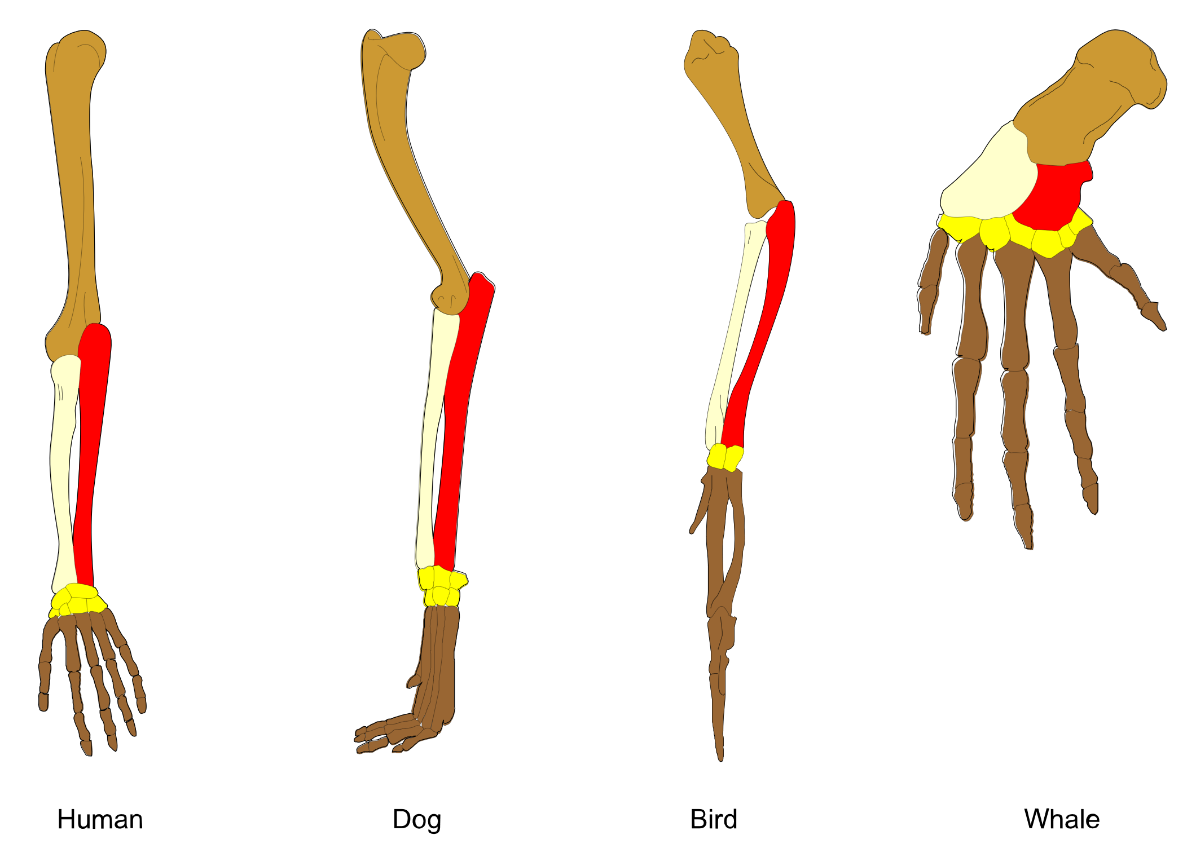
Photo Deconstruction
Describe what you see.
What do you think these images represent?
Notes:
K20 Center. (n.d.). Photo or picture deconstruction. Strategies. https://learn.k20center.ou.edu/strategy/140
Petrovič, V. V. (2011). Homology vertebrates. Wikimedia Commons. https://commons.wikimedia.org/w/index.php?curid=37704829

Slide 12
Dig Deeper
What evidence suggests that these organisms are related?
Notes:
MooMooMath and Science. (2023, November 1). Homologous structures [Video]. YouTube. https://www.youtube.com/watch?v=VLi_PQ6-aK8

Slide 13
Who “Nose”?
Picture the nose of a pig, an elephant, and a human.
How do these structures function? What do they do?
Do these noses look the same?
Are they in the same location?
Do they have the same shape?
Homologous structure: An organ or body part that appears in different organisms and has a similar structure and location, but doesn’t always share the same function.
Notes:
Stewart, L. (2023, November 21). Homologous structures: Definition, structure & characteristics. Study.com. https://study-com.translate.goog/academy/lesson/homologous-structures-comparison-of-body-structures-across-species.html?_x_tr_sl=en&_x_tr_tl=es&_x_tr_hl=es&_x_tr_pto=wa

Slide 14
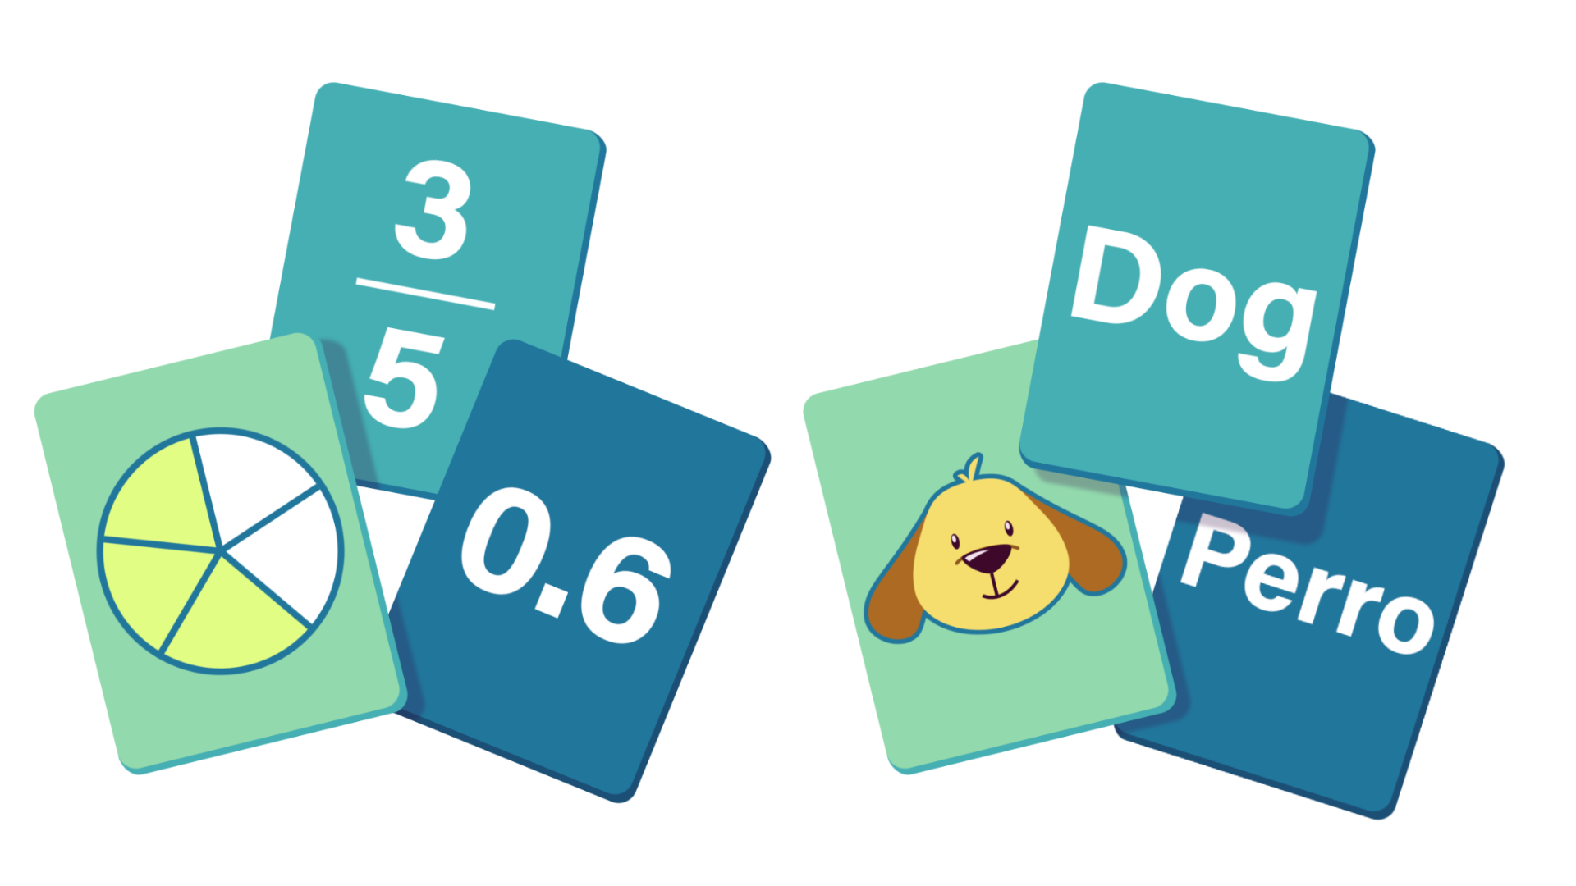
Hand It to the Animals
Navigate to https://bit.ly/animal-hands-cards.
Complete the card matching activity.
Match the animal to the correct hand x-ray.
Match the function of the hand to each image.
Notes:
K20 Center. (n.d.). Card matching. Strategies. https://learn.k20center.ou.edu/strategy/1837

Slide 15
Hand It to the Animals
Navigate to https://bit.ly/animal-hands-cards.
Describe the characteristics of each x-ray including fingernails, claws, bone density, and padding.
Determine which animal the hand belongs to and the function of each hand.
Record your responses on the chart.

Slide 16
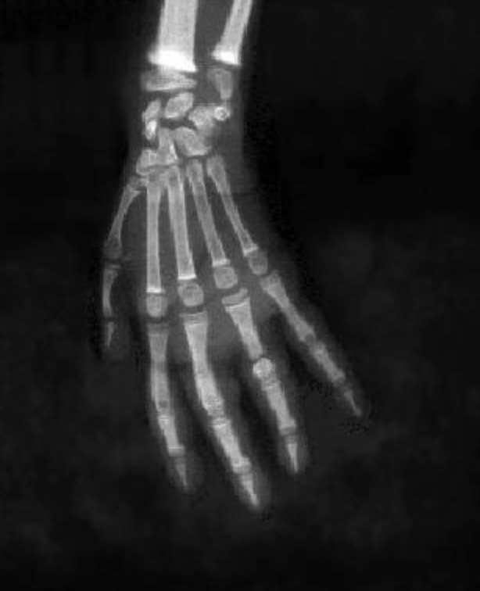
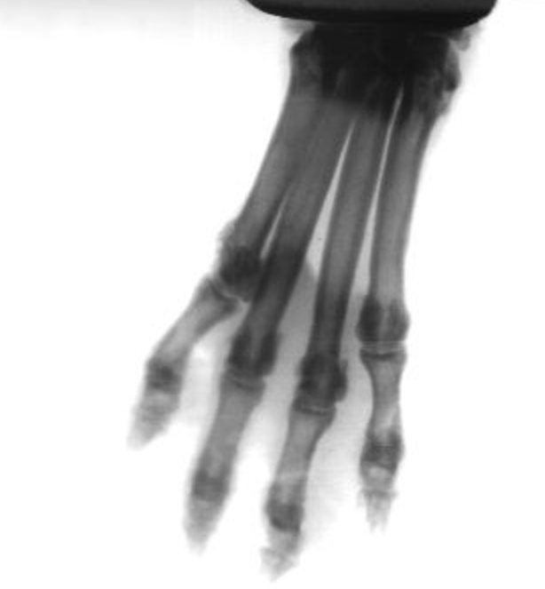
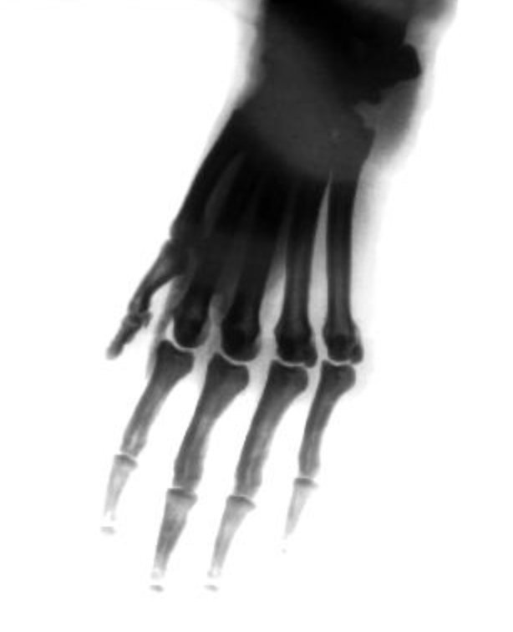
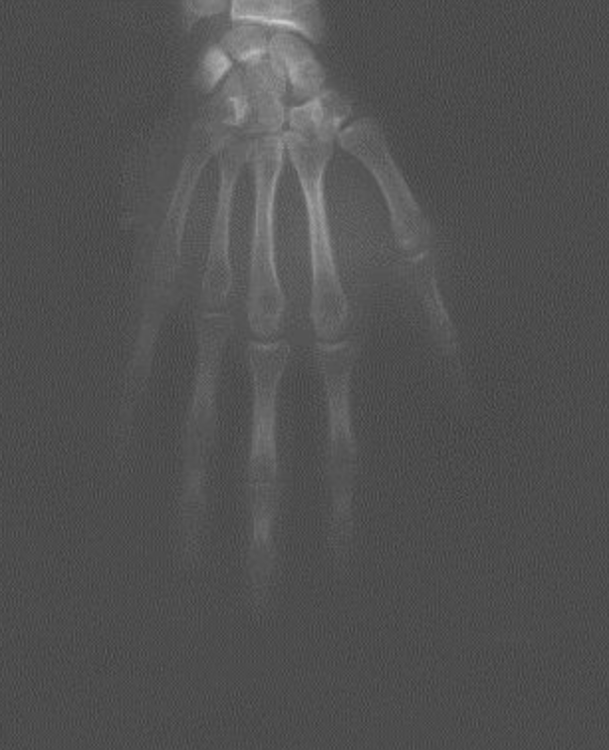
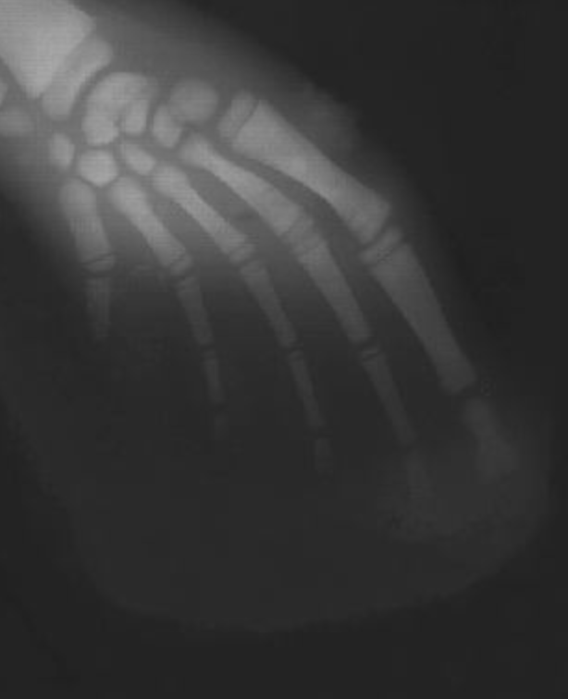
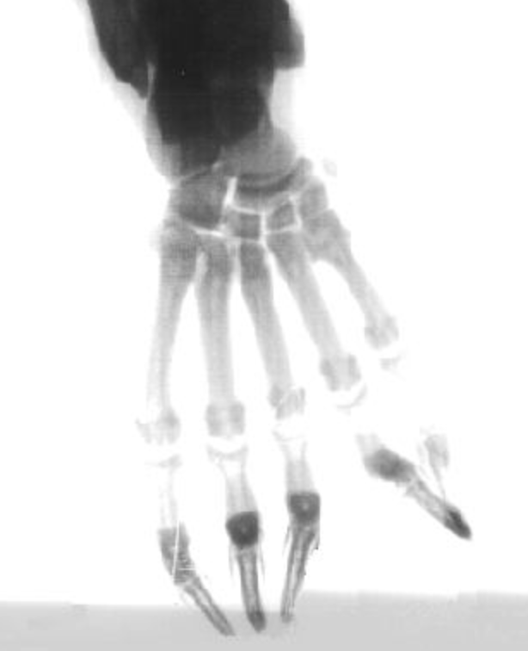
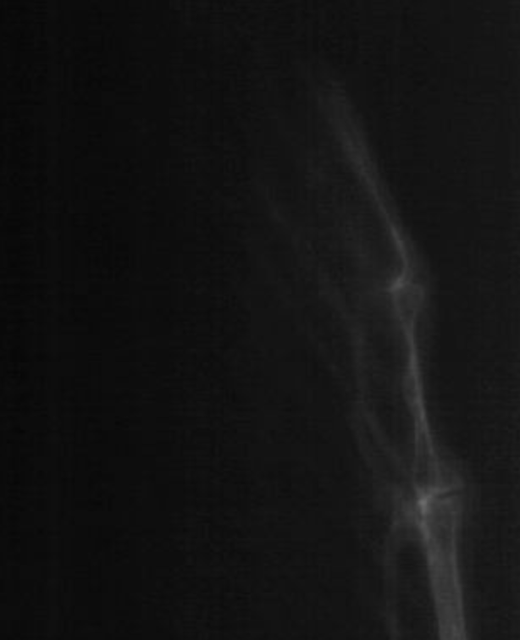
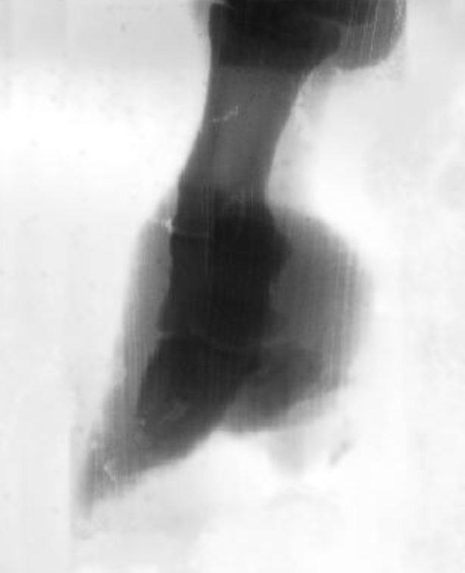
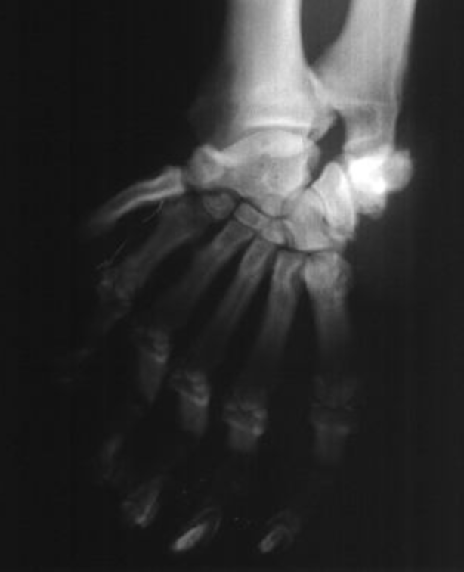
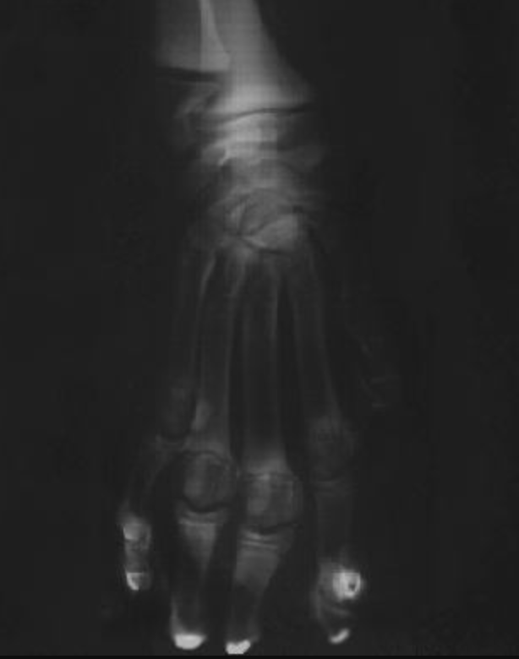
Hand It to the Animals
1 | 2 | 3 | 4 | 5
6 | 7 | 8 | 9 | 10

Slide 17
Hand It to the Animals: Discussion
Which parts of this activity were easy?
Which parts were difficult?
What did you notice about the x-rays?

Slide 18
Claim, Evidence, Reasoning
With your group members, develop a claim about the following prompt:
What is the relationship between the animals? Base your claim on what you see in the x-rays.
Record your response on your CER handout.
Provide evidence for your claim.
Explain your reasoning and how the evidence supports your claim.
Notes:
K20 Center. (n.d.). Claim, evidence, reasoning (CER). Strategies. https://learn.k20center.ou.edu/strategy/156

Slide 19
But Now I Know…
Consider the following question:
How do scientists determine relationships between today’s organisms and their ancestors using their physical appearance and characteristics?
Respond to the question on your handout. Describe how your thoughts have changed during the lesson.
Notes:
K20 Center. (n.d.). I used to think . . . but now I know. Strategies. https://learn.k20center.ou.edu/strategy/137

