Slide 2
The Emancipation Proclamation
Expanding the Goals of the Civil War

Slide 3
Text Impressions
President of the United States | forever free
proclamation | such persons
war measure | received into the Armed Services
declare | act of justice
slaves | military necessity
states in rebellion

Slide 4
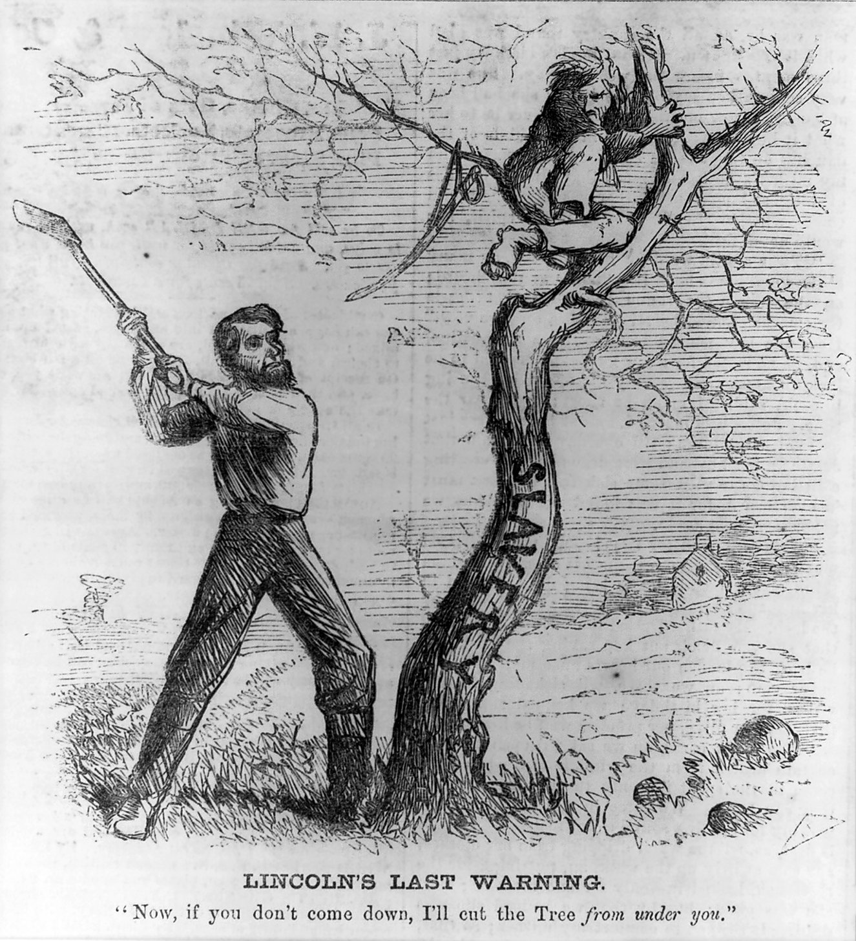
Notes:
Bellew, F. (1862). Lincoln’s last warning. Library of Congress; reproduction number LC-USZ62-48218. Retrieved from: https://commons.wikimedia.org/w/index.php?search=lincoln%27s+last+warning&title=Special%3ASearch&go=Go&ns0=1&ns6=1&ns12=1&ns14=1&ns100=1&ns106=1#/media/File:Lincoln's_Last_Warning,_October_1862.jpg

Slide 5
Essential Questions
How did the Emancipation Proclamation affect the Civil War?
What was its impact on the institution of slavery in the United States?
How is Juneteenth related to emancipation?

Slide 6
Lesson Objectives
Analyze texts to determine the effect of the Emancipation Proclamation on the Union’s goals of the Civil War.
Clarify misconceptions surrounding the proclamation.
Debate the pros and cons for establishing Juneteenth as a federal holiday.

Slide 7
Emancipation Proclamation Card Sort
Find the heading cards: “The Emancipation Proclamation Did…” and “The Emancipation Proclamation Did Not…”
Next, sort the remaining cards into one of these two categories.
Be prepared to explain your choices to the class.

Slide 8
Why-Lighting: The Emancipation Proclamation
As you read the Emancipation Proclamation, highlight the three most important ideas presented in the document.
Next to each highlighted phrase, explain why you highlighted that phrase.

Slide 9
Paired Text Analysis: The Emancipation Proclamation
The Emancipation Proclamation freed enslaved people in the states that were rebelling against the U.S.
Abraham Lincoln presented freeing enslaved people in the Confederacy as a necessary war measure to help defeat the Confederacy and end the war.
Black men freed from slavery were then able to be accepted into the Union military.

Slide 10
Why-Lighting: Lincoln’s First Inaugural Address
As you read Lincoln’s first inaugural address, highlight the most important idea represented in the document.
Next to the highlighted phrase, explain why you highlighted that phrase.

Slide 11
Paired Text Analysis: Lincoln’s First Inaugural Address
In 1861 (right before the Civil War began), Lincoln stated that he did not intend to take any action to interfere with slavery in the slave states (where slavery already existed).

Slide 12
Both Texts Together
The goals of the Civil War expanded with the issuance of the Emancipation Proclamation to include freeing slaves as a legitimate aim in addition to preserving the Union.

Slide 13
Both Texts Together
2.
The Emancipation Proclamation threatened the institution of slavery (1) by freeing enslaved people in the states that were rebelling against the U.S. and (2) by allowing formerly enslaved people to join the Union Army. It was a first step toward total abolition of slavery.

Slide 14
Card Sort Revisited
Look back at the way you categorized the cards about the Emancipation Proclamation.
Based on the information we have read and discussed, are there any statements that you would move?
Make any necessary changes and be prepared to discuss your answers with the class.

Slide 15
Juneteenth
What is Juneteenth?
How is Juneteenth connected to emancipation?
Why is Juneteenth a significant holiday in the U.S.?

