Slide 2
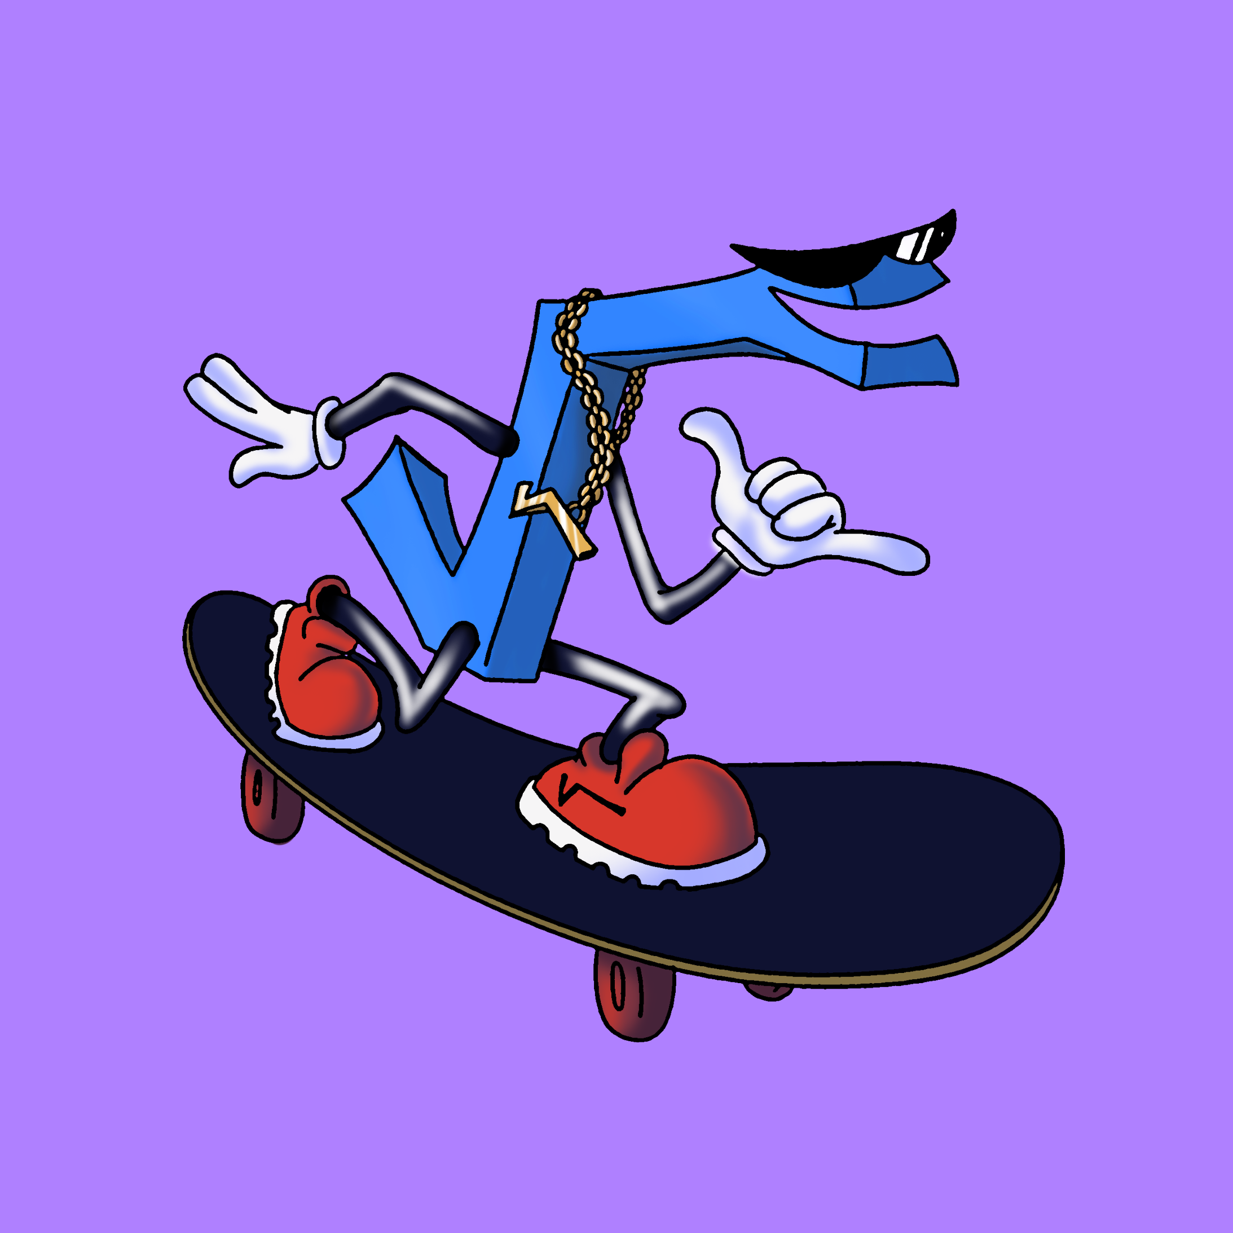
Simply Radical, Part 2
Manipulating Radical Expressions

Slide 3
Essential Question
What does it mean to simplify a radical expression?

Slide 4
Learning Objectives
Add, subtract, multiply, and divide radical expressions.
Rationalize the denominator of a radical expression.

Slide 5

Question Formulation Technique
Read the 2 completed problems on the next slide.
In your group:
  Write as many questions as you can
  about the problems.
  Rewrite any statements as questions.
The goal is to generate questions, not to judge or answer any of the questions yet.
Notes:
K20 Center. (n.d.). Question formulation technique. Strategies. https://learn.k20center.ou.edu/strategy/5188

Slide 6

Question Formulation Technique
4-Minute Timer
Notes:
K20 Center. (n.d.). Question formulation technique. Strategies. https://learn.k20center.ou.edu/strategy/5188
K20 Center. (2021, September 21). 4 minute timer. [Video]. YouTube. https://www.youtube.com/watch?v=kpCsfuvzQeY

Slide 7

Question Formulation Technique
In your group, narrow down your list
of questions to your top 3 questions.
Prepare to share your questions with the class.
3-Minute Timer
Notes:
K20 Center. (n.d.). Question formulation technique. Strategies. https://learn.k20center.ou.edu/strategy/5188
K20 Center. (2021, September 21). 3 minute timer. [Video]. YouTube. https://www.youtube.com/watch?v=iISP02KPau0

Slide 8
Radical Connections
Highlight all equivalent expressions with the same color. You’ll need 4 different colors.
Use a calculator to check for equivalence.
Then use what you highlighted to complete the table.

Slide 9

I Notice, I Wonder
Review what you wrote in the table.
What do you notice?
What do you wonder?
Notes:
K20 Center. (n.d.). I notice, I wonder. Strategies. https://learn.k20center.ou.edu/strategy/180

Slide 10
I Notice, I Wonder
What did you notice about each row?
What did you notice about each column?
What do you still wonder?
Notes:
K20 Center. (n.d.). I notice, I wonder. Strategies. https://learn.k20center.ou.edu/strategy/180

Slide 11
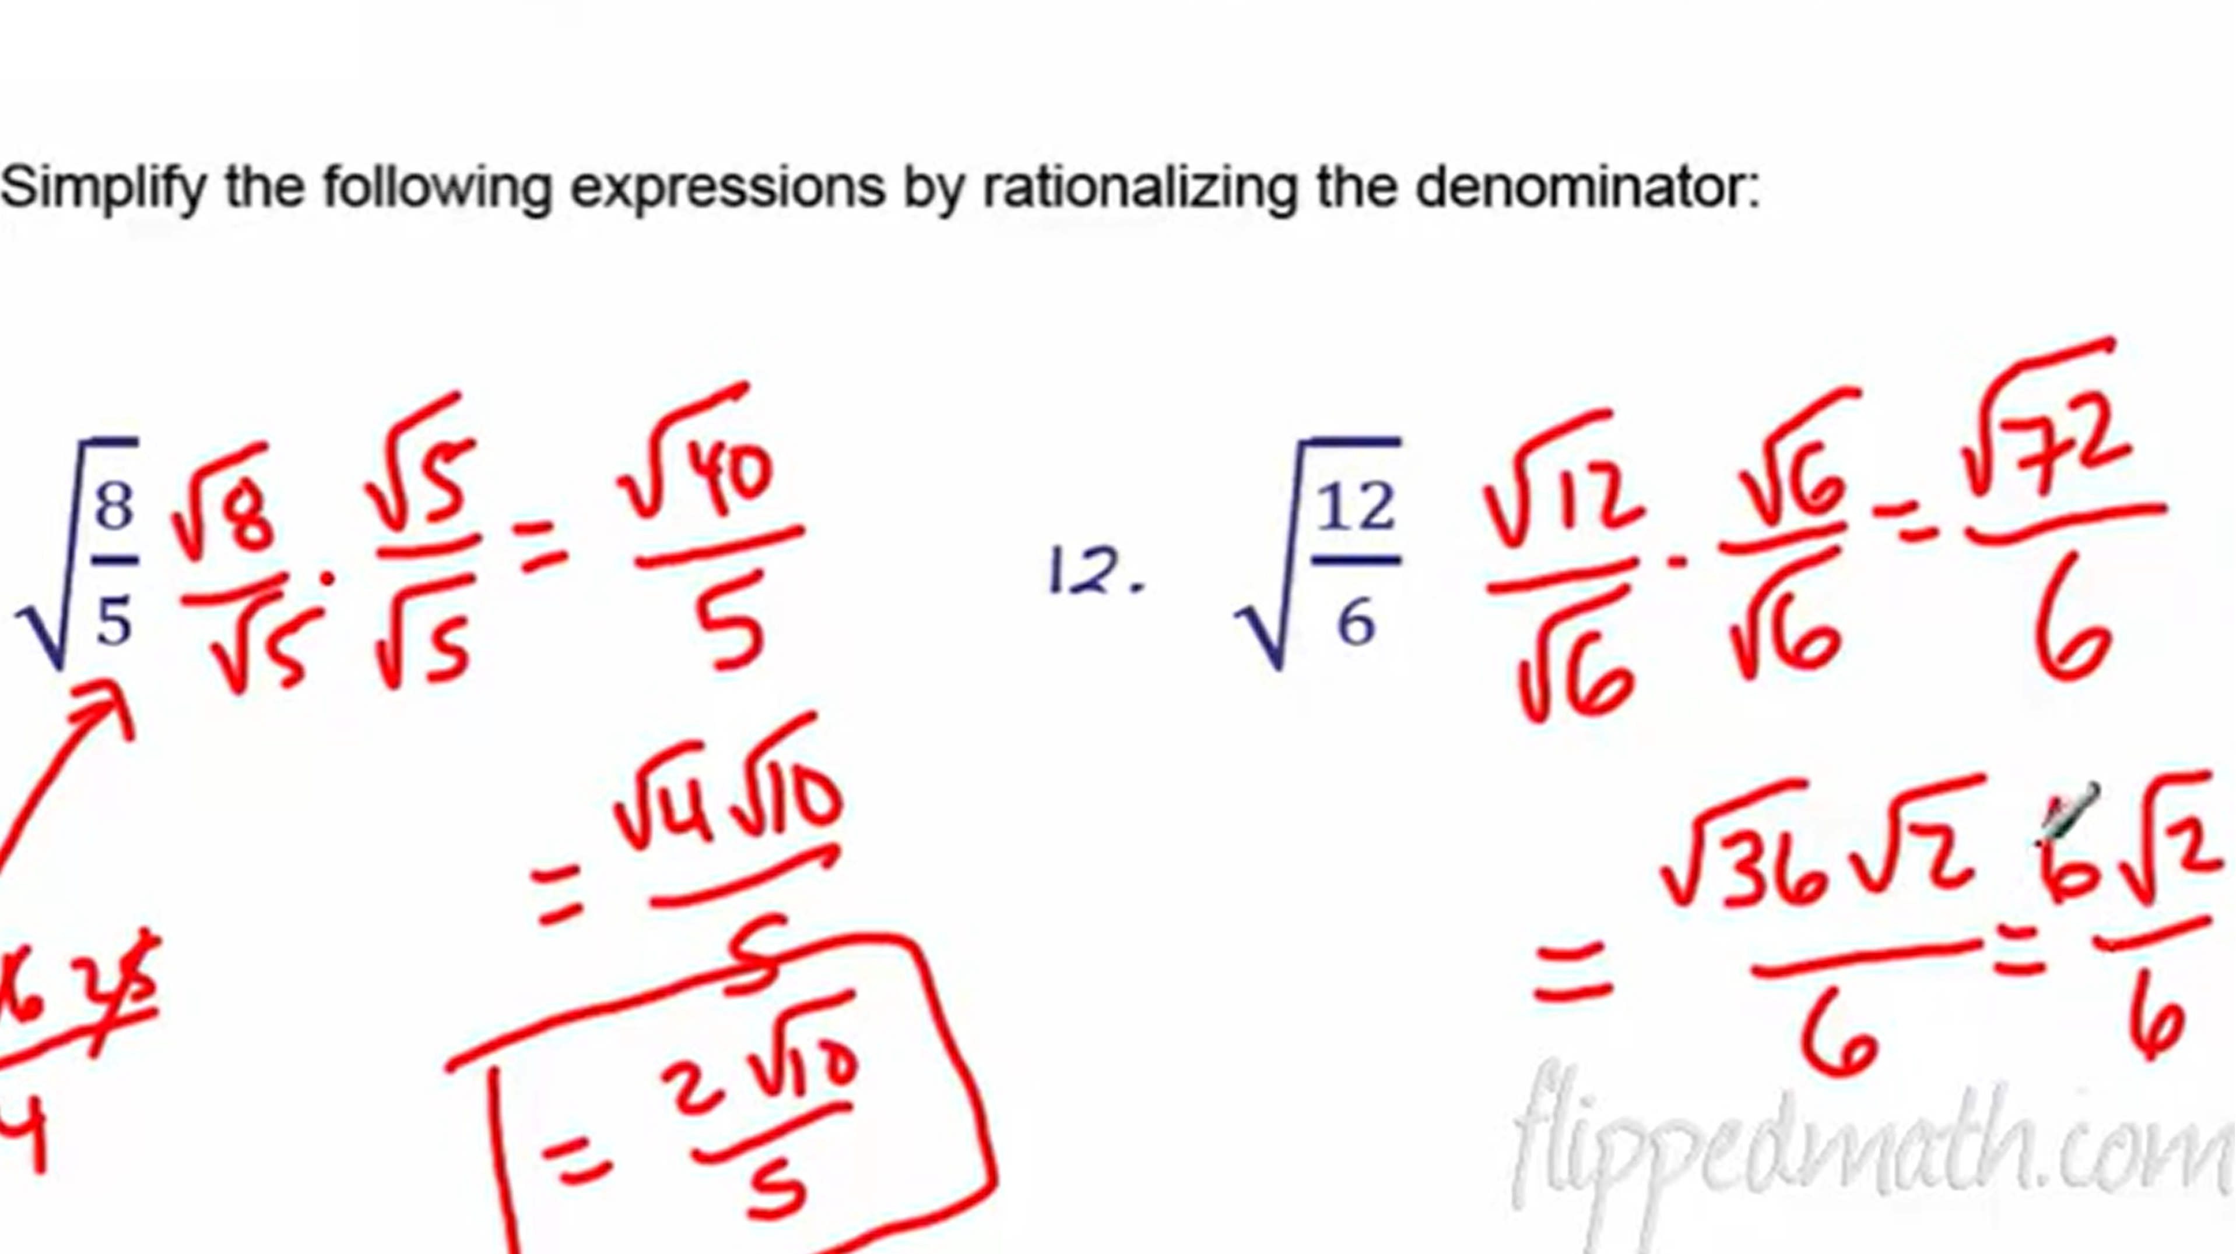
Operations with Square Roots
Notes:
The Algebros. (2020, November 29). Adding and Subtraction of Square Roots (Radicals) [Video]. YouTube. https://www.youtube.com/watch?v=YP7L62Kx2v8

Slide 12
Operations on Radicals: Summarize
What must be true to add or subtract square roots?
How do you add or subtract square roots?
How do you multiply or divide square roots?
When do you need to rationalize a denominator?
How do you rationalize a denominator?

Slide 13
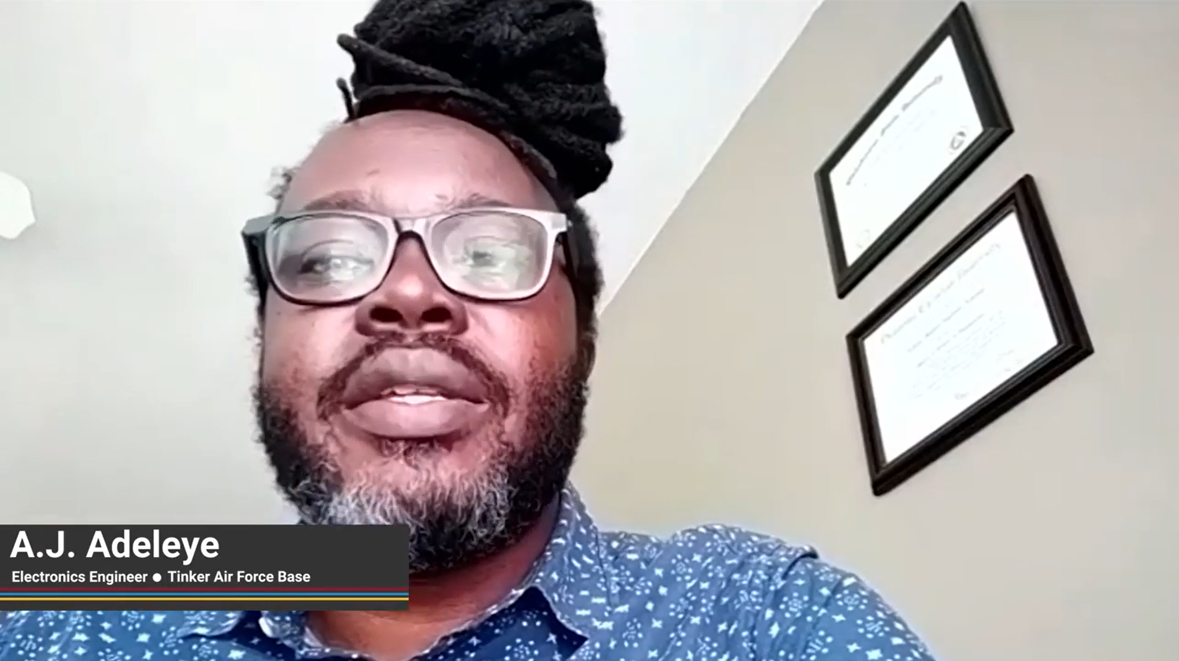
Electronics Engineer
Notes:
K20 Center. (2021, December 13). Electronics - A.J. Adeleye. [Video]. YouTube. https://www.youtube.com/watch?v=S38tfPRzAxk

Slide 14
Electronics Engineering
What is one part of the job that sounds interesting?
What is one part of the job that sounds challenging?
What can you do now if you’re interested in becoming an electronics engineer?

Slide 15
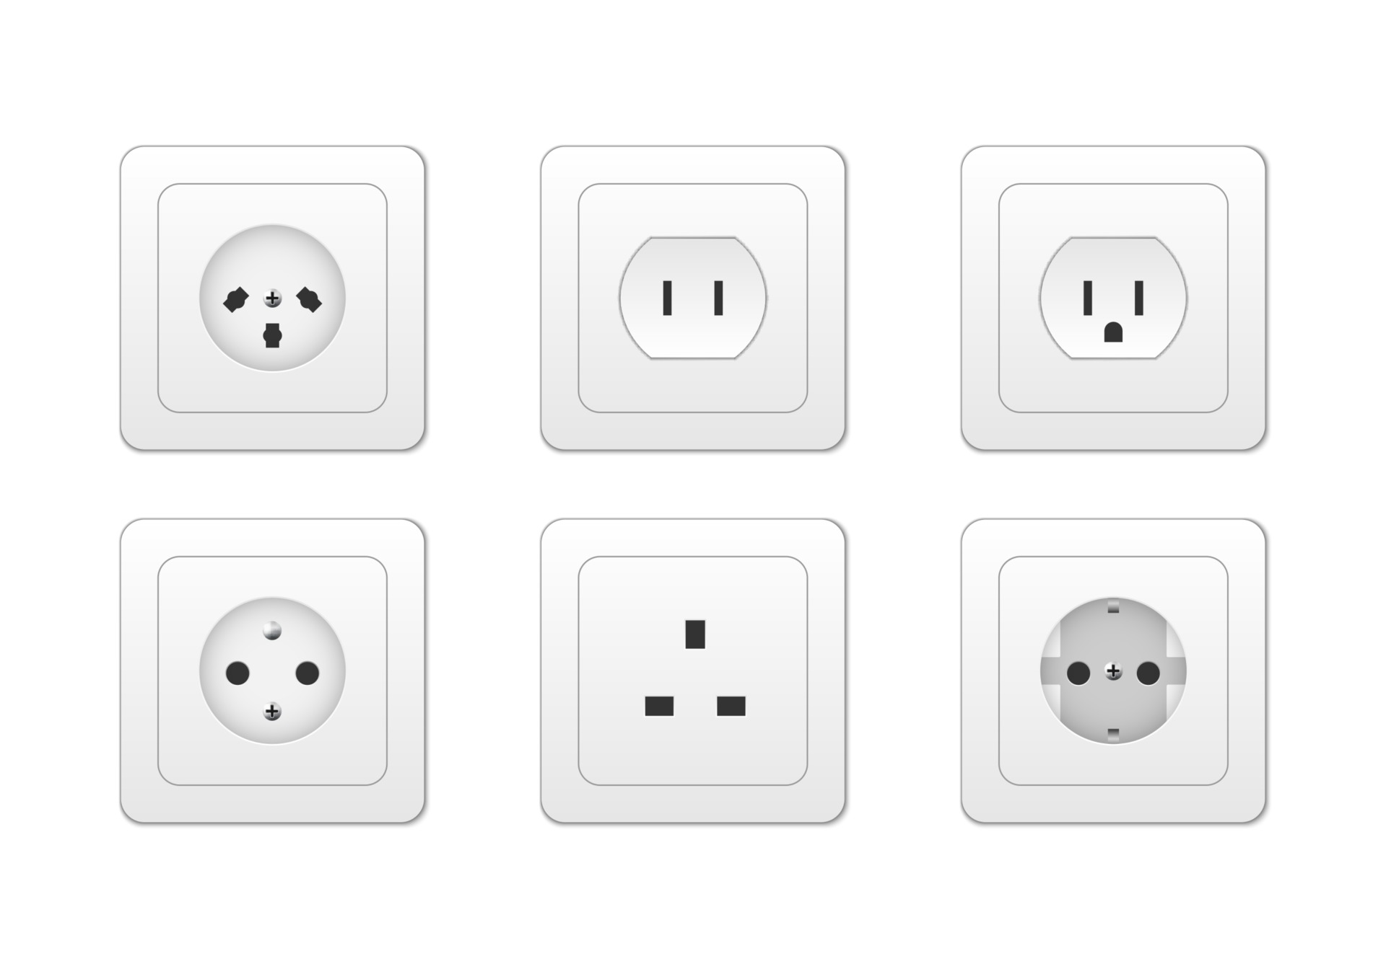
You’re the Engineer
You are testing a new hair dryer that will be
sold in different countries. You know that
wall outlets provide alternating current,
or AC, which means the voltage changes in a repeating wave pattern instead of staying constant. Because
AC voltage changes, engineers use RMS voltage to describe the effective voltage that powers a device.
Notes:
Chaiwut Sridara. (n.d.). Electricity outlet socket types [Illustration]. Vecteezy. https://www.vecteezy.com/vector-art/2687436-electricity-outlet-socket-types-3d-vector-illustration

Slide 16
You’re the Engineer
During testing, the hair dryer reaches
a peak voltage of 324 volts.
Use this formula and information to complete your handout.
RMS
voltage
maximum
voltage
Notes:
Chaiwut Sridara. (n.d.). Electricity outlet socket types [Illustration]. Vecteezy. https://www.vecteezy.com/vector-art/2687436-electricity-outlet-socket-types-3d-vector-illustration

Slide 17

Reflection
Take one minute to silently reflect on the list of questions generated at the beginning of the lesson.
Which questions have
been answered?
Which questions have not
been answered?
Do you have any new questions?
1-Minute Timer
Notes:
K20 Center. (2021, September 21). 1 minute timer. [Video]. YouTube. https://www.youtube.com/watch?v=6ilD555O_RE

Slide 18


Quick Write
Spend the next 2 minutes writing a response
to the questions on the previous slide.
2-Minute Timer
Notes:
K20 Center. (n.d.). Quick write. Strategies. https://learn.k20center.ou.edu/strategy/1127
K20 Center. (2021, September 21). 2 minute timer. [Video]. YouTube. https://www.youtube.com/watch?v=HcEEAnwOt2c

