Slide 2
Speak Up!
9th–12th Grade
English Language Arts

Slide 3
Essential Questions
How does speechmaking apply to the real world?
What makes a speech great?

Slide 4
Learning Objectives
By the end of this lesson, you will be able to:
  Identify and describe the four major types of speeches
  Determine the appropriate type of speech for a variety of purposes and/or occasions

Slide 5
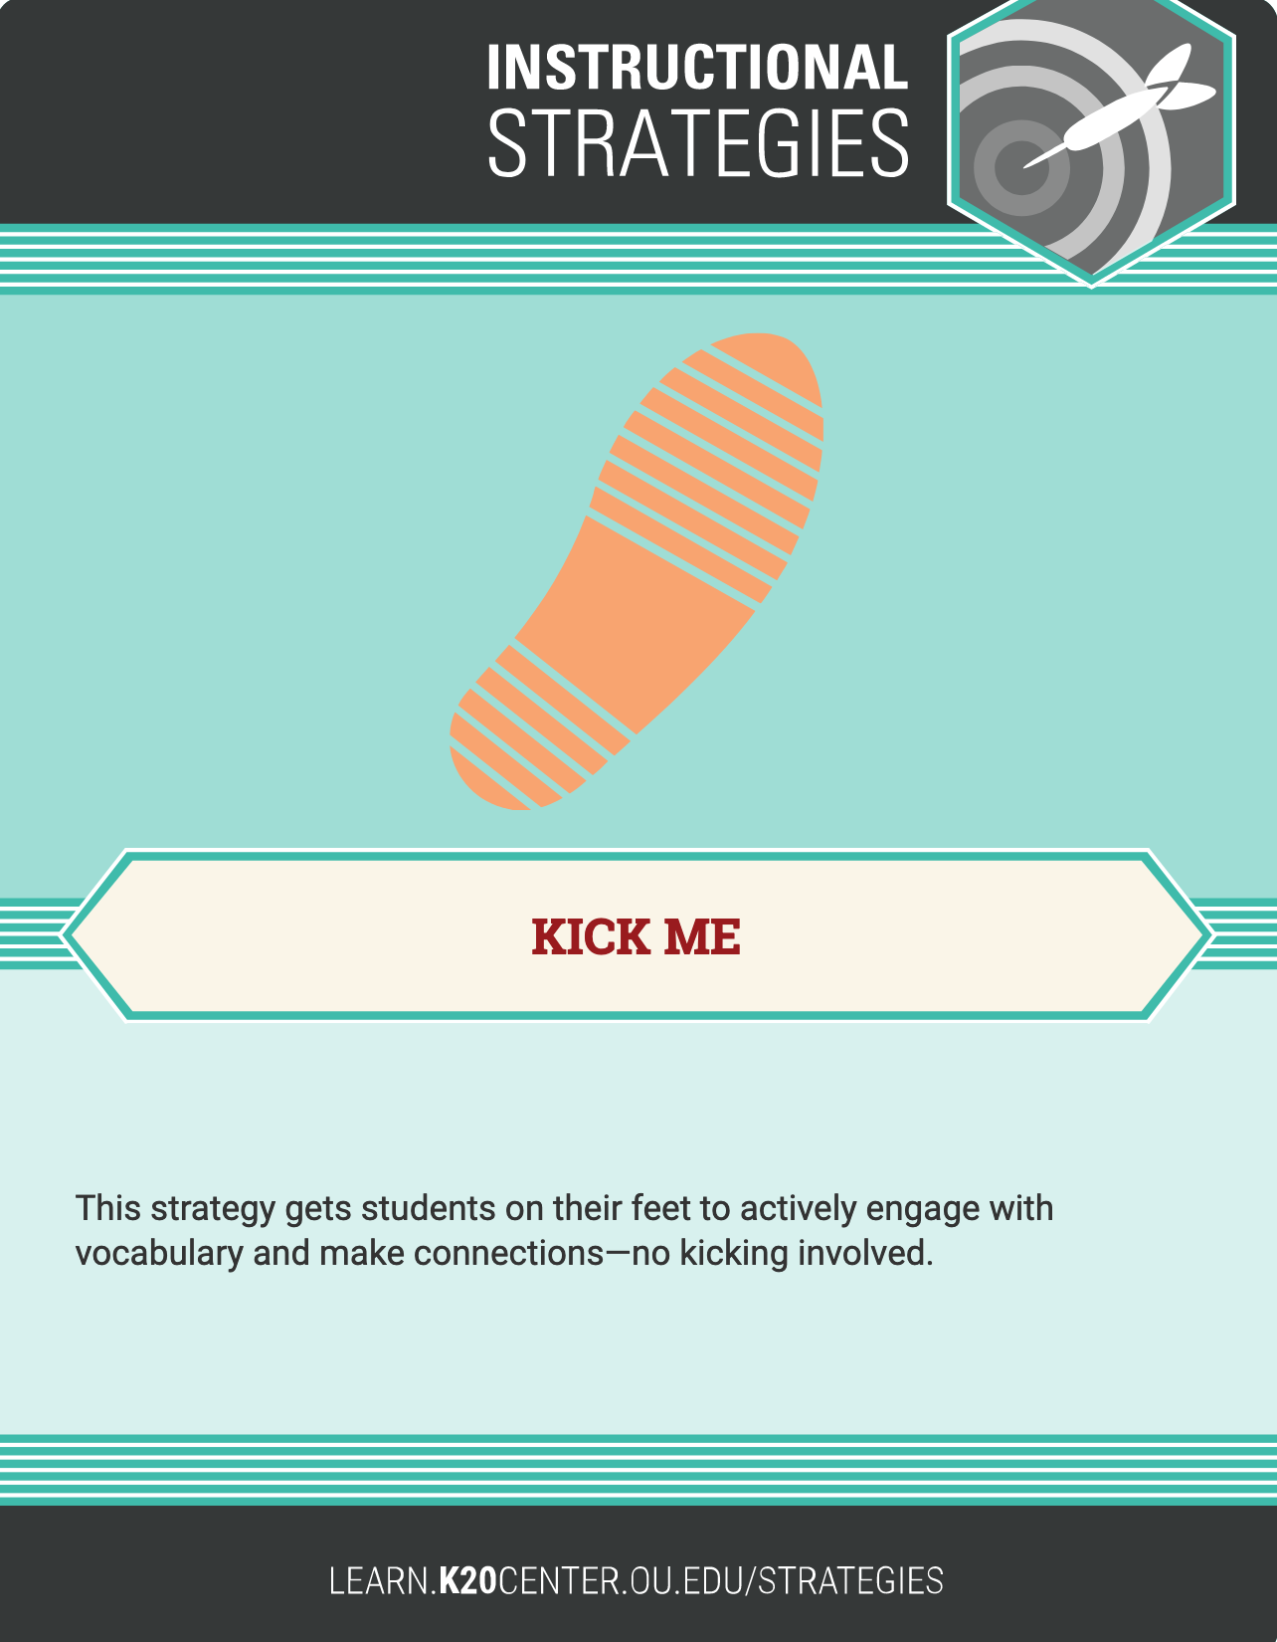
Speeches & Authors
First, find out what you are. Then, find your match.
You may:
  ask two questions per person
  before finding a new partner.
  ask “yes” or “no” questions.
You may not:
  ask a partner more than two questions.
  tell your partner what they are unless they ask directly (“Am I Abraham Lincoln?”).

Slide 6
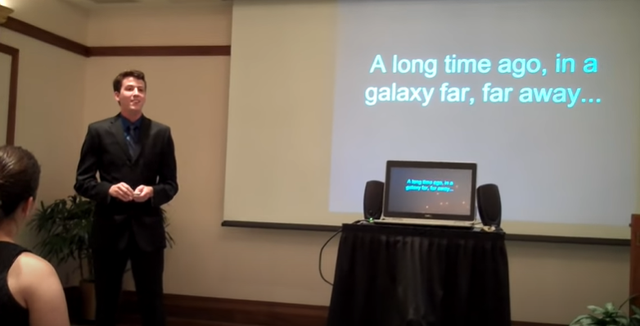
Informative Speech: Star Wars (7 min)
On your note catcher, record what you notice about informative speeches.
Belmont Speech Lab. (2011, December 20). Informative Speech: Star Wars. YouTube. Retrieved from https://youtu.be/GSIppEr0Nws
Notes:
This type of speech, students may note, is intended to inform, and provides the audience with interesting or useful information.

Slide 7
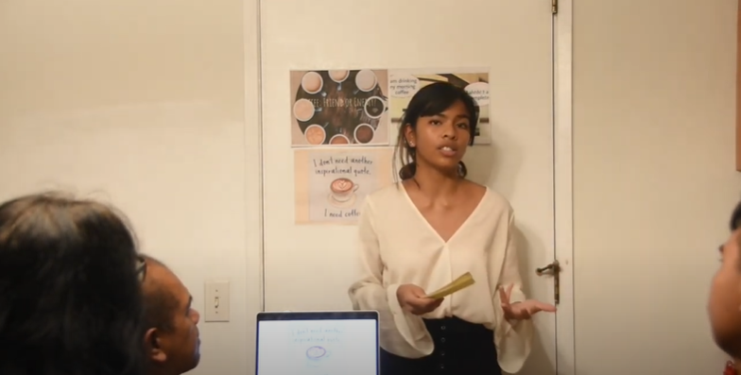
Informative Speech: How Healthy Is Coffee? (8 min)
On your note catcher, record what you notice about informative speeches.
Megan, B. (2019, October 15). Informative Speech. YouTube. Retrieved from https://youtu.be/lE1HXJgDBYg
Notes:
This type of speech, students may note, is intended to inform, and provides the audience with interesting or useful information.

Slide 8
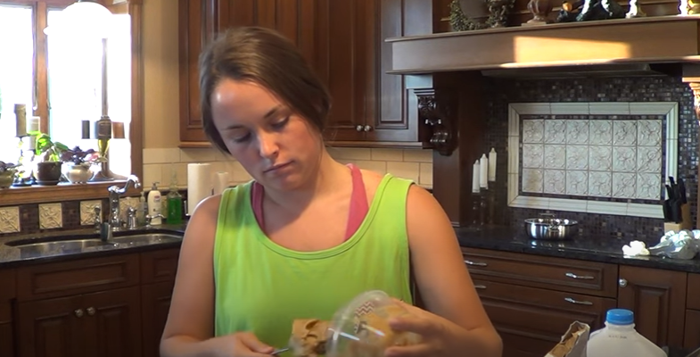
Demonstrative Speech: No-Bake Cookies (5 min)
On your note catcher, record what you notice about demonstrative speeches.
Spears, J. (2014, June 13). Demonstration Speech: No-Bake Cookies. YouTube. Retrieved from https://youtu.be/8wyzrkmbhLQ
Notes:
This type of speech is similar to an informative speech, but more specifically demonstrates or instructs the audience on how to perform a specific task. This typically includes a step-by-step demonstration with props.

Slide 9
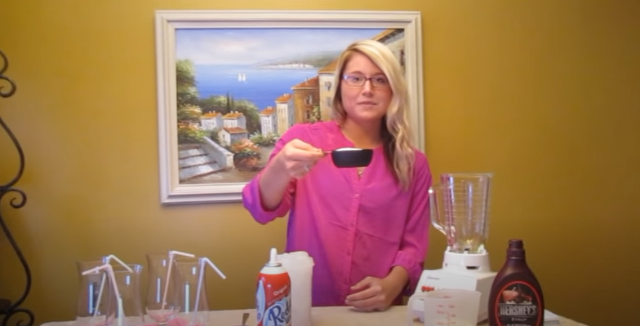
Demonstrative Speech: Frozen Hot Chocolate (4 min)
On your note catcher, record what you notice about demonstrative speeches.
Harms, N. (2013, February 24). Demonstrative Speech: How to Make Frozen Hot Chocolate. YouTube. Retrieved from https://youtu.be/UF_P514soas
Notes:
This type of speech is similar to an informative speech, but more specifically demonstrates or instructs the audience on how to perform a specific task. This typically includes a step-by-step demonstration with props.

Slide 10
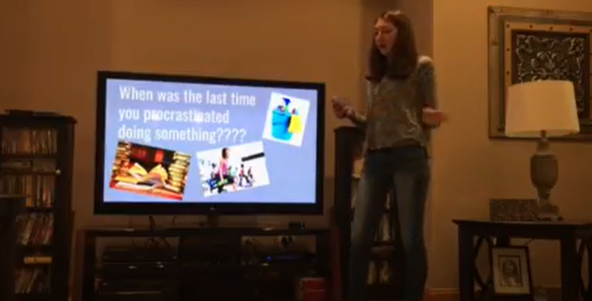
Persuasive Speech: Procrastination (7 min)
On your note catcher, record what you notice about persuasive speeches.
Ricciardi, M. (2017, November 3). Persuasive speech on procrastination. YouTube. Retrieved from https://youtu.be/Gxl72FQNQtk
Notes:
In this type of speech, the speaker advocates for a given cause or action. Their job is to persuade the audience to agree with them and possibly to take action.

Slide 11
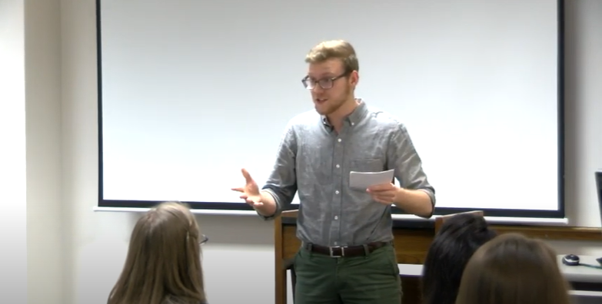
Persuasive Speeches: Supporting Charities (30 min)
On your note catcher, record what you notice about persuasive speeches.
Parkland College. (2019, May 8). 2019 David Jones Persuasive Speech Contest. YouTube. Retrieved from https://youtu.be/D9v-Q1sRQGs
Notes:
In this type of speech, the speaker advocates for a given cause or action. Their job is to persuade the audience to agree with them and possibly to take action.

Slide 12
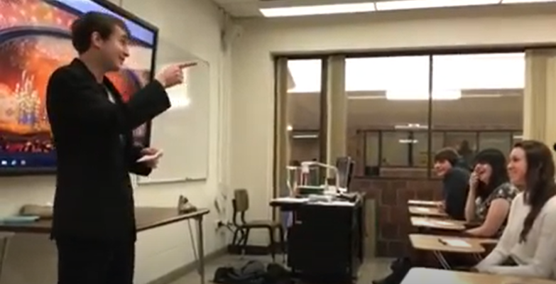
Special Occasion Speech: Oscar Award Acceptance (3 min)
On your note catcher, record what you notice about special occasion (or extemporaneous) speeches.
Sebastian, M. (2018, March 23). Hilarious Sample Special Occasion Speech!. YouTube. Retrieved from https://youtu.be/hKyFNe0wsSE
Notes:
This type of speech, students may note, is intended to entertain, to inspire a sense of community, or to celebrate a common bond among the audience members and speaker.

Slide 13

Special Occasion Speech: Maid of Honor Speech (6 min)
On your note catcher, record what you notice about special occasion (or extemporaneous) speeches.
HappilyEverHermano. (2016, October 10). Perfect Maid of Honor Speech. YouTube. Retrieved from https://youtu.be/av-aIV8leKQ
Notes:
This type of speech, students may note, is intended to entertain, to inspire a sense of community, or to celebrate a common bond among the audience members and speaker.

Slide 14
Poster Presentation
Decide which type of speech most interests you.
Move to the large poster with your chosen type of speech.
Collaborate with your group to create a brief presentation that includes:
  the purpose of your chosen type of speech.
  major characteristics of your chosen type of speech.

Slide 15
Poster Presentation
Nominate a representative to share a few characteristics of your type of speech.
Ask the class for examples of situations or topics where this type of speech would be appropriate. Add these examples to the poster.

Slide 16
Speech Outline
Choose a type of speech to prepare and present.
Choose a topic appropriate to that type of speech.
Review the rubric and decide what to include.
Write an outline for a 1–2 minute speech.
  Not a full speech—just an outline!

