Slide 2
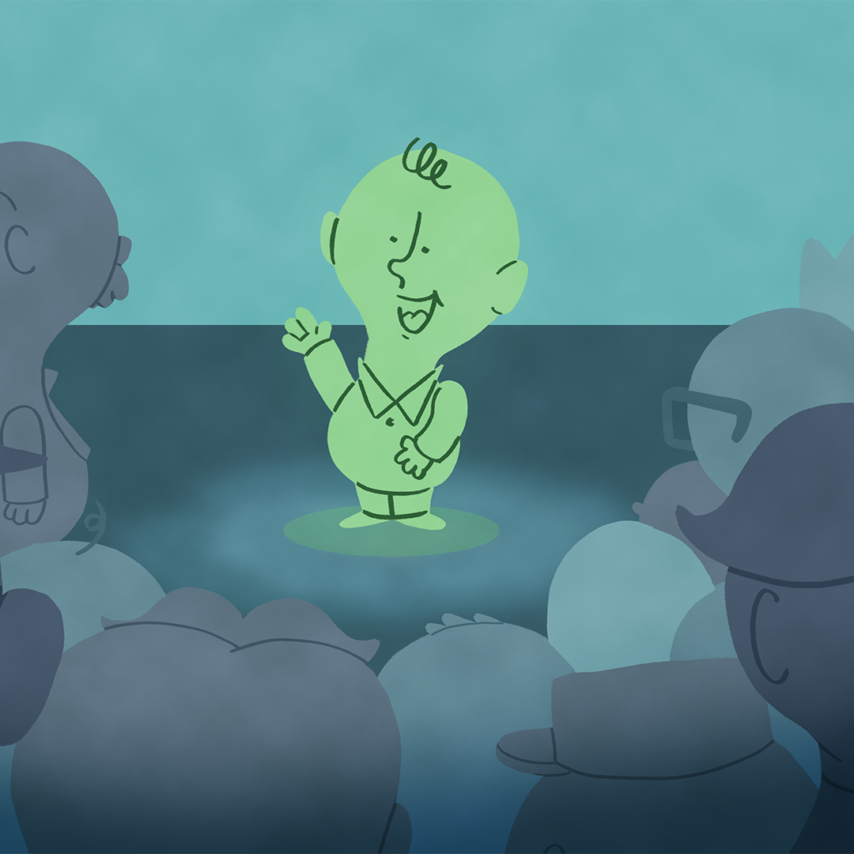
Speak Up!
Four Categories of Speeches

Slide 3
Essential Questions
How does speechmaking apply to the real world?
What makes a speech “great”?

Slide 4
Learning Objectives
Identify and describe the four major types of speeches.
Determine the appropriate type of speech for a variety of purposes and occasions.

Slide 5

Speeches & Authors
Pair up with a partner and read the label on their back.
Ask two questions of your partner to help you determine what your own label says.
  Ask “yes” or “no” questions.
  Do not ask your partner more than two questions.
  Do not tell your partner what they are unless they directly ask, “Am I (author/speech)?”
Once you know what your label is, find the speech or author that matches you.
Notes:
K20 Center. (n.d.). Kick me. Strategies. https://learn.k20center.ou.edu/strategy/121

Slide 6
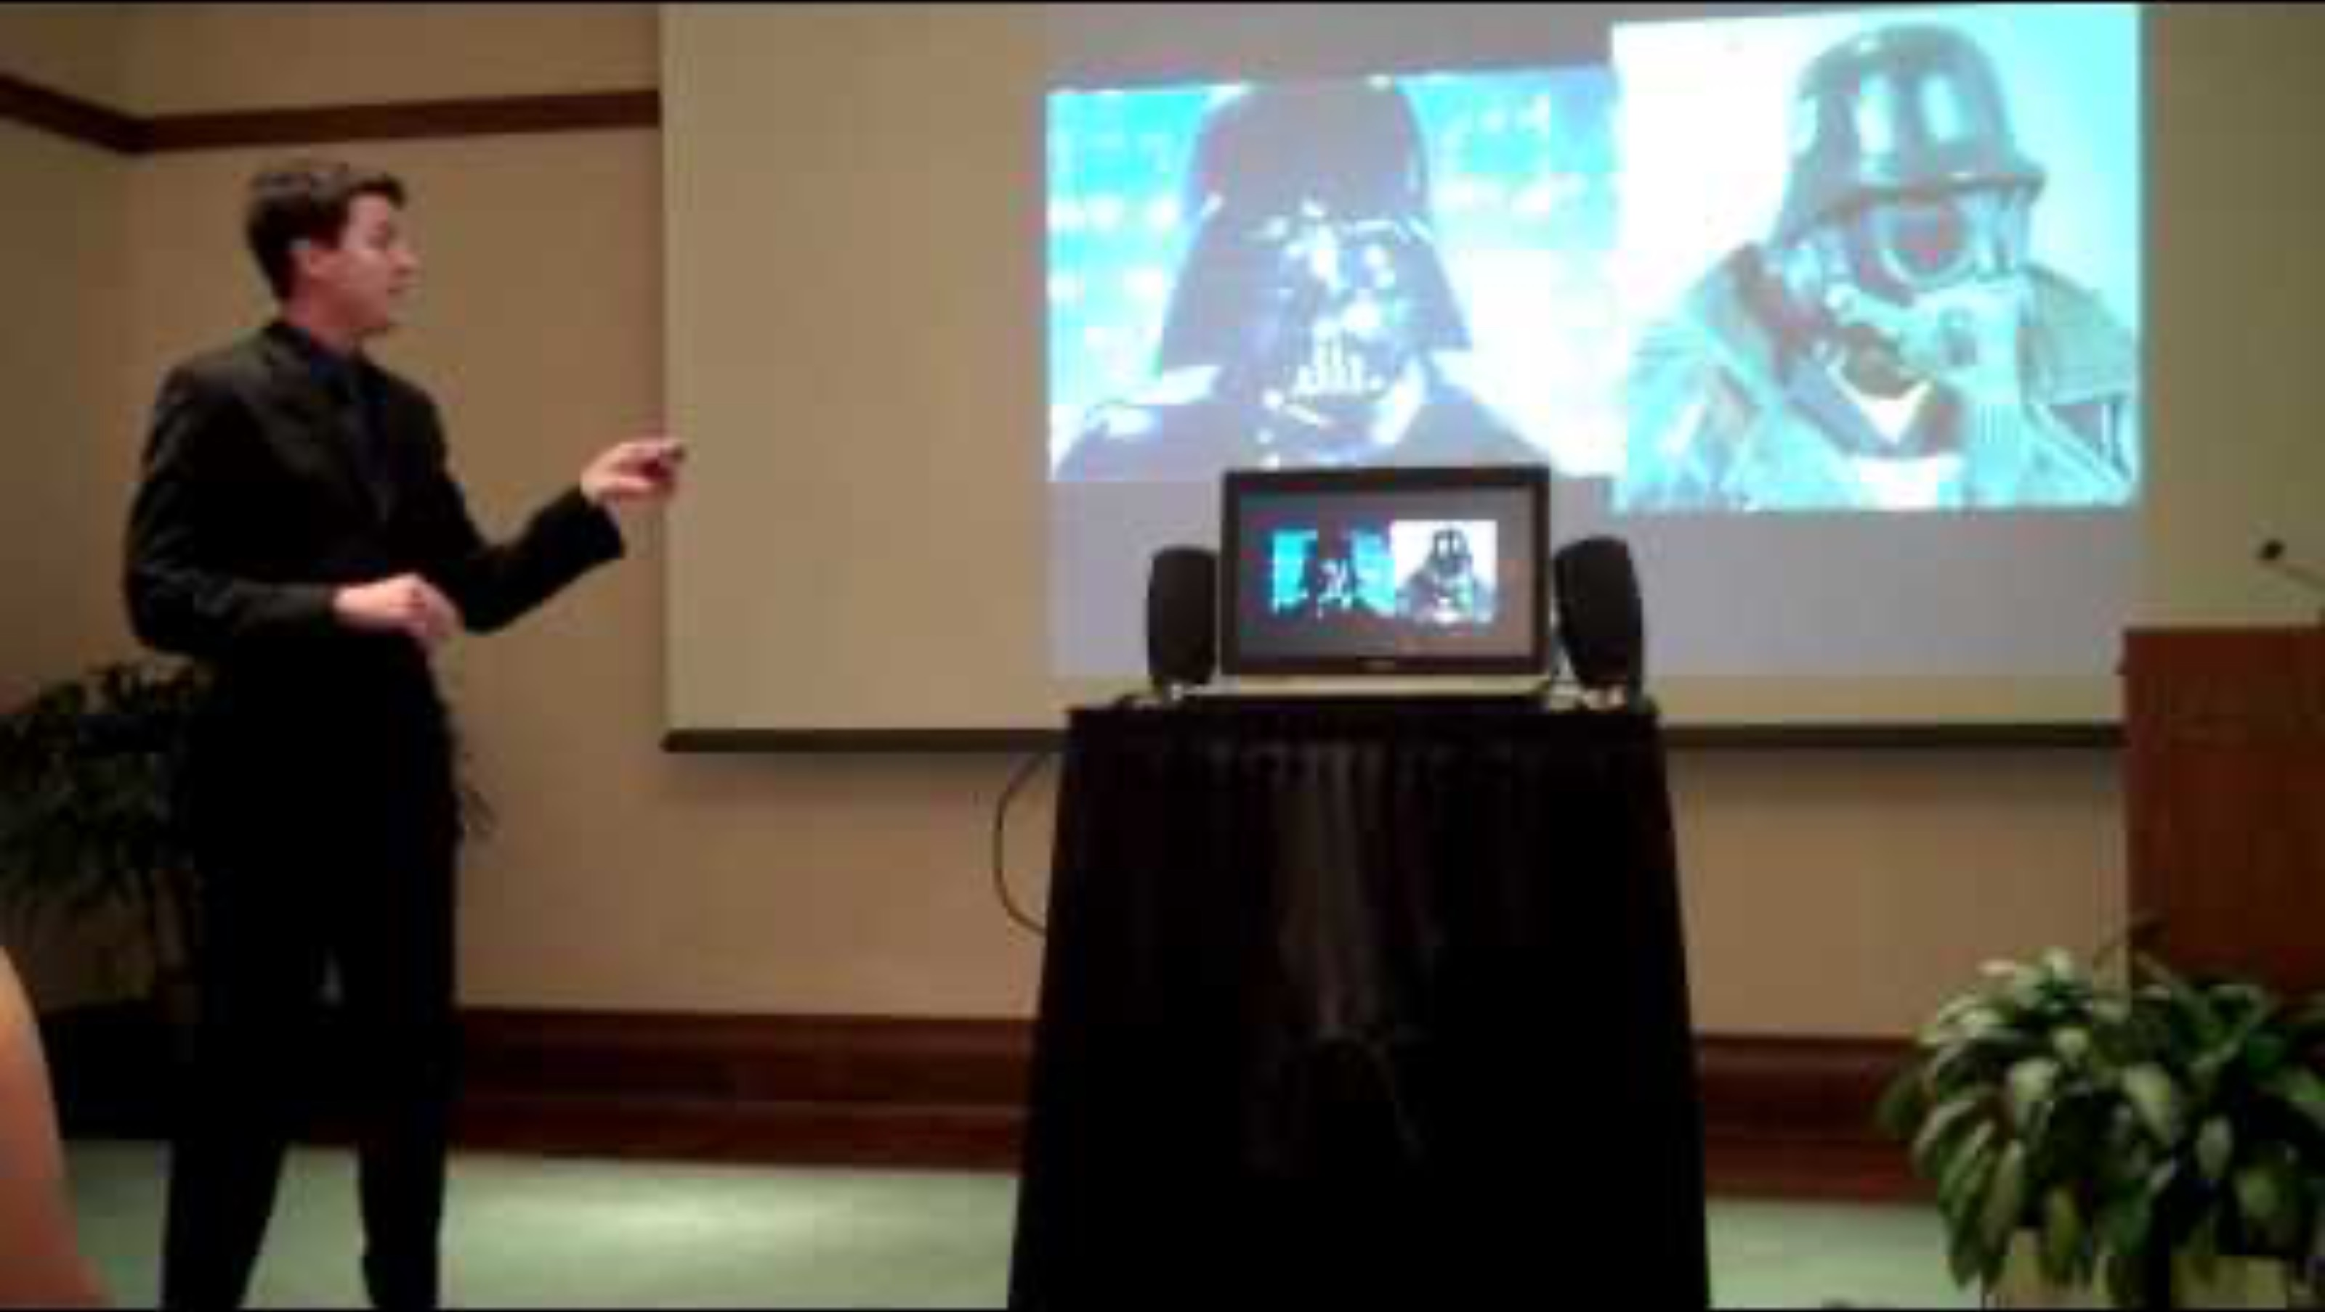
Informative Speech: Star Wars
Notes:
Belmont Speech Lab. (2011, December 20). Informative speech: Star Wars [Video]. YouTube. https://www.youtube.com/watch?v=GSIppEr0Nws

Slide 7
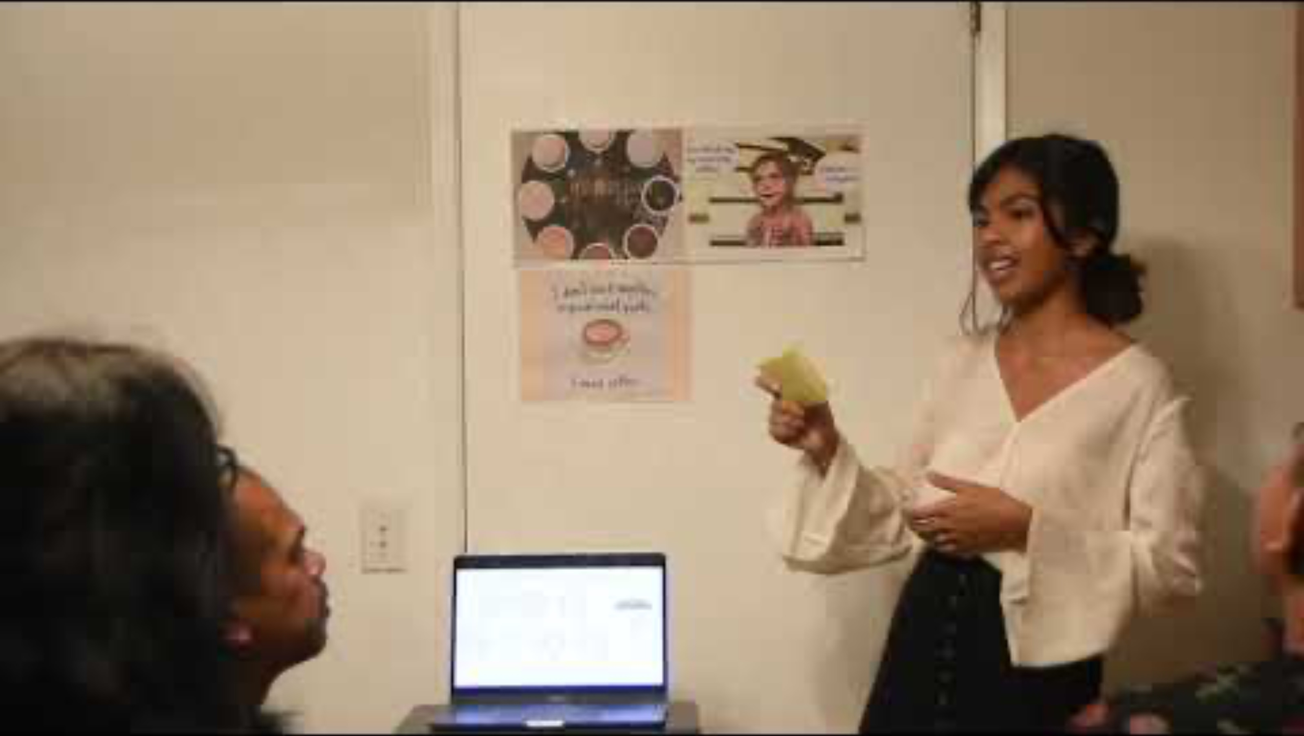
Informative Speech: How Healthy Is Coffee?
Notes:
bethmegan. (2019, October 15). Informative speech [Video]. YouTube. https://www.youtube.com/watch?v=lE1HXJgDBYg

Slide 8
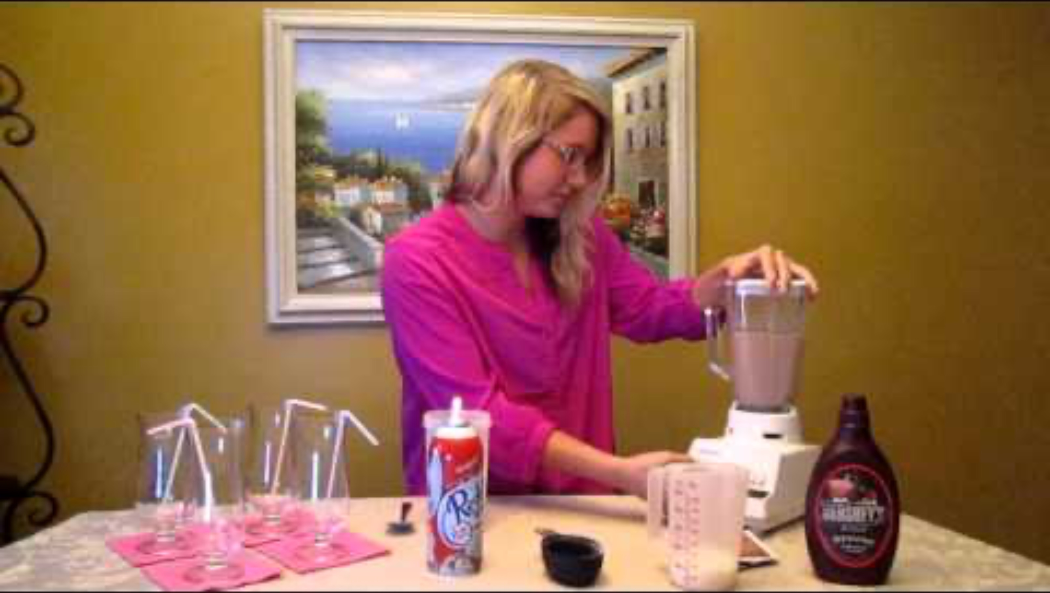
Demonstrative Speech: How to Make Frozen Hot Chocolate
Notes:
Harms, N. (2013, February 24). Demonstrative speech: How to make frozen hot chocolate [Video]. YouTube. https://www.youtube.com/watch?v=UF_P514soas

Slide 9

Five Minute Demonstrative Speech: Creating a Gift Basket
Notes:
Harrell, M. O. (2013, September 16). Five minute demonstrative speech [Video]. https://www.youtube.com/watch?v=_ntYZjkogWM&list=PLcrDT-GpAgOXvlq_CCWz-f4YOJ-2a43gW&index=2

Slide 10
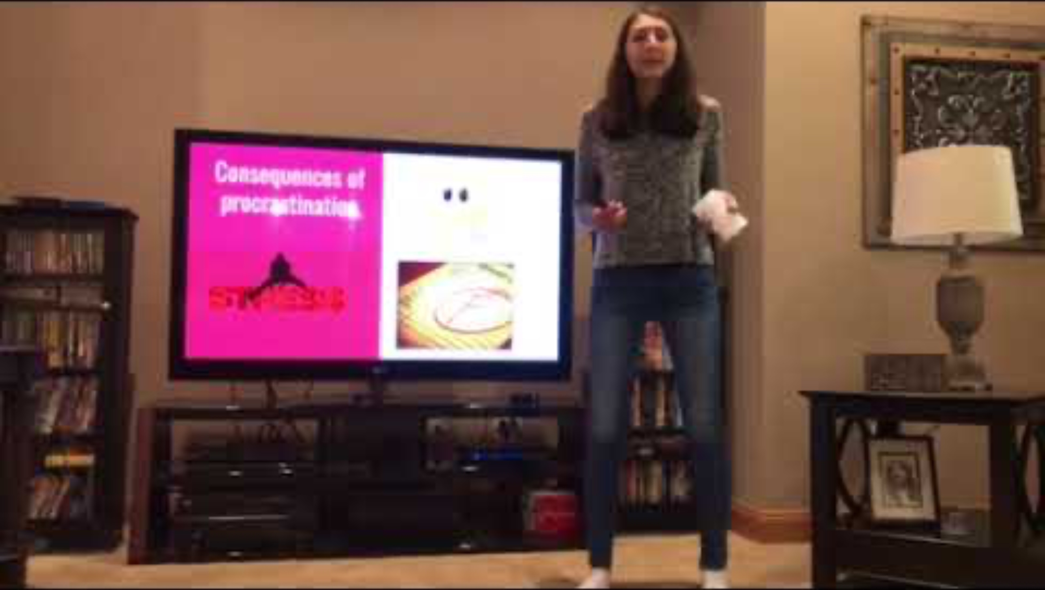
Persuasive Speech on Procrastination
Notes:
Ricciardi, M. (2017, November 3). Persuasive speech on procrastination [Video]. YouTube. https://www.youtube.com/watch?v=Gxl72FQNQtk

Slide 11
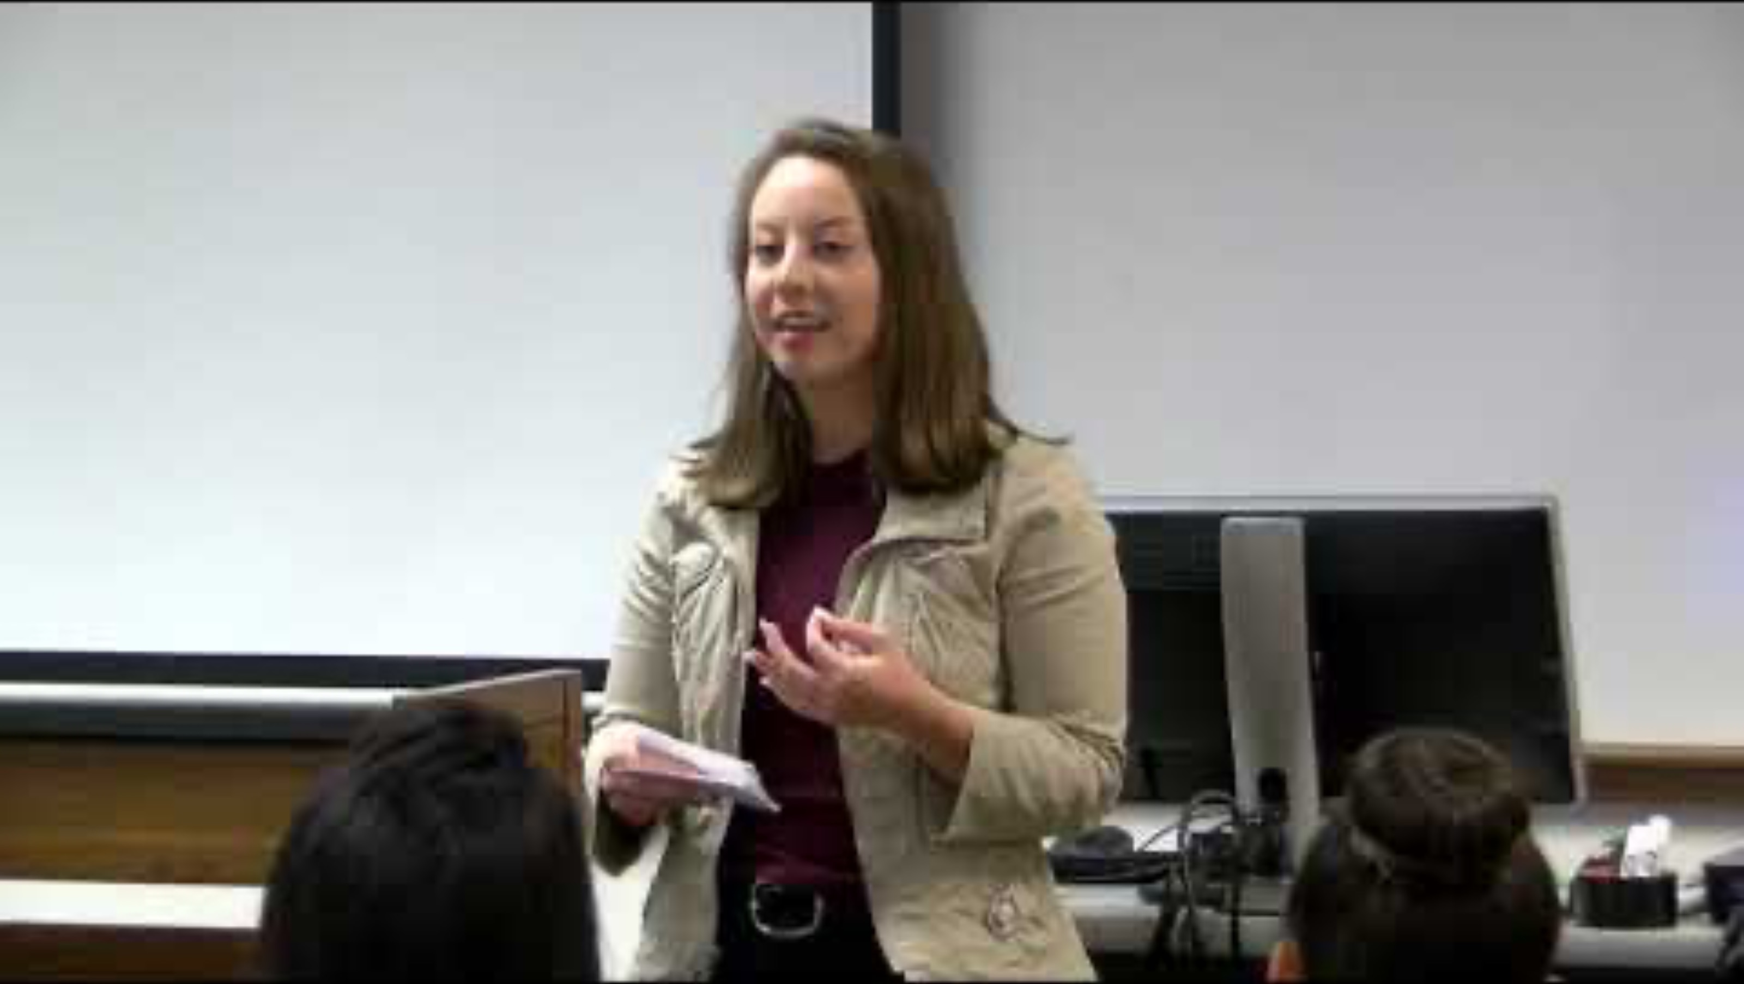
Persuasive Speech: Supporting Charities
Notes:
Parkland College. (2019, May 8). 2019 David Jones persuasive speech contest [Video]. YouTube. https://www.youtube.com/watch?v=D9v-Q1sRQGs

Slide 12
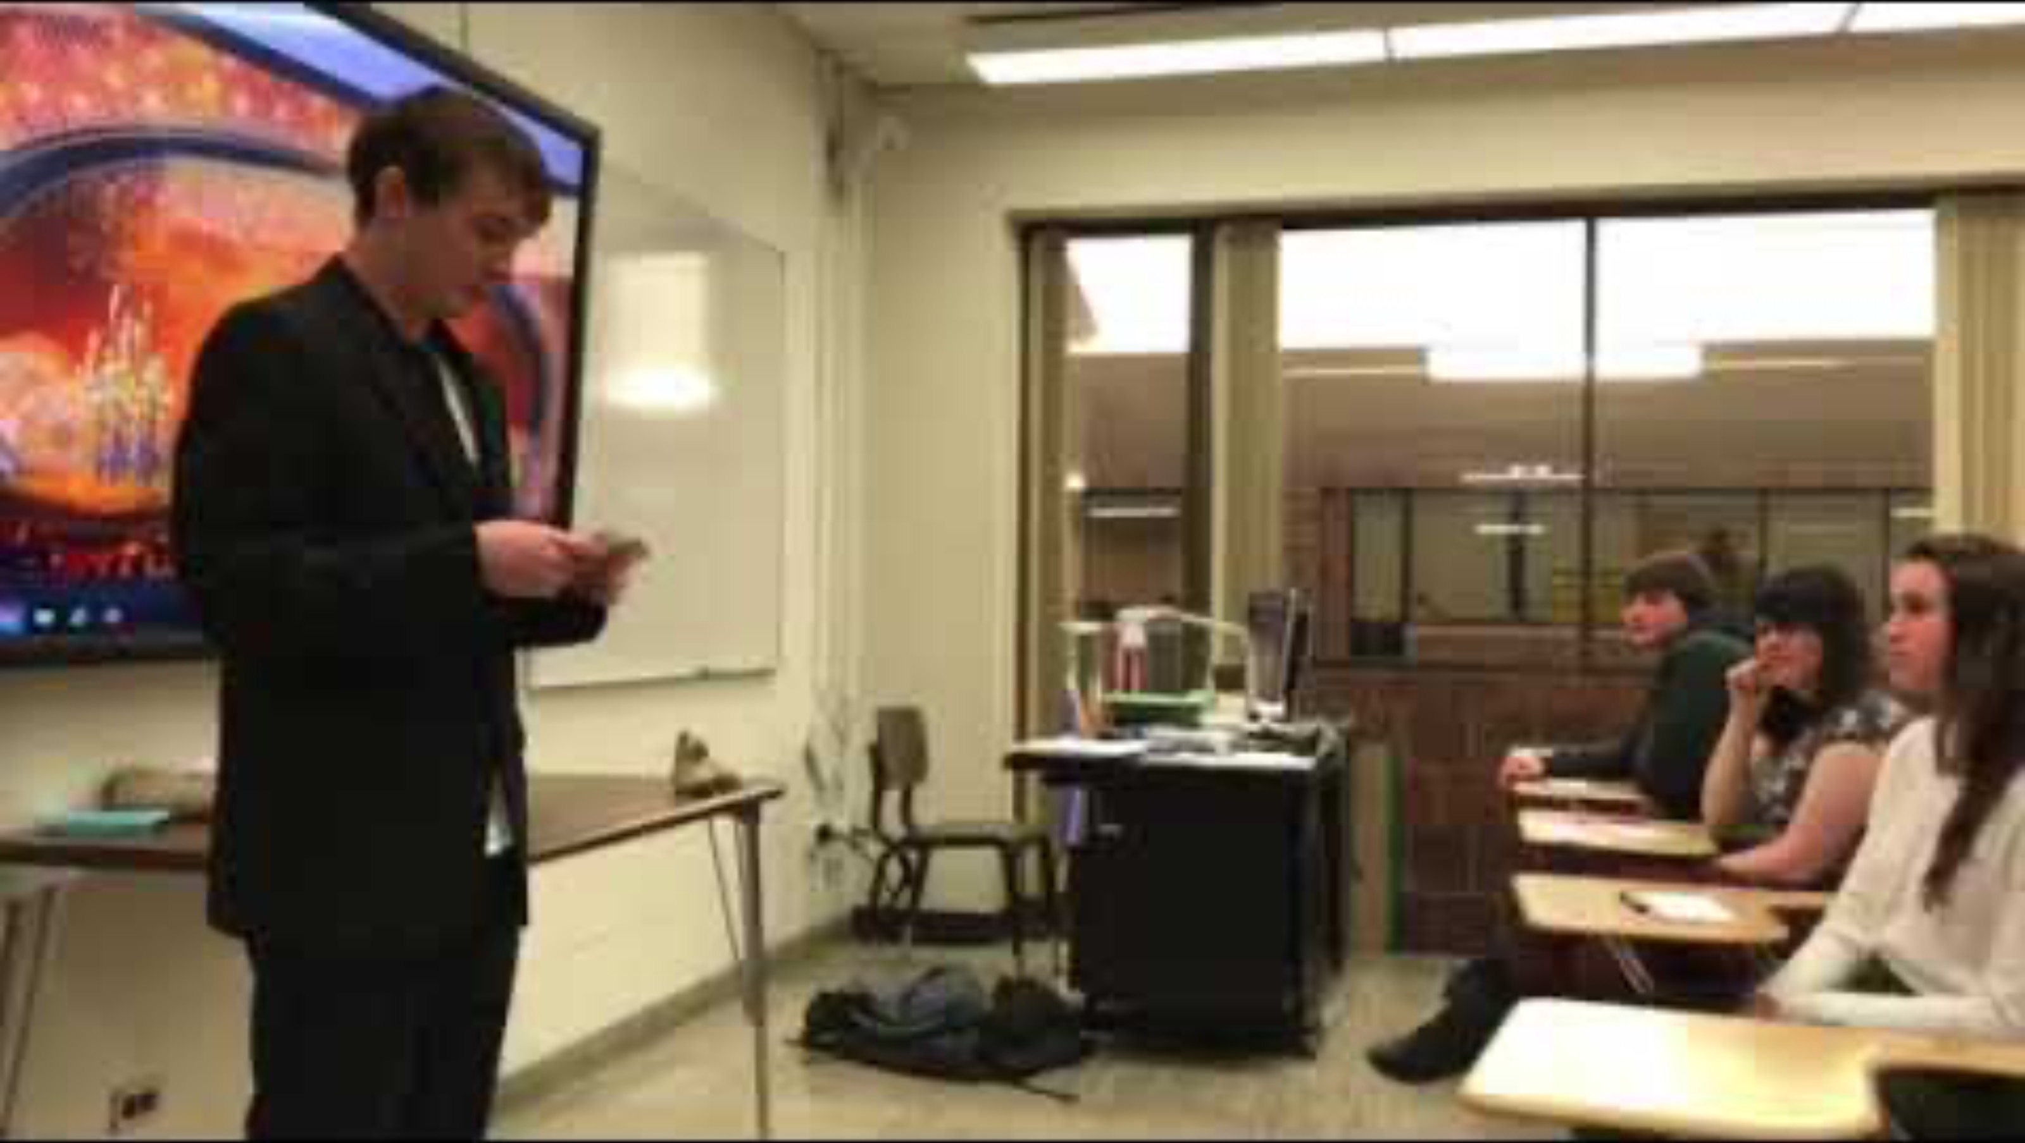
Special Occasion Speech: Oscar Award Acceptance
Notes:
Sebastian, M. (2018, March 23). Hilarious sample special occasion speech! [Video]. YouTube. https://www.youtube.com/watch?v=hKyFNe0wsSE

Slide 13

Special Occasion Speech: Maid of Honor Speech
Notes:
HappilyEverHermano. (2016, October 10). Perfect maid of honor speech [Video]. YouTube. https://www.youtube.com/watch?v=av-aIV8leKQ

Slide 14

Pick a Speech
Decide which type of speech most interests you.
Move to the poster labeled with your chosen type of speech.
With the group at your chosen poster, create a brief presentation that includes:
  the purpose of your chosen speech type
  main characteristics of your chosen speech type
Notes:
K20 Center. (n.d.). Four corners. Strategies. https://learn.k20center.ou.edu/strategy/138

Slide 15
Poster Presentation
Nominate a representative from your group to share a few characteristics of your chosen type of speech.
Ask your classmates for examples of situations or topics where your type of speech would be appropriate.
  Add any examples to your poster.

Slide 16
Speech Outline
Choose a type of speech to prepare and present.
Choose a topic appropriate to that type of speech.
Review the rubric and decide what to include in your speech outline.
Write an outline for a 1–2-minute speech.
  You don’t have to write a full speech—just an outline.

